Slide 1

Follow the Leader: Rhetorical Analysis of Adolf Hitler
Katrina Muller
Cecil Kramer
Marie Mallory

Slide 2

Research Question
Can the leadership style of Adolf Hitler be seen through the rhetoric and language in his speeches?

Slide 3
Justification
Hitler at Heldenplatz. Austria, 1938.

Slide 4
Justification
This is the first time that this leadership study in rhetorical analysis.
It will determine how we see these types of leaders use rhetoric to change their leadership style throughout their time in power.

Slide 5
Theory
Situational Leadership
Identification
Polarization

Slide 6
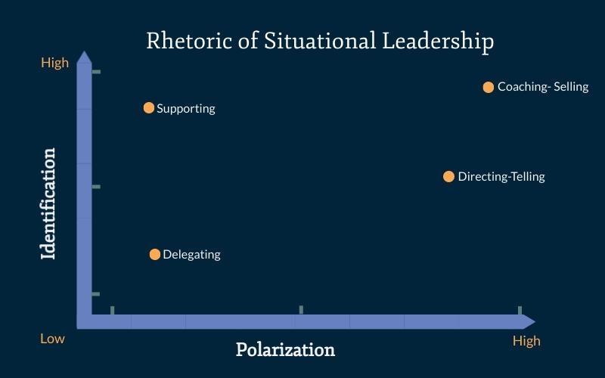
Leadership Graph
Notes:
Created by Me

Slide 7
Identification and Polarization Chart
 | Polarization: |  | Identification:
A. | Using words such as "them," "they" "enemy." | A. | Terms that unify speaker and audience such as "we" "us" "our"
B. | Description of negative actions of the enemy | B. | Presenting a shared value or belief or interest
C. | Claims against the opposing group | C. | Creating and elaborating a shared goal
D. | Threats of the enemy or perceived evil | D. | Emphasizing a common hardship
E. | Overtly negative connotation when referencing the opposition | E. | Positive reference to the third person
F. | Distinction from other groups | F. | Invitation to participate in group/ call to action
G. | Coercion of those "on the line" between groups | G. | Level of concern
H. | Describe other groups as "unlawful, bad, worse." | H. | Common past, present, or future
I. | Public confrontation | I. | Describe their causes as good, lawful, overtly positive
Notes:
Created by Me

Slide 8
Methodology
Choose speeches.
Analyze speeches for identification and polarization.
Place speech on situational leadership graph based on number of identification vs. polarization.
Discuss what the results mean.

Slide 9
Studied Material
Speech One- September 18,1922- After WWI
Speech Two- March 27, 1936- Campaign speech
Speech Three- May 26, 1944- The end of WWII

Slide 10
Findings
1922 Speech One- Directing/ Telling
1936 Speech Two-Delegating
1944 Speech Three- Coaching/ Selling

Slide 11
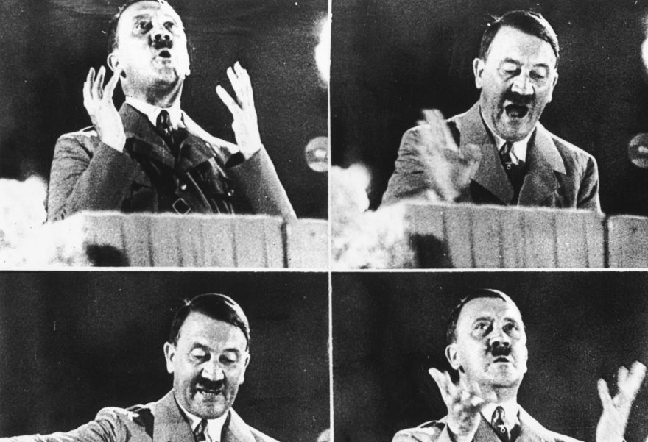
Adolf Hitler October 1944

Slide 12
Analysis
What do these results mean for Adolf Hitlers style of leadership through the use of rhetoric.

Slide 13
Conclusion
Adolf Hitler’s use of situational leadership can be seen through the rhetoric and language in his speeches.

Slide 14
Limitations
Overlap in information between Identification and polarization.
Original intent of the speech, hearing and seeing them.
As the author and analyzer know how the effect of Adolf Hitler's leadership.

Slide 15
Suggestion for Further Study
Situational leadership theory analyzed through the lens of polarization and identification with other famous orators.
Other rhetorical theories applied to leadership theories.

Slide 16
Work Cited
“Hitler Speech October 1944.” Getty Images/ Keystone/ NPR, Google, 7 Mar. 2017, www.google.com/url?sa=i.
Commons, Wikimedia. “Hitler at Heldenplatz.” ABC News, 17 Jan. 2018, www.abc.net.au/news/2018-01-17/hitler-at-heldenplatz/9337080?nw=0.

