Slide 1
Sending out an SOS: Professional School Counselor Identity Formation and Practice

Slide 2
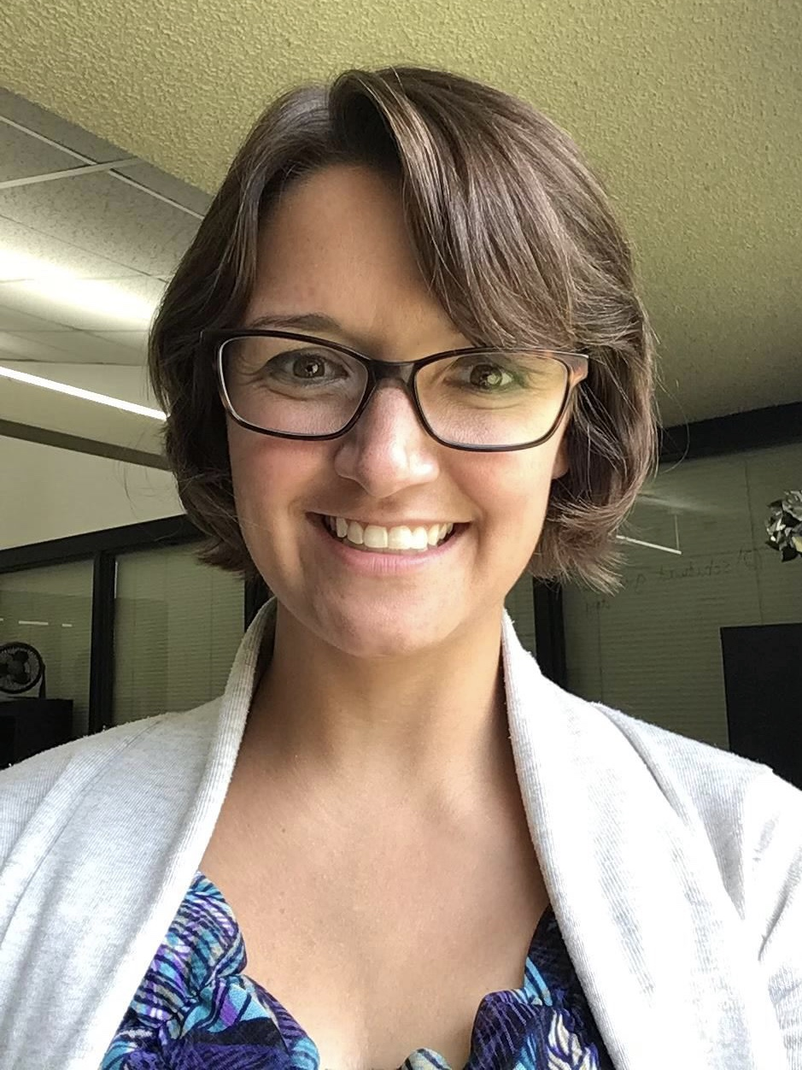
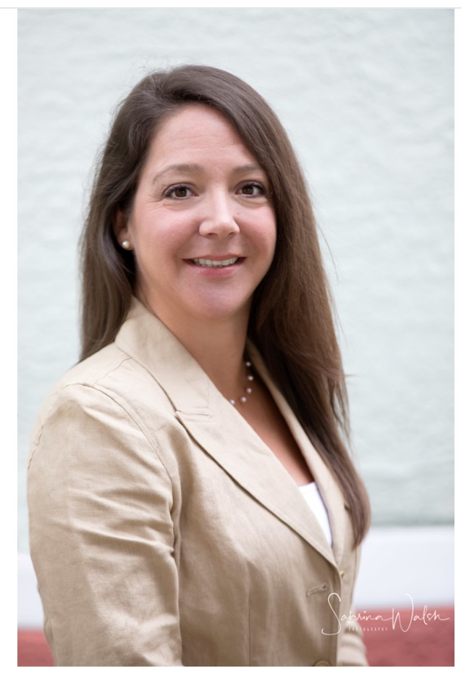
Introductions
Mrs. Alicia N. Gouge
Graduate Student​
Capri Brooks,
Ph.D., LPC-S, NCC, NCSC
Summer Kuba,
Ph.D., Ed.S., MSW​

Slide 3
Objectives
Professional School Counseling (PSC)
Identity development & standards of practice
Role ambiguity
Professional Practice
Challenges
Implications for future practice

Slide 4
Identity Development & Standards of Practice: The Importance of Professional Supervision
Importance of Professional Supervision
Comprehensive School Counseling Program Design & Implementation
ASCA Mindset & Behaviors
Evidence-Based Interventions
How do we know what we are doing is working?
Data
Mental Health Services
Professional Development

Slide 5
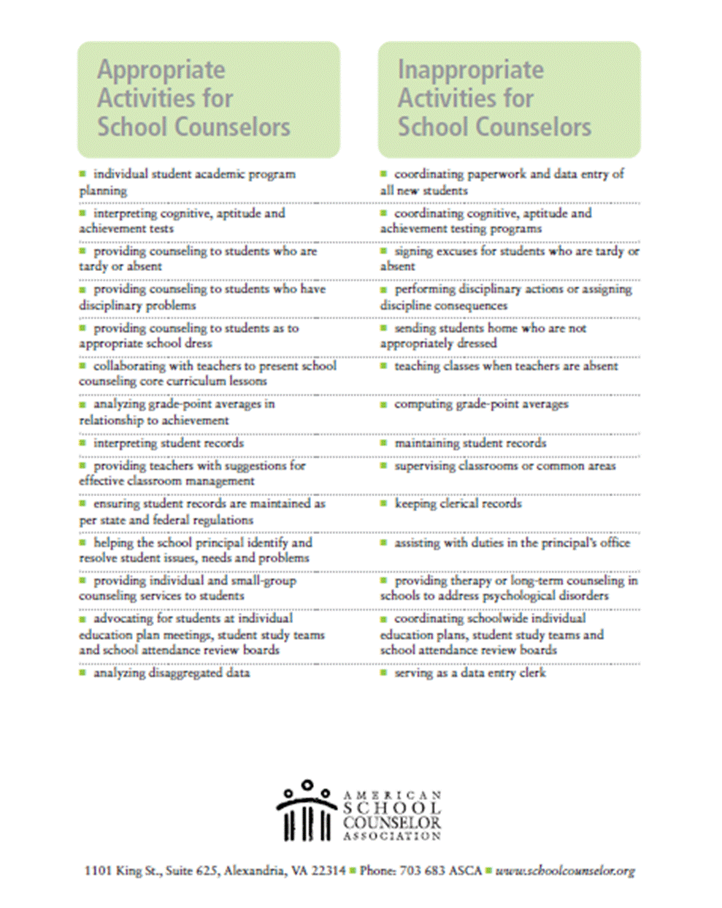
Role Ambiguity
Educator vs School Counselor
Leader
Teacher
Mental Health Professional
Advocate
(Curray & Bickmore, 2012; Eckhardt McLain, 2019; Lambie et al., 2019)​

Slide 6
Professional Practice: Challenges
Multi-systemic Ethical Dilemmas
ACA Code of Ethics
ASCA Ethical Standards
Lack of in-service supervision
Lack of counselor peers for consultation
School administration expectations & evaluations
(Bledsoe et al., 2019; Duncan et al., 2014; Curray & Bickmore, 2012; Lambie et al., 2019; Luke et al., 2013; Slaten & Baskin, 2014)

Slide 7
Implications for Future Practice
PSC Burnout
PSC Competence vs. Incompetence
ASCA
Quality of DCSCPs, student achievement & development
(Collins, 2014; Eckhardt McLain, 2019; Fye et al., 2018; Gibson et al., 2012; Villares & Dimmitt, 2017)

Slide 8
References
Bledsoe, K. G., Logan-McKibben, S., McKibben, W. B., & Cook, R. M. (2019). A content analysis of school counselor supervision. Professional School Counseling, 22(1), 1-8.
Collins, T. P. (2014). Addressing mental health needs in our schools: Supporting the role of school counselors. The Professional School Counselor, 4, 413-416.
Curray, J. R., & Bickmore, D. (2012). School counselor induction and the importance of mattering. Professional School Counseling, 15(3), 110-122.
Duncan, K., Brown-Rice, K., & Bardhoshi, G. (2014). Perceptions of the importance and utilization of clinical supervision among certified rural school counselors. The Professional Counselor, 4, 444-454.
Eckhardt McLain, G. (2019). Mentor academy for school counselors: A model plan. Journal of Professional Counseling: Practice, Theory, & Research, 46(1-2), 39-47.
Fye, H. J., Gnilka, P. B., & McLaulin, S. E. (2018). Perfectionism and school counselors: Differences in stress, coping, and burnout. Journal of Counseling and Development, 96, 349-360.

Slide 9
References
Gibson, D. M., Dooley, B. A., Kelchner, V. P., Moss, J. M., & Vacchio, C. B. (2012). From counselor-in-training to Professional School Counselor: Understanding professional identity development. Journal of Professional Counseling: Practice, Theory, and Research, 39(1), 17-25.
Lambie, G. W., Stickl Haugen, J., Borland, J. R., & Campbell, L. O. (2019). Who took “counseling” out of the role of Professional School Counselors in the United States? Journal of School-Based Counseling Policy and Evaluation, 1(3), 51-61. https://doi.org/10.25774/7kjb-bt85
Luke, M., Goodrich, K. M., & Gillbride, D. D. (2013). Intercultural model of ethical decision making: Addressing worldview dilemmas in school counseling. Counseling and Values, 58, 177-194. https://doi.org/10.1002/j.2161-007X.2013.00032.x
Slaten, C. D., & Baskin, T. W. (2014). Contextual school counseling: A framework for training with implications for curriculum, supervision, practice, and future research. The Counseling Psychologist, 42(1), 97-123.
Thacker, N. E., & Diambra, J. F. (2019). Parallel process of professional identity development during clinical supervision. The Journal of Counselor Preparation and Supervision, 12(3).
Villares, E., & Dimmitt, C. (2017). Updating the school counseling research agenda: A Delphi study. Counselor Education & Supervision, 56, 177-192. https://doi.org/10.1002/ceas.12017

