Slide 1
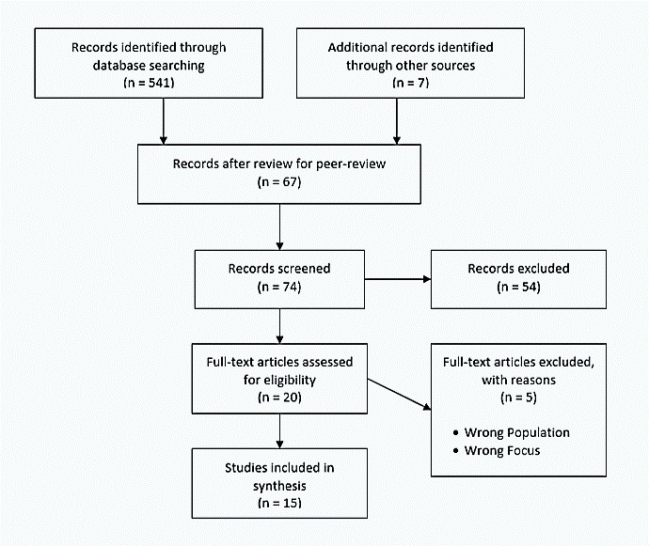
The Role of Social Media in Advancing Nursing Students’ Education and Professional Identity
Cortney Maffett
Abstract and/or Background
Methods
Results and/or Conclusion
Evidence supports the effectiveness of social media (SM) to enhance learning in undergraduate students
SM promotes engagement and creates an enjoyable learning experience
SM influences development of professional identity (PI) in the undergraduate nursing student; however, a direct relationship between SM and PI is not fully established.
Exploring this topic will assist educators in understanding the relationship among SM, knowledge development, and PI to promote effective use of technology within undergraduate nursing programs.
New strategies may save time, money, and resources while enhancing satisfaction among students
Understanding how students learn effectively will allow educators to implement positive change within nursing programs while promoting the use of cost-effective technologies.
A comprehensive literature review of current research studies was conducted
Full-text, peer-reviewed publications in English within 5 years
The keywords “social media,” “nursing students,” and “identity” were included in the search
Dissertations, book reviews, and newspaper articles were excluded
The search yielded 541 results, 15 were included in the synthesis
Use of SM increases student engagement with higher education content, improves interest, and provides opportunities for interaction with the educator (Thalluri & Penman, 2015)
SM affects student views based upon how the public image stereotypes nursing professionals (Green, 2018)
Three themes relate SM to nursing PI: learning about PI, adoption of PI, and sharing personal understanding of PI (Alharbi et al., 2020)
Concerns exist regarding professionalism among students using social media
Demographics play a role in student behaviors with SM; older students may produce less unethical behavior on SM than younger students (Smith & Knudson, 2015)
Nurse educators can promote positive change within nursing programs through use of cost-effective technologies
Future Work
Introduction
Compare effects of SM and other strategies on students’ professional identity and learning outcomes
Compare undergraduate nursing programs that allow SM use for learning with programs that do not use such strategies for effective decision making in students
Test the findings in different settings and populations
Figure 1. PRISMA Flow Diagram of Study Inclusion (PRISMA Flow Diagram, 2015)
SM effectively enhances learning in undergraduate nursing students
Use of SM has become a strategy for learning facilitation, organizational growth, and student critical reflection
SM tools offer interactive communication tools which are easily accessible for valuable information
Positive PI contributes to decreases in stress, job satisfaction, development of robust nurses, and increased retention rates
Research Question:
How does the rapid advancement in technology and SM affect undergraduate nursing programs?
Are undergraduate nursing students’ learning outcomes and PI influenced by SM?
Implementation of SM within a Nursing Program
Advantages | Disadvantages
Easily accessible Collaboration Content Interaction Peer Mentoring Discussion Groups Interaction with Educator Engagement Student Reflection Cost-effective Communication | Miscommunication Lack of privacy Distraction Unethical Behavior Student Discomfort Absence of E-Professionalism
References and Acknowledgments
Alharbi, M., Kuhn, L., & Morphet, J. (2020). Undergraduate nursing students’ adoption of the professional identity of nursing through social media use: A qualitative descriptive study. Nurse Education Today, 92(Journal Article), 104488. https://doi.org/10.1016/j.nedt.2020.104488
Green, J. L. (2018). Peer support systems and professional identity of student nurses undertaking a UK learning disability nursing programme. Nurse Education in Practice, 30(Journal Article), 56–61. https://doi.org/10.1016/j.nepr.2017.11.009
Lahti, M., Haapaniemi-Kahala, H., & Salminen, L. (2017). Use of social media by nurse educator students: An exploratory survey. The Open Nursing Journal, 11, 26-33. doi: 10.2174/1874434601711010026A1
Lopez, V. & Cleary, M. (2018). Using social media in nursing education: An emerging teaching tool. Issues in Mental Health Nursing, 39(7), 616-619. doi: 10.1080/01612840.2018.1494990
Price, A. M., Devis, K., LeMoine, G., Crouch, S., South, N., & Hossain, R. (2018). First year nursing students use of social media within education: Results of a survey. Nurse Education Today, 61(Journal Article), 70–76. https://doi.org/10.1016/j.nedt.2017.10.013
PRISMA Flow Diagram. (2015). PRISMA Transparent Reporting of Systematic Reviews and Meta-Analyses. Retrieved October 1, 2020 from http://www.prisma-statement.org/PRISMAStatement/FlowDiagram.aspx
Smith, G. C., & Knudson, T. K. (2016). Student nurses’ unethical behavior, social media, and year of birth. Nursing Ethics, 23(8), 910–918. https://doi.org/10.1177/0969733015590009
Thalluri, J., & Penman, J. (2015). Social Media for Learning and Teaching Undergraduate Sciences: Good Practice Guidelines from Intervention. Electronic Journal of E-Learning, 13(6), 455.
Acknowledgement: Dr. Rachel Joseph, Faculty mentor
Table 1. Advantages and disadvantages of implementing social media in nursing programs based upon literature review findings (Alharbi et al., 2020; Lahti et al., 2017; Lopez & Cleary, 2018; Price et al., 2017; Smith & Knudson, 2015; Thallri & Penman, 2015)

