Slide 1
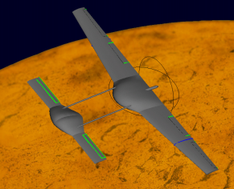
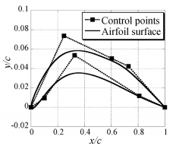
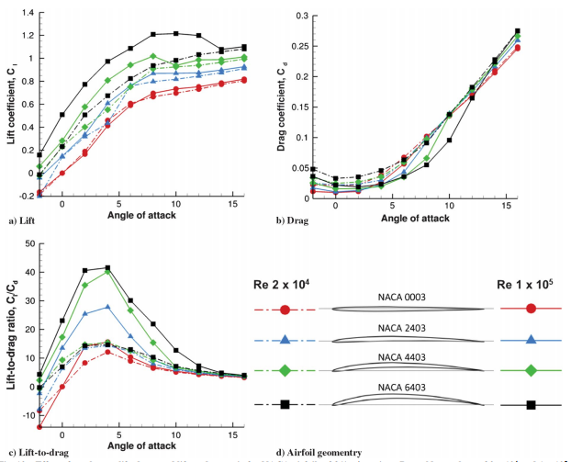
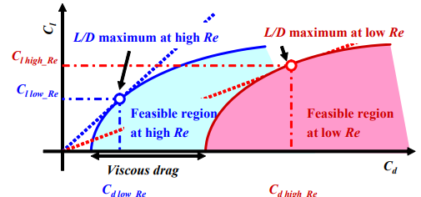
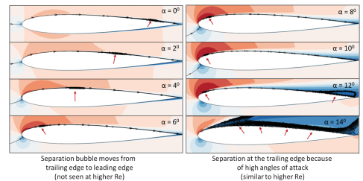
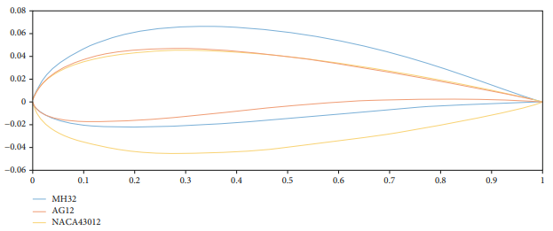
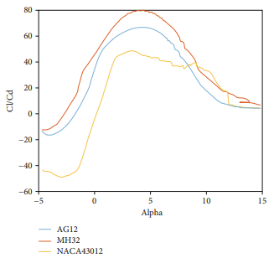
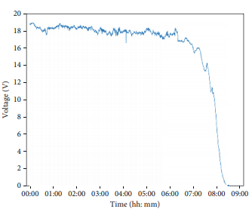
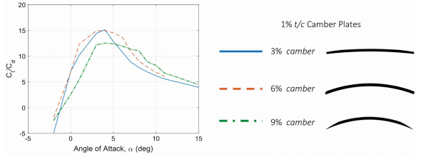
Review of UAV design development for exploration on other planets
Aaron Young
Abstract and/or Background
Results and/or Conclusion
Our knowledge of outer space and celestial bodies is ever-expanding. As time moves on, we push further and further into space using new methods and innovations. The best way to acquire such knowledge is to experience it firsthand. Over the next decade, we as a species aim to send a group of our own kind to earth’s moon and beyond. An important aspect of this pursuit of knowledge is safety. Finding new ways for astronauts to survey and observe vast landscapes and points of interest is beneficial as one must be careful within the hazardous environments we plan to explore. This presentation seeks to examine the current state of development of UAVs with sustainable propulsion systems as an effective way for explorers to safely take data and scope out large areas without the risk of traveling long distances and using crucial resources. Current designs by NASA incorporate a multi-rotor copter that lacks the ability to carry any significant payload. A juxtaposing design for a fixed wing craft has been in the works since 2006. By using atmospheric data gathered by the Japanese government, researchers have theorized an optimal cruising altitude based upon assumed Reynolds numbers of Mars and Earth atmospheres being 10⁵ and 10⁷ respectively. This was reviewed more closely in 2018 at the University of Maryland. Measurements of lift, drag, and an inspection of flow boundary separation were recorded at the low Reynolds numbers found in Mars’ atmosphere. Lastly, a theoretical prototype was simulated using ANSYS fluent. Researchers in Mexico approximated masses of various UAV components and observed the behavior of several airfoil geometries during flight. The conglomeration of these various data sources provides a solid starting point for a concrete initial design of a fixed-wing prototype.
Results
Results
The study from JAXA was able to refine the B-spline curves to generate a optimized airfoil configuration. For Mars’ and Earth’s respective Reynolds numbers, a table of C_{d}, C_{l}, pressure, and viscous drag were generated. (Table. 1) The same was done for the variation in Mach number applied. (Table 2.)
The various geometries tested at the University of Maryland that no matter the airfoil shape, a general trend amongst all geometries shows an optimal angle of attack to be around 3-5% (Fig. 8) However, as the angle of attack increases the leading edge of the separation boundary layer approaches the leading edge of the geometry. (Fig. 9)
Ruiz and their colleagues had results that mirrored that of the research done in Maryland, of the three geometries tested, a general trend of 3-5% is an optimal angle of attack for the craft to maximize the lift to drag ratio.(Fig. 10) From these values a general fuel consumption was simulated to determine a baseline fuel economy. (Fig. 11)
Conclusions
Despite there already being a working design in effect for a controlled aerial device, a fixed wing model would prove to be a more beneficial design based upon the considered needs of the application. Due to Mars’ atmosphere being less than 1% thinner than Earth’s, a larger airfoil surface area and increased angle of attack of around 3-5% would be needed to maintain a sufficient level of lift produced. This could explain why the current design of the helicopter only has a flight time of around 90 seconds as the rotors applied cover significantly less area.
Figure 1. Mars Helicopter (NASA)
Introduction and/or Research Question
Figure 2 Rendered Model of proposed prototype
Figure 3. Parameterization of airfoil geometry based on B-splines
While there already exists a working prototype for a UAV, it is quite simple and isn’t exactly capable of performing heavy tasks. (Fig. 1). This design may have the ability of flight, the need to move large quantities of cargo or take long survey flights isn’t within the realm of possibility with a design like this. Between the two main types of autonomous aircraft available, each type has its own benefits and weaknesses.
Fixed wing aircraft like that studied by the Japan Aerospace Exploration Agency (JAXA), typically provide for increased flight time and increased efficiency of the fuel source being used. (Fig. 2) The optimization of these fixed-wing designs is the basis for many of the sources presented here and possible future endeavors built upon said sources.
Future Work
Figure. 8 A cataloging of the coefficients produced by each airfoil geometry
Narrow results to a limited number of desirable configurations.
Pinpoint a more precise angle of attack between the nominal 3-5%.
Incorporate studies and values pertaining to lift and drag generated by tail stabilizers.
Generate overall thrust requirements based upon the varying cruising altitudes of operation.
Work with varying surface areas to determine optimal wingspan.
Figure 4. The increase in viscous drag forces the feasible region of the geometry optimization to shift to the right.
Methods
Figure 5. How angle of attack effects boundary layer separation creep.
Figure 9. How the angle of attack changes the location of boundary layer separation
1 2 3 4 5 6 7 8 9 10 11 12 13 14
In a 2006 JAXA study, an array of airfoil cross sections were generated with the use of B-Spline curves containing eight control points. The control points on the ends of the cross section are fixed leaving six points that can be optimized. (Fig. 3) Through a series of configurations, a small set of geometries were derived. A standard control Mach number and Reynolds number were applied to each to simulate both atmospheres of Earth and Mars. From these Computational Fluid Dynamics (CFD) simulations, a comparison of these factors and how they affected surface pressure at both locations was generated. (Fig. 4)
The estimated Reynolds number for atmospheric conditions on Mars fall between 10⁴ and 10⁵. Researchers at the University of Maryland focused on the effects of increased angles of attack on boundary layer separation. (Fig. 5) A standard NACA 0009 , a reverse configuration NACA 0012, Clark-Y, flat plate airfoil(1, 3, 5% thickness), and thin cambered plates(3, 6, 9% camber) were studied. A 2D CFD program was developed in house to look at the points along the top face of the listed airfoils boundary layer separation began to occur. Due to the low Reynolds numbers of Mars’ atmosphere, assumptions that flows remained either turbulent or laminar were avoided.
University Researchers in Mexico in 2019 estimated the weight of the total bill of materials (BOM) for a fixed-wing craft and used this data to test a list of varying airfoil geometries. (Fig. 6) By varying the angle of attack within CFD simulations, a coefficient of drag (C_{d}) and Coefficient of lift (C_{l}) were generated to determine an overall lift to drag ratio.
(Fig. 7)
1 2 3 4 5 6 7 8 9 10 11 12 13 14
References and/or Acknowledgments
A
B
A. G. Escobar-Ruiz, O. Lopez-Botello, L. Reyes-Osorio, P. Zambrano-Robledo, L. Amezquita-Brooks, and O. Garcia-Salazar, “Conceptual Design of an Unmanned Fixed-Wing Aerial Vehicle Based on Alternative Energy,” International Journal of Aerospace Engineering, vol. 2019, pp. 1–13, Nov. 2019, doi: 10.1155/2019/8104927.
A. Oyama and K. Fujii, “A Study on Airfoil Design for Future Mars Airplane,” presented at the 44th AIAA Aerospace Sciences Meeting and Exhibit, Reno, Nevada, Jan. 2006, doi: 10.2514/6.2006-1484.
J. Winslow, H. Otsuka, B. Govindarajan, and I. Chopra, “Basic Understanding of Airfoil Characteristics at Low Reynolds Numbers (104–105),” Journal of Aircraft, vol. 55, no. 3, pp. 1050–1061, May 2018, doi: 10.2514/1.C034415.
K. McSweeney, “NASA is developing drones for Mars exploration,” ZDNet. https://www.zdnet.com/article/nasa-develops-drones-for-mars-exploration/ (accessed Feb. 26, 2021).
mars.nasa.gov, “Mars Helicopter.” https://mars.nasa.gov/technology/helicopter/ (accessed Feb. 25, 2021).
C
Figure. 6 Various airfoil shapes considered
Figures. 10 & 11 Respectively, a comparison of angle of attack to the resulting lift/drag ratio and the drop in accumulator voltage measured during a predicted flight
Figure. 7 The lift/ drag ratio from the various airfoils tested in figure 6

