Slide 1
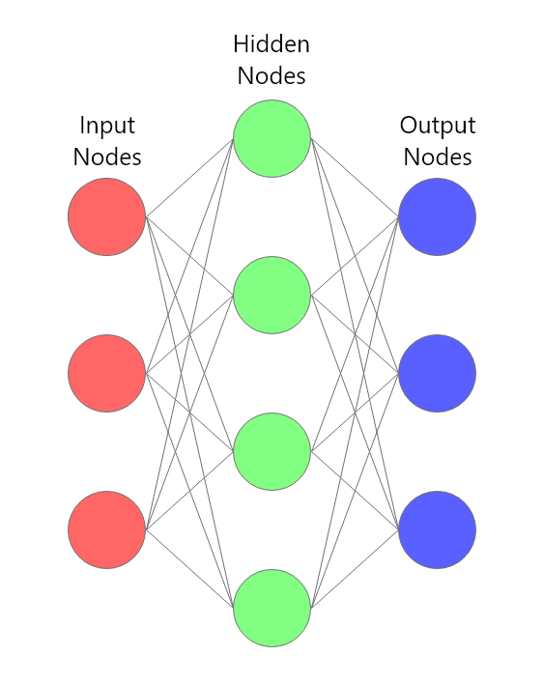
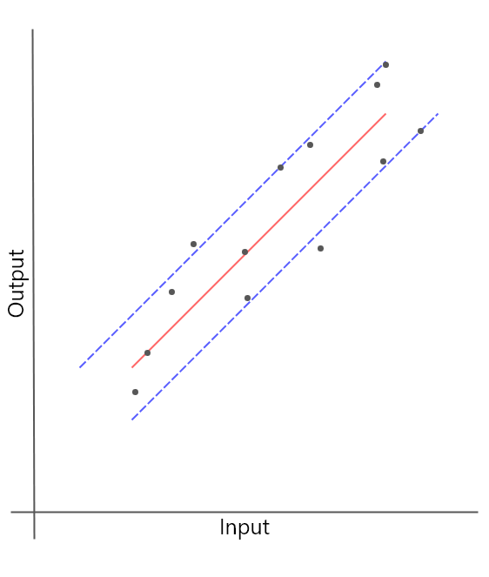
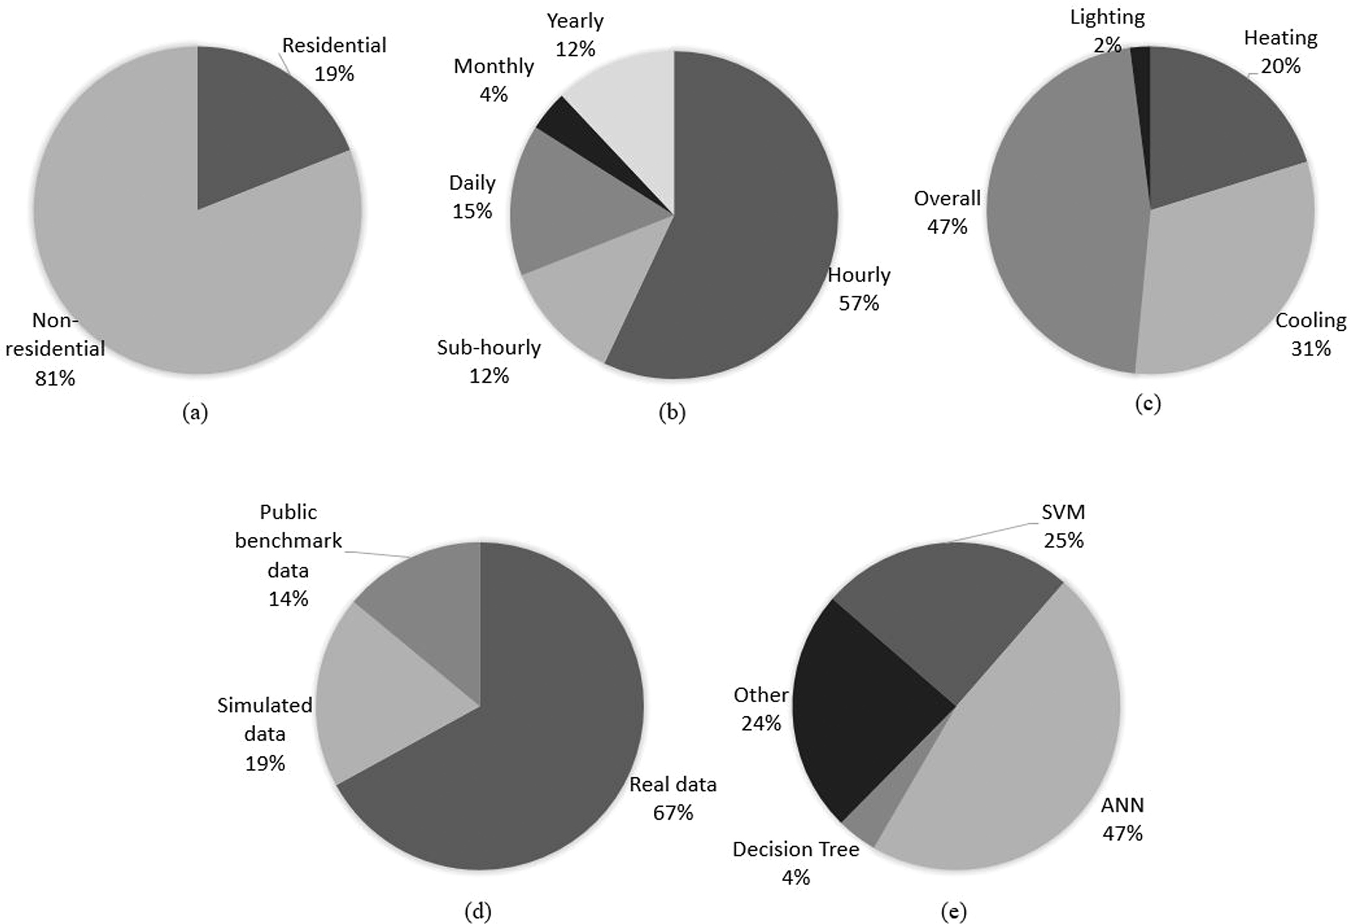
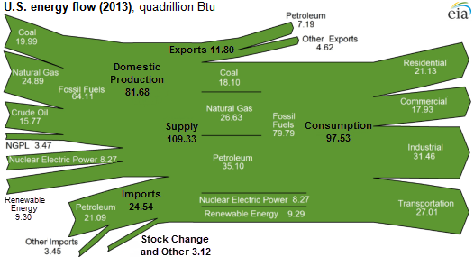
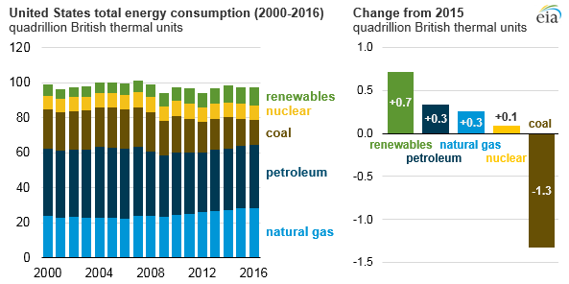
Machine Learning Models for Energy Consumption Prediction in Buildings
Kolton Musgrove and Hector Medina
Abstract
Expected Challenges
Background: Over the past few decades, there has been an unprecedented rise the popularity of machine learning techniques for the solving of varied problems. Building energy consumption accounts for 32% of energy consumed in 2010 (Oswaldo) and 40% in the US (Robinson). With the majority of energy sources relying on resources that are both non-renewable and potentially pollutive, the reduction of energy consumption can result in a financial benefit for institutions and for humanity. Machine learning techniques rely on architectures that have different costs and benefits (Shafique). By analyzing the costs and benefits of these algorithms, researchers can gain a better understanding of which applications would be beneficial for the field of energy consumption predictive modeling. There are multiple major model architectures including the following: multi-layer perceptron, non-linear autoregressive, non-linear autoregressive with exogeneous inputs, support vector regression, k-nearest neighbor regressor, conditional restricted Boltzmann machine, hidden Markov model, hierarchical mixture of experts. By comparing these models, their data and computation requirements as well as the potential benefits for accuracy and different prediction horizons, it is possible to present a roadmap for future research surrounding energy consumption predictive modeling. Methods: By examining the existing literature for the field of energy consumption predictive modeling (ECPM), a list of the most used model architectures is compiled. These architectures are then examined in isolation, relative to one another, and within the broader field of ECPM. Expected Results: By identifying the current trends of the field and the utilization of specific architectures, it would be possible for us to identify possible new models or hybrid models that could yield improve prediction accuracy.
In the process of conducting the individual analysis of each architecture, the amount of data present in the research papers we analyze will be a highly limiting factor in the quality of analysis we can provide. If there are multiple papers that utilize the same overarching architecture with differences in implementation, but do not make those differences public, it will be difficult to provide an accurate analysis on this model architecture. However, if this is the case, articles can be selected or omitted based on the amount of information about the models that the articles contains.
In the process of conduction comparative analysis of the architecture, the most likely concern would be fairly comparing the model architectures given the widely varying data requirements, input structures, output structures, and processing techniques. The resolving factor in this situation would be the error metrics that are common across the different architectures.
In the process of comparing the models in the light of the broader context of ECPM, the difficulty would be in comparing model architectures that use different datasets that have different properties, attributes, are representative of different structures, and are recorded from different geographical locations. The resolving factor for this issue would be to focus on the general requirements for each model and the attributes of data that are similar across the different datasets. This would allow for a fair comparison given the widely disparate sets of data.
With this data accumulated and the models evaluated, the se
Figure 1. Simplified Model of a Neural Network
Data is passed from the input nodes, through weighted edges, to the hidden layers that perform different transformations and manipulations based on the given architecture, through unweighted edges to the output nodes as predictions. This model will vary greatly based on the architecture including different amounts and types of input, weighted or unweighted edges, the number of function of hidden layers, and the size of the output. These variations all result in different model attributes such as robustness, accuracy, prediction horizon, data requirements, computational complexity, etc.
Figure 2. Simplified Model of a Support Vector Regressor
A support vector regressor creates a mapping from inputs to outputs in an n-dimensional space. It then approximates the function that maps the inputs to outputs by creating a region of acceptable error surrounding a polynomial function. Because of the relative simplicity when compared to a Neural Network, there are certain real-time situations where SVRs are more optimal than their NN counterparts.
Introduction
Expected Results
The consumption of energy by buildings accounts for a significant portion of total energy consumption. In the US, building energy consumption (BEC) accounts for a total of 40% of total energy consumption (Robinson) and globally it accounts for 38% (Oswaldo). This energy consumption results in an increase of CO2 in the atmosphere and can lead to lower quality of living in highly urbanized regions (Shafiei). Implementing technologies that increase energy efficiency have been shown to reduce energy consumption by 15-20% and benefit from incremental life-cycle costs (Kneifel). By predicting the energy consumption businesses, universities, and homeowners would be enabled to significantly reduce their energy costs and reduce their carbon footprint. There are multiple ways to predict energy consumption. The most common types are physics-based models that approximate the physical properties of the building in each environmental state and predict how much energy would then be used by the building, statistical models that attempt to approximate a non-linear function that maps inputs such as temperature, occupancy, historical energy consumption, etc. to future energy consumption, and there are grey-box models that combine the two approaches. This poster will focus on statistical models and more specifically, machine-learning-based models. Through the recent advancements of machine learning models and the reduction in cost of compute power, using on-line energy prediction methods have become practical and highly cost efficient. As seen in figure 3, these recent advancements have also led to the field being dominated by ANN architectures in recent years (Amassali). By comparing the models that have already been tested in the field of ECPM, we hope to identify the future capabilities of such models and the potential for the development of hybrid models that combine the benefits of several submodels.
After reviewing the architectures, there would be trends and themes common among them, but also differences in input necessities, processing methods, computation times, and output methods. These differences could be characterized and compared to the most common datasets in ECPM to identify what models do not fit the trend of available data or which ones are no longer practical due to the size of the available datasets and their computational complexity. The results of the architecture comparison could also yield to new possible hybrid models that play to the strengths of the existing data and their constituent architectures.
Conclusions
As a result of this literature review, weaknesses and strengths of a variety of model architectures would be presented in a format that would make it easier for researchers to identify fruitful routes of model development in the field of ECPM. The literature review would also identify potential, unutilized hybrid models that could take advantage of the rapidly changing ECPM landscape.
Figure 3. Pie Charts Displaying Statistics on the Field of ECPM (Amasyali et al.)
The top, left chart displays the percentage of non-residential and residential buildings. The top, middle chart displays the prediction horizon. The top, right chart displays the types of energy predicted. The bottom, left chart displays the type of data that models are trained on. The bottom, left chart displays the type of model used to predict energy consumption. The bottom, right chart makes it clear that ANNs are the most common type of model in the field currently.
Figure 4. US Energy Consumption Flow from Production to Sector Consumption (Joyce)
The US consumes a total of 97.53 Quadrillion British Thermal Units of Energy Per Year. Roughly 80% of the total, and 100% of the renewable, comes from domestic production. Renewable, green energy sources only account for a total of 9.30 Quad. Btu. This amounts for roughly 10% of the total energy consumption of the US. The largest consuming sector for energy is Industrial at 31.46 quadrillion Btu per year. Combined with all other non-residential sectors, therefore the ones for whom buildings consume a large amount of the total energy, more than 70% of all energy consumed is consumed by non-residential sectors.
Methods
References
Research Description
Use an online database to search for relevant articles with the keywords, “Building Energy Consumption”, “Energy Consumption Prediction”, and “Machine Learning Energy Consumption”.
Compile a list of highly-cited, influential papers from the research database findings.
Examine the citation lists of these articles to identify additional relevant articles.
Conduct a literature review of the articles to identify a list of machine learning architectures that have been used in the field.
Analyze each of these model architecture individually, in comparison to each other, and in the light of the field of ECPM.
Examine the costs and benefits of each architecture to determine any likely hybrid models that could present an opportunity for future research.
From a cursory search, there are more than 100 articles that discuss the prediction of energy consumption in buildings. The majority of these articles are based on artificial neural networks or support vector regressors. An artificial neural network is a mathematical model that mimics the interactions found in neurons (Figure 1). Support vector regressors are regression algorithms that attempt to fit an acceptable error margin to a given set of data and then use that error margin to predict new data points (Figure 2). Both are used to model the relationship of inputs and outputs in complex, non-linear relationships.
A
B
Oswaldo, L., Urge-Vorsatz, D., Ahmed, A. Z., Akbari, H., Bertoldi, P., Cabeza, L. F., ... & Vilarino, M. V. (2014). Climate change 2014: mitigation of climate change: working group III contribution to the IPCC fifth assessment report.
Robinson, C., Dilkina, B., Hubbs, J., Zhang, W., Guhathakurta, S., Brown, M. A., & Pendyala, R. M. (2017). Machine learning approaches for estimating commercial building energy consumption. Applied energy, 208, 889-904.
Shafique, M., Theocharides, T., Bouganis, C. S., Hanif, M. A., Khalid, F., Hafız, R., & Rehman, S. (2018, March). An overview of next-generation architectures for machine learning: Roadmap, opportunities and challenges in the IoT era. In 2018 Design, Automation & Test in Europe Conference & Exhibition (DATE) (pp. 827-832). IEEE.
Shafiei, S., & Salim, R. A. (2014). Non-renewable and renewable energy consumption and CO2 emissions in OECD countries: a comparative analysis. Energy Policy, 66, 547-556.
Kneifel, J. (2011). Beyond the code: Energy, carbon, and cost savings using conventional technologies. Energy and Buildings, 43(4), 951-959.
Amasyali, K., & El-Gohary, N. M. (2018). A review of data-driven building energy consumption prediction studies. Renewable and Sustainable Energy Reviews, 81, 1192-1205.
Joyce, M., & Repice, R. (2014). Domestic production satisfies 84% of total US energy demand in 2013. EIA, monthly energy review.
Mobilia, M., & Comstock, O. U. S. (2017). energy consumption rose slightly in 2016 despite a significant decline in coal use. Today in Energy: US Energy Information Administration (EIA).
C
Figure 5. Total Energy Consumption of the US from 2000-2016 (Mobilia)
This graph demonstrates the significant reduction of coal use from 2000-2016. While there has been a large reduction of reliance on coal, the lack of predictability, or accurately predicting models, of energy consumption has increased the difficulty of adopting renewables.

