Slide 1
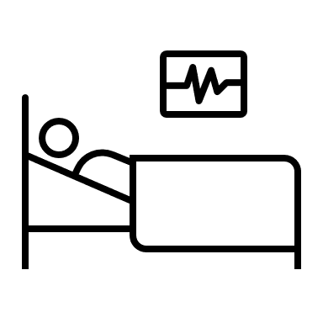
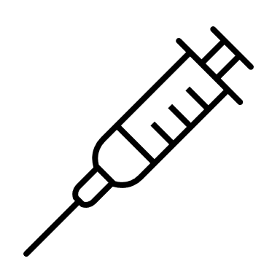
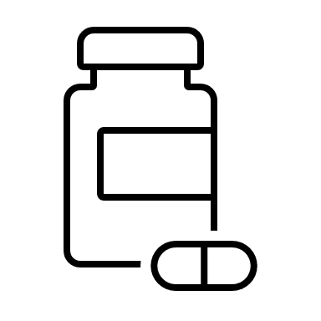
Polycystic Ovarian Syndrome and Insulin Resistance:
Treatment Modalities and Complication Prevention
Sarah Mann
Abstract
Contributing Factors
Obesity
Excess Fetal Androgen Exposure & Maternal Factors
Insulin Resistance
Genetic Variations
Lifestyle Choices
Conclusion
Polycystic ovarian syndrome (PCOS) is a chronic, multifactorial reproductive and endocrine disorder that affects between 9-18% of women and causes approximately 80% of anovulatory infertility cases (Balen et al., 2016).
PCOS' pathophysiology, potential complications, treatment methods, and nursing considerations were included within the research to create a thorough foundation of knowledge.
The research goal was to evaluate current literature and demonstrate the need to establish a more beneficial, evidence-based approach for long-term PCOS management.
Many patients do not receive holistic, comprehensive care.
Treatments should be individualized and tailored to patient-specific needs.
Providers and patients alike lack knowledge of PCOS.
PCOS may cause long-term systemic complications without proper treatment.
Dietary modification and exercise is an integral part of PCOS management.
Further research is necessary to evaluate specific dietary recommendations, exercise types, and potential supplements, particularly inositols, for PCOS treatment.
Further research must also explore PCOS etiology, genetic factors, and maternal influences, such as androgen levels and maternal PCOS diagnosis.
Common Clinical Manifestations
Oligomenorrhea
Oligoovulation
Polycystic Ovaries
Hyperandrogenism: Acne and Hirsutism
Weight Gain and Obesity
Mood Liability
Insulin Resistance: Hyperglycemia, Metabolic Inflexibility, Elevated A1C Levels, Pre-Diabetes
Introduction
Insulin resistance (IR) is highly correlated with PCOS and increases the risk of sequelae, including obesity and diabetes mellitus type II.
PCOS includes multiple clinical manifestations that may significantly impact a patient’s quality of life, including physical, social, and emotional.
Currently, the primary treatments for PCOS are hormonal birth control and metformin. However, this neglects to address the underlying problems of PCOS and is not necessarily reflective of patient-centered care.
Despite being a common condition, its etiology and treatment modalities remain poorly defined. Without proper understanding and management of the condition, women may suffer numerous chronic complications.
Proper diagnosis and evidence-based disease management are critical for patients’ lifelong well-being.
PCOS Complications
Cardiovascular Disease
Infertility
Miscarriage and Other Pregnancy Complications
Diabetes Mellitus Type II
Endometrial Hyperplasia and Uterine Cancer
Non-Alcoholic Fatty Liver Disease
Depression and Anxiety
Future Work
Enhance knowledge and care competency on PCOS among medical professionals, including nurses, and their ability to sufficiently educate patients.
Update evidence-based practice guidelines for PCOS treatments and complication prevention.
Evaluate genetic causes of PCOS and possible connections to disorders such as autism and endometriosis.
Determine the effectiveness of non-pharmacological PCOS treatment modalities, including dietary supplements.
References
Balen, A. H., Morley, L. C., Misso, M., Franks, S., Legro, R. S., Wijeyaratne, C. N., . . . Teede, H. (2016). The management of anovulatory infertility in women with polycystic ovary syndrome: An analysis of the evidence to support the development of global WHO guidance. Human Reproduction Update, 22(6), 687-708. doi:10.1093/humupd/dmw025
Cooney, L. G., & Dokras, A. (2018). Beyond fertility: Polycystic ovary syndrome and long-term health. Fertility and Sterility, 110(5), 794-809. doi:10.1016/j.fertnstert.2018.08.021
De Leo, V., Musacchio, M. C., Cappelli, V., Massaro, M. G., Morgante, G., & Petraglia, F. (2016). Genetic, hormonal and metabolic aspects of PCOS: an update. Reproductive Biology and Endocrinology, 14(1). https://link-gale-com.ezproxy.liberty.edu/apps/doc/A461871422/AONE?u=vic_liberty&sid=AONE&xid=c53946e2
Gadalla, M. A., Norman, R. J., Tay, C. T., Hiam, D. S., Melder, A., Pundir, J., Thangaratinam, S., Teede, H. J., Mol, B., & Moran, L. J. (2020). Medical and Surgical Treatment of Reproductive Outcomes in Polycystic Ovary Syndrome: An Overview of Systematic Reviews. International journal of fertility & sterility, 13(4), 257–270. https://doi.org/10.22074/ijfs.2020.5608
Kriedt, K. J., Alchami, A., & Davies, M. C. (2019). PCOS: Diagnosis and management of related infertility. Obstetrics, Gynaecology & Reproductive Medicine, 29(1), 1-5. doi:10.1016/j.ogrm.2018.12.001
Mcewen, B., & Hartmann, G. (2018). Insulin resistance and polycystic ovary syndrome (PCOS): Part 1. The impact of insulin resistance. Journal of the Australian Traditional-Medicine Society, 24(4), 214+. https://link-gale-com.ezproxy.liberty.edu/apps/doc/A573095765/HWRC?u=vic_liberty&sid=HWRC&xid=fbfb098e
Palomba, S., Santagni, S., Falbo, A., & La Sala, G. B. (2015). Complications and challenges associated with polycystic ovary syndrome: current perspectives. International Journal of Women's Health, 7, 745+. https://link-gale-com.ezproxy.liberty.edu/apps/doc/A446184699/AONE?u=vic_liberty&sid=AONE&xid=ff9b837d
Patel, S. (2018). Polycystic ovary syndrome (PCOS), an inflammatory, systemic, lifestyle endocrinopathy. Journal of Steroid Biochemistry and Molecular Biology, 182, 27-36. doi:10.1016/j.jsbmb.2018.04.008
1 2 3 4 5 6 7 8 9 10 11 12 13 14
Pharmacological Treatments
Metformin
Hormonal Birth Control
Progesterone Only Medications
Antiandrogens
Assisted Reproductive Medication and Technology: Clomiphene Citrate, Aromatase Inhibitors, Gonadotrophins, Laparoscopic Ovarian Drilling
1 2 3 4 5 6 7 8 9 10 11 12 13 14
Non-Pharmacological Treatments
Dietary Modifications, such as gluten-free and dairy-free
Regular Exercise
Weight Loss
Stress Reduction
Counseling
Dietary Supplements: Inositols and Vitamin D
A
B
Methods
A literature review was conducted to evaluate PCOS pathophysiology, complications, and disease management. The review was limited to scholarly journal articles published within the past 5 years.
C

