Slide 1
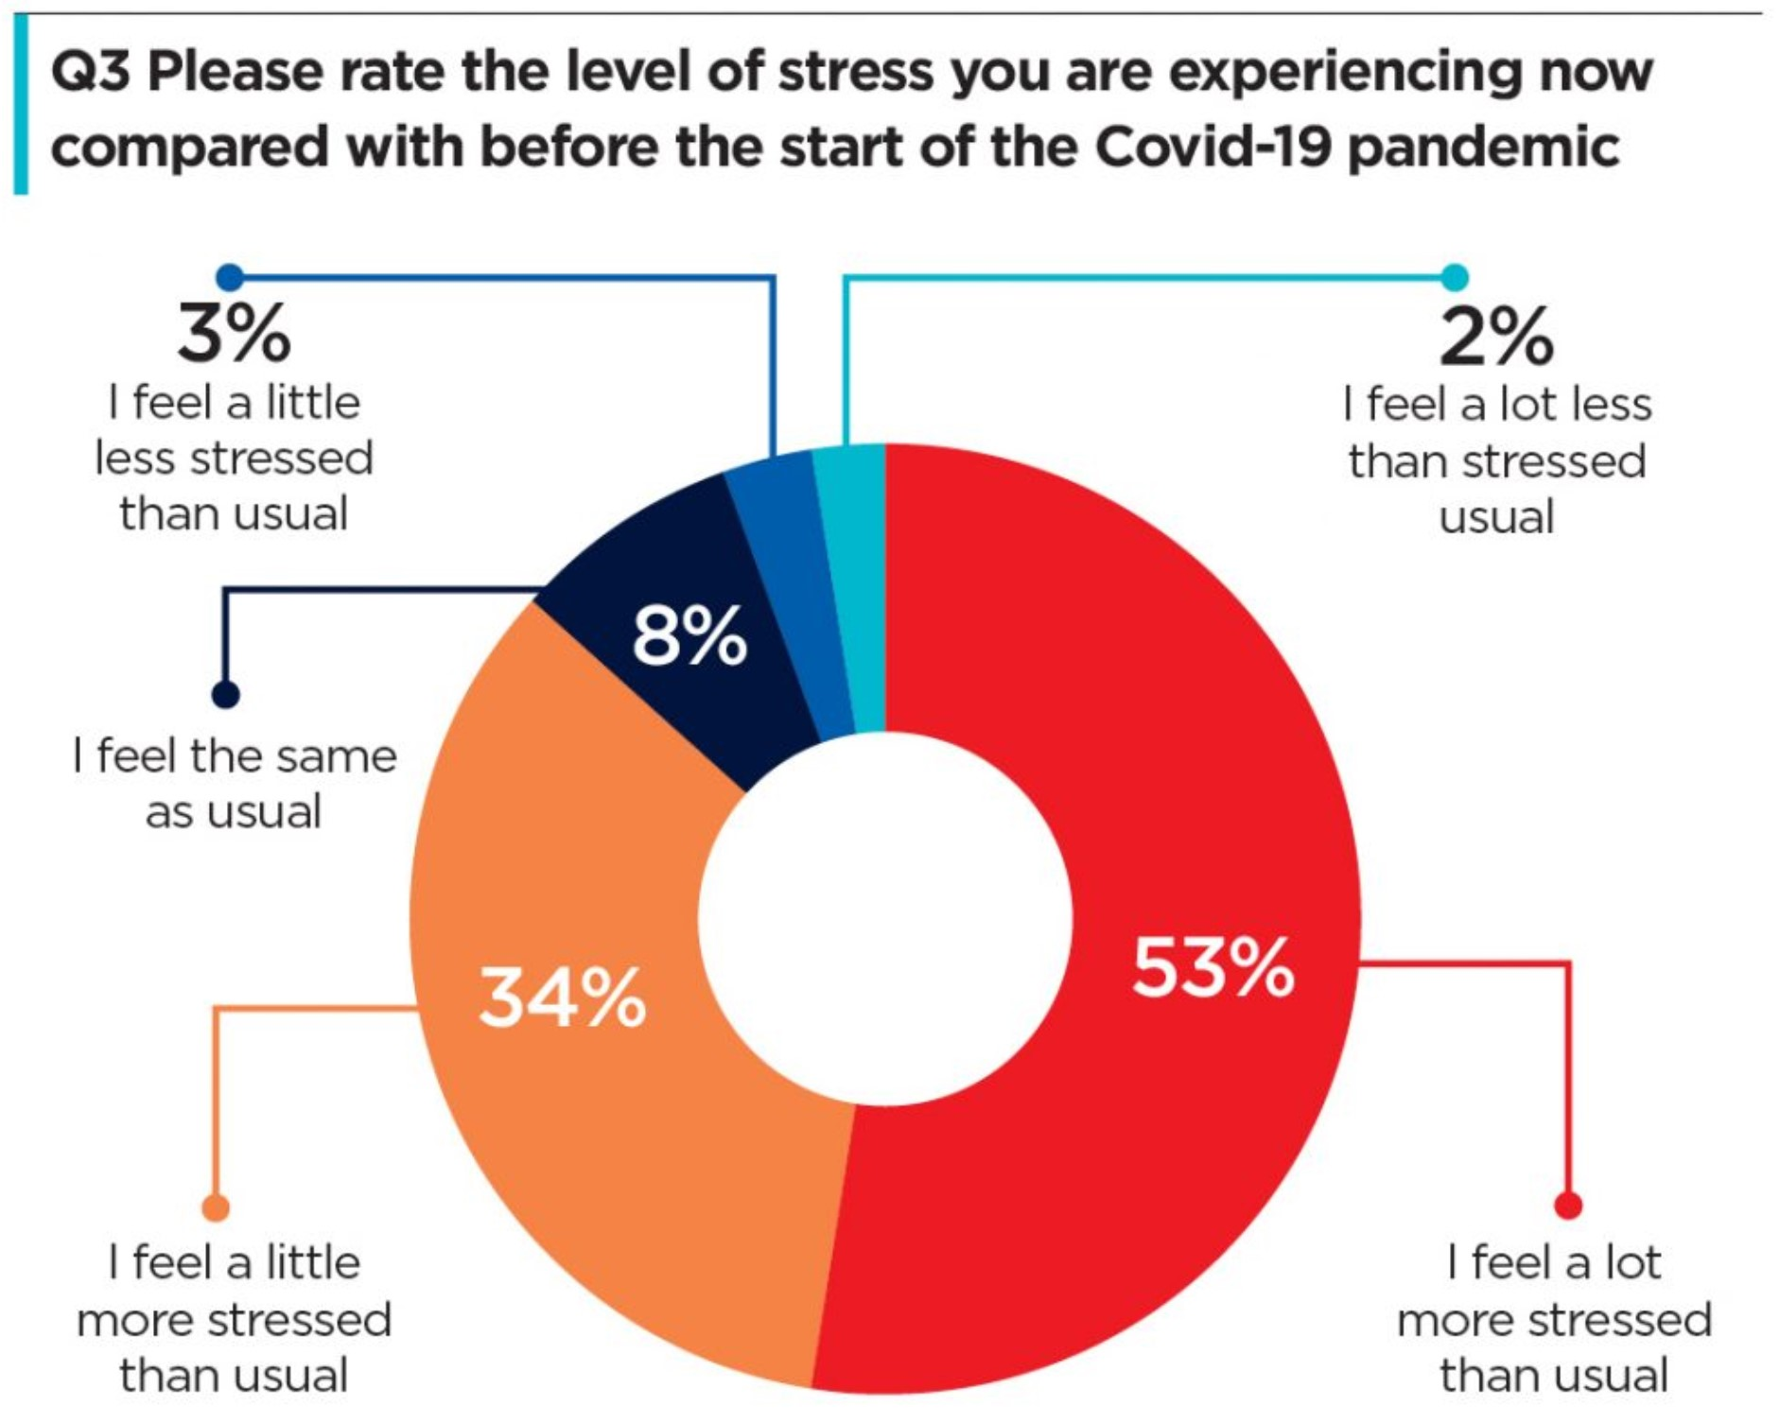
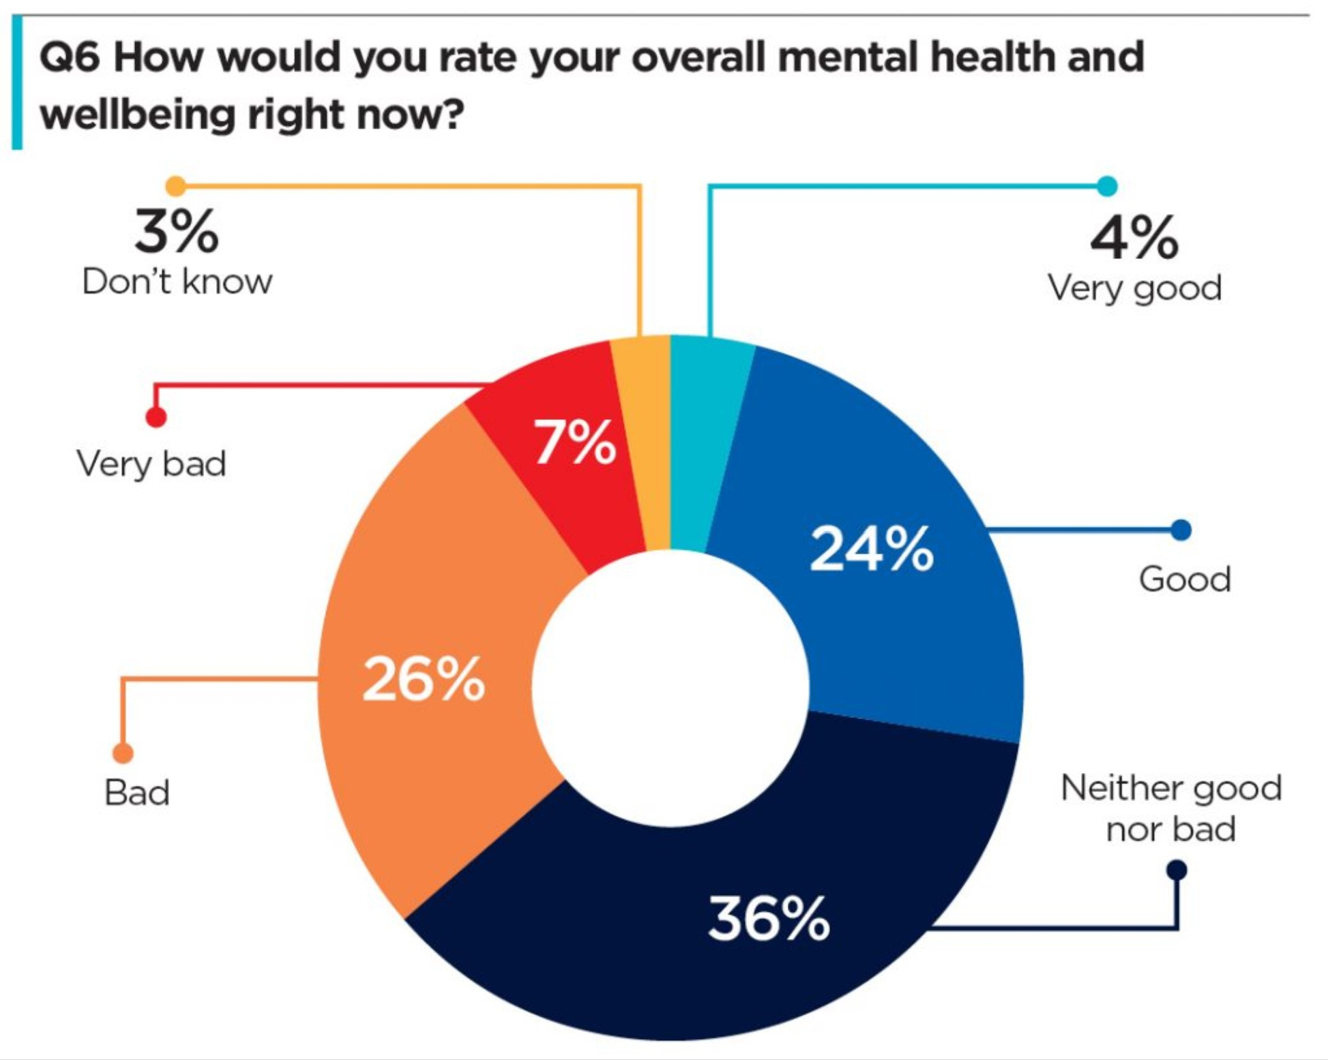
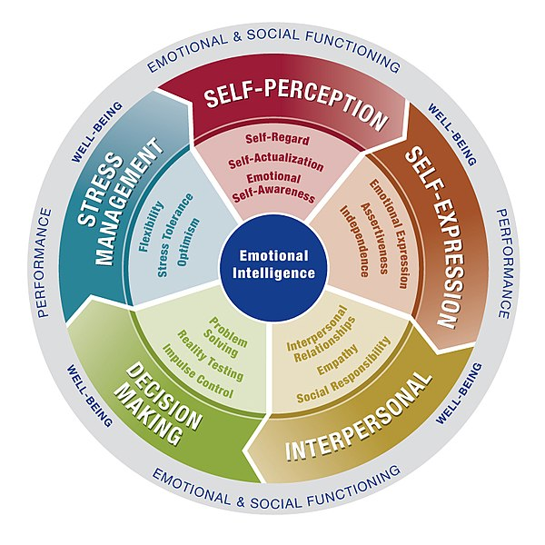
The Effects of Emotional Education on the Mental Health of Future Nurses
Summer M. Hepler, BSN, RN
Research Question/Hypothesis
Literary Review Findings
Do nurses that were enrolled in nursing programs that required emotional education courses as a part of their curriculum report less experiences of mental health issues such as acute stress disorder (ASD), post-traumatic stress disorder (PTSD), and compassion/empathy fatigue/burnout than nurses that did not receive emotional education as a part of their nursing education curriculum? By requiring courses in emotional education as a part of nursing education curriculum, nurses will be better prepared with the knowledge and coping mechanisms needed to traverse the tumultuous emotional pathway that so often runs parallel with the care that they give, therefore resulting in less reports of stress disorders and burnout amongst the nursing population.
There is a significant need for more research surrounding the effects that adequate courses in emotional education as a part of the required curriculum of nursing schools has on the well-being of nursing students during their educational journey but also how this education serves to prepare these individuals for the mental, emotional, and even spiritual dilemmas they may face once they enter and practice in the healthcare field. While there were many articles that referred to emotional intelligence in relation to nursing students, there were few that focused on emotional education. This implies that even though there is acknowledgment that emotional intelligence has been proven to be a beneficial characteristic in nurses, there is little being done to nurture this trait. Each of the reviewed articles speaks to a need for more research on this subject, with one even calling for the need of a specific pedagogy, or framework, needed to help facilitate this form of education.
By providing this substantial research indicating not only the short-term but also the long-term evidence indicating the benefits and detriments of the required addition of emotional education to the curricula’s of nursing schools, nursing students will have the opportunity to receive the training needed to establish and develop caring nurse-patient relationships, effective techniques for coping and grieving, and therapeutic communication methods, all of which will help alleviate the intense stressors that lead nurses down paths of mental health issues, emotional fatigues, and eventual burnout.
Introduction
In the face of the global pandemic known as novel coronavirus, more and more nurses worldwide are reporting symptoms of both Acute Stress Disorder (ASD) and Post-Traumatic Stress Disorder (PTSD), two very profound mental health issues that have the potential to alter the lives of those they affect (Marshall, 2020). As hindsight almost always being more revealing than those moments experienced in the throes of the event, the question arises, “could we have been better prepared?” While this question has been asked a multitude of times about the physical supplies and personal protective equipment needed and there have been many acknowledgements of the stressors that nurses’ were and still are experiencing, there have been few conversations as to what could have been done or provided, prior to the outbreak of COVID-19 that may have helped prepared nurses worldwide mentally, emotionally, and even spiritually for the onslaught that has recently afflicted so many (BBC News, 2020; Veenema & Meyer, 2020). With the World Health Organization (2020) now suggesting that “we must prepare for the next pandemic now” (para. 11), there must be a movement to better arm the nurses of the world with the emotional education needed to not only protect themselves but to also be able to better serve the patients that they care for.
Quality nursing care transcends more than only the physical care of a patient, of some of the very physical skills such as physical assessments, intravenous (IV) line placements, and medication administrations. While these are very important in the physical healing of the patient, to offer holistic care is to see the patient as an entire entity and treat each aspect of their being, which includes the emotional, mental, and spiritual needs of the patient as well. To meet these very personal needs successfully, nurses may be placed in a position where they feel they must open themselves up to nurture the nurse-patient relationship that is such a vital part of the care they provide. However, what is the cost of the compassion and empathy to the nurse and how do they cope? What of the frustration and grief that nurses so often experience as the result of patients they cannot save or situations they cannot change? How do nurses survive this onslaught without experiencing mental health concerns such as the ASD and PTSD most recently being seen in the nurses caring for COVID-19 patients? The answer lies in proper emotional education either through in-service opportunities for practicing nurses in the field or by the addition of emotional education as a part of the required nursing school curriculum.
Image: CI Photos/shutterstock.com
Appendix
Conclusion
The responsibility of insuring the mental health of the nurses of the future falls upon the Advance Practice Registered Nurses, the Nurse Researcher, and the Nurse Educators of today. As Christian nurses in these very vital roles, however, the necessity to find answers for those suffering mental health complications because of the priceless service they provide should be a burning need in their hearts, their souls. David shares in Psalms 34:18 that “The LORD is nigh unto them that are of a broken heart; and saveth such as be of a contrite spirit” (King James Bible, 2020), to assure God’s children that it is when they suffer the most that their Heavenly Father clings closest to them. He then shares in a later chapter that the Lord “healeth the broken in heart, and bindeth up their wounds” (King James Bible, 2020, Psalms 147:3), that not only does the Lord walk with His children when they are at their very lowest, suffering their greatest despairs, but He heals their hearts, and He binds their wounds. The hands that serve the Lord in this sacred purpose of binding are those of the Christian nurses he blesses with such honor. By searching for a solution to the causes for the increasing number of nurses being diagnosed with mental health issues and then developing a plan, such as implementing mandatory emotional education and training, future generations of nurses will be armed with the knowledge and coping mechanisms needed to survive in a profession where emotions are such an essential part of the care they provide.
“The Healer” by Nathan Greene
Use QR Code to visit
website of artist
Figure 1. 2020 Nursing Times Survey Results indicating levels of stress in nurses at bedside (Ford, 2020)
Figure 2. 2020 Nursing Times Survey Results indicating nurses’ self-perceived mental health and wellbeing status (Ford, 2020)
Methodology
To determine the long-term benefits for nurses that receive emotional education as a required part of their nursing education, this research project will follow two groups of entry-level nursing students, one group that will receive the emotional education courses and the other that will not. As a quantitative descriptive longitudinal study, this research project will follow the two cohorts for a total of nine years using questionnaires, online surveys, and possible focus groups with the participants. There will be a total of five data collecting activities spread over the nine-year period with the first of these being conducted at the start of the nursing student’s educational journey, prior to taking any nursing courses (year 0). The remaining four data-gathering events will be staggered at two years into their four-year degree completion plan (year 2), upon completion of their program prior to graduation (year 4), one year into their nursing careers (year 5), and then finally, five years into their nursing careers (year 9). By gathering information throughout their educational process and into their respective careers, the expectation is that the value of the required emotional education will be evident in their shared experiences.
References
BBC News. (2020). Coronavirus: ‘Nurses’ prepare for the worst but not
this’. https://www.bbc.com/news/world-us-canada-52094331
Ford, S. (2020). Exclusive: Nursing Times survey reveals negative
impact of COVID-19 on nurse mental health [Infographic].
https://www.nursingtimes.net/news/mental-health/exclusive-survey-
reveals-negative-impact-of-covid-19-on-nurse-mental-health-29-04-
2020/
Gómez-Díaz, M., Delgado-Gómez, M., Gómez-Sánchez, R. (2017).
Education, emotions, and health: Emotional education in nursing.
Procedia – Social and Behavioral Sciences, 237, 492-498.
http://doi.org10.1016/j.sbspro.2017.02.095/
King James Bible. (2020). King James Bible Online.
https://www.kingjamesbibleonline.org/ (Original work published
1611)
Marshall, B. (2020). Impact of COVID-19 on nurses’ mental health.
Issues in Mental Health Nursing, 41(10), 853-854.
https://doi.org/10.1080/01612840.2020.1819083
Orak, R. J., Farahani, M. A., Kelishami, F. G., Seyedfatemi, N.,
Banihashemi, S., & Havaei, F. (2016). Investigating the effect of
emotional intelligence education on baccalaureate nursing students’
emotional intelligence scores. Nursing Education in Practice, 20, 64-
69. http://doi.org/10.1016/j.nepr.2016.05.007
Veenema, T. G., & Meyer, D. (2020). Why America’s nurses were not
prepared for the coronavirus pandemic.
https://www.forbes.com/sites/coronavirusfrontlines/2020/06/04/why-
Americas-nurses-were-not-prepared-for-the-coronavirus-
pandemic/?sh=4886651c164b
World Health Organization. (2020). World Health Assembly charts
course for COVID-19 response and global health priorities.
https://www.who.int/news/item/05-11-2020-world-health-assembly-
charts-course-for-covid-19-response-and-global-health-priorities
Figure 3. Emotional education, which is the educational field of emotional intelligence, is a relatively new field of education that was first recognized in the 1990s (Orak, et al., 2016). The purpose of emotional education is to attempt to develop an individual’s emotional intelligence, as well as to enhance their ability to cope with the stressors of the nursing profession by teaching various coping mechanisms and communication methods (Gómez-Díaz, Delgado-Gómez, & Gómez-Sánchez, 2017).
Infographic: Cheryl Keates/cherylkeates.com

