Slide 1
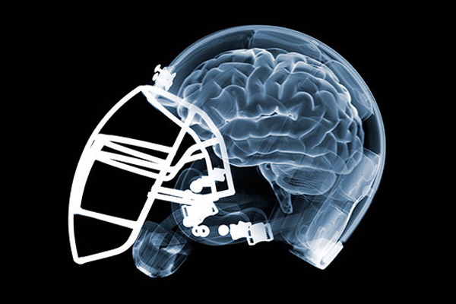
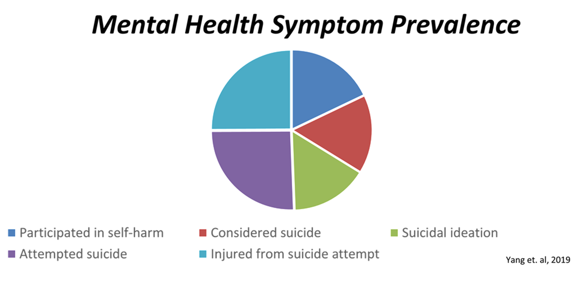
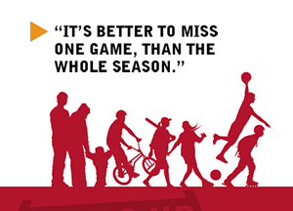
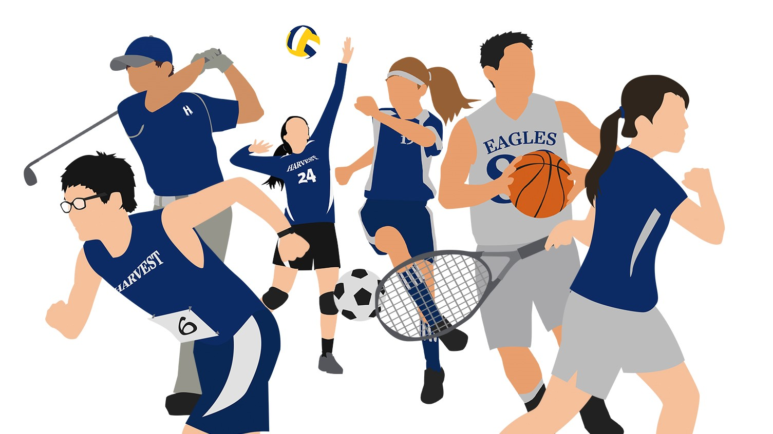
Mild to Moderate Concussions: Psychological Outcomes in Collegiate Athletes
Megan Briceland and Thomas Kazmierczak
What’s the Problem?
Results and/or Conclusion
Annually 3.8 million concussions related to competitive sports and recreational activities occur in the United States. Concussions occur most frequently in collegiate athletes who participate in football, hockey, rugby, soccer, basketball and other high impact and high contact sports. Athletes between the ages of 18 and 25 are at an increased risk of a prolonged recovery time with complex post-concussion symptoms (Harmon et. al, 2013). Many coaches and athletes may understand the physical post-concussion symptoms but there is not a wide understanding of the mental health and suicide implications that many athletes may experience. While severely injured athletes get high acuity care and follow up, those with mild to moderate concussions (also called mild traumatic brain injury; mTBI) may not receive as much attention, especially for treatment relating to mental health complications. The prevalence of depression after an mTBI was identified as 35% and diagnosis of major depressive disorder was listed at an additional 15% (Vargas et. al, 2015). The rates of self harm (26%), suicidal ideation (24%), attempted suicide (38%), and injury from a suicide attempt (37%) are substantial in adolescent and collegiate athletes aged 17-22 who suffered from a mild to moderate concussion (Yang et. al, 2019). Despite the prevalence of mental health complication within the collegiate athlete population, the National Collegiate Athletic Association (NCAA) concussion protocol guidelines for symptom screening is very vague when discussing the nursing assessment and interventions appropriate for recovery and return to play for these student athletes.
The current protocols that address monitoring the mental health components of the healing and treatment process after mTBI are subpar.
20% of collegiate athletes who suffer from a mild to moderate concussion report having serious depressive side effects up to 3 weeks after treatment (Vargas et. al, 2015).
Better understanding of the linkages between sports related concussions in collegiate athletes and depression, anxiety, aggression, and suicide will help reduce the suicidal deaths
Proper management can increase the quality of life of collegiate athletes who sustained mTBI
By adding a mental health component to concussion symptom screenings and post-concussion protocol, health care providers can recognize early warning signs of depression, anxiety, and aggression which will help to prevent suicide in collegiate athletes.
2
1
3
Future Work
Research Question
1. Prevalence of aggression, anxiety, depression and suicide rates related to collegiate athletes who lost athletic scholarship opportunities related to disqualification of play following an mTBI.
2. Analysis of nursing implications for patient education in the adolescent/pediatric population regarding sports safety leading to prevention of mTBI during later collegiate play.
3. Nursing education strategies that will best prevent recurrent mTBI in collegiate athletes regarding appropriate safety equipment use and aggressive play.
4. Chronic mental health effects of former collegiate student athletes who participated in competitive impact sports and the development of chronic traumatic encephalopathy in later adulthood.
5. The most beneficial evidence-based emergency nursing practice related to the treatment of mTBI with loss of consciousness within the first 24 hours post-injury period in order to prevent long term complications.
Definition: Concussion is defined as a traumatically induced transient disturbance of brain function and involves a complex pathophysiological process. Concussion is a subset of mild traumatic brain injury (MTBI) which is generally self-limited and at the less-severe end of the brain injury spectrum (American Medical Society for Sports Medicine)
Prevalence of mental health complications following a mTBI includes depression, anxiety, aggression, and suicide. Current NCAA protocols currently do not have a mental health screening protocol
Research Questions:
Does the current guidelines for collegiate athletes address depression, anxiety, aggression and suicide in collegiate athletes who suffered a sports-related mild to moderate concussion
Are Collegiate athletes appropriately screened and treated currently to reduce the long-term mental health effects of mTBI
In collegiate athletes who experience mTBI, will adding a mental health screening tool to the NCAA concussion protocol produce less aggression, depression, and suicide amongst college athletes as compared to current guidelines.
5
4
Current Concussion Protocols
NCAA Phase of Concussion Safety Protocol | Goals and Outcomes
Diagnosis of concussion | Concussion trained personnel must be present and available during all NCAA competition in contact and collision sports.
Implementation after diagnosis | Student-athlete with symptoms consistent with a concussion must be removed from practice or competition for evaluation
Evaluation of concussion | Must be completed by an athletic trainer or team physician. Must be removed from play for that calendar day. Assess for cervical spine trauma, skull fracture, intracranial bleed or catastrophic injury. Symptom assessment, physical and neurological exam, cognitive assessment and balance exam. Glasgow coma scale < 13 on initial assessment, or GCS <15 at 2 hours or more post-initial assessment, prolonged loss of consciousness, focal neurological deficit suggesting intracranial trauma, repetitive emesis, persistent worsening mental status, or spine injury– Emergency plan initiated.
Post-concussion management: Return-to-play | Each NCAA student-athlete must undergo a supervised stepwise progression management plan by a health care provider with a concussion specialty. Step-wise return goes as follows: symptom-limited activity, light aerobic exercise without resistance training, sport-specific exercise and activity without head impact, non-contact practice with progressive resistance training, unrestricted training, unrestricted return to sport. (NCAA, 2020)
References & Acknowledgments
CDC (2021). Mild TBI pocket guide. American College of Emergency Physicians.
Datoc, A., Horne, K., Golden, C., (2020). Sport-related concussion and risk for suicide in athletes. Science Direct: Aggression and Violent Behavior. 54. https://doi.org/10.1016/j.avb.2020.101413.
Downie, K., Cunningham, A., Jafri, M., (2021). Nurse-driven universal concussion screening: A quality improvement initiative. Journal of Trauma Medicine. 28 (1). www.journalofnursing.com.
Harmon, K., Drezner, J., Gammons, M., Guskiewicz, M., Halstead, M., Herring, S., Kutcher, J., Pana, A., Putukian, M., Roberts, W., (2012). American Medical Society for Sports Medicine position statement: Concussion in sport. American Medical Society for Sports Medicine. 47. p. 15-26. doi: 10.1136/bjsports-2012-091941
ImPACT. (2020). Setting up a concussion protocol: Quick reference guide. ImPACT. https://impacttest.com/concussion-protocol-101-guide/
ImPACT (2020). Post-concussion symptom scale. ImPACT.
Leclerc, S., Lassonde, M., Delaney, S., Lacroix, V., and Johnston, K., (2011). Recommendations for grading of concussion in athletes. Journal Sports Medicine 31 (8). p. 629-636. doi: 0112-1612/01/0008-0629/SS22.00/0.
Moore, P., Mawdsley, L., Jackson, CF., Atherton, MJ. (2017). Psychological interventions for persisting post-concussion symptoms following traumatic brain injury. The Cochrane Collaboration. John Wiley & Sons, Ltd. 8. doi: 10.1002/14651858.CD012755.
National Collegiate Athletic Association (2021). Concussion safety protocol template. National Collegiate Athletic Association.
National Collegiate Athletic Association (2021). Concussion safety protocol checklist. National Collegiate Athletic Association.
Piebes, M., Gourley M., Valovich T., (2019). Caring for student athletes following a concussion. The Journal of School Nursing. 25 (4).
Vargas, G., Rabinowitz, A., Meyer, J., Arnett, P., (2015). Predictors and prevalence of post concussion depression symptoms in college athletes. Journal of Athletic Training. 50 (3). p. 250-255. doi: 10.4085/1062-6050-50.3.02.
Yang, M., Clements-Nolle, K., Parrish, B., Yang, W., (2019). Adolescent concussion and mental health outcomes: A population-based study. American Journal of Health Behavior. 43 (2). p. 258-265. doi: https://doi.org/10.5993/AJHB.43.2.3
What is a concussion? “CDC Injury Center” Google Images, January 1, 2021, https://www.google.com/imgres?imgurl=https://www.cdc.gov/headsup/images/brain_injury_basics_flexslider/concussion_228x143.png&imgrefurl=https://www.cdc.gov/headsup/basics/concussion_whatis.html&tbnid=aY60fqVspQjclM&vet=1&docid=KEwLPYh6Cg6gBM&w=228&h=143&hl=en&source=sh/x/im. Accessed March 15, 2021.
Free PNG Logo. “NCAA PNG Logo” Google Images, January 1, 2021, https://www.freepnglogos.com/pics/ncaa-png-logo. Accessed March 15, 2021.
Jeanne Marie Laskas. “Bennet Omalu, Concussions, and the NFL: How One Doctor Changed Football Forever” GQ.com, September 19, 2009, https://www.gq.com/story/nfl-players-brain-dementia-study-memory-concussions. Accessed March 15, 2021.
U.S. Department of Health & Human Services. “Responding to a Concussion and Action Plan for Coaches” Centers for Disease control, January 1, 2021, https://www.cdc.gov/headsup/basics/concussion_respondingto.html. Accessed March 15, 2021.
Sports and Athletics. “Harvest Christian Academy.” Google Images, January 1, 2021, https://www.google.com/imgres?imgurl=https://hcaguam.org/wp-content/uploads/Harvest-Athletics-1.jpg&imgrefurl=https://hcaguam.org/athletics/&tbnid=67wTgvGPN10_7M&vet=1&docid=YhlPbB8_wlDxGM&w=1505&h=846&source=sh/x/im. Accessed March 15, 2021.
Acknowledgement: Dr. Rachel Joseph, Faculty Mentor
Methods
A
B
Literature was reviewed using search terms such as: Concussion, mental health, depression, anxiety, mTBI, psychotherapy, collegiate athletes.
Databases used: Databases from JFL
Other sources: current NCAA concussion standards and diagnostic tools for identifying preliminary symptoms of mTBI, and tools used to track the progression of the concussion throughout the treatment and healing process.
Sports Concussion Assessment Tool, third edition (SCAT3)
US Centers for Disease Control and Prevention
Canadian Medical Association policy statement on head injury and sport, ThinkFirst Canada
Reviewed 25 peer reviewed articles that reported on the prevalence and severity of mental health symptoms following a sports-related concussion in the collegiate student athletes.
C
Contact
M. Briceland: mcbriceland@liberty.edu
T. Kazmierczak: tpkazmierczak@liberty.edu
Notes:
Questions:
Title/name font size (Capitalize all the Significant Words) Mild to Moderate Concussions : Psychological Outcome in Collegiate Athletes
Images/table/figure for middle section? Yes
Do we need a literature review section? Methods section: Search terms used: Databases used: how many articles: How many Sports guidelines checked
Is this the undergraduate template?
Results section: bulleted points

