Slide 1
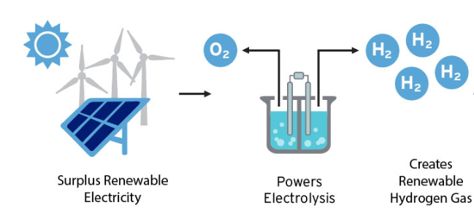
Hydrogen Combustion Engines with Fluid Dynamics
Isabelle Ambrose
Background
Results and/or Conclusion
A research analysis of using hydrogen fuel inside aircrafts to reduce air pollution and efficiency. Inside the engine of an aircraft working on hydrogen fuel cells and the process of developing hydrogen fuel from a renewable resource.
In the field of aviation and engineering, hydrogen combustion engines could allow for a more efficient and environmentally friendly way to grow the airline industry while producing less harmful gases to the atmosphere.
u
With the growing concern of pollution, the use of hydrogen energy inside the aviation industry could prove to be a new source of fuel that allows for clean energy.
Through the continuation of simulations and research, the growth in the field of hydrogen energy could prove to be a solution to the problem of pollution.
m sensing.
R
“Unlocking the Potential of Hydrogen Energy Storage.” Fuel Cell & Hydrogen Energy Association. (22 September 2019) https://www.fchea.org/in-transition/2019/7/22/unlocking-the-potential-of-hydrogen-energy-storage. ( 15 March 2021)
Introduction
What is Fluid Dynamics?
The subject of fluid dynamics can be described as the study of fluid in motion or fluid flow.
With the growing world, as engineers we continue to strive to improve the world, we live in to be more efficient.
In application to aircrafts, fluid dynamics plays a role in a variety of important tasks in aerodynamics.
Aerodynamics is a science that directly focuses on moving air and its impact on solid bodies placed in the flow field as an obstacle.
Future Work
Determine the different levels of efficiency of Hydrogen Combustion Engines through simulations in ANSYS Fluent
Study the efficiency of the processes of converting and storing renewable hydrogen for aircraft fuel. metabolism based on Quorum sensing.
Dolan, C “Commercial Aircraft. Airbus.” Airbus, (2019, July 22), https://www.airbus.com/aircraft.html . (2021 March 15).
Research Questions
Methods
What types of renewable energy can be researched and expanded through engineering?
What is the future of industry for aviation with hydrogen energy?
What are the benefit(s) of converting current aircraft engines to hydrogen energy?
Can Computational Fluid Dynamics benefit the expansion of the field of hydrogen combustion engines in aircrafts?
Through further study of hydrogen combustion engines, ANSYS Fluent, a computational fluid dynamic simulation software, will be used to continue research and simulation of aircraft engines.
The simulations will grow knowledge of the field to understand the true efficiency of the engines compared to other modern engines used in commercial aircrafts.
References and/or Acknowledgments
http://ahea.org/files/pro2002beaumaster.pdf
Commercial Aircraft. Airbus. https://www.airbus.com/aircraft.html.
Dolan, C. (2019, July 22).
Unlocking the Potential of Hydrogen Energy Storage. Fuel Cell & Hydrogen Energy Association. https://www.fchea.org/in-transition/2019/7/22/unlocking-the-potential-of-hydrogen-energy-storage.
Renewable Electrolysis. NREL.gov. https://www.nrel.gov/hydrogen/renewable-electrolysis.html.
U.S. Energy Information Administration - EIA - Independent Statistics and Analysis. Use of hydrogen - U.S. Energy Information Administration (EIA). https://www.eia.gov/energyexplained/hydrogen/use-of-hydrogen.php.

