Slide 1
Chaim Potok, Hasidism, and Hybridity
By Sara Williams

Slide 2
Thesis
Among the growing conversation of hybridity and anti-Semitism in the mid-20th century, Chaim Potok provides insight on the unique Jewish community in New York, expounding on the tension between the secular and the sacred.

Slide 3
Popular Holocaust Based Literature
1
We Were the Lucky Ones by Georgia Hunter
The Book Thief by Markus Zusak
The Tattooist of Auschwitz by Heather Morris
The Boy in Striped Pajamas by John Boyne
Sarah’s Key by Tatiana de Rosnay
Schindler’s List by Thomas Keneally
2

Slide 4
These are not the only
narratives on Jewish culture, though.

Slide 5
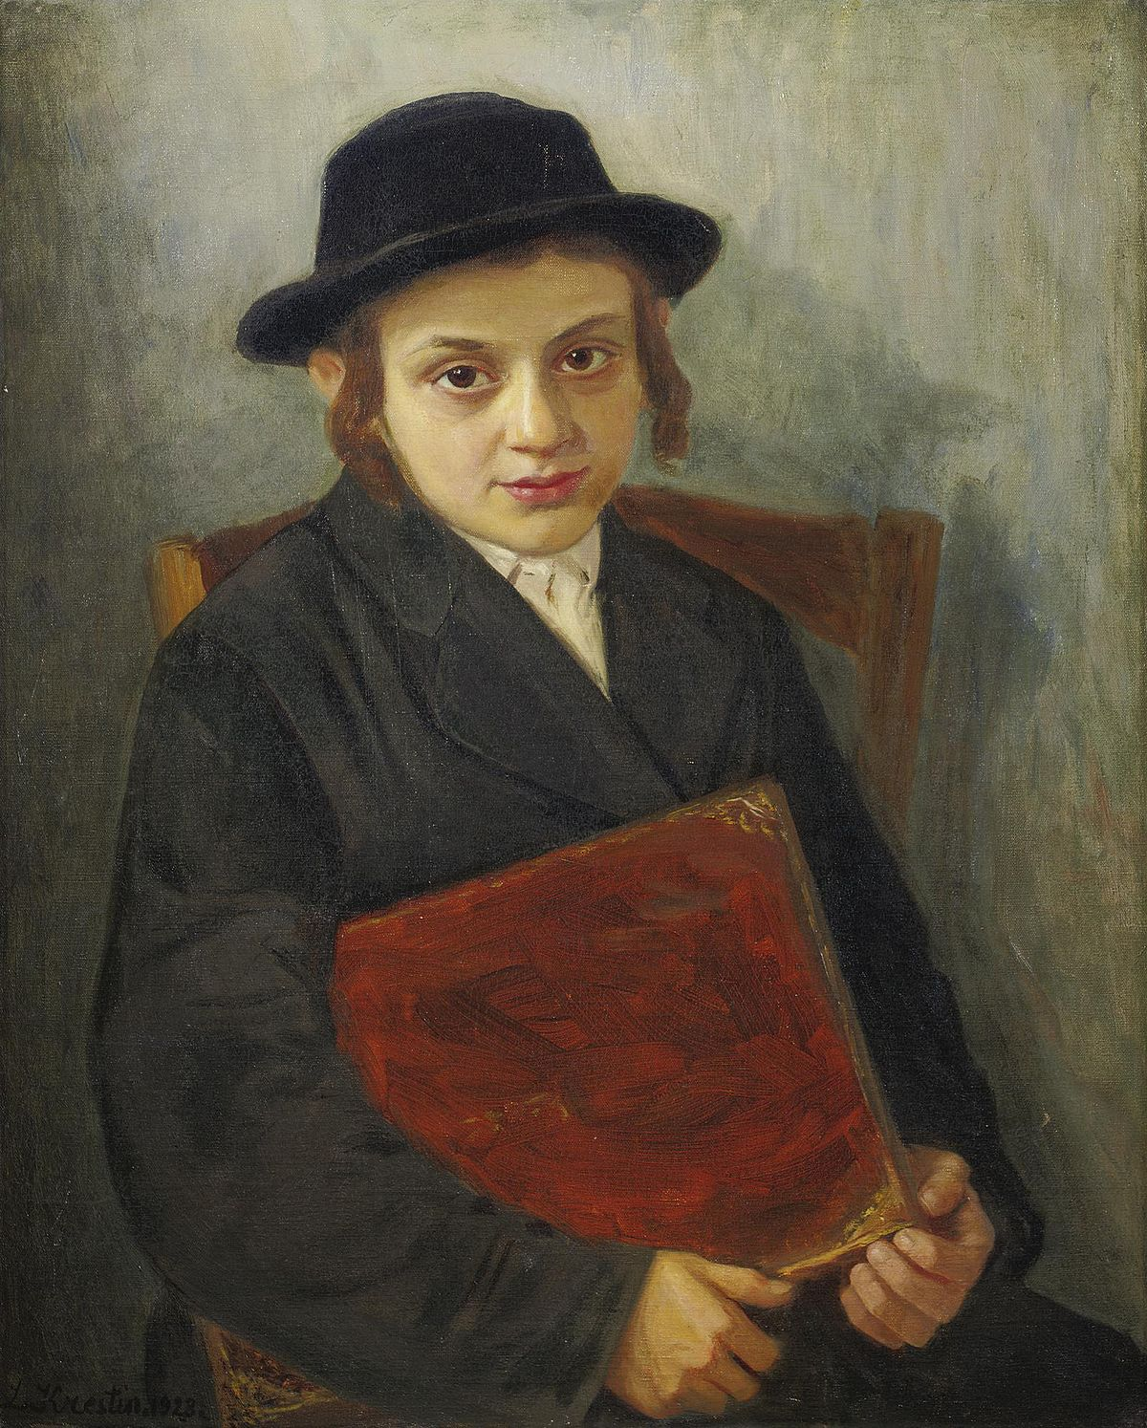
4
3
.

Slide 6
The Expert: Homi Bhabha
5
“The migrant culture of the ‘in between’, the minority position, dramatizes the activity of cultures untranslatability and in doing so it moves the question of cultures appropriation beyond assimilationist’s dreams…” (Bhabha 321).

Slide 7
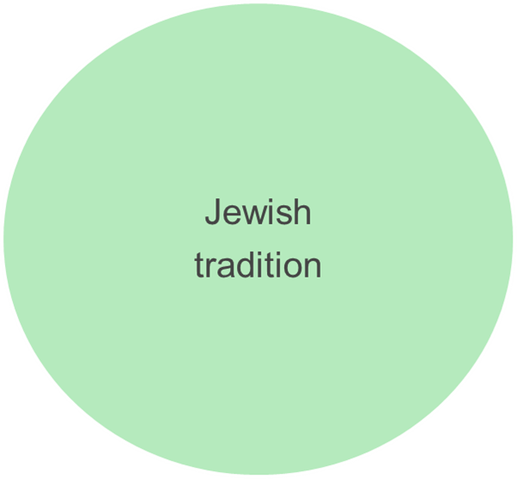
The Third Space
Asher Lev

Slide 8
7
8
6

Slide 9
Yiddish vs. English
Shabbat = Sabbath (Saturday)
Rebbe = Rabbi (religious teacher)
Sitra Achra = The Other Side (Evil)
Ribbono Shel Olom = Master of the Universe

Slide 10
9
“He has extended the range of Jewish-American writing and using the depth of his knowledge of Judaism has made an important contribution to American literature” (Abramson qtd. in Devir 154)
Chaim Potok

Slide 11
Images Cited
1. “The Book Thief: Markus Zusak.” Amazon, https://www.amazon.com/Book-Thief-Markus-Zusak/dp/0375842209. Accessed 24 March 2021.
2. “We Were the Lucky Ones: Georgia Hunter.” Amazon, https://www.amazon.com/Were-Lucky-Ones-Georgia-Hunter/dp/0399563083. Accessed 24 March 2021.
3. Krestin, Lazar. “Portrait of a Jewish Boy.” 1923. Accessed 24 March 2021
4. “Congregation Kol Israel.” Photo Gallery, ckibrooklyn.org. Accessed 24 March 2021
5. “Homi K. Bhabha.” Department of Comparative Literature, Harvard University, https://complit.fas.harvard.edu/people/homi-k-Bhabha. Accessed 24 March 2021
6. The Marvelous Mrs. Maisel Shop. Danezon.com. Accessed 24 March 2021
7. “Naama Potok and Adena Potok.” Alamy.com. Accessed 24 March 2021
8. “Jewish Relgious Clothing.” Wikipedia.com. Accessed 24 March 2021.
9. “Chaim Potok.” Fun Facts Friday: Chaim Potok. ManoflaBook blog. Accessed 24 March 2021.

Slide 12
Works Cited
Bhabha, Homi K. The Location of Culture. Routledge Classics, 1994.
Devir, Nathan P. “Conceptions of Idolatry and Secular Art in Chaim Potok’s Asher Lev Novels.” Journal of Modern Jewish Studies, vol. 13, no. 2, May 2014, pp. 150–166. EBSCOhost, doi:10.1080/14725886.2014.918715.
Diner, Hasia. “Encountering the Holocaust: Postwar American Jewry and the Catastrophe.” Reconstructing the Old Country: American Jewry in the Post-Holocaust Decades. Wayne State University Press, 2017. Pp. xi-xviii. Project MUSE, muse.jhu.edu/book/56573.
Fuchs, Esther. “The Enemy as Woman: Fictional Women in the Literature of the Palmach.” Israel Studies, vol. 4, no. 1, Spring 1999, pp. 212- 233. EBSCOhost, doi:10.2979/ISR.1999.4.1.212.

Slide 13
Works Cited continued
Kauvar, Elaine M. “An Interview with Chaim Potok.” Contemporary Literature, vol. 27, no. 3, Fall 1986, pp. 291-317. EBSCOhost, doi:10.2307/1208347.
Lederhendler, Eli. “The Eastern European Jewish Past and It’s Historians: Cultural Interventions in Postwar America.” Reconstructing the Old Country: American Jewry in the Post-Holocaust Decades. Wayne State University Press, 2017. Pp. 23-43. Project MUSE muse.jhu.edu/book/56573.
Levy, Lital, and Allison Schachter. “Jewish Literature / World Literature: Between the Local and the Transnational.” PMLA, vol. 130, no. 1, 2015, pp. 92–109. JSTOR, www.jstor.org/stable/44015687. Accessed 21 Jan. 2021.
Potok, Chaim. My Name Is Asher Lev. Anchor Books, 1972.

