Slide 1
THE VOTE: GENDER IDENTIFICATION IN THE WOMEN'S SUFFRAGE MOVEMENT THROUGH THE RHETORIC OF CARRIE CHAPMAN CATT By. Sarah Perkins A master’s thesis submitted to the Liberty University School of Communication and The Arts

Slide 2
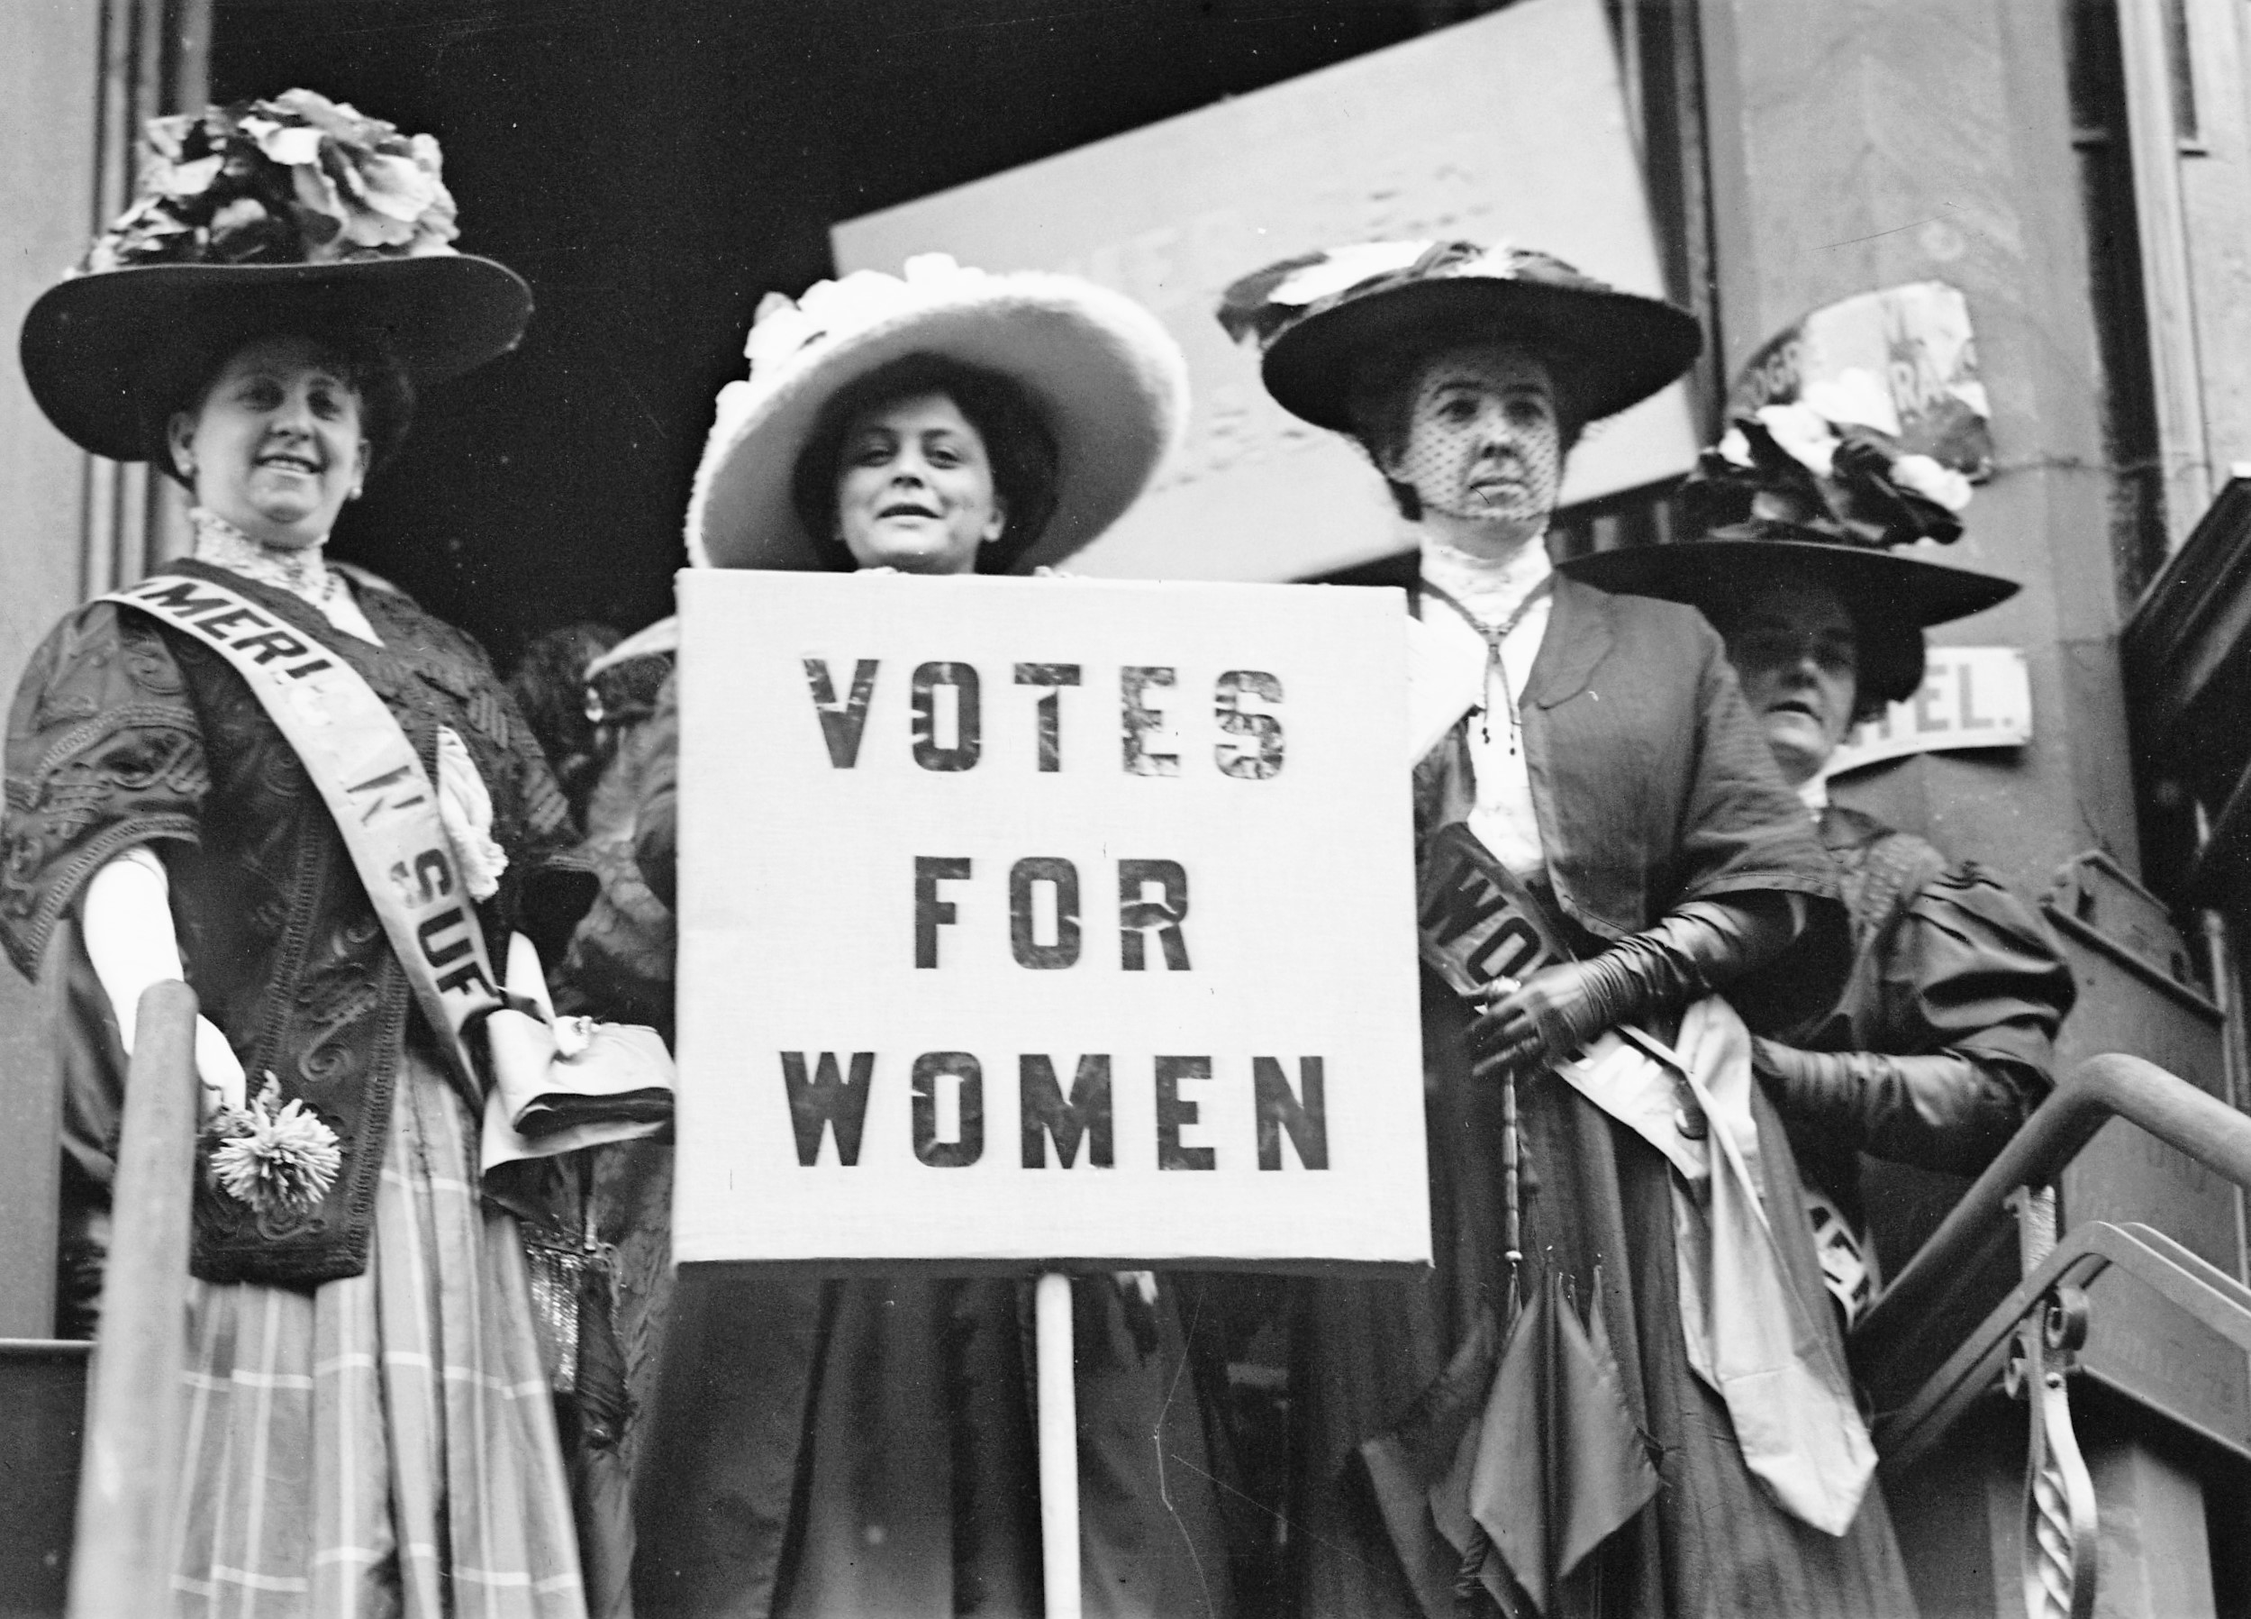
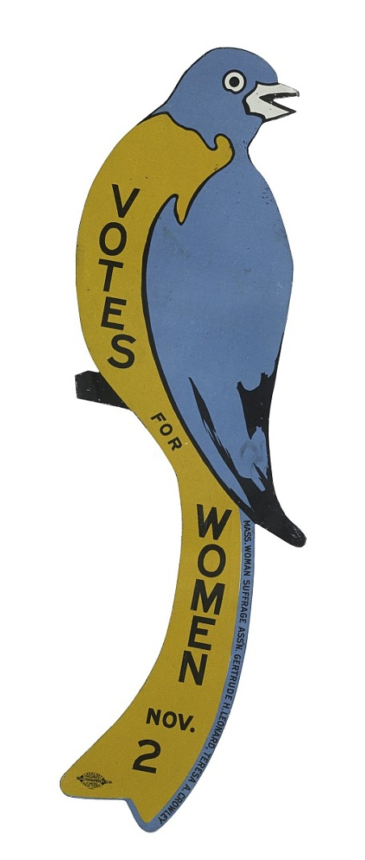
Women’s Suffrage Movement
Woman Suffrage Bluebird Sign. (n.d.). Smithsonian Institution. https://www.si.edu/object/woman-suffrage-bluebird-sign:nmah_508085
Weingartner, T. (2020). Exhibit Examines Ohio’s Forgotten Role In The Women’s Suffrage Movement. @917wvxu. https://www.wvxu.org/post/exhibit-examines-ohios-forgotten-role-womens-suffrage-movement#stream/0
‌
‌

Slide 3
Carrie Chapman Catt, 1818
Source: Carrie Chapman Catt | Photograph. (2003, December 1). Wisconsin Historical Society.
https://www.wisconsinhistory.org/Records/Image/IM1818

Slide 4
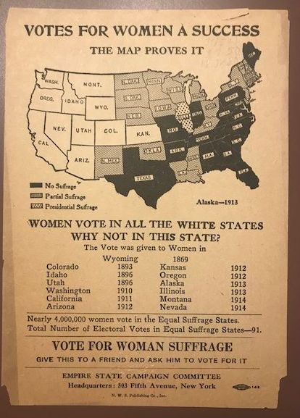
The Goal: The 19th Amendment
Source: Smith, C. (2019, December 11). Mapping the Suffragist Years | Worlds Revealed: Geography & Maps at The Library Of Congress. Loc.gov. https://blogs.loc.gov/maps/2019/12/mapping-the-suffragist-years/
‌

Slide 5
Research Question
How did Carrie Chapman Catt use persuasive rhetoric in the women's suffrage movement to identify with men and women?

Slide 6
Justification
To this day, women still do not have equal rights with men, according to the U.S. Constitution.
Despite no fundamental changes, this thesis gives women the tools of persuasion to fight for women’s rights, 98 years later.

Slide 7
Artifacts
Open Address to the U.S. Legislature
The Crisis
November 1917
This was delivered on several occasions in late 1917 and 1918 during her speaking tours.
Sept. 7, 1916
This was delivered to a group of suffragists in Atlantic City, New Jersey at an emergency convention of the NAWSA.

Slide 8
Study Design
The thesis analyzes the rhetoric of two contrasting speeches using Kenneth Burke's identification theory.
The study analyzes the way Carrie Chapman Catt changes her rhetoric to achieve her goal of the 19th amendment.

Slide 9
Methodology

Slide 10
Level 1 – using the word “we” instead of pronouns like “I” and “me”

Slide 11
Level 3 – uses adaptable language by changing speech style

Slide 12
Level 4 – uses examples easy to understand to recognize similarities

Slide 13
Level 5 – uses moral symbols or revered documents

Slide 14
Level 6 – identify with values of a known hero

Slide 15
Level 7 – refer to an individual/social movement unrelated, but well-liked

Slide 16
Conclusion
Carrie Chapman Catt use persuasive rhetoric in the women's suffrage movement to identify with men and women differently by changing her speaking style. This in turn won her the vote for suffrage.

Slide 17
Limitations
Similarities in levels
Overlap in levels

Slide 18
Suggestions for Further Study
Using this framework for other contrasting speeches in history

