Slide 1
The Gilded Finch: An Exploration of Class Conflict
Research completed by:
Mattea Harrison

Slide 2
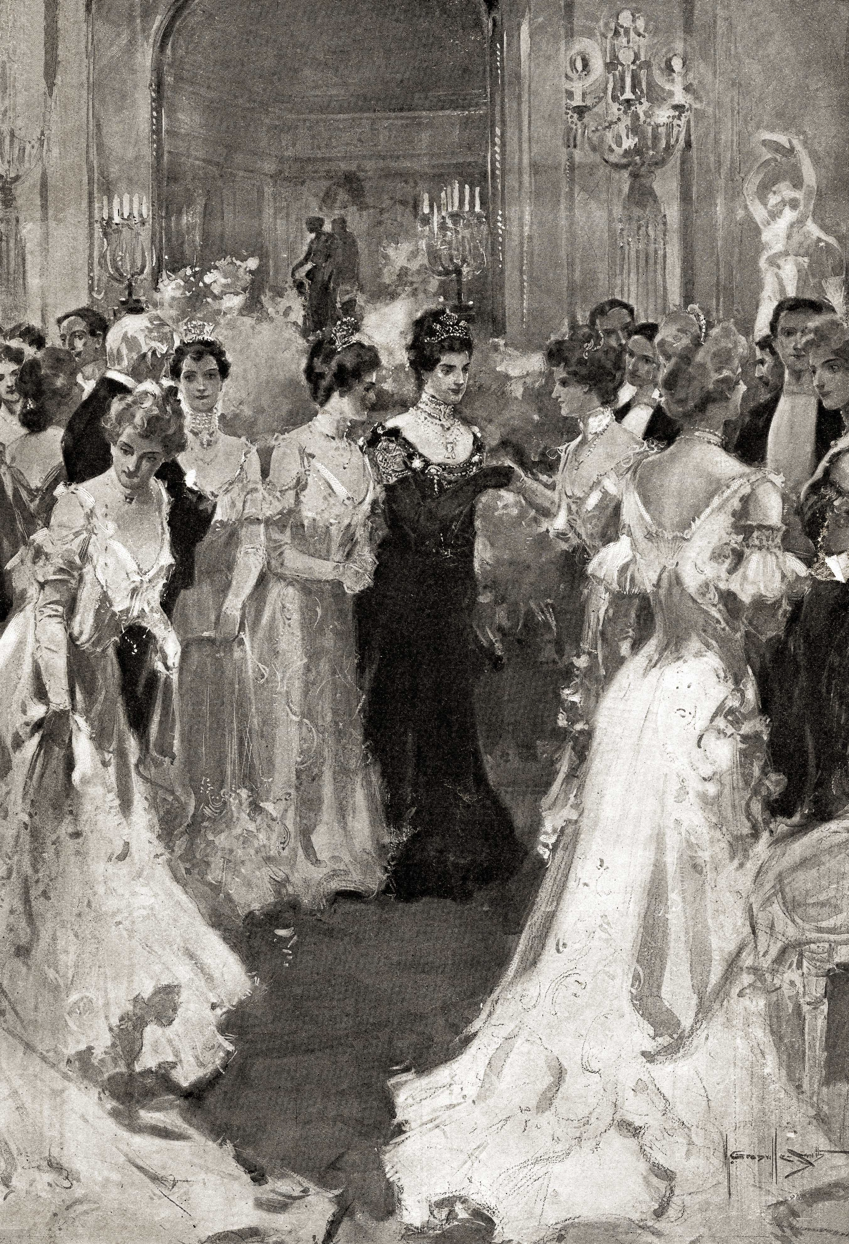
Initial Quandary
The Vanderbilt Ball of 1883
Interclass conflict
Notes:
https://magazine.stregis.com/mrs-astor-invites-2/

Slide 3
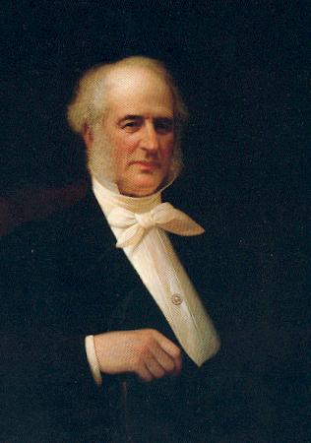
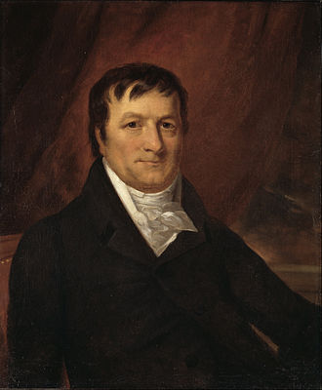
Source of Wealth
Commodore Cornelius Vanderbilt
Steamboats
Railroads
John Jacob Astor
Fur Trading
Real Estate
Notes:
https://en.wikipedia.org/wiki/John_Jacob_Astor
http://www.psy.vanderbilt.edu/history/1873.html

Slide 4
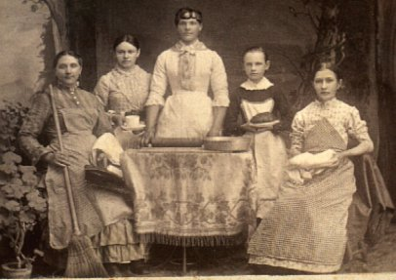
Treatment of Servants
Overseeing a house
Individual jobs
Notes:
https://www.sensibility.com/blog/resources/vintage-images/house-servants-photograph

Slide 5
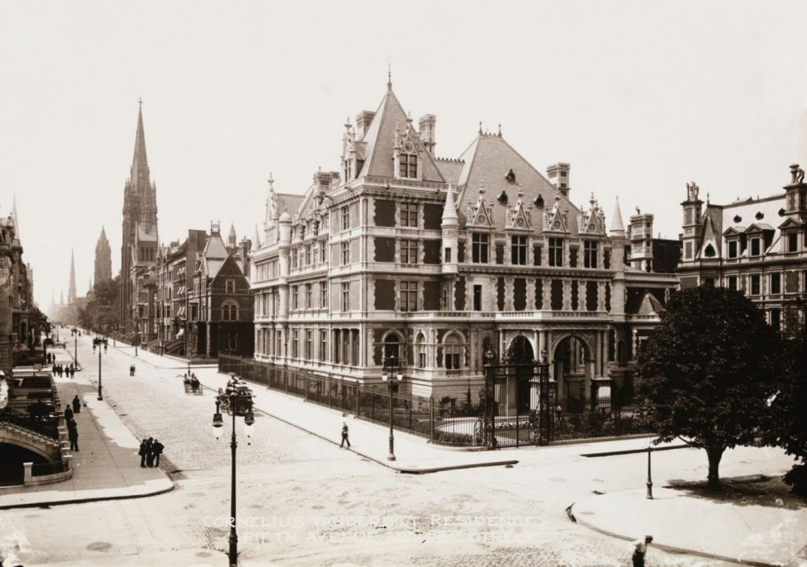
Rules of Etiquette
European Model
Making Calls
Writing Letters

Slide 6
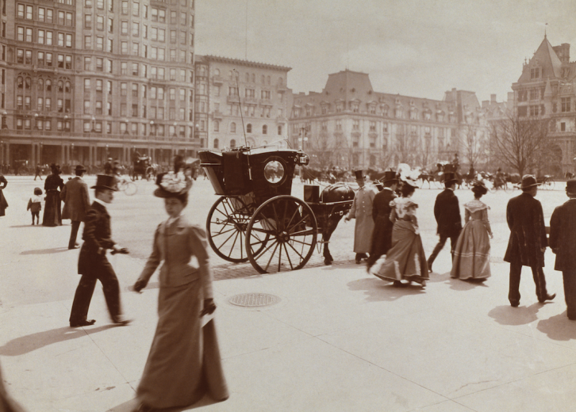
Social Interactions
Gender Specific Spaces
Church and Philanthropy
Notes:
https://stacker.com/stories/4000/50-photos-american-life-19th-century

Slide 7
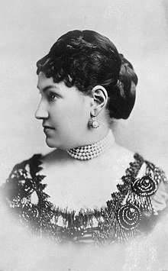
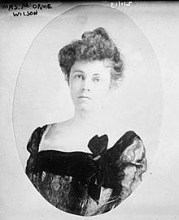
The relationship between Mother and Daughter: Astor
Caroline, Mother
Carrie, Daughter
Caroline was very controlling.
Notes:
https://en.wikipedia.org/wiki/Caroline_Schermerhorn_Astor
https://en.wikipedia.org/wiki/Carrie_Astor_Wilson

Slide 8
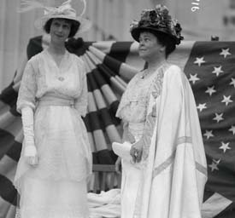
The relationship between Mother and Daughter: Vanderbilt
Alva, Mother
Consuelo, Daughter
Progressive Education Ideas
Consuelo was raised to be independent
Notes:
https://www.edwardianpromenade.com/books/the-dollar-princess-and-her-mother/

Slide 9
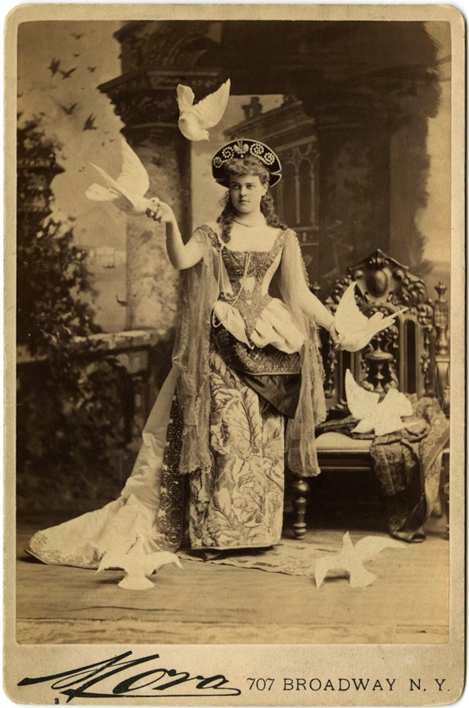
The Vanderbilt ball of 1883
March 26th
660 Fifth Avenue
Peak of rivalry
Notes:
https://www.messynessychic.com/2015/07/16/what-they-wore-to-the-vanderbilt-ball-inside-the-photo-album/

Slide 10
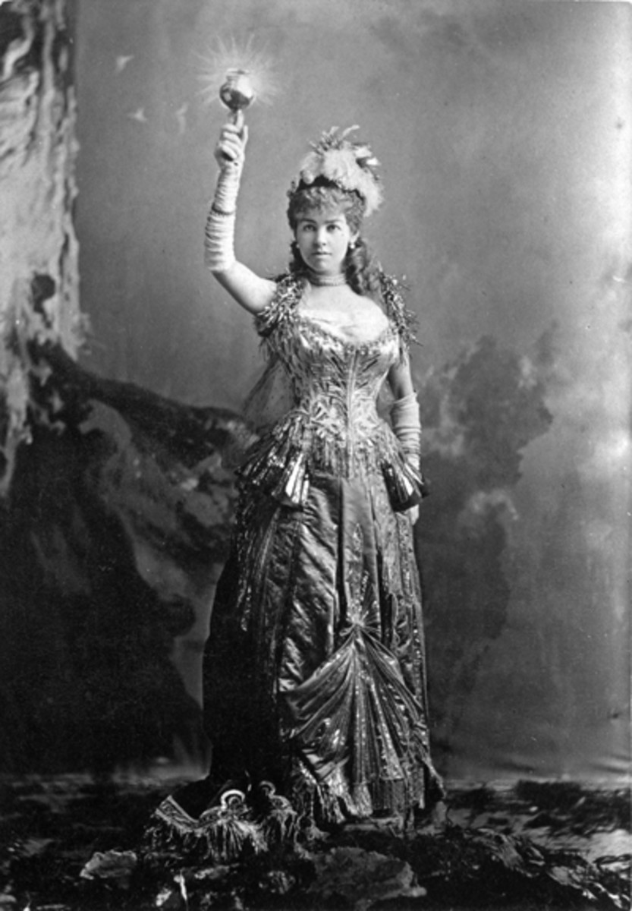
Application of research
Purpose
Integration
Notes:
https://www.antiquetrader.com/collecting-101/the-vanderbilt-ball-of-1883

Slide 11
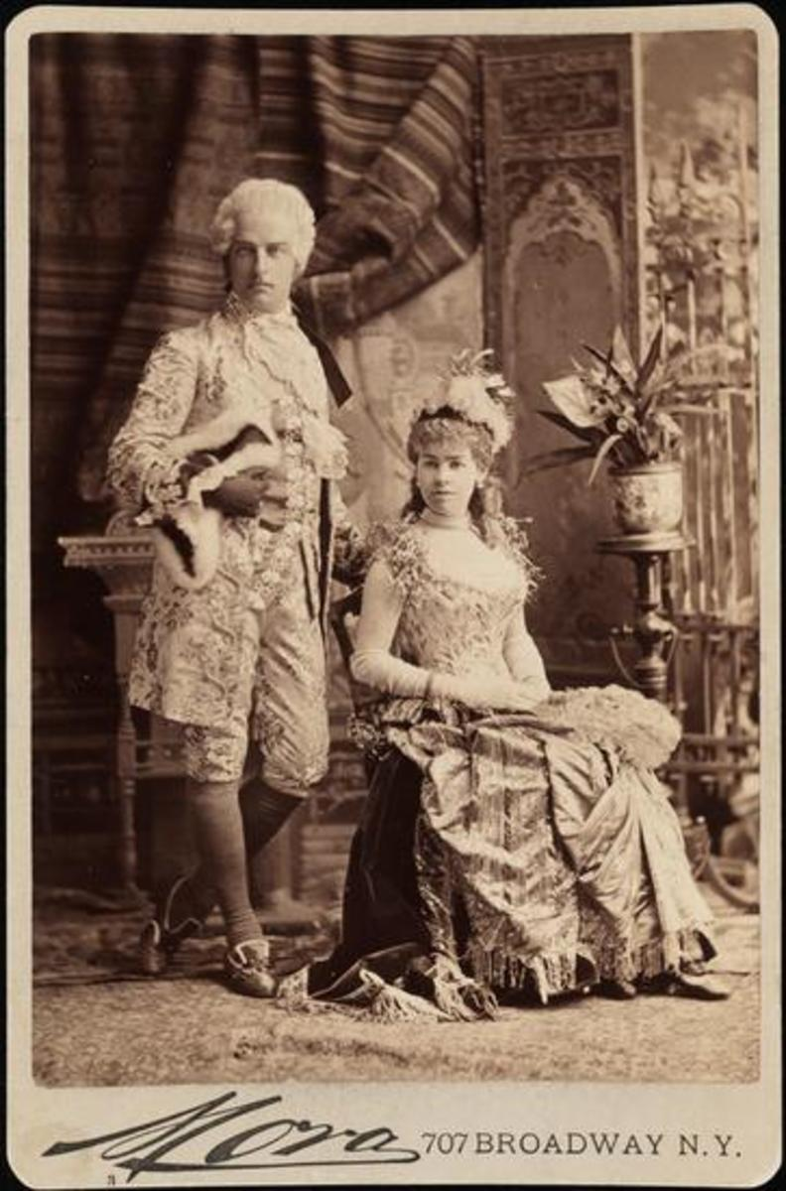
Outline of The Gilded Finch
Scene 1:
Introduction of Vanderbilts and Astors
Idea of Ball
Scene 2:
A ladies’ tea
Scene 3:
Preparation for the ball
Scene 4:
Mrs. Astor makes a call
Scene 5:
The Ball

