Slide 1
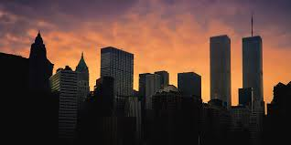
9/11 and Muslim Americans HIWD:497 - Islam in America
Notes:
- Ask about personal experiences
- What impacts of 9/11 have you seen?

Slide 2
8:46
9:03
9:30
10:03
Notes:
These four times mark a drastic shift in the nation

Slide 3
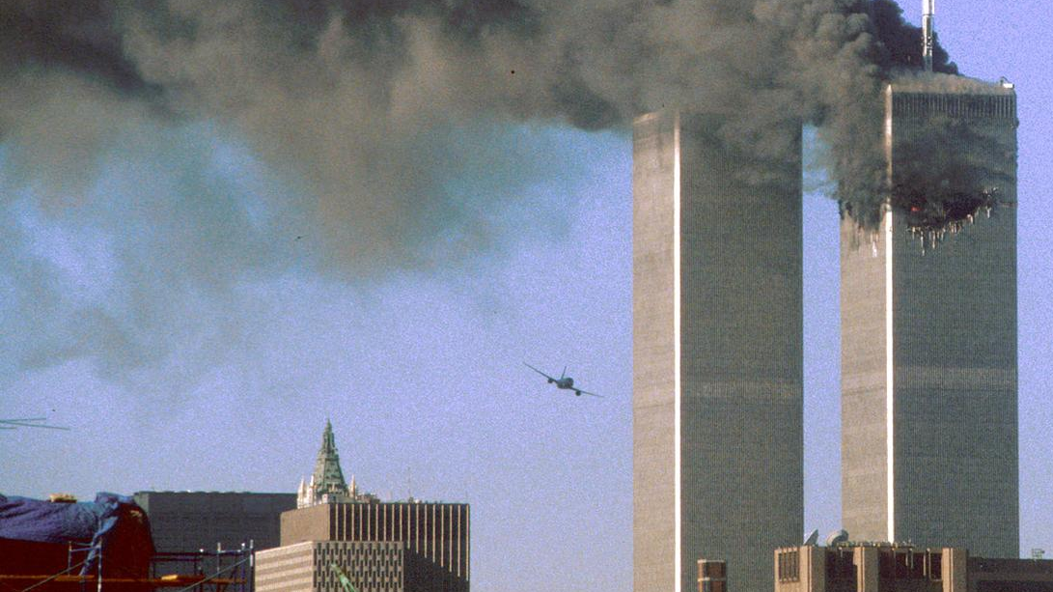
8:46
The first hijacked aircraft crashed into the north tower of the World Trade Center
In the first 18 minutes, over 3,000 calls flooded 911 Operation centers
At this point, people assumed that this was an accident
Story- Khaled A. Beydoun
Notes:
- Khaled is a professor of Law at the University of Detroit

Slide 4
Khaled A. Beydoun
In 2001, had just begun his career as a law professor
Awoke on the morning of 9/11 to the sound of multiple calls from his mother
He answered and she said "Turn on the TV"
Notes:
- Two Muslim brothers escorted her home
- Along the way she feared for her life

Slide 5
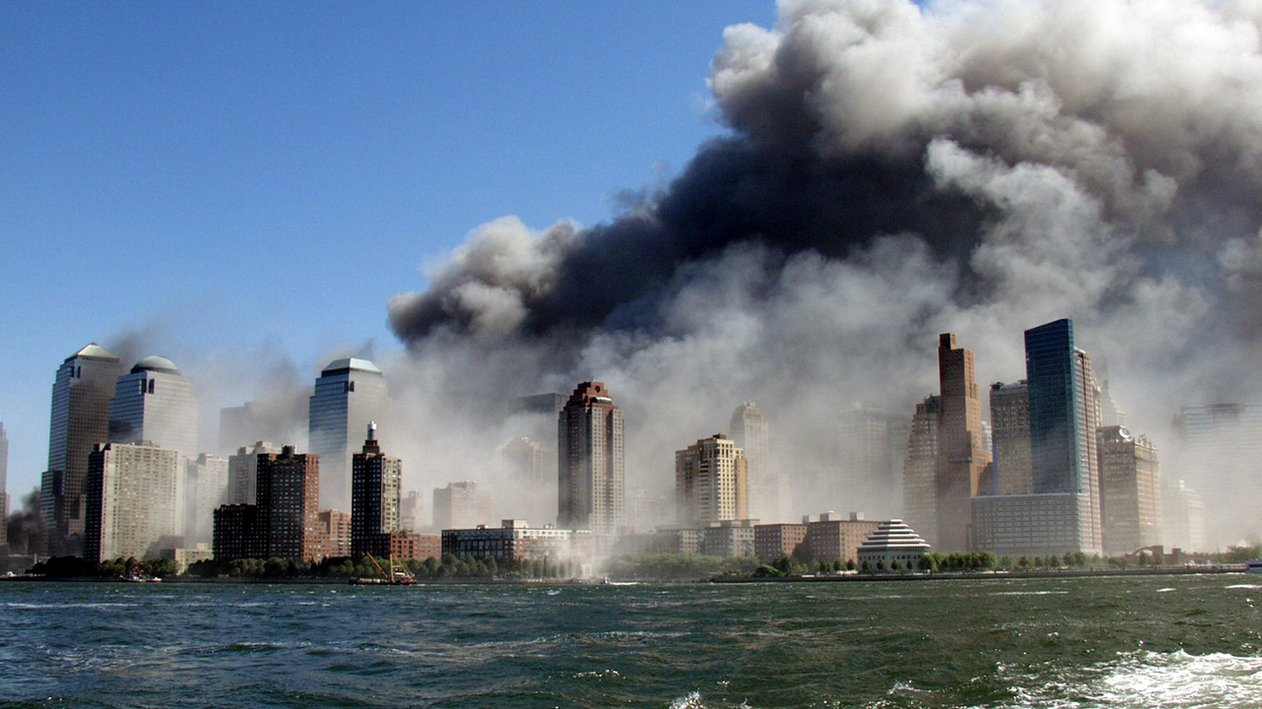
-Khaled A. Beydoun
"I recall the surreal images and events of that day as if they happened yesterday. And just as intimately, I remember the four words that repeatedly scrolled across my mind after the first plane crashed into the world trade center. 'Please don't be Muslims, please don't be Muslims'…"
Notes:
- other interviews with muslims reveals that they had no idea the attacks were planned, they thought it was an accident
- They grieved along with the nation

Slide 6
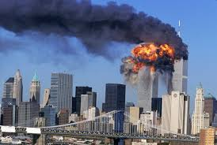
9:03
The second hijacked aircraft crashed into the south tower of the World Trade Center
The world watched as this horrific event unfolded
At this point, people knew that this was no accident
Members of Al-Qaeda were attacking America
Story- Maya
Notes:
- In an interview for a book, one student shared her own story of 9/11

Slide 7
Maya
College student at Columbia
Was in the library all morning. At 9:30 she heard a student on the phone discussing "the terrorists"
She collected her bags and went to the Muslim Students Association, where she, along with other Muslim students stayed for four hours, afraid to leave
Notes:
- Two Muslim brothers escorted her home
- Along the way she feared for her life

Slide 8
"That day, people didn't wait for investigations to take place; people didn't even wait to hear more on the news. It was just hours after the attack, and there were people behind my back that spit on me, people who said, 'We are going to kill them all; we are going to kill them all.'"
- Interview with Maya
Notes:
- Violence was kept at bay by the presence of a few policemen
- From 2000-2001, violence against Muslim Americans and Arabs increased by 1600%

Slide 9
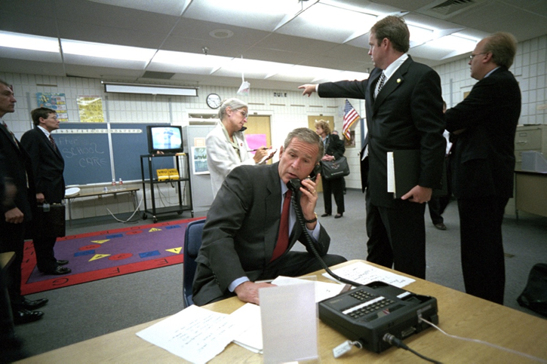
9:30
At an elementary school in Florida, President Bush confirmed the terrorist attacks
Only minutes after this address, the third hijacked plane hit the pentagon

Slide 10
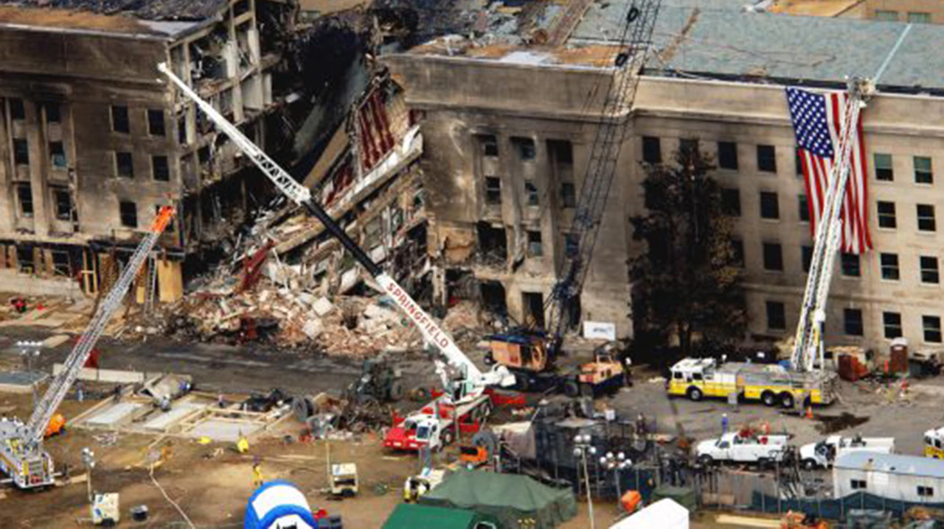

Slide 11
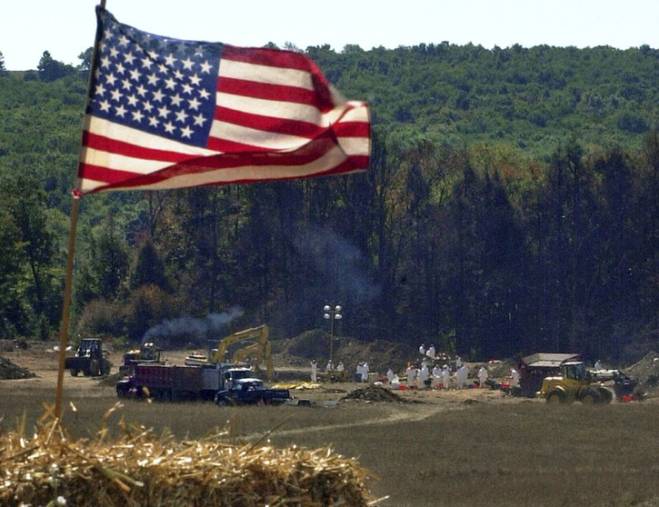
10:03
The final plane was recaptured and landed in a field in Pennsylvania, killing the passengers and hijackers

Slide 12
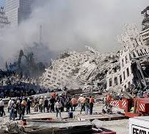
Overall, this attack took the lives of just under 3,000 people and forever changed the lives of countless others
The Pew Research Center estimates that approximately 20 percent of Americans knew someone (or knew someone who knew someone) who was injured or killed in the attacks
After these events, 90 percent of Americans exhibited symptoms of PTSD
Notes:
- This event lives in the minds of contemporary Americans

Slide 13
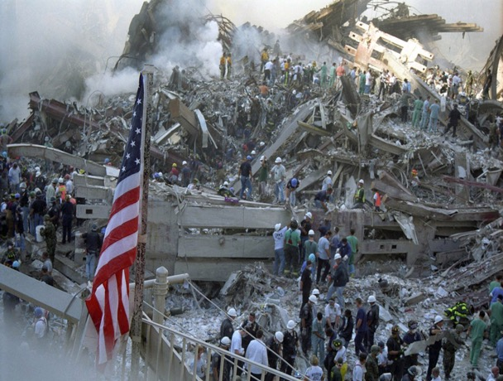
Economic Loss
U.S. Government Accountability Office estimates that $80 to $100 billion of loss in both direct costs (human life, infrastructure, economic loss, etc.) and indirect costs (losses harder to estimate)
Domestic and International travel fell by 30 percent
In the last three months of 2001, just under 100,000 jobs were lost in New York City alone
Notes:
- People react to natural disasters differently than intentional attacks
- The Americans blamed all Muslims- and perceived Muslims for the attack

Slide 14
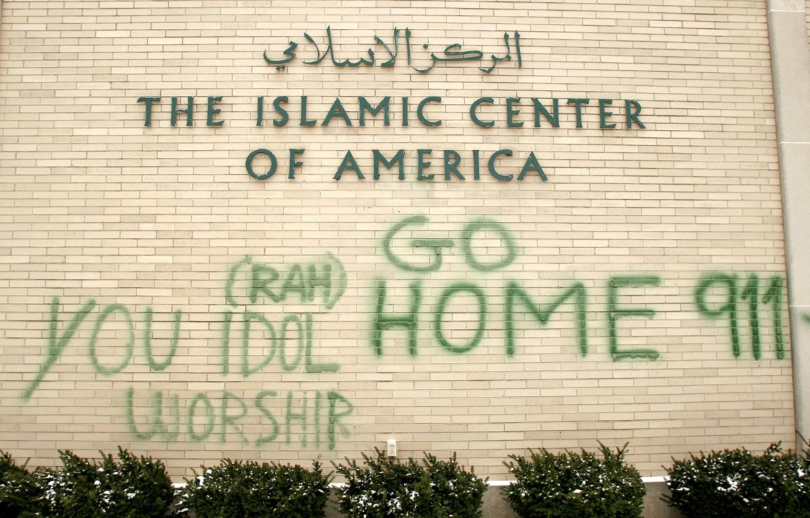

Slide 15
Works Cited
Fig. 1 - Vitali, Joann. “Nyc Skyline Sunrise with Twin Towers.” Fine Art America, May 3, 2013. https://fineartamerica.com/featured/nyc-skyline-sunrise-with-twin-towers-joann-vitali.html. Accessed, March 21, 2020.
Fig. 2 - University of Amsterdam. “Beels, Yu-Bin, Flickrcc, in 9/11: One Event, Many Meanings.” September 4, 2019. https://www.uva.nl/en/content/news/press-releases/2019/09/9-11-one-event-many-meanings.html?cb. Accessed, March 21, 2020.
Fig. 3 - Hiro Oshima. “WireImage.” Getty Images. https://www.history.com/topics/21st-century/9-11-timeline. Accessed, March 21, 2020.
Fig. 4 - Robert Clark, “An explosion rips through the south tower of the World Trade Center as smoke billows from the north tower,” Associated Press. https://www.latimes.com/travel/la-xpm-2001-sep-12-na-sept-11-attack-201105-01-story.html. Accessed, March 21, 2020.
Fig. 5 - US National Archives, “Dan Bartlett, deputy assistant to the president, points to news footage of the attacks while President Bush listens to new security information.” https://www.businessinsider.com/photos-president-bush-911-attacks-2019-9#dan-bartlett-deputy-assistant-to-the-president-points-to-news-footage-of-the-attacks-while-president-bush-listens-to-new-security-information-2. Accessed, March 21, 2020.
Fig. 6 - Thomas Brading, “Army leaders share stories of the 9/11 Pentagon attack,” Army News Service, September 11, 2020 https://www.army.mil/article/238930/army_leaders_share_stories_of_the_911_pentagon_attack. Accessed, March 21, 2020.
Fig. 7 - The Week. In “What happened to the passengers of United Airlines flight 93 on 9/11?” September 11, 2018, https://www.theweek.co.uk/94482/911-crash-what-happened-to-the-passengers-on-united-airlines-flight-93. Accessed, March 21, 2020.
Fig. 8 - Beth A. Keiser, in “Tuesday, and After: New Yorker writers respond to 9/11.” AFP, Getty, https://www.newyorker.com/magazine/2001/09/24/tuesday-and-after-talk-of-the-town. Accessed, March 21, 2020.
Fig. 9 - Dr. Emil Chynn, “Of the 2,996 who died on 9/11, including the 19 hijackers, 2,606 were killed at the World Trade Center and the surrounding area.” Caters News Agency, 10 Sep 2019, https://www.thesun.co.uk/news/9898159/harrowing-unseen-9-11-pics-show-devastation-and-bloodshed-at-ground-zero-through-the-eyes-of-first-doctor-on-scene/. Accessed, March 21, 2020.
Fig. 10 - Bill Pugliano, “anti-Muslim graffiti on the wall of the Islamic Center of America in Dearborn MI.” Getty, https://www.wnycstudios.org/podcasts/otm/segments/breaking-news-consumers-handbook-islamophobia-edition. Accessed, March 21, 2020.

