Slide 1
Death and the Transformation of Women’s Roles Surrounding Death: An Analysis of Jacques-Louis David’s History Paintings
By Miranda Boljat

Slide 2
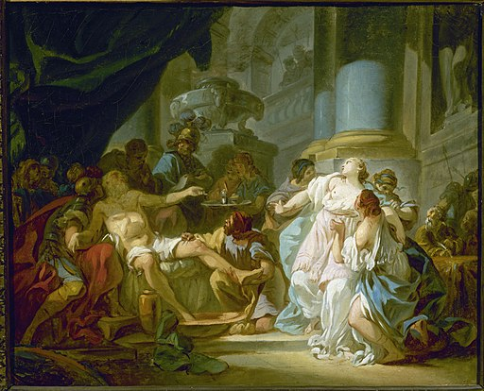
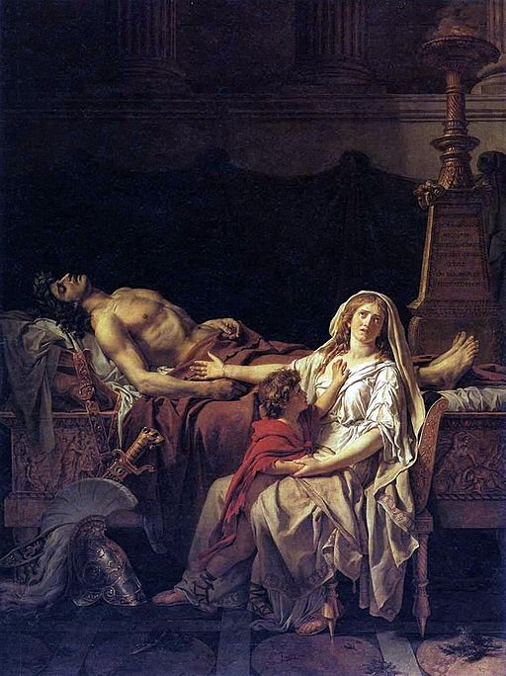
David before the Revolution
Rococo
Neoclassicism

Slide 3
The Oath of the Horatii
1784
-Commission for Direction des Bâtiments du Roi -Reception may have motivated David’s portrayal of men as strong and resolute and women as diminished in grief, powerless

Slide 4
David’s Entry into Politics
In 1790, he joined the Jacobin party
-David’s experience of favoritism in the Academy factored into his resentment of the old system
- He became a Deputy in the Convention, where he voted for the deaths of Louis XVI and Marie Antoinette
-Established the French Institute, which replaced the Academy
This Photo by Unknown Author is licensed under CC BY-NC

Slide 5
The Lictors Bring Brutus the Bodies of his Sons
1789
- Painted before joining the Jacobin party in 1790
-Commissioned originally by the Crown for the Salon of 1787
- The Direction des Bâtiments du Roi had attempted to stop David from painting this piece after seeing a preliminary sketch where the heads of the sons were on stakes

Slide 6
The Intervention of the Sabine Women
1799
-David’s painting process was hindered by time in prison.
-Notable subject choice as opposed to the Rape of the Sabine Women- calls for reconciliation

Slide 7
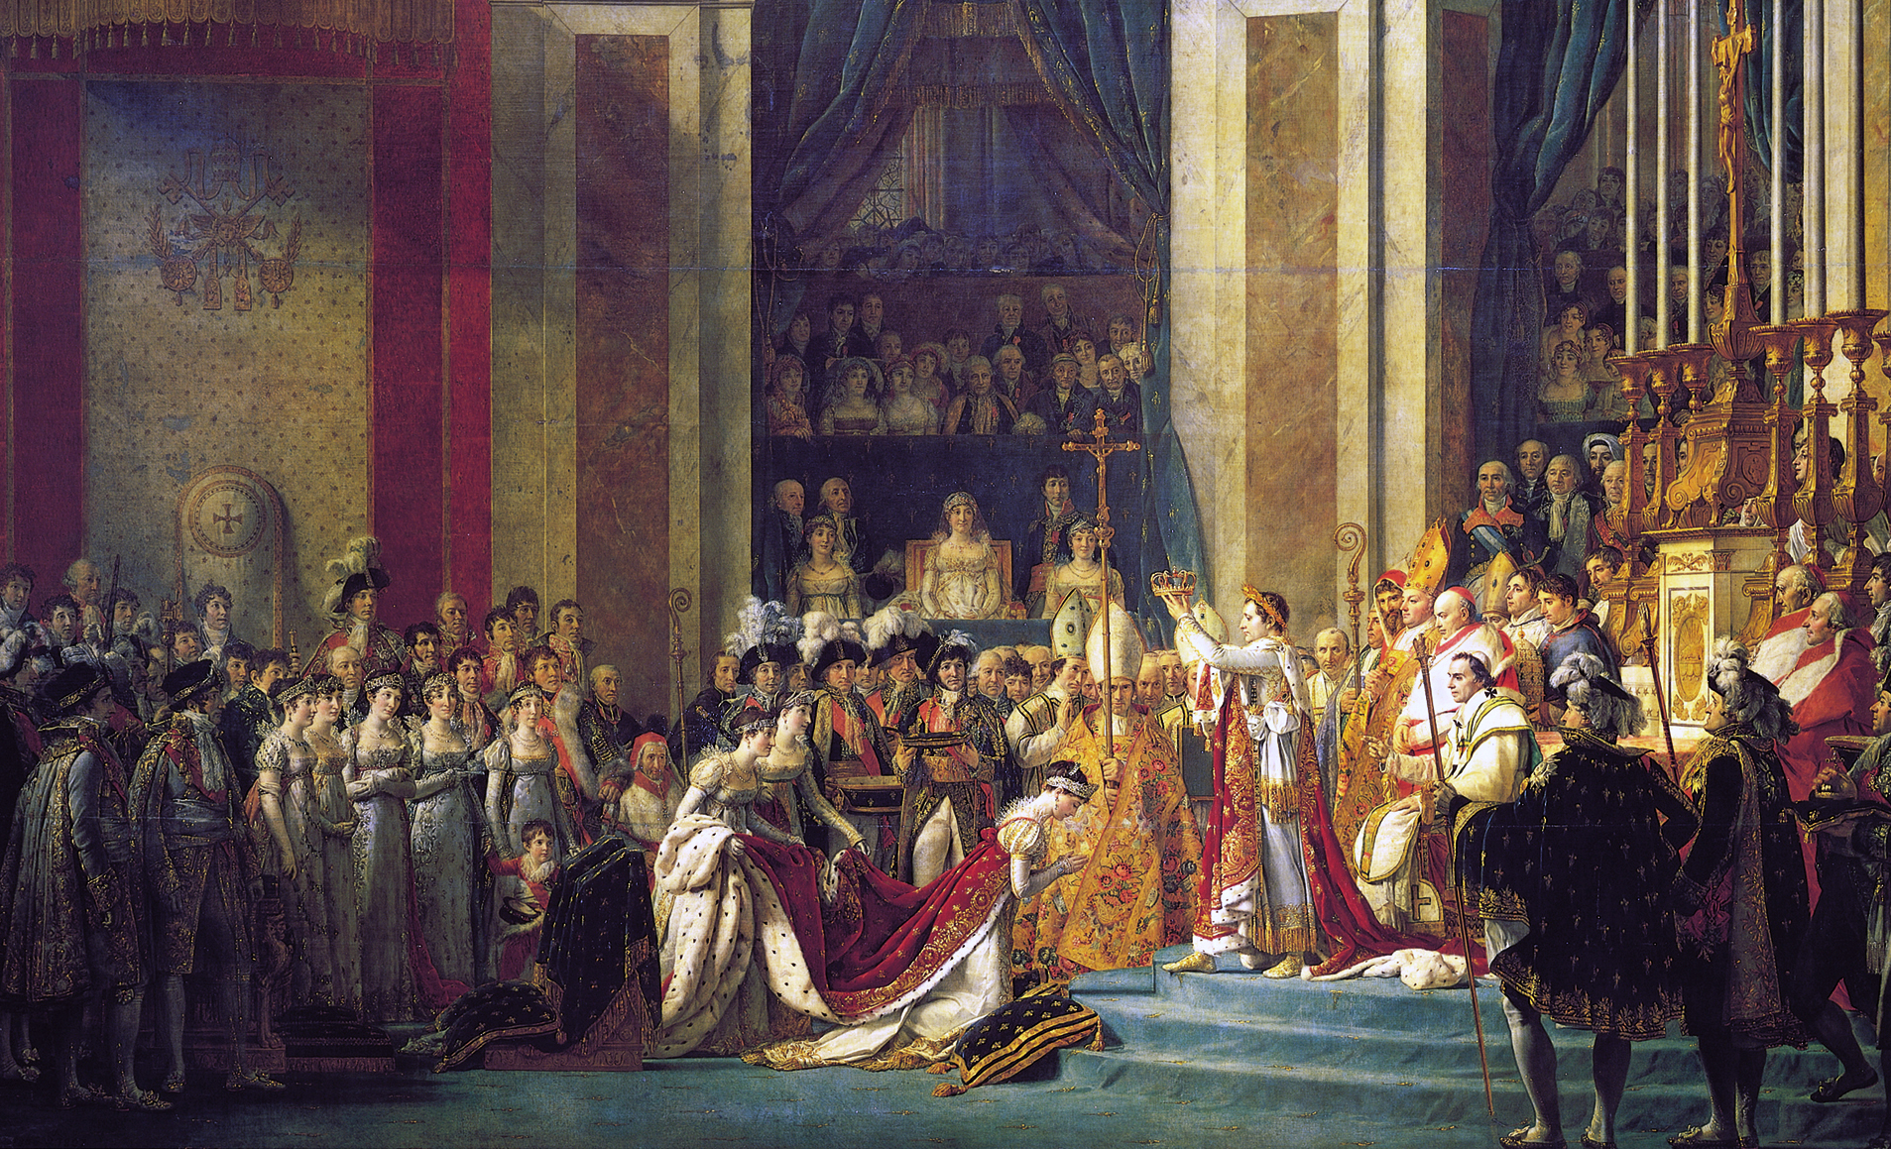
David After Napoleon
During the reign of Napoleon, David painted many different pieces of propaganda for him, including several iconic portraits.
However, this resulted in less history paintings.
After Napoleon lost power, then, David was also exiled from France.

Slide 8
Mars Disarmed by Venus and the Three Graces
1824
-David’s final statement from exile
-Subject traditionally symbolizes peace, a theoretically hopeful message as David approaches death
-However, the awkward posing of the female and male roles undercuts the positive message, revealing David’s own alienation and emptiness

Slide 9
Conclusion
-Early in his career, David represented his experience learning both Rococo and Neoclassical ideals while in the Academy
-Later in life, he became the face of the Neoclassical movement with his impactful pieces of art
-By the end of his life, David expressed his freedom from political ties and his sad separation from the world of strife in turns
-David captured the changing role of death, addressing by turns the emotional drama, propaganda power, and grief of the topic
-He also explored portraying women as both passive and active, emphasizing the contradictions in the female situation throughout the revolution, Napoleonic era, and beyond

Slide 10
Paintings Cited
David, Jacques-Louis, The Death of Seneca, 1773, Musée du Louvre, Paris, https://library.artstor.org/#/asset/ARTSTOR_103_41822000741346;prevRouteTS=1604780097169.
David, Jacques-Louis, The Departure of Hector, 1812, Musée du Louvre, Paris, https://library.artstor.org/#/asset/ARMNIG_10313259059;prevRouteTS=1604782942916.
David, Jacques-Louis, The Intervention of the Sabine Women, 1799, Musée du Louvre, Paris, https://library.artstor.org/#/asset/SCALA_ARCHIVES_1039931969;prevRouteTS=1604782672860.
David, Jacques-Louis, The Lictors Bring Brutus the Bodies of his Sons, 1789, Musée du Louvre, Paris, https://library.artstor.org/#/asset/LESSING_ART_1039789204;prevRouteTS=1604782205173.
David, Jacques-Louis, Mars Disarmed by Venus and the Three Graces, 1824, Musées Royaux des Beaux-Arts, Brussels, https://www.fine-arts- museum.be/en/exhibitions.
David, Jacques-Louis, The Oath of the Horatii, 1784, Musée du Louvre, Paris, https://library.artstor.org/#/asset/ARMNIG_10313257933;prevRouteTS=1604781867276.
David, Jacques-Louis, The Sorrow of Andromache, 1781, Musée du Louvre, Paris, https://library.artstor.org/#/asset/LESSING_ART_1039789184;prevRouteTS=1604781696125.

Slide 11
Bibliography
Borde, Philippe. Jacques-Louis David: Empire to Exile. New Haven: Yale University Press, 2005.
Chu, Petra ten-Doesschate. Nineteenth-Century European Art. Boston: Prentice Hall, 2012.
Jarrassé, Dominique. 18th-Century French Painting. Paris: Terrail, 1998.
Lee, Simon. David. London: Phaedon Press, 1999.
Maleuvre, Didier. "David Painting Death." Diacritics. 30, 3 (2000): 13-27. Accessed November 6, 2020. http://www.jstor.org/stable/1566340.
Padiyar, Satish. “Dispossessed: On Late David.” in David After David: Essays on the Later Work, ed. Mark Ledbury. Williamstown, Sterling and Francine Clark Art Institute, 2007.
Padiyar, Satish. “Last Words: David's Mars Disarmed by Venus and the Graces (1824). Subjectivity, Death, and Postrevolutionary Late Style.” Journal of the International Association of Research Institutes in the History of Art 23 (2011). http://www.riha- journal.org/articles/2011/2011-apr-jun/padiyar-last-words.

