Slide 1
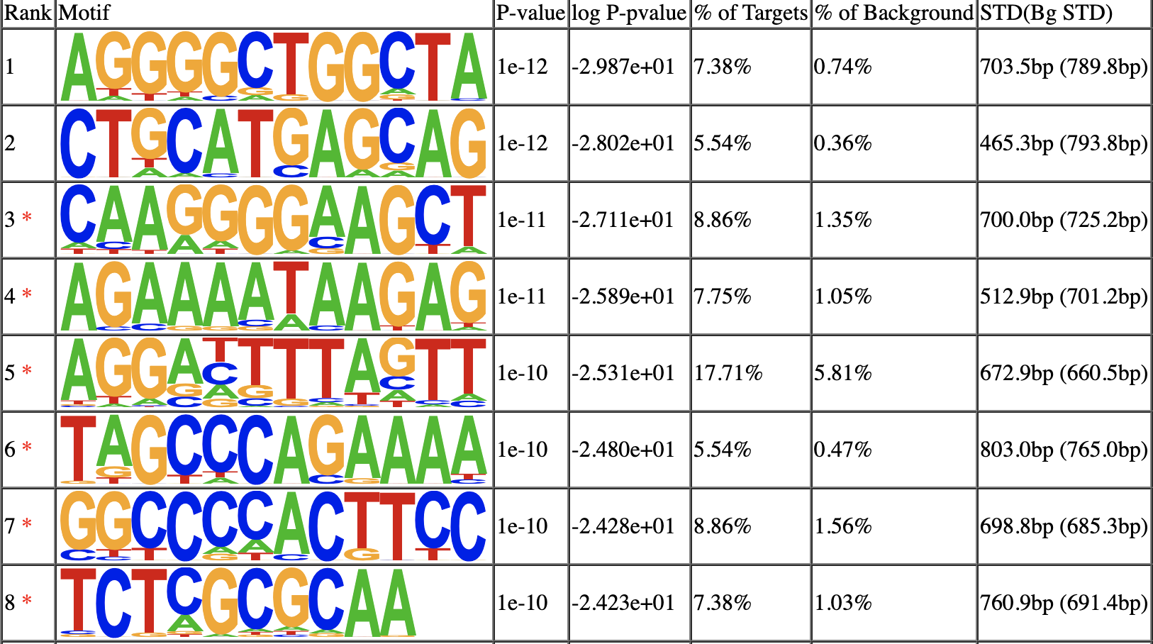
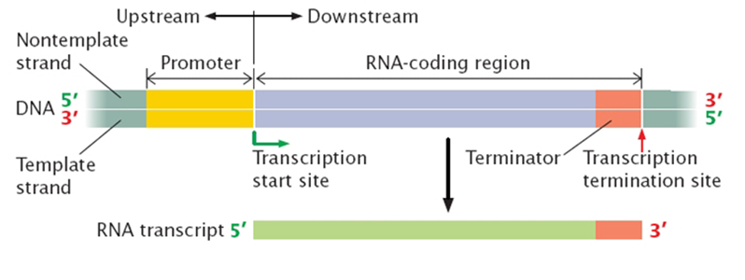
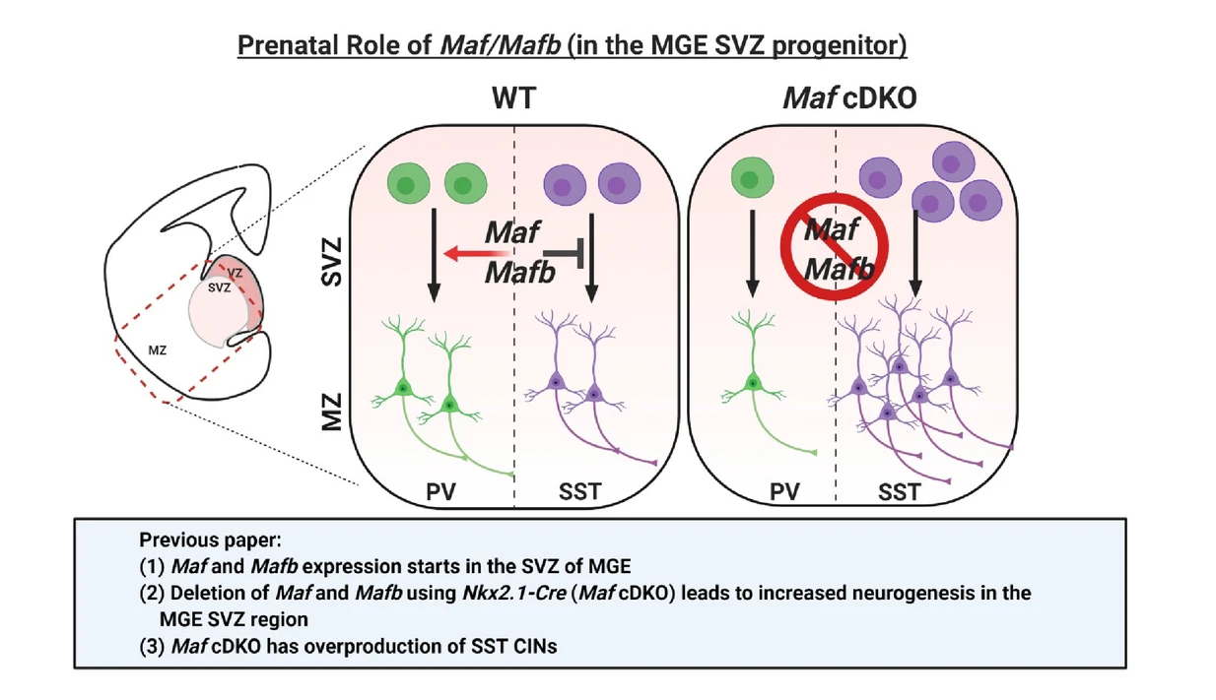
Locations of MafB Genes in Mice Genome
Joshua Sparks, Michael S. Price, Gary D. Isaacs
Abstract
Results and Conclusion
BACKGROUND: DNA Methylation influences DNA regulation, and without Methylated DNA gene regulation declines. The lack of DNA Methylation is associated with Alzheimer's disease, a cognitive disease that impairs function. Lab mice without folate in their diets show loss of cognitive functions, showing a possible correlation between folate and Alzheimer's disease. Microarray analysis was performed on mice after 4 months of a folic acid diet which removed all folate, and two genes , Zfp410 and MafB, were found to have enriched Motif binding sites.
METHODS: Utilize HOMER (Hypergeometric Optimization of Motif Enrichment) and Perl scripts to find the locations of enriched Motif binding sites.
RESULTS: The locations of MafB in three genes were found in the mouse genome, mm10.
Results
In prior work (Lawton, 2020) 462 downregulated and upregulated genes were found in folate-deficient mice when compared to control mice. Of these 462 genes, MafB and Zfp410 were found to have enriched Motif binding sites. (Figure 3) Through the use of HOMER and Perl scripts, the locations of the MafB Motifs were discovered in three genes of the mice genome mm10. The three genes are located on chromosome 9 F2 (Gene ID 66387), chromosome 18 (Gene ID 13505), and chromosome 19 (Gene ID 74306).
Introduction and/or Research Question
Figure 1. HOMER de novo Motif Results. The figure above demonstrates the HOMER analysis of tissue cell DNA found in the hippocampus of folate-deficient mice. Column 1 depicts the rank of the motif base on P-values, with an * depicting a possible false positive result. Motifs without this * are highly likely to be genuine motifs. Column two shows the motif sequences found through HOMER analysis. Column 3 depicts the P-values for each motif. A lower P-value signifies the motif is more likely to be genuine. Column 4 takes the log of the P-value. Columns 5 and 6 show the concentration of the sequences compared to other genes.
Introduction: Gene expression begins with converting DNA into mRNA through a process called transcription. Transcription initiates at the transcription start site (TSS) which is bound by repressor or activator transcription factors. These factors facilitate the amount of transcription which occurs on DNA, effectively managing the amount of mRNA produced. Certain sequences of DNA surrounding the TSS assist these transcription factors in binding to the TSS on the promotor gene (Figure 2). The area near the TSS is estimated to be 2000 base pairs upstream of the promoter, as well as 500 base pairs downstream. These areas near the TSS are called Motifs. Motifs are discovered through analyzing the position weight matrix (PWM) of the DNA, which is described as the specificity of a transcription factor binding in a way that is unique when compared with other background genes (Figure 2). Analysis of motifs through PWM can be accomplished through computer software and programming due to their differing lengths among a vast number of gene strands. HOMER is a free software for motif discovery and next-gen sequencing analysis that utilizes command line programs and motif algorithms to analyze large amounts of mRNA sequence data for motifs and compares it with genome specific motif sequences (Figure 3). As part of a nutritional study assessing the effects of folate deficiency on cognition, gene expression data from hippocampus tissue was obtained from four-week-old folate replete and folate deficient mice. Various genes were identified to be differentially expressed between these conditions and utilizing HOMER, common DNA binding motifs were identified in the regions immediately surrounding the start codon of each differentially expressed gene. These motifs were then queried against publicly available databases of known DNA binding motifs to determine what transcription factors regulate these genes. MafB, a protein involved in fetal brain development,(Figure 4) was discovered to have enriched Motif binding sites in prior work. (Lawton, 2020) This gene may be a target for treatment of cognition related diseases in mice and humans.
Question: Where in the mice genome are MafB transcription factor binding sites found?
Future Work
Figure 3. MafB Position Weight Matrix Score. The higher the weight of the nucleotide (A, T, C, or G) in the position weight matrix, the higher the chance the nucleotide must be present in that position of the sequence. The Motif above is that of MafB, a protein commonly found in blood cells of mice as well as neuronal development in fetal mice.
With the locations of MafB in mice now known, future research will use ChIP sequencing (ChIP-Seq) to identify genome-wide DNA binding sites for MafB and Zfp410 transcription factors. This will confirm the results from the HOMER analysis findings for Motif sequences.
Figure 2. Simple Image of Transcription. Featuring the promotor region (yellow) and the Transcription start site (TSS, green arrow).
References and Acknowledgments
1. A. Lawton et al., Folate-Dependent Cognitive Impairment Associated With Specific Gene Networks in the Adult Mouse Hippocampus. Front. Nutr. 7(2020).
2. “HOMER (v4.10, 5-16-2018).” Homer Software and Data Download, UCSD, homer.ucsd.edu/homer/index.html.
3. Attwood, J.T., R.L. Yung, and B.C. Richardson, DNA methylation and the regulation of gene transcription. Cell Mol Life Sci, 2002. 59(2): p. 241-57.
Taher, N., et al., Amyloid-beta alters the DNA methylation status of cell-fate genes in an Alzheimer's disease model. J Alzheimers Dis, 2014. 38(4): p. 831-44.
4. S. Maimaiti et al., Neuron-specific Mafb knockout causes growth retardation accompanied by an impaired growth hormone/insulin-like growth factor I axis. Exp Anim. 68, 435-442 (2019).
5. Figure 4. E. L. Pai et al., Maf and Mafb control mouse pallial interneuron fate and maturation through neuropsychiatric disease gene regulation. eLife. 9, e54903 (2020).
Figure 4. The role of MafB in fetal development aims to regulate somatostatin (SST) interneuron neurogenesis. Without MafB, neurogenesis of SST is not regulated. The role of MafB in adult mice is yet to be realized but has been linked to cognition function. (E. L. Pai et al, 2020)

