Slide 1
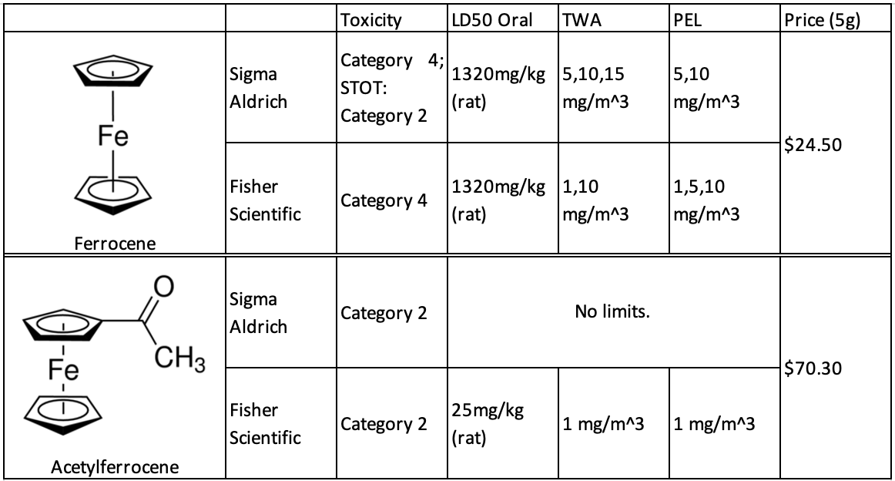
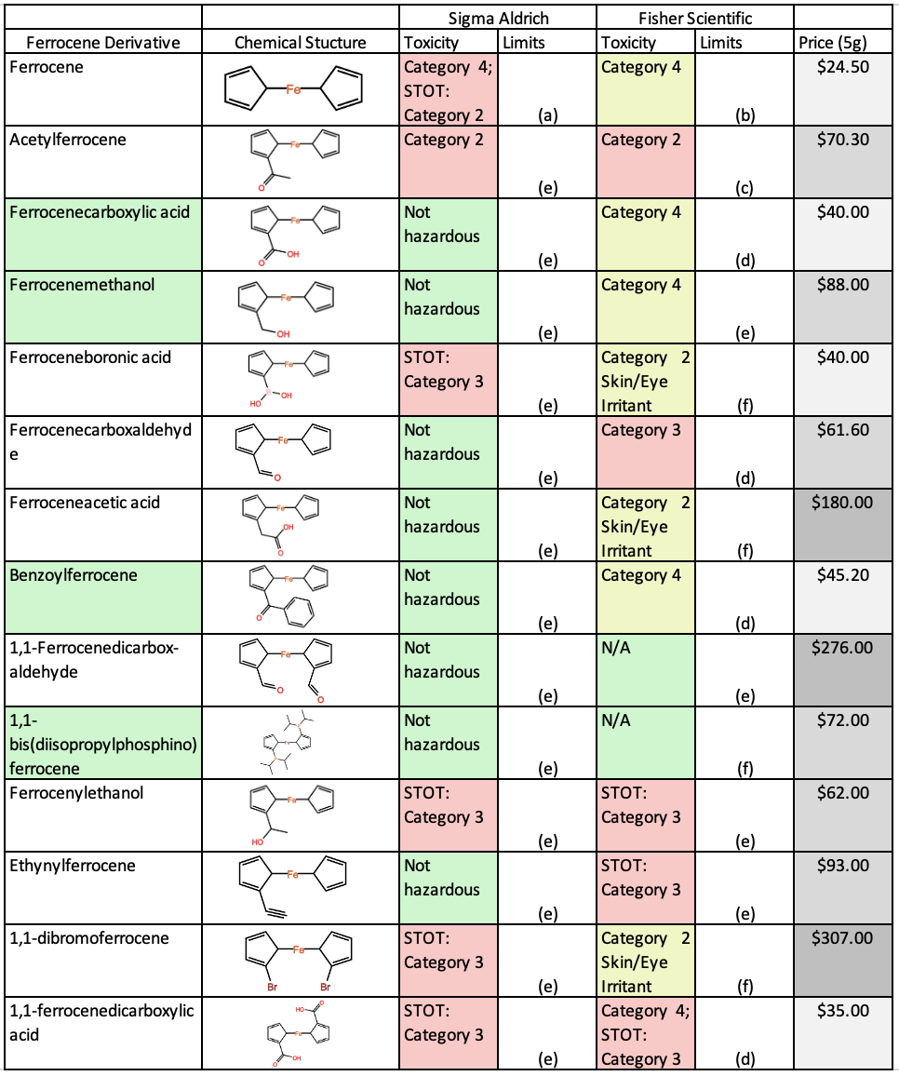
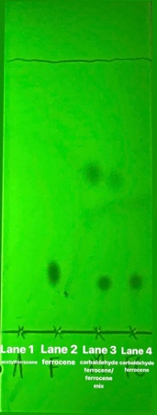
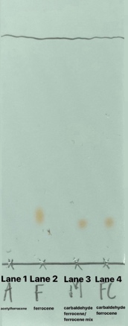
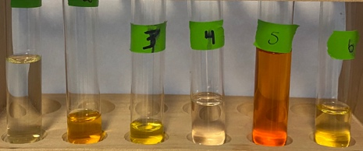
Greening of Ferrocene Column Chromatography
Marissa Scilley, Anderson Hill, and Dr. M. Korn*
Abstract & Background
M. Synthesis and properties of polyimide/silver nanocomposite containing dibenzalacetone moiety in the main chain. Journal of Saudi Chemical Society 2013, 17, 419-
Results
The current undergraduate organic chemistry laboratory at Liberty University introduces the separation technique of column chromatography through the isolation of acetylferrocene from a mixture of ferrocene and acetylferrocene. Upon analysis of safety data sheets and literature research, acetylferrocene was identified as a toxic compound.
Petroleum ether, a flammable liquid that doubles as an aspiration and cancer hazard, is also utilized as a column and TLC solvent in the current ferrocene/acetylferrocene lab. With the goal of keeping usage of hazardous compounds to a minimum, a non-hazardous compound to replace toxic acetylferrocene and a non-carcinogenic solvent to replace petroleum ether have been investigated.
1. Literature Search for Ferrocene Compounds
An advanced search was conducted via the Journal of Chemical Education website database with keywords “ferrocene and chromatography” to yield 66 results. Of the 66 results, 50 results were useful for further research regarding chromatographic experiments involving ferrocene and its various derivatives (Figure 1). The majority of results listed the use of ferrocene and acetylferrocene compounds. Column chromatography accounted or the major separation technique (60%), followed by TLC (20%) (Figure 2). Additional information from chemical suppliers resulted in some 30+ different ferrocene derivatives, of which 12 specific ones are listed in Table 2.
Petroleum ether and ethyl acetate (EA) were found to form the most widely used solvent (mobile phase) across the isolated literature for TLC analysis.
2. Assessment of Health Risks of Ferrocene Compunds
Health risks for those 12 new ferrocene derivatives are compiled in Table 2 and compared to ferrocene and acetyl ferrocene. They are ranked and color coded from high risk (#1) to lower risk (#4) – based on available data. Specific heath data, such as LD50 and Permissible Exposure Limits (PEL) were only available for few compounds. Based on the non-hazardous nature of ferrocenecarboxaldehdye, this compound was chosen as a substitute for acetyl ferrocene.
Cyclohexane was used as an alternative, solvent in lieu of petroleum ether, as it lacks the ‘reproductive toxicity’ characteristic of the latter. [5]
3. Affordability Assessment of Compounds
Based on published on-line prices, a 5g sample of a ferrocene compound ranges from about $40 to $307 (Table 2). Among all compounds, ferrocene is still the least expensive compound ($25/5g). Dividing the 5g price by 200 student pairs experiments, would result in $1.50/student pair for the most expensive compound, compared to 35cents for acetyl ferrocene.
4. Feasibility Studies for Chromatography
The new mixture ferrocene (F) / ferrocenecarboxaldehdye (FC) was tested against the former compound, acetyl ferrocene (AF) in TLC (Figure 3 and 4). The results show that FC behaves in the same manner as AF: it rises to about the same height as AF (Table 3) and has a similar color (orange), and thus can clearly be distinguished from F (larger height and yellow).
5. Column Chromatography
The new greener mixture F/FC with the less hazardous solvent mixture, cyclohexane/EA, was tested for its performance in column chromatography. As Figure 5 and 6 show, a clear separation of F (yellow) and FC (orange) from a mix of both was successfully accomplished.
Figure 1. Main ferrocene mixtures used in Journal of Chemical Education advanced search via keywords “ferrocene and chromatography.” Of the used results, 43 yielded the use of acetylferrocene and ferrocene while the remaining 7 used a variety of compounds, as shown above.
Figure 2. Main techniques used in Journal of Chemical Education advanced search via keywords “ferrocene and chromatography.” Of the used results, 34 yielded the use of column chromatography/chromatography, 10 used TLC analysis, 5 used HPLC, and 1 was listed as other.
Table 1. Toxicity, exposure limits, and prices of ferrocene and acetylferrocene from the SDS’ from Sigma Aldrich and Fisher Scientific.
Table 2. List of ferrocene derivatives considered to replace ferrocene and acetylferrocene,
including the chemical structures, toxicity, exposure limits, and prices of each. Toxicity and exposure limits obtained from Sigma Aldrich and Fisher Scientific, and the prices were obtained from suppliers listed on Scifinder-n.
Introduction and Research Question
With an emphasis on replacing hazardous chemicals with less hazardous ones, ‘greening’ the organic chemistry laboratory will not only reduce the exposure of students and faculty to hazardous chemicals but also reduce the amount of toxic waste.
We selected to green a common organic laboratory experiment - the column chromatography of ferrocene and acetylferrocene (structures are shown in Table 1). This experiment introduces one of the most important separation techniques in chemistry and biology: column chromatography. In column chromatography, a mixture of compounds is placed on top of the packing material (typically silica gel) and then separated by slowly running a solvent through the column, selectively carrying individual compounds along with it, and thus separating them.
In order to green this experiment, we asked the following questions:
What other ferrocene compounds are known?
Are any of the known ferrocene derivatives less toxic than the presently used compounds?
Are less hazardous compounds financially affordable?
Do mixtures of less hazardous ferrocene compounds separate as effectively as the existing system?
Can individual compounds of that mixture be easily identified (e.g. by exhibiting different colors)?
Can a less toxic, greener, solvent than petroleum ether be found and effectively be used as a solvent (mobile phase) to accomplish separation of greener ferrocene compounds through column chromatography?
B
A
(a)
(b)
(a)
(b)
AF
F
M
FC
AF
F
M
FC
Future Work
Figure 3. Expected results of silica TLC plate with a petroleum ether:ethyl acetate (4:1) mobile phase (a) before run; (b) after completion of run: AF = acetyl ferrocene; F = ferrocene; M = mixture of both; FC = ferrocenecarboxaldehdye
Figure 4. Silica TLC plate with a petroleum ether:ethyl acetate (4:1) mobile phase after observation (a) under UV light (254 nm); (b) under natural sunlight; lane 1 =AF; lane 2 = F; lane 3 F/FC mix; lane 4 = FC
1. Identify other ferrocene derivatives that are less toxic than ferrocene
2. Complete TLC and column chromatography with other greeen ferrocene derivatives.
3. Adjust the student Organic Chemistry laboratory to include the most green ferrocene derivatives.
4. Test suitable syntheses of ferrocene derivatives for future lab integration.
Methods
(a) LD50 Oral = 1320 mg/kg (rat); TWA = 5,10,15 mg/m^3; PEL = 5,10 mg/m^3
(b) LD50 Oral = 1320 mg/kg (rat); TWA = 1,10 mg/m^3; PEL = 1,5,10 mg/m^3
(c) LD50 Oral = 25 mg/kg (rat); TWA = 1 mg/m^3; PEL = 1 mg/m^3
(d) LD50 Oral = none given; TWA = 1 mg/m^3; PEL = 1 mg/m^3
(e) No exposure limits
(f) Exposure limits not given
Literature Search for Ferrocene Compounds
Chemical databases (SciFinder) [1], chemical manufacturer websites (e.g. Sigma-Aldrich [2]) and the Journal of Chemical Education [4] were searched for known ferrocene compounds.
2. Assessment of Health Risks of Ferrocene Compunds
Safety data sheets (SDS) available through two companies’ websites (Sigma-Aldrich and Fisher Scientific [3]) were analyzed for safety data.
3. Affordability Assessment of Compounds
Prices for each of the identified ferrocene derivatives were compiled based on a 5g amount, suitable for about 200 student experiments (approximate number of experiments for one fiscal year).
4. Feasibility Studies for Chromatography
Thin-layer chromatography (TLC) served as an experiment to test the feasibility whether a newly identified ferrocene/new compound pair would actually separate into two distinguishable compounds.
5. Column Chromatography
Column chromatography of a greener ferrocene-pair with a greener solvent was conducted.
Table 3. Rf values of ferrocene, acetylferrocene, F/FC mix, and FC under UV light (254 nm)
References
[1] https://scifinder.cas.org
[2] https://www.sigmaaldrich.com
[3] https://www.fishersci.com
[4] https://pubs.acs.org/journal/jceda8
[5] https://www.sigmaaldrich.com/MSDS/MSDS/DisplayMSDSPage.do?country=US&language=en&productNumber=227048&brand=SIAL&PageToGoToURL=https%3A%2F%2Fwww.sigmaaldrich.com%2Fcatalog%2Fproduct%2Fsial%2F227048%3Flang%3Den (accessed Mar-16-21).
(1) https://www.tcichemicals.com/SG/en/p/F0998 (accessed December-15-2020).
(2) http://www.chem.ucla.edu/~harding/IGOC/F/ferrocene.html (accessed Dec.15-2020).
(3) https://en.wikipedia.org/wiki/Acetylferrocene (accessed Dec.15-2020).
(5)https://www.sigmaaldrich.com/catalog/product/aldrich/106860?lang=en&region=US&cm_sp=Insite-_-caSrpResults_srpRecs_srpModel_acetylferrocene-_-srpRecs3-1. (accessed March-14-2021).
(5)https://www.fishersci.com/us/en/home.html?cid=SEM_GAW_20190715_TFMZTQ&ppc_id=FisherSciBrand_goog_979894219_47449837174_fisher%20scientific_e_231758087493_6117969446770926659&s_kwcid=AL!4428!3!231758087493!e!!g!!__EFKW__&ef_id=CjwKCAiAhbeCBhBcEiwAkv2cY-wNIfjQ55vkuV8vw-qemgYbMpnoHEHmRHd6VOmvNoT9LCB0zLaZVhoCyMoQAvD_BwE:G:s&gclid=CjwKCAiAhbeCBhBcEiwAkv2cY-wNIfjQ55vkuV8vw-qemgYbMpnoHEHmRHd6VOmvNoT9LCB0zLaZVhoCyMoQAvD_BwE. (accessed March-14-2021).
(6) Results from search for keywords ”ferrocene and chromatography” for Journal of Chemical Education, October 2020.
F
AF
F/FC
FC
MG1655
Figure 5. Progress of the column chromatographic separation of the F/FC mixture with the observed yellow F band separated from the orange FC band by an observed white middle band.
Figure 6. All test tube fractions (1-6) collected; test tube 2 and 3 (yellow) contained F; test tube 5 (orange) contained FC; test tubes 1,4, and 6 contained in-between fractions where both compounds may have been present.

