Slide 1
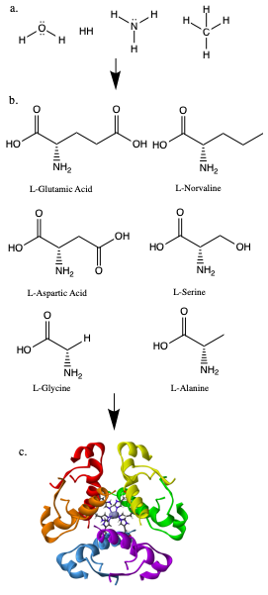
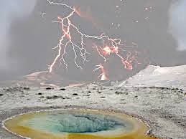
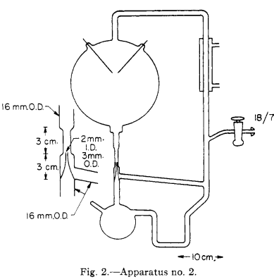
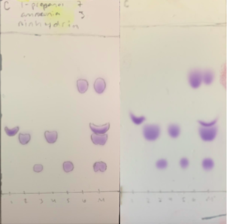
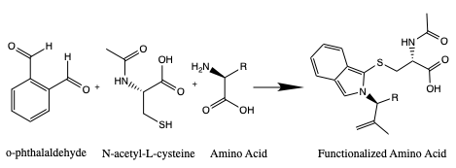
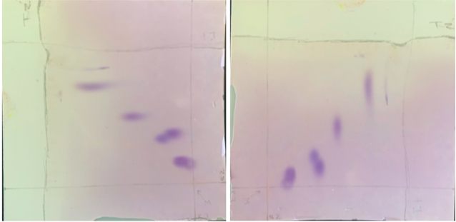
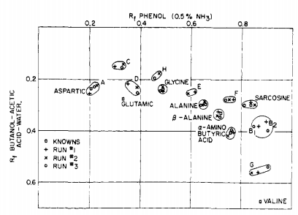
Incorporating The Origin of Life Theme in Organic Chemistry Laboratories:
Analyses of Amino Acids
Emmalyn Sarver and Dr. Michael Korn
Abstract
Results and Conclusion
Began studying efficient ways to analyze and separate the five most abundant amino acids produced in Urey-Miller type experiments through thin layer chromatography (TLC). Compared multiple TLC techniques, including one- and two-dimensional TLC as well as various stationary and mobile phases to achieve optimum separation between amino acids.
Results
Some separation was achieved through one-dimensional TLC which could identify serine and norvaline in an unknown sample. However, little separation was achieved between serine and glycine as well as aspartic acid and glutamic acid (Fig. 4).
It was observed that Urey-Miller used two-dimensional TLCs as a method for analyzing the products of the experiments ran using their apparatus. As a result, two-dimensional TLCs were run for this research. Better separation was achieved for each of the amino acids, although better separation could be achieved in the future with other mobile phases.
More will be added here as the research progresses over the next month.
Conclusions
Introduction and Research Question
Over the past century, various ideas concerning the origin of life on earth have developed. One of the ideas was that organic compounds which serve as the basis for life were formed spontaneously in the early earth environment from methane, ammonia, water, and hydrogen gas (Fig. 1). In the early 1950s, Miller and Urey created an apparatus (Fig. 3) that tested this hypothesis by exposing the gases to electrical discharges. Multiple amino acids were identified, supporting the hypothesis that organic compounds necessary for life could be synthesized from an early earth atmosphere in a ”primordial soup” environment (Fig. 2). While the model for the early earth atmosphere has updated (reducing to weakly reducing or neutral), Urey-Miller type experiments have displayed that the production of amino acids can still be achieved (Cleaves et al.).
The overarching goal of our research is aimed at introducing the origin of life debate into the Organic Chemistry Laboratory curriculum by replicating the Urey-Miller experiment with the model used in Cleaves et al. The focus of the current research, as an aspect of this experiment, is on the development of efficient methods for the separation and analysis of amino acids via thin-layer chromatography (TLC) so that products of the replicated Urey-Miller experiment can be analyzed.
Research Question
What are the optimal thin-layer chromatography (TLC) conditions and methods (mobile and stationary phases, unfunctionalized/functionalized amino acids, chromophore visualizations) for the analyzation of the most prevalent amino acids in Urey-Miller related experiments?
Figure 2. One of the leading ideas for the production of amino acids and more complex organic compounds on early earth is the “primordial soup,” which features a variety of gases, warm weather, lightning, and volcanoes. Taken from the Prebiotic chemistry themed issue from The Royal Society of Chemistry 2013, Chem. Soc. Rev., 2013, 42, 2186.
Figure 3. The second apparatus design used by Urey and Miller in 1955. The experiments performed through this apparatus produced several amino acids, including those in Fig. 1. Taken from The Journal of the American Chemical Society, Volume 77, No.9, May 12, 1955, Stanley L. Miller.
Figure 4. Two thin layer chromatographies of the six amino acids shown in Figure 1 side-by-side. The stationary phase was cellulose paper. The mobile phase was 1-propanol, ammonia (7:3, v:v). The acids were visualized with ninhydrin. “M” is the mix of all the amino acids analyzed. Numbers 1-6 are the amino acids:
1. alanine 2. glycine 3. aspartic acid
4. serine 5. glutamic acid 6. norvaline
Notice that the mix of the amino acids did not have good separation, and if analyzing an unknown sample there would be no difference between glycine and serine or aspartic acid and glutamic acid. This therefore required other options, including new mobile phases and a new method: 2-dimensional thin layer chromatography.
Methods
Figure 5. Derivatization (or visualization) of amino acids. OPA and NAC react with the amine group on the amino acid, creating a ”Functionalized Amino Acid.” The product fluoresces under UV-light, which allows for visualization of the amino acids. TLC plates were dipped in either ninhydrin (Figures 4 and 7) or an OPA/NAC solution.
Future Work
Preparation:
0.4M borate buffer solution (pH 10.2).
Boric acid and sodium hydroxide.
O-phthaldaldehyde N-acetyl-L-cysteine (OPA/NAC) solution. (Fig. 5)
0.746mmol of OPA and 0.613mmol of NAC in 10mL of the 0.4M borate buffer solution. Used for the visualization of amino acids in thin layer chromatography because it fluoresces amino acids under UV light. The chemical reaction of OPA/NAC with L-enantiomer amino acids is shown in Figure 1, where “R” is the side chain of the amino acid.
0.02M solutions of amino acids in 0.1M HCl. Amino acids used:
aspartic acid (Asp), alanine (Ala), glycine (Gly), glutamic acid (Glu), serine (Ser), norvaline (Nva). Nva is a non-natural amino acid used as a reference. The other five used are the predominant amino acids produced in Urey-Miller related experiments.
1-Dimensional TLCs:
Multiple vertical developments of the 6 amino acids. The mobile phase (eluent) was 1-propanol:ammonium hydroxide (7:3, v:v). Multiple stationary phases were used: silica gel and cellulose. TLC plates were dipped in either ninhydrin or OPA/NAC solution for visualization to enhance detection of the amino acids. Amino acids were spotted 1cm away from the bottom of the TLC and the solvent ran up to about 1cm from the top of the TLC plate. Rf values were calculated.
2-Dimensional TLCs:
The amino acids were spotted at the corner of 1cm from the bottom and 1cm from the right side of the cellulose plate. The first mobile phase was 1-propanol:ammonium hydroxide (7:3, v:v). After completion and drying, the plate was turned 90° to the right (so that the track from the first development was on the bottom) and developed again in a separate chamber with the second mobile phase: 20mL phenol liquified and 10 drops of ammonium hydroxide. The plate was removed from the chamber and dried, then visualized in ninhydrin. Rf values were calculated for each development.
Functionalized amino acids in TLCs.
Find and test the efficiency and separation produced by different solvents.
More will be added here as the research progresses over the next month.
Figure 1. Elements bond together to form compounds. Urey-Miller has shown that reducing compounds can form amino acids. Amino acids can bond together to form polypeptides, or proteins. (a.) The reducing gaseous compounds used in the original Urey-Miller apparatus. (b.) Except Norvaline, the five most abundant amino acids produced in the Urey-Miller experiment. All six were analyzed via TLC. (c.) The protein insulin, which is made of many amino acids (see References for source).
References and/or Acknowledgments
Figure 6. The results of the two-dimensional thin-layer chromatographies run by Urey and Miller in 1955. This shows how aspartic acid, glutamic acid, alanine, and glycine are among the most abundant amino acids in their results.
Figure 7. The two-dimensional chromatographies run through this research. This is the same TLC from two perspectives. The bottom-right corner of the left TLC is where the “mix” of the amino acids were spotted. These then ran up along the right side of the plate in its first development. The plate was then turned 90 degrees to the right (shown by the TLC on the right) and the amino acids ran through a second development. The plate was visualized through ninhydrin and the Rf values were recorded for each development.
-Cleaves, H.J.; Chalmers, J.H.; Lazcano, A.; Miller, S.L.; Bada, J.L. A Reassessment of Prebiotic Organic Synthesis in Neutral Planetary Atmospheres. Orig. Life Evol. Biosph. 2008, 38, 105-115.
-Miller, S. L. Production of Some Organic Compounds under Possible Primitive Earth Conditions. Journal of the American Chemical Society. 1955, 77, 2351-2361.
-[Regular Insulin Hexamer Protein]. (n.d.). Retrieved March 15, 2021, from https://www.pngwing.com/en/free-png-zrajg

