Slide 1

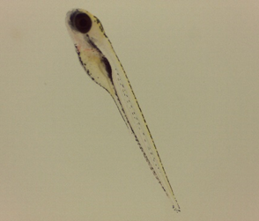
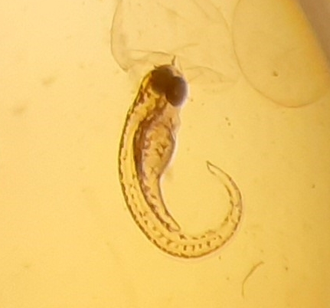
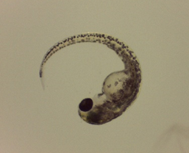
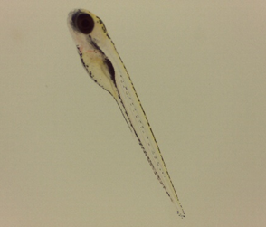
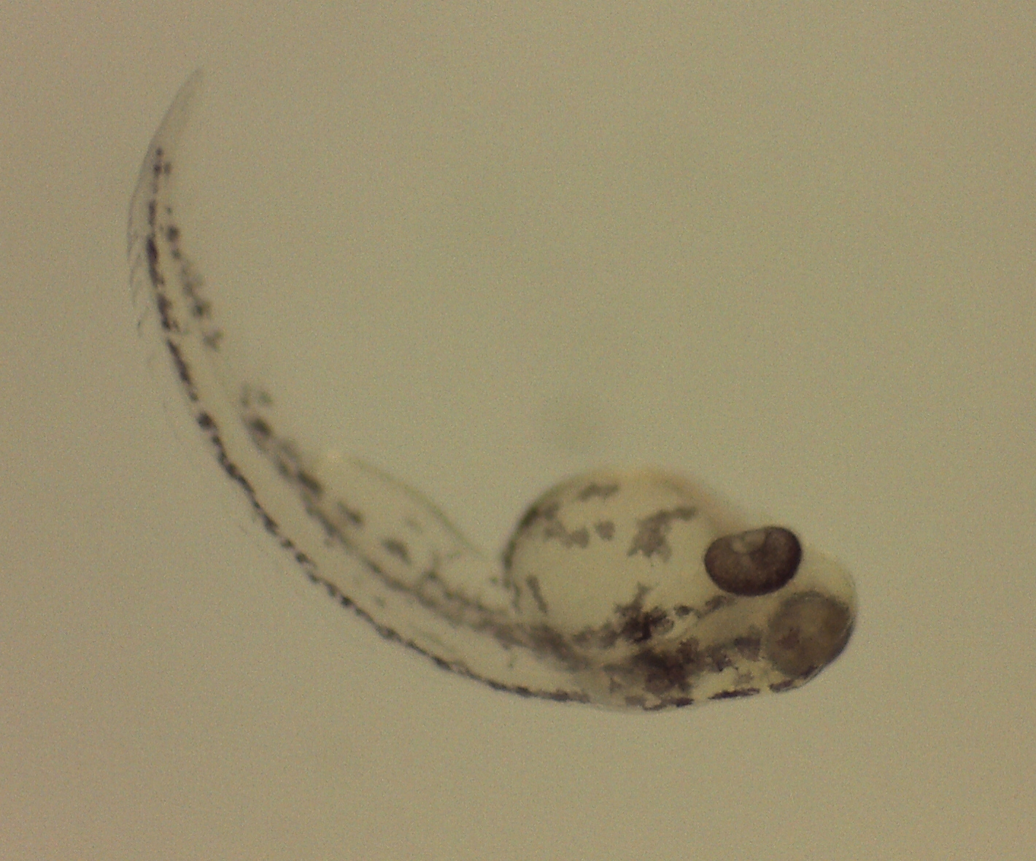
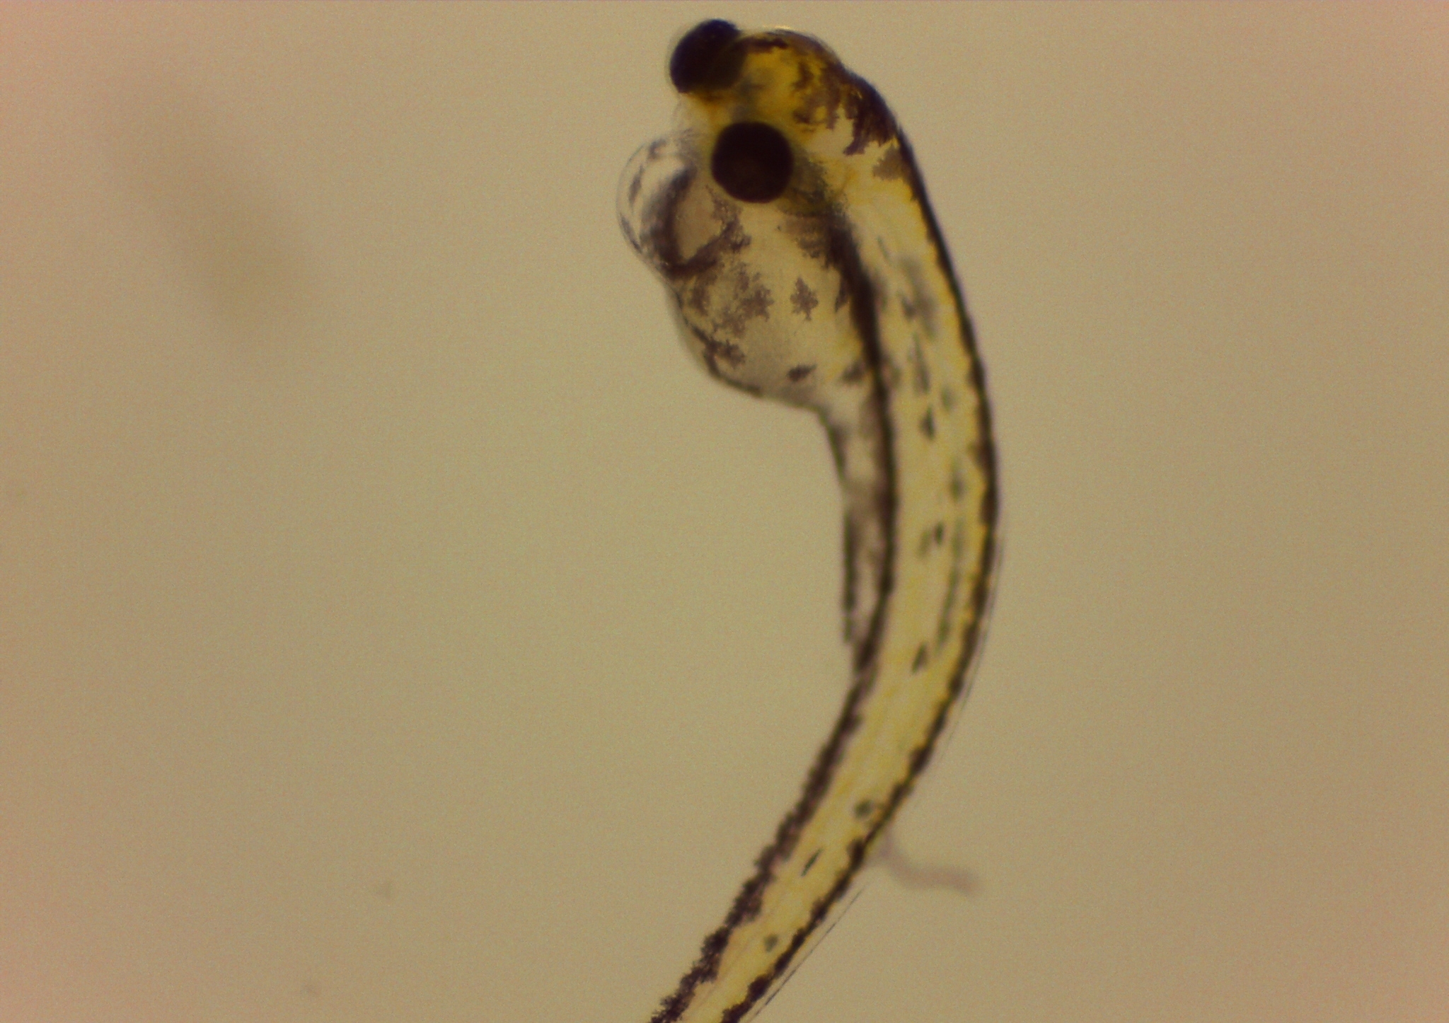
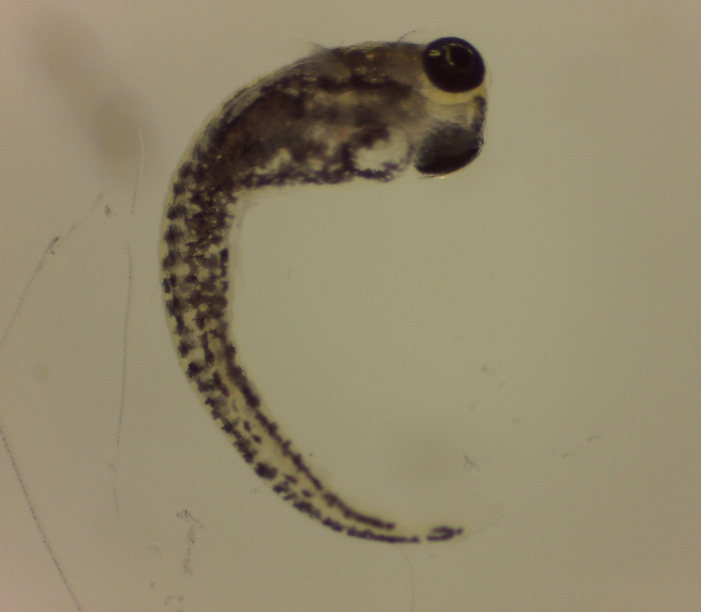
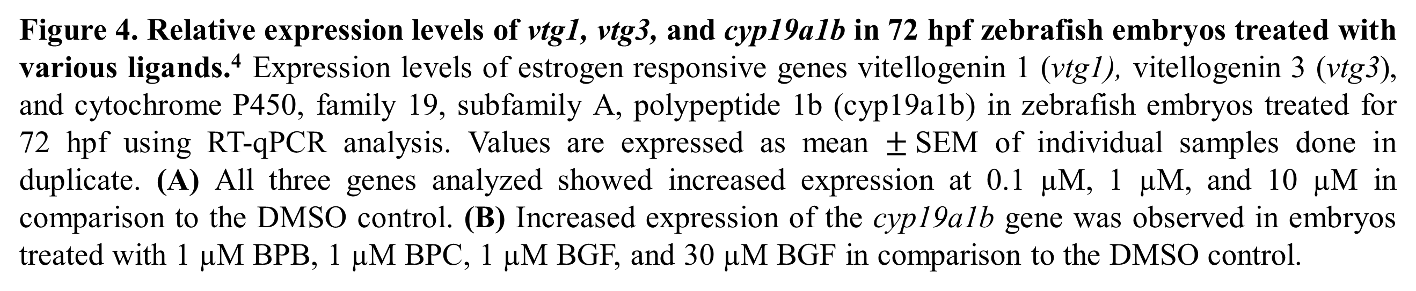
An Examination of the Effects of Bisphenol A and Bisphenol A Derivatives During Zebrafish Development
Rachel Nas, Jonathan Westlake, Neal McCaffrey, Pierce Knepley, Robert Fisher, Gabrielle Dampf, M.S., and Cameron Q. Sheeler, PhD
Abstract
Initial Results
Discussion and Conclusions
Bisphenol A (BPA) is a chemical commonly used in the manufacturing of plastics and is an estrogen-mimicking endocrine disruptor. The purpose of this research project is to investigate whether the bisphenol alternatives Bisphenol B (BPB), Bisphenol C (BPC), or Bisguaiacol F (BGF) can induce estrogen responsive genes during zebrafish embryo development. This response will be tested through image analysis of the morphological changes and possible developmental abnormalities in zebrafish embryos that result at 72 and 96 hours post fertilization (hpf). The total RNA will be isolated to determine if BPA and BPA alternatives induce estrogen-responsive genes using real-time quantitative reverse transcription PCR (RT-qPCR). Understanding the effects of BPA replacements will help in assessing their risk and usage.
Morphological Changes
Our dose response assays performed using the yeast-based system identified BPB and BPC to be as estrogenic as BPA, while BGF did not exhibit an estrogenic response. This could indicate that BPB and BPC are not suitable replacements for BPA, but BGF could serve as a safer alternative to BPA. Additionally, BGF is synthesized from a renewable, non-petroleum-based source and could serve as a non-estrogenic, green replacement for BPA.
From the initial toxicological assays performed on the zebrafish embryos, we determined that 100 µM of BPA, BPB, and BPC is toxic to the embryos. The LD₅₀ and the maximal tolerated dose for all compounds is still be determined.
Analysis of the morphological changes caused by these BPA replacements indicated that in the presence of high concentrations of E2, BPA, BPB, and BPC (Figure 2B-F) spinal deformities and heart and yolk edema were observed. In comparison, the DMSO control (Figure 2A) showed no anatomical abnormalities.
Genetic Analysis
The relative expression levels of three estrogen-responsive genes (vtg1, vtg3, and cyp19a1b) were analyzed for the ligands E2, BPB, BPC, and BGF using RT-qPCR. In the presence of 0.1 µM, 1 µM, and 10 µM E2, increased expression of all three genes was observed in comparison to the DMSO control (Figure 3A). Increased expression was also observed for the cyp19a1b gene in the presence of 1 µM BPB, 1 µM BPC, 30 µM BGF, and 1 µM BGF in comparison to the DMSO control (Figure 3B).
D
A
A
B
C
.
h
y
Introduction and Hypothesis
The petroleum-based compound, Bisphenol A (BPA), has been widely used in the manufacturing of both commercial and consumer plastic products. It has been found that BPA is an endocrine-disrupting compound with estrogenic properties, and it has been implicated in numerous endocrine disorders. As a result, manufacturers are now seeking alternatives such as BPB, BPC, and BGF (Figure 1). BGF is a compound of interest, as it is synthesized from paper pulp products and could serve as a non-petroleum based green alternative. The short and long-term health effects of these replacements are unknown. Therefore, comprehensives studies must be conducted to determine their health risk. Our lab is currently studying the effects of such compounds using a zebrafish model, as zebrafish have a 70% homologous genome to that of humans¹.
A yeast genetic system was used to identify potential environmental estrogens. Using this system, BPB and BPC were identified to have estrogenic properties similar to BPA, while BGF did not appear to be estrogenic². Further analysis of these compounds must be conducted. In this study, we will analyze morphological changes and estrogen responsive genes using real time quantitative reverse transcription PCR (RT-qPCR) during zebrafish embryo development. We hypothesize that the compounds shown to be estrogenic using our yeast-based system will induce estrogen responsive genes and have similar toxic effects as that of BPA during zebrafish embryo development, whereas BGF will not induce estrogen responsive genes.
Figure 1. Structures of Estrogen, BPA, and BPA Replacements. (A) 17β-Estradiol (E2), (B) Bisphenol A (BPA), (C) Bisphenol B (BPB), (D) Bisphenol C (BPC), (E) Bisguaiacol F( BGF)
D
y
E
h
F
y
h
Figure 2. Teratogenic effects of bisphenol analogs and estrogen on zebrafish embryos exposed for 96 hpf. ⁴ (A) DMSO control, (B) 10 µM E2 with spinal deformation, (C) 50 µM BPA with spinal deformation, yolk edema (y), and heart edema (h), (D) 30 µM BPB with spinal deformation and heart (not shown) and yolk edema (y), (E) 10 µM BPB with heart (h) and yolk edema and spinal deformation, (F) 10 µM BPC with spine deformation and heart edema (h)
.²
Future Work
The maximal tolerated dose and LD₅₀ for BPA, BPB, BPC, and BGF will be determined, and the maximal tolerated dose for these compounds will be used to identify morphological abnormalities^{5,6} and estrogen responsive genes⁷ at 72 and 96 hpf.
BPA is also able to exert its effect through the androgen receptor. Therefore, we will also determine if these compounds can induce known androgen responsive genes in zebrafish embryo development⁸.
RNA-seq analysis will be used to generate a genomic profile of 17 β-estradiol, BPA, BPB, BPC, and BGF responsive genes during various time points of zebrafish embryological development. This model will allow for a more accurate assessment of the potential risks of BPA replacements.
A
B
C
A
D
E
Methods
Morphological Studies
Ligands used: 17β-Estradiol (E2), BPA, BPB, BPC, and BGF
Zebrafish embryos are used to determine the toxicological effects of a select number of ligands.
The zebrafish are kept on a 14:10 hour light-dark cycle. Natural breeding is used by separating two males and one female in a breeding tank. Spawning occurs at the onset of the light cycle and allowed to continue for 30 minutes.
Embryos are collected and randomly separated into 6-well plates, with 5-10 embryos per well.
Tested compounds are dissolved in DMSO such that 1 µL of the solution in 1 mL of E3 (0.5 mM NaCl, 0.33 CaCl₂, 0.33mM MgSO₄, and 0.17mM KCl) yields the desired concentration. The embryos are incubated in experimental conditions at 28.5°C. DMSO is used a control.
At 72 and 96 hours post fertilization (hpf), a set of embryos are used for developmental analysis and another set of is used for RNA isolation.
Genetic Analysis
The following estrogen-responsive genes (vtg 1, vtg3, and cyp19a1b) were chosen for RNA analysis.
At 72 hpf, total RNA was isolated from zebrafish embryos after being exposed to the experimental conditions using the Trizol method for use in real-time quantitative reverse transcription PCR (RT-qPCR) to quantitate the expression of genes of interest.
DMSO will be used as the control.
Zebrafish studies were approved by the Institutional Animal Care and Use Committee at Liberty University⁹.
B
References and Acknowledgements
Howe, K., Clark, M. D., Torroja, C. F., Torrance, J., Berthelot, C., Muffato, M., … Stemple, D. L. (2013). The zebrafish reference genome sequence and its relationship to the human genome. Nature, 496(7446), 498–503. doi:10.1038/nature12111
Nas, R., Hankey, J., Curtis, E., and Sheeler, C. (2020). An Examination of the Effects of Bisphenol A and Bisphenol A Derivatives During Zebrafish Development. Poster presentation. Presented at NURVA conference, January 25, 2020 at Hampden-Sydney College.
The BGF used in the dose response assays and toxicological studies was synthesized in the lab of Stephen T. Hobson, PhD., Department of Biology and Chemistry, Liberty University.
Images and figures used with permission from Cameron Sheeler, Ph.D., Department of Biology and Chemistry, Liberty University.
Moreman, J., Lee, O., Trznadel, M., David, A., Tetsuhiro, K., and Tyler, C. (2017) Acute Toxicity, Teratogenic, and Estrogenic Effects of Bisphenol A and Its Alternative Replacements Bisphenol S, Bisphenol F, and Bisphenol A in Zebrafish Embryo-Larvae. Environmental Science & Technology, 51(21): 12796-12805. doi: 10.1021/acs.est.7b03283.
Martinez, R., Esteve-Codina, A., Herrero-Nogareda, L., Ortiz-Vallnueva, E., Barata, C., Tauler, R., Raldua, D., Pina, B., Navarro-Martin, L. (2018). Dose dependent transcriptomic responses of eleutheroembryos to Bisphenol A. Environmental Pollution, 243(Pt B): 988-997. doi: 10.1016/j.envpol.2018.09.043.
Hao, R., Bondesson, M., Singh, A., McCollum, C, Knudsen, B., Gorelick, D., Gustafsson, J. (2013). Identification of Estrogen Target Genes during Zebrafish Embryonic Development through Transcriptomic Analysis. PLoS ONE, 8(11):e79020. doi: 10.1371/journal.pone.0079020.
Acconica, F., Pallottini, V., Marino, Maria. (2015). Molecular Mechanisms of Action of BPA. Dose-Response, 1-9. doi: 10.1177/1559325815610582.
IACUC permission was obtained for any assays with zebrafish embryos, IACUC approval numbers: 38.180815 and 39.180615
This work is supported by a grant from the Center for Research & Scholarship (PR1926). Liberty University
Figure 4. Relative expression levels of vtg1, vtg3, and cyp19a1b in 72 hpf zebrafish embryos treated with various ligands.⁴ Expression levels of estrogen responsive genes vitellogenin 1 (vtg1), vitellogenin 3 (vtg3), and cytochrome P450, family 19, subfamily A, polypeptide 1b (cyp19a1b) in zebrafish embryos treated for 72 hpf using RT-qPCR analysis. Values are expressed as mean $±$SEM of individual samples done in duplicate. (A) All three genes analyzed showed increased expression at 0.1 µM, 1 µM, and 10 µM in comparison to the DMSO control. (B) Increased expression of the cyp19a1b gene was observed in embryos treated with 1 µM BPB, 1 µM BPC, 1 µM BGF, and 30 µM BGF in comparison to the DMSO control.
Notes:
Goal of this project: BPA is a known estrogen-mimicking chemical, want to see if alternatives being used are harmful. BGF is a compound of interest
Used a yeast dose response assay to initially determine estrogenicity
^{Did zebrafish embryo assays}
^{Hope to do RT-qPCR}

