Slide 1
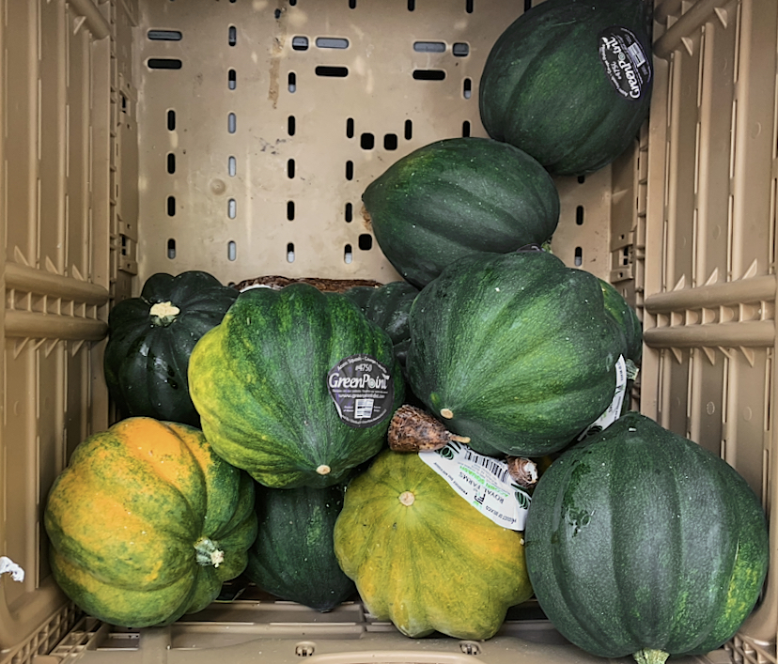
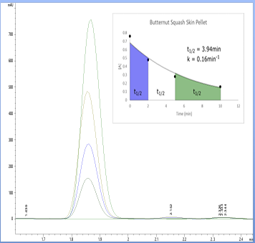
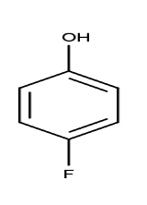
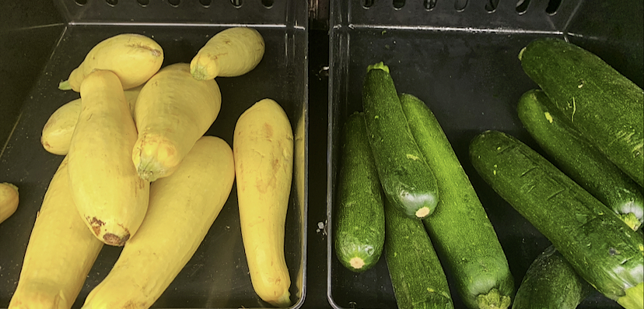
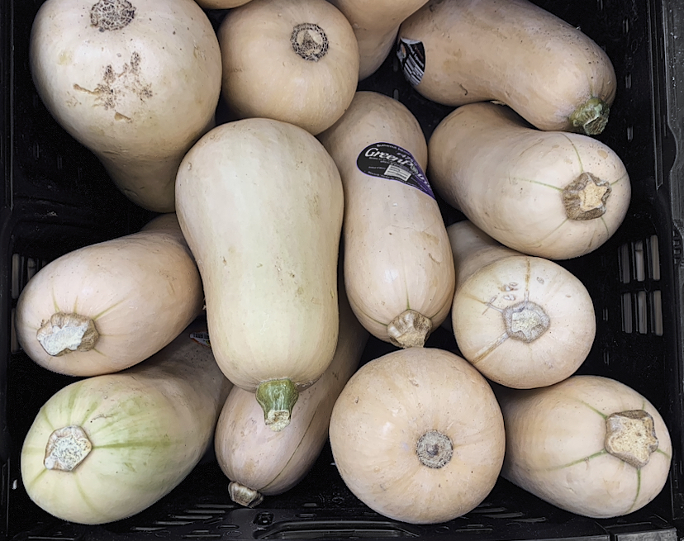
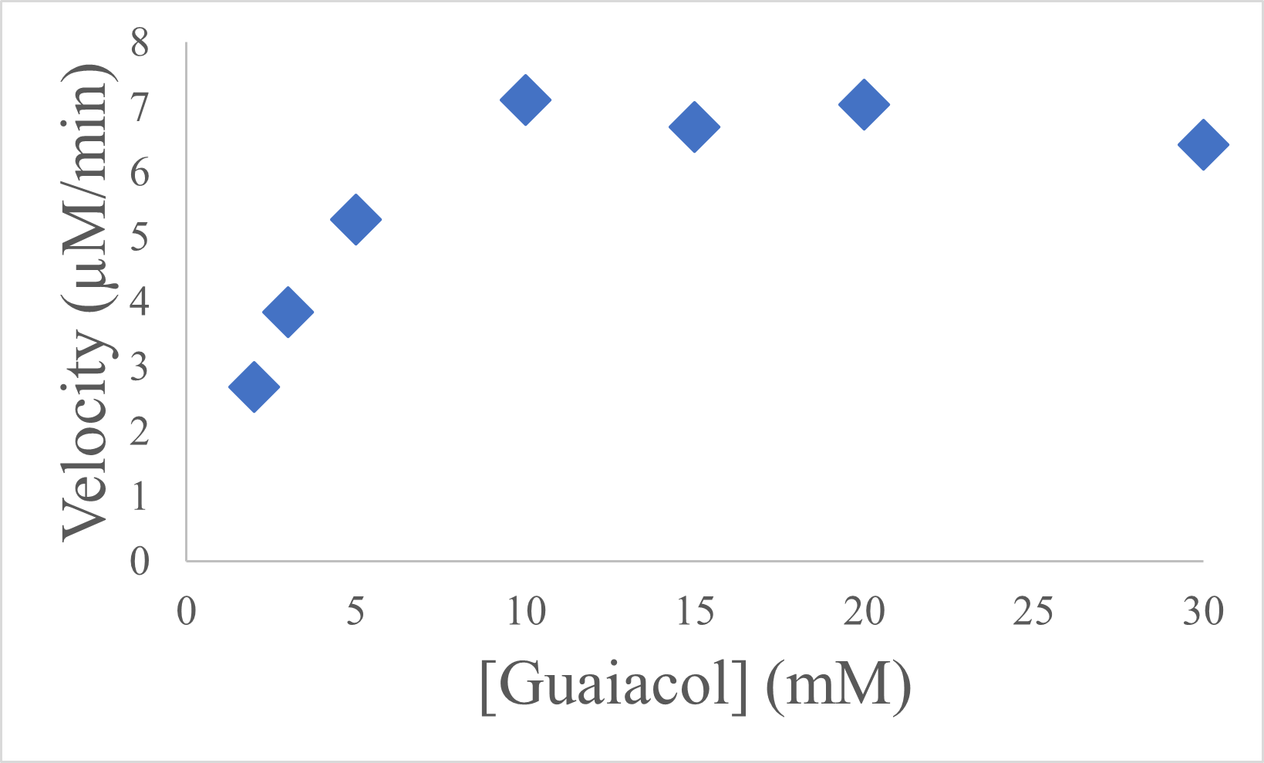
Characterization of Peroxidases from Zucchini and Squash Skin
and Their Potential Use in Bioremediation
Taylor Villani, Christina Hardin, Alexa Deckert, Kalie Nuss, Gregory M. Raner, PhD
Abstract and Background
Results and Future Work
Peroxidases are a ubiquitous class of enzymes found in plants, fungi, and other higher organisms that catalyze chemical oxidations using hydrogen peroxide as an oxidant. The electron donors can be polyphenolic compounds, ascorbate, and several amino acids (1). Specifically, horseradish peroxidase (HRP) has been the most commonly used and studied. HRP first appeared in scientific literature approximately 200 years ago and has been the subject of numerous studies (2). Peroxidases have many potential uses, including large-scale biocatalytic functions and wastewater remediation. In relation to remedial applications, the ability to degrade halogenated phenolic wastewater contaminants is a significant challenge, one that this project will directly address. The specific purpose of this research is to observe the ability of selected purified peroxidase samples to degrade a variety of toxic fluorinated phenolic compounds and compare these rates to determine the optimal sample for degradation. This will be achieved by screening common plant samples for optimal rates of degradation using phenol derivatives with diverse fluorine substitution patterns. Through screening of our peroxidase “library,” a group of peroxidases coming from the squash family have emerged as outstanding candidates for this type of application (Figure 1). This is due to the extremely high rate of catalysis in the breakdown of fluorinated phenolic substrates. In this group, the skin showed especially high activity. Thus, we will describe methods for purifying five different squash peroxidases from the skin of these fruits and provide a full characterization of the individual enzymes, including molecular weight and catalytic prowess in the desired catalytic process. The ability of each peroxidase to degrade a variety of fluorinated aromatic compounds will be reported in terms of their efficiency, pH optimum, and overall rates of catalysis. By studying these squash/zucchini peroxidase, we hope to find more options and better sources for catalysts for these oxidative reactions.
A purification protocol was developed by running the crude sample through column chromatography, using an ammonium sulfate purification method, and dialysis. The SDS-Page showed a sufficient purity for future work.
By using the guaiacol oxidation assay (Figure 5), we were able to determine the activity of the squash and zucchini samples based on the amount of peroxidase obtained from the plant samples. Our results showed yellow squash, butternut squash, and spaghetti squash all had high peroxidase activity. The acorn squash showed the lowest activity, with a slower reaction, turning from clear to a slight red color.
The samples were tested for heme content, and it was assumed that there is 1:1 ratio of heme to peroxidase. Butternut squash showed the highest heme activity, indicating of the squash analyzed, it contained the highest peroxidase activity. Furthermore, since all of the samples contained heme, data supports that these proteins are heme peroxidases.
For HPLC using a variety of fluorophenols, the rate of degradation was measured for each sample. As the number of fluorine groups attached to each phenol increased, the degradation of each substrate decreased. This is because adding fluorine groups draw the electron density away from the hydroxyl groups, making it harder to be oxidized. Therefore, Zucchini and the Butternut Squash showed the strongest peroxidase activity because with increasing fluorinated compounds found on the fluorophenol substrate, there was still a relatively high rate of degradation.
To continue this research, we will be performing an “Ascorbate Clock” assay, a variation of an ascorbate-based chronometric determination of steady-state rate constants from published research, in order to determine the electron transfer rate of each peroxidase sample (4). This assay uses a series of ascorbic acid concentrations to determine the rate constants. When the reaction begins, the peroxidase will first metabolize the ascorbic acid, which does not produce a change in color. However, once the peroxidase has metabolized all of the ascorbic acid, it will begin to oxidize the guaiacol resulting in a change in color to red. The lag time was tracked using a spectrophotometer by measuring the change in absorption over a period of time.
Furthermore, future work will involve purifying the proposed dimer product from the fluorophenol-peroxidase reaction.
Summary:
Screening showed higher 4-fluorophenol degradation in five squash/ zucchini samples.
Degradation was found to occur in the fluorinated series, and with increasing fluorination, degradation rates decreased.
Based on the kinetic studies, the Zucchini and Butternut Squash were determined to have the highest activity.
Since all samples contained heme, data supports that these proteins are heme peroxidases.
Figure 1. Peroxidase library relative degradation of 4-fluorophenol. The peroxidase library was screened to determine which samples have the most peroxidase activity. The 4-FP peak integration area from the chromatograms of each sample were compared and plotted according to percent degradation relative to the least degraded sample.
Fig. 1. Kalie, Nuss; “Squash Array”; Mar 13, 2021; photograph
Figure 3. Time-Constraint Assays Conducted for Butternut Squash Enzyme Sample The image and graph above depict the results of running purified butternut squash enzymatic samples through a time-constraint assay to measure the disappearance of 4-fluorophenol to determine the rate of activity exhibited by the isolated enzyme. The half-life of our 4-flurophenol substrate was reported to be t_{1/2} =3.94 min, while the resulting rate constant of enzymatic functions was reported to be k = 0.16 min⁻¹.
Crude Sample
Column Chromatography using DEAE
0-40% Ammonium Sulfate Purification
 |  | Degradation (% from 0 minutes to 15 minutes)
 | Heme Concentration ( µM) | 4-Flurophenol (%) | 3,4-Diflurophenol (%) | 3,4,5-Triflurophenol (%) | 2,3,4,5,6-Pentaflurophenol (%)
Acorn Squash |  | 21.6 | 5.9 | 0
Butternut Squash | 0.75 | 65.5 | 64.6 | 54.1
Spaghetti Squash | 0.50 | 9.5 | 42.4 | 15.6
Yellow Squash | 0.45 | 97.5 | 10.98 | 0.4
Zucchini
Research Questions
To develop a purification scheme and obtain large quantities of purified squash peroxidase by using multiple purification methods
To screen the squash/zucchini samples for rates of overall degradation with different fluorinated phenolic substrates
To characterize the peroxidase in terms of its physical and chemical properties
Diluted
Pellet
Purified Peroxidase Enzyme
Dialysis
Diluted Pellet
40-70% Ammonium Sulfate Purification
Methods
Scheme 1. Standard purification method.
The purification method currently being used is a process that takes the crude sample and runs it through column chromatography in order to separate out the peroxidase from the waste. The liquid from the column chromatography is then processed through an ammonium sulfate purification in order to precipitate out the peroxidase enzyme, which will then be resuspended and put through dialysis to ensure that high salt concentration does not interfere with future results. This method is still being improved upon as more plant sources are tested and according to the results of the assays.
This study involves characterizing the peroxidase enzyme isolated from squash and studying activities and oxidative properties, increasing its potential for industrial or biotechnological value. In order to complete this objective, a large amount of purified squash peroxidase will be generated, the peroxidase will be characterized, according to its chemical and physical properties, and the oxidative properties with breakdown of fluorinated compounds will be explored.
Plant material from squash and zucchini will be processed and crushed with buffer solution. The peroxidase will then be isolated using a variation of a standard purification protocol from published peroxidase research (3). The peroxidase will be further purified using chromatography, ammonium sulfate precipitation, and dialysis. It will then be analyzed by SDS-Page to determine its purity (Scheme 1, Figure 3).
Once these samples have been purified, a heme analysis will be performed using HPLC to confirm the presence of heme in the sample, determining its concentration (Figure 3). Moreover, various kinetics assays will be performed to assess peroxidase activity by determining Km and Vmax by the rate at which the enzyme oxidizes guaiacol and how tightly it binds to guaiacol during the reaction. (Figure 3).
Additional oxidative activities related to squash peroxidase will also be explored. A series of fluorinated substrates will be used in order to study the influence of these substrates on the redox properties of the enzyme using HPLC analysis. The substrates included in the fluorinated series will be 4-fluorophenol, 3,4-difluorophenol, 3,4,5-trifluorophenol, and 2,3,4,5,6-pentafluorophenol. The degradation of the fluorinated series will be examined to determine the reactivates enzyme (Figure 4). In order to identify the products of the peroxidase reaction, mass spectrometry will be used.
Figure 4. HPLC and Heme Analysis Table for Specific Squash Analyzed The table above depicts all of the HPLC results for the fluorinated series chosen for the specific squash listed. The heme concentration is indicated as a standard used to determine the optimal enzyme, degrading the most toxic fluorophenol in the shortest amount of time in the least concentration. The degradation is reported as half-life. The heme concentration is measured based on a standard curve.
1 2 3 4 5 6 7 8 9 10 11 12 13 14
1
2
3
4
1: molecular marker
2: crude acorn squash material
3: after column chromatography and centrifugation
4: after column chromatography, centrifugation, ammonium sulfate salting, and dialysis (this sample was used in analysis)
Sample | V_{max} (µM/min) | K_{m} (mM) | K_{cat}
Acorn Squash | 7.15 | 3
Butternut Squash | 35 | 7.5 | 4.67x10⁷
Spaghetti Squash | 1.75 | 2.5 | 3.50x10⁶
Yellow Squash | 7.75 | 3 | 1.72x10⁷
Zucchini | 44.5 | 7.5
References
Figure 2. Determining Purity through Gel Electrophoresis (SDS-Page).
This gel was run with a molecular marker, crude acorn squash material, a sample from after column chromatography, and a final purified sample. The result indicates the sample was purified to completion because it no longer is visible on the gel after the process of column chromatography. The purification steps taken were centrifugation, column chromatography, ammonium sulfate salting, and dialysis. Additionally, HPLC was run. For this particular plant, ANS, column chromatography appears to be sufficient for a purified sample.
Fig. 2 Villani, Taylor; “Squash Sample SDS-Page”, Oct. 24, 2020, photograph
Bursal, E. (2013). Kinetic properties of peroxidase enzyme from chard (beta vulgaris subspecies cicla) leaves. International Journal of Food Properties, 16(6), 1293-1303. doi:10.1080/10942912.2011.585729
Krainer, F. W., & Glieder, A. (2015). An updated view on horseradish peroxidases: Recombinant production and biotechnological applications. Applied Microbiology and Biotechnology, 99(4), 1611-1625. doi:10.1007/s00253-014-6346-7
Lavery, C. B., Macinnis, M. C., Macdonald, M. J., Williams, J. B., Spencer, C. A., Burke, A. A., . . . D’Cunha, G. B. (2010). Purification of peroxidase from horseradish (armoracia rusticana) roots. Journal of Agricultural and Food Chemistry, 58(15), 8471-8476. doi:10.1021/jf100786h
Goodwin, D. C., & Hertwig, K. M. (2003). Peroxidase-catalyzed oxidation of capsaicinoids: Steady-state and transient-state kinetic studies. Archives of Biochemistry and Biophysics, 417(1), 18-26. doi:10.1016/S0003-9861(03)00321-7
50
30
Figure 5. A guaiacol oxidase assay compared to the heme analysis are tools used to measure the kinetic characteristics and concentration of squash peroxidase.
The guaiacol assay is the main tool that is being used in order to measure the kinetic components of the five types of squash peroxidase. This is due to the easily measured color change that occurs when the product, tetraguaiacol is formed, creating a burnt red color that can be measured using a spectrophotometer.
A heme analysis was also performed to quantify the amount of peroxidase in each sample. By using this method, it is assumed that the heme to peroxidase ratio is a 1:1 ratio. By using the concentration obtained from the heme analysis with the oxidation assay, a specific activity can be calculated per peroxidase.
25
15
kDa

