Slide 1
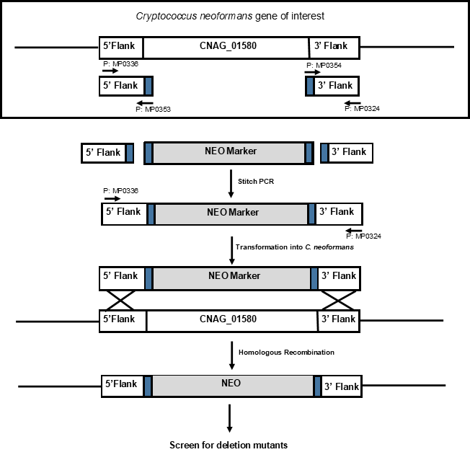
Deletion of pH Response Genes in Cryptococcus neoformans.
Hannah Finson¹, Kristen John¹, J. Andrew Alspaugh³, Hannah Boyd², and Michael S. Price^{2,3}
¹Dept. of Biology and Chemistry and ²Dept. of Molecular and Cellular Sciences, Liberty University, Lynchburg, VA,
³Department of Medicine, Duke University.
Introduction & Background
Methods
Results
Cryptococcus neoformans is a fungal pathogen that can be fatal for people with immuno-deficiency disorders, such as HIV/AIDS. C. neoformans infects the lungs and travels to the central nervous system, where it causes potentially fatal meningoencephalitis if untreated (1). C. neoformans is known to be able to influence host responses to those that are favorable for growth and survival. During infection, C. neoformans encounters large changes in pH from acidic in the environment to basic in the host to acidic in the macrophage phagolysosome. pH adaptation occurs in C. neoformans through the Rim pathway in fungi. First, the pathogen moves from the generally acidic exterior environment and enters the slightly alkaline environment of the human body. This induces alkaline-specific protein production to maintain cellular processes so the cells can survive. Investigators at Duke University identified several C. neoformans genes that play a role in this process through a screen of Rim pathway-related mutants (2). One of the genes identified is the putative sterol regulatory element-binding protein cleavage activating protein CNAG_01580.
CNAG_01580 is homologous in sequence to the Saccharomyces cerevisiae gene SCP1. This gene encodes for sterol regulatory element binding protein (SREBP) cleavage activation protein (3). This activation is triggered by extracellular acidic pH (4). The gene was identified in a mutagenesis screen of C. neoformans for growth inhibition at pH 8. Using overlap Polymerase Chain Reaction (PCR), a gene deletion construct for the C. neoformans gene was made for functional analysis of the gene. This construct was introduced into wild-type C. neoformans via Biolistic Transformation, and alterations in virulence-related traits will be assessed. Furthermore, a murine infection model will be used to analyze the effect these genes have on virulence. If these genes have a significant effect on virulence, they will present interesting new targets for antifungal therapy.
Overlap PCR was utilized to create a gene deletion construct in order to characterize the function of the gene CNAG_01580 in C. neoformans (Figure 1). Once the deletion construct was confirmed, it was transformed into wild-type (WT) C. neoformans strain KN99α cells using Biolistic Transformation (5). Using Southern hybridization, the transformants will be tested to ensure correct homologous recombination occurred. Once the transformants are verified, the gene deletion strain will be assessed for alterations in virulence and pH-related phenotypes such as production of capsule and melanin, survival in macrophages, and growth at pH 8. Growth of the mutant cells at pH 7 versus pH 4, and in 1.5M NaCl versus no salt will also be tested. The goal in this is to determine the function of CNAG_01580 in pH adaptation and in the Rim pathway. Lastly, virulence of the gene deletion strain will be assessed in a murine model of cryptococcal disease.
DNA ladder
CNAG_01580
5’ flank
CNAG_01580
3’ flank
NEO
CNAG_02291
5’ flank
CNAG_02291
3’ flank
NEO
Figure 2: (A) The stitch PCR product for CNAG_01580 was run on a 0.7% agarose gel as shown by band (a). A band at 4KB was visible, which was the expected size as the approximate size of the 5’ flank, the 3’ flank, and NEO combined was 4KB. This indicated that the stitch PCR was successful. (B) Transformation was done using Biolistic Transformation. Transformants were plated on a NEO plate. Since colonies were observed, it can be concluded that the NEO resistance gene marker successfully integrated into the genome. Correct integration site will be confirmed with Southern Hybridization (8).
1Kb 1 2 3 4 5 6 7 8 1Kb
A
B
Future Work
Screening. As it is possible for the gene deletion constructs to insert themselves in various locations within C. neoformans DNA, the transformant colonies will be picked and screened for homologous recombination by Southern hybridization.
Phenotype characterization. Once the C. neoformans cells have been successfully transformed, the mutant strains will be picked and grown on different agar plates. The mutant cells will be tested for growth at pH 7 and in 1.5 M NaCl. Screening these mutants on several media could help distinguish their various functions from each other within pH adaptation pathways. The mutant cells will also be tested for virulence using waxworm larvae and/or mouse models of infection. Virulence phenotypes will be evaluated in the gene deletion strains.
Figure 1: Diagram of the creation of gene deletion constructs using overlap PCR. These constructs were then transformed into C. neoformans (8).
Results
References & Acknowledgements
Polymerase chain reaction (PCR) was done to amplify the 5’ and 3’ flanks as well as the neomycin resistance gene (NEO). These are the knockout construct segments. Then, using stitch PCR, the gene construct was made for CNAG_01580 using primers MP0336 and MP0324 (Figure 2).This product was transformed into the wild type strain KN99α using Biolistic Transformation. Transformants were plated on neomycin-containing (NEO) plates. Colonies were observed, indicating that the NEO resistance gene selectable marker was inserted into the genome.
M. S. Price, M. Betancourt-Quiroz, J. L. Price, D. L. Toffaletti, H. Vora, G. Hu, J. W. Kronstad, J. R. Perfect, Cryptococcus neoformans requires a functional glycolytic pathway for disease but not persistence in the, N. Huda, S. K. Esher, J. A. Alspaugh, Thost. mBio 2, e00103-00111 (2011)10.1128/mBio.00103-11).
K. S. Ost, T. R. O'Mearahe Cryptococcus neoformans alkaline response pathway: identification of a novel rim pathway activator. PLoS genetics 11, e1005159 (2015); published online EpubApr (10.1371/journal.pgen.1005159).
https://www.pombase.org/gene/SPBC3B9.15c
Kondo, A., S. Yamamoto, R. Nakaki, T. Shimamura, T. Hamakubo, J. Sakai, T. Kodama, T. Yoshida, H. Aburatani, and T. Osawa. Extracellular acidic pH activates the sterol regulatory element-binding protein 2 to promote tumor progression. Cell Reports. 18, 2228–2242. http://dx.doi.org/10.1016/j.celrep.2017.02.006
Lin X, Chacko N, Wang L, Pavuluri Y. 2015. Generation of stable mutants and targeted gene deletion strains in Cryptococcus neoformans through electroporation. Medical mycology 53:225-234.
R. C. Davidson, J. R. Blankenship, P. R. Kraus, M. de Jesus Berrios, C. M. Hull, C. D'Souza, P. Wang, J. Heitman, A PCR-based strategy to generate integrative targeting alleles with large regions of homology. Microbiology 148, 2607-2615 (2002); published online EpubAug (10.1099/00221287-148-8-2607).
Norrander J, Kempe T, Messing J Gene. 1983 Dec;26(1):101-6.
Figures 1, 2. Finson, Hannah; “Lab Data and Scheme;” 3 March 2021, photograph.
This work is funded through grants from the Liberty University Center for Research and Scholarship and LUCOM
Research Question
Does deletion of CNAG_01580 affect pH adaptation in Cryptococcus neoformans?
A
B

