Slide 1
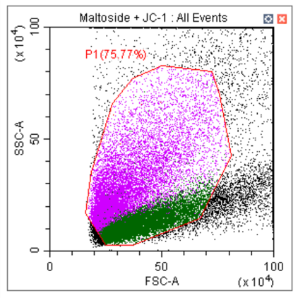
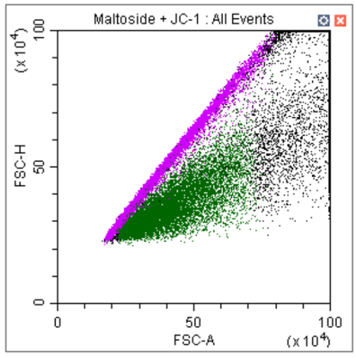
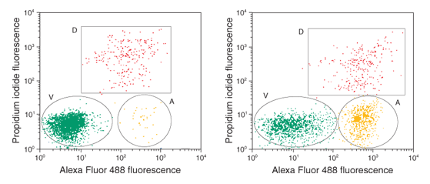
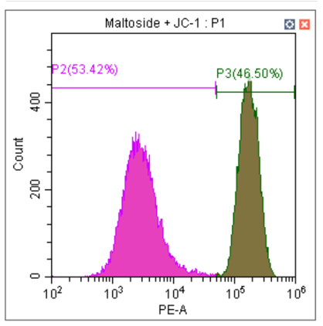
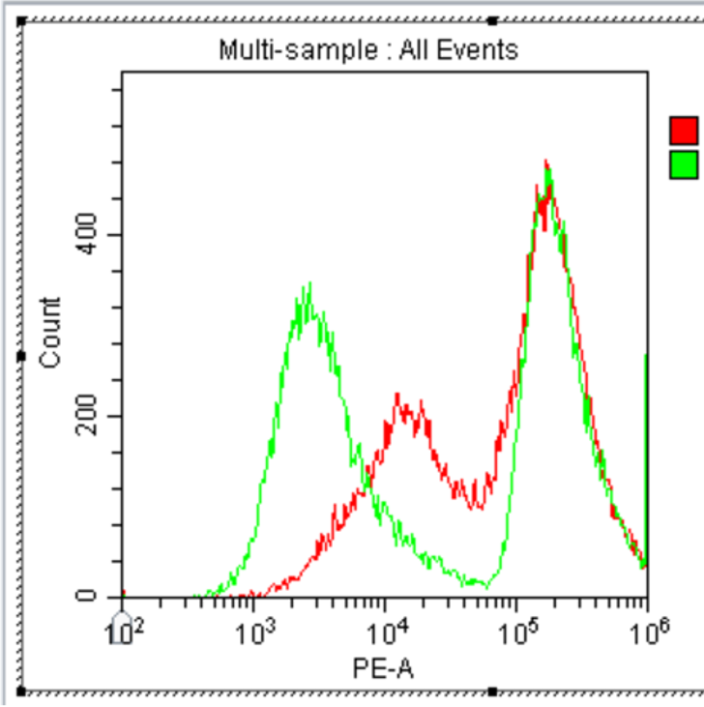
Flow Cytometry Analysis of a JC-1 Assay in Isolated Mitochondria
Olivia Echols and Dr. Abigail Solitro
Department of Biology and Chemistry
Abstract
Results and Conclusion
Cancer cells possess many distinctive features that allow them to persist and proliferate. One such attribute is the ability to evade apoptosis, or programmed cell death. Apoptosis is a pathway that acts as an immediate eliminator of dysfunctional cells; without it, malignant tumors are able to grow rapidly. In order to develop effective cancer therapeutics, a reliable way to monitor apoptosis must be developed. Many events occur in a cell before it undergoes apoptosis, two of which are the disruption of mitochondrial membrane potential and the translocation of phosphatidylserine (PS) from the inner to the outer leaflet of the plasma membrane. Two assays are commonly used to detect these changes; the JC-1 assay detects mitochondrial integrity, and the annexin V assay detects PS in the outer leaflet. In a past study, our team demonstrated that the use of a Beckman Coulter CytoFLEX instrument is a comprehensive way to analyze pre-apoptotic cells. Utilizing a JC-1 assay allowed us to measure the overall health of 25,000 non-small cell lung cancer cells per condition. In the current study, we hypothesized that the JC-1 assay could be performed on isolated mitochondria to directly measure mitochondrial integrity indicative of early-stage apoptosis. We also predicted that the use of an annexin V assay on whole cells would give additional insight into the cells’ apoptotic mechanisms. The development of these assays will lay the framework for future research regarding the inner workings and transformations of lung cancer cells.
A
B
Figures 1 and 2 present the findings of our isolated mitochondria JC-1 assays. An initial assay was performed using a standard concentration of maltoside set by the BIOL 415 lab curriculum. The results show two distinct populations emitting different levels of PE. PE emission is often used as a marker to identify healthy, intact cells or samples; therefore, a high PE emission exhibited by the mitochondria (P3) inferred a relatively intact population. Half of the sample showed a lower PE emission (P2), suggesting that part of the sample was more ruptured than the other half. Our team hypothesized that increasing the maltoside concentration would decrease the P3 peak and increase the P2 peak.
To test this hypothesis, we used four concentrations of maltoside ranging from 1-10mM. As the maltoside concentration increased, a shift in only the P2 population was observed (Table 1). The P3 peak remained at the same emission level and did not decrease in height. A third peak, P4, emerged between P2 and P3. As the experiment progressed, the amounts of total events assayed/recorded decreased due to increased deterioration of the mitochondria by the maltoside. This concentration gradient did not explain the presence of the P3 population and did nothing to affect it. We can conclude that the P3 peak likely does not represent “healthy” mitochondria; one explanation for the peak could be debris clouding the results.
A literature review of JC-1 assays showed no published works utilizing JC-1 for isolated mitochondria. This led the team to believe that JC-1 dye may be unreliable for use in isolated mitochondria.
C
D
Figure 3. Annexin V assay example results. In this assay done by Thermo Fisher Scientific, Jerkat cells were treated with camptothecin (right) or left untreated (left). Cells were stained with Alexa Fluor-conjugated Annexin V to identify apoptotic cells and propidium iodide to identify dead cells. Analysis by flow cytometry shows three distinct populations of cells. The green population shows viable cells (V), yellow shows apoptotic cells (A), and red shows dead cells (D). The camptothecin-treated sample displays a higher percentage of apoptotic cells than the basal level displayed in the untreated group.
Introduction
Table 1. Increasing maltoside concentration shows a shift in the P2 population only.
A cancer cell acquires many transformative properties that allow it to persist and metastasize. Some of the hallmarks of cancer progression are the abilities to chronically grow and divide, resist anti-growth signals, and evade cell death or apoptosis (1). Apoptosis is a pathway that acts as an immediate eliminator of dysfunctional cells; without it, malignant tumors are able to grow rapidly. The induction of apoptosis is the aim of many cancer therapeutics. Therefore, a need exists for reliable methods of monitoring apoptosis in various disease contexts in order to develop and test anticancer therapies.
In a past study, our team utilized a JC-1 assay with whole cells on a flow cytometer to monitor apoptosis. The JC-1 assay acted as indicator of cell health by means of measuring mitochondrial membrane potential. In the event of apoptosis, a cell's mitochondria lose structural integrity. The membrane-permeant JC-1 dye exhibits a potential-dependent accumulation in the mitochondria. In healthy cells, the dye fluoresces red; in pre-apoptotic cells, the dye fluoresces green. Our team demonstrated that the use of a flow cytometer could yield meaningful data regarding this assay.
In the current study, we hypothesized that the JC-1 assay could be performed on isolated mitochondria to directly measure mitochondrial integrity indicative of early-stage apoptosis. Utilizing individual organelles in scientific research is a common way to study underlying mechanisms that affect a cell’s metabolism.
We also predicted that the use of an annexin V assay on whole cells would give additional insight into the cells’ apoptotic mechanisms. Annexin V acts as an apoptosis indicator by binding to the phospholipid phosphatidylserine (PS). In healthy cells, PS in located in the inner leaflet of the plasma membrane; during apoptosis, PS is translocated to the outer leaflet. By measuring the amounts of bound annexin V in our samples, we can measure the relative amount of pre-apoptotic cells. The development of these assays will lay the framework for future research regarding the inner workings and transformations of lung cancer cells.
Sample | Sample Size (P1) | Mean PE Emission (P1) | Sample Size (P2) | Mean PE Emission (P2) | Sample Size (P3) | Mean PE Emission (P3) | Sample Size (P4) | Mean PE Emission (P4)
Unlabeled | 25000 | 170.5 | 3449 | 677.9 | 0 | N/A | 0 | N/A
diH₂O + JC-1 | 25000 | 109370.5 | 7356 | 18691.6 | 17511 | 147967.2 | 5955 | 23270.6
1 mM Maltoside + JC-1 | 25387 | 81612.6 | 12410 | 3687.4 | 12918 | 156810.2 | 591 | 19891.0
2 mM Maltoside + JC-1 | 19513 | 97642.8 | 7361 | 2526.2 | 11512 | 162685.4 | 590 | 23884.8
5 mM Maltoside + JC-1 | 15063 | 75191.6 | 6718 | 2027.7 | 7418 | 148306.5 | 907 | 21347.7
10 mM Maltoside + JC-1 | 11279 | 60897.0 | 4809 | 1516.5 | 4703 | 138716.6 | 1688 | 16520.8
Figure 1. JC-1 expression in maltoside-treated mitochondria. (A) SSC v. FSC dot plot showing basic granularity vs. size characteristics of isolated murine brain mitochondria. The gated population represents mitochondria of uniform size/granularity. (B) FSC-H vs. FSC-A dot plot showing mitochondria that were analyzed by the flow cytometer simultaneously due to physical interaction or inefficient flow. (C) Histogram plot showing PE emission of gated population: P2 capturing those mitochondria hypothesized to be ruptured, and P3 capturing those hypothesized as intact. (D) Samples were overlaid, with the diH₂O sample shown in red, and the maltoside sample in green. A maltoside treatment shows a shift in the P2 population only.
Future Work
Annexin V assay: Because of the lack of scientific literature surrounding the JC-1 assay in isolated mitochondria, the team will explore an alternative means of studying apoptosis in cancer cells. An annexin V assay will be compared to the results of a previously conducted JC-1 assay on whole cells. The assay will quantify the cells and distinguish populations of healthy and dying cells (Figure 3). Once the annexin V assay protocol is established, downstream assays to measure the effects of various drugs on cancer cell apoptosis can be done.
Methods: Thermo Fisher Scientific’s published protocol (3) will be used as a foundation for the experiment. The research team will use a Beckman Coulter CytoFLEX instrument to assess three different samples of 25,000 A549 non-small cell lung cancer cells. One sample will be treated with CCCP, a mitochondrial uncoupler and inducer of apoptosis. This sample will serve as a positive control and used to ensure that the stains are responsive to changes in the cells’ apoptotic mechanisms. Another sample will be treated with DMSO, the solvent, and serve as a negative control. Both control samples will be stained with fluorochrome-conjugated Annexin V and propidium iodide (PI). The third sample will be left unstained and untreated. The samples will be analyzed on the flow cytometer with 488 nm excitation using fluorescein isothiocyanate (FITC) and PI emission filters.
Additional studies:
Elucidate the identity of the maltoside-treated mitochondria peaks
Test the isolated mitochondria JC-1 assay with CCCP
Use a different dye, MitoProbe, for the isolated mitochondria assay
Perform apoptosis assays in a different cell line
A
B
Figure 2. A maltoside concentration gradient does not explain the presence of a second mitochondrial population. (A) Histogram plot showing PE emission of mitochondria in the diH₂O sample. P2 and P3 gates separate the two populations based on diH₂O and maltoside data: P2 capturing mitochondria that are ruptured, and P3 capturing those hypothesized to be intact. (B) PE emission of mitochondria in the lowest maltoside concentration sample. The two populations indicate a leftward shift in the ruptured population. (C-D) PE emission of middle-range maltoside concentrations. (E) PE emission of mitochondria in the highest maltoside concentration sample. The histogram shows a leftward shift in P2 and the emergence of an additional, distinct peak, P4. (F) Overlaid graphs of all samples. Maltoside treatment shows a shift in the P2 population only. Increasing concentrations of maltoside show a slight shift (though likely not statistically significant) in the P2 population. Overall, increasing concentrations of maltoside decreased the total number of events assayed, and therefore the height of each peak. The P3 population remained roughly the same in all samples.
1 2 3 4 5 6 7 8 9 10 11 12 13 14
1 2 3 4 5 6 7 8 9 10 11 12 13 14
A
B
JC-1 Assay
Thermo Fisher Scientific’s published protocol (2) was used as a foundation for the experiment, and the assay was adapted to Liberty University’s novel flow cytometry platform. The research team used a Beckman Coulter CytoFLEX instrument to assess three different samples of 25,000 mitochondria isolated from murine brain tissue. One sample was treated with maltoside, a detergent. This sample served as a positive control and was used to ensure that the JC-1 dye was responsive to changes in the mitochondrial membrane potential. Another sample was treated with diH₂O, the solvent, and served as a negative control. Both control samples were stained with JC-1 dye. The third sample was left unstained and untreated. The samples were analyzed on the flow cytometer with 488 nm excitation using fluorescein isothiocyanate (FITC) and phycoerythrin (PE) emission filters. An additional experiment was completed using varying concentrations of maltoside to ensure an effective dose was used, in addition to exploring the effects of an increasing concentration.
C
C
D
E
F
References and Acknowledgments
Hanahan, D., & Weinberg, R. A. (2011). Hallmarks of Cancer: The Next Generation. Cell, 144(5), 646–674. doi: 10.1016/j.cell.2011.02.013
JC-1 Dye for Mitochondrial Membrane Potential. (n.d.). Retrieved from https://www.thermofisher.com/us/en/home/life-science/cell-analysis/cell-viability-and-regulation/apoptosis/mitochondria-function/jc-1-dye-mitochondrial-membrane-potential.html#protocol
Annexin V Staining Protocol for Flow Cytometry. (n.d.). Retrieved from https://www.thermofisher.com/us/en/home/references/protocols/cell-and-tissue-analysis/protocols/annexin-v-staining-flow-cytometry.html

