Slide 1
Analysis of BMI, Skinfold Measurements, and Exercise Heart Rate Against Average Steps of Gratiot Co. Youth from 2011-2015
Ewa Makowka and Jasmin Martinez

Slide 2
Introduction
Jankowski M. et al ¹
Kasch pulse recovery test
Observed overweight and obese children
Dorsey KB. et al ²
Overweight and obese individuals performed less physical activity
Differences in obese, overweight, and normal weight children were observed using height, weight, waist and hip circumference, skinfold thickness, and BMI ³
Raistenskis J. et al ⁴
Overweight/obese children were less physically active and walked less in 6-minute walk test

Slide 3
Introduction Cont.
Carson V. et al – systematic review ⁵
Higher screen time associated with lower physical activity
Fakhouri TH. et al
Very obese individuals had lower physical activity compared to normal weight or slightly overweight ⁶
Boys did have more physical activity compared to girls ⁷
Arundell L. et. al ⁸
Children spent half of the after-school period in sedentary time and such sedentary time was higher in adolescents

Slide 4
Study Problem
Objective
Analyze average steps of Gratiot Co. youth in rural Michigan against their quartiles of body mass index, exercise heart rate and skinfolds
Quartiles are separated into 0-25th, 26th-50th, 51st-75th and 76th-100th percentiles
Hypothesis
Null: No difference of average steps between quartiles
Alternative: Average number of steps decrease as the quartiles increase

Slide 5
Methods
Type of study conducted
Cross-Sectional Study
Description of the population
Gratiot Co. youth in rural Michigan aged 11-13
Procedures for how surveillance was conducted
6-minute step-test tracked by pedometer
BMI
Skinfold
EHR

Slide 6
Methods Cont.
Data collection
Data combined from 2011-2015
Variables were sorted into quartiles
Data management
Individuals with missing data removed
Kruskal Wallis
Mann-Whitney U

Slide 7
Table 1: Descriptive statistics of average steps of Gratiot Co. youth between 2011-2015
 |  | MALE | FEMALE
N | Valid | 1149 | 1087
 | Missing | 32 | 34
MEAN |  | 670.97 | 664.43
STD. DEVIATION |  | 74.681 | 72.612
QUARTILES | Min | 157 | 145
 | 25th | 647 | 637
 | 50th | 689 | 680
 | 75th | 715 | 712
 | Max | 947 | 860

Slide 8
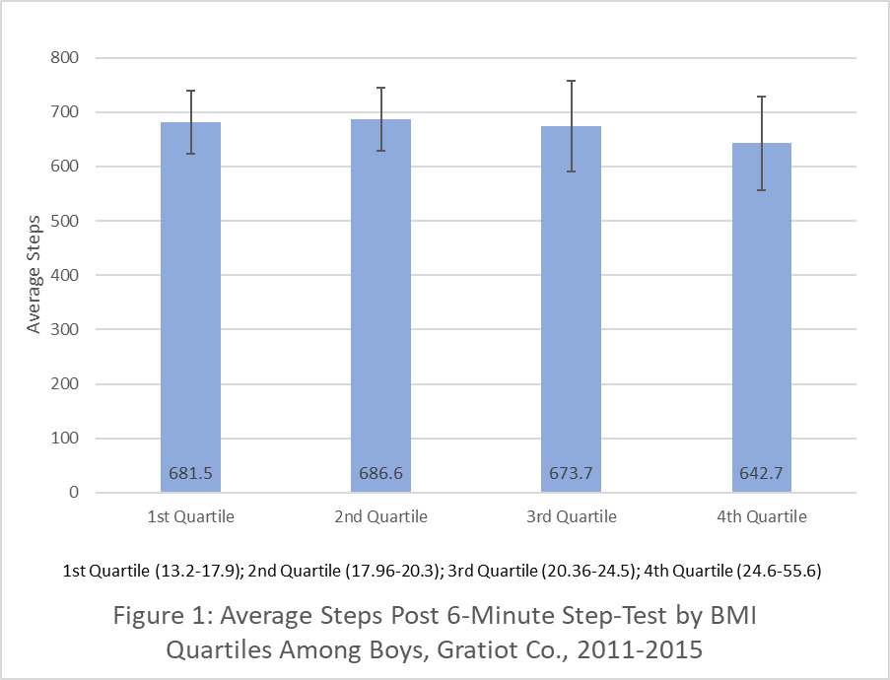
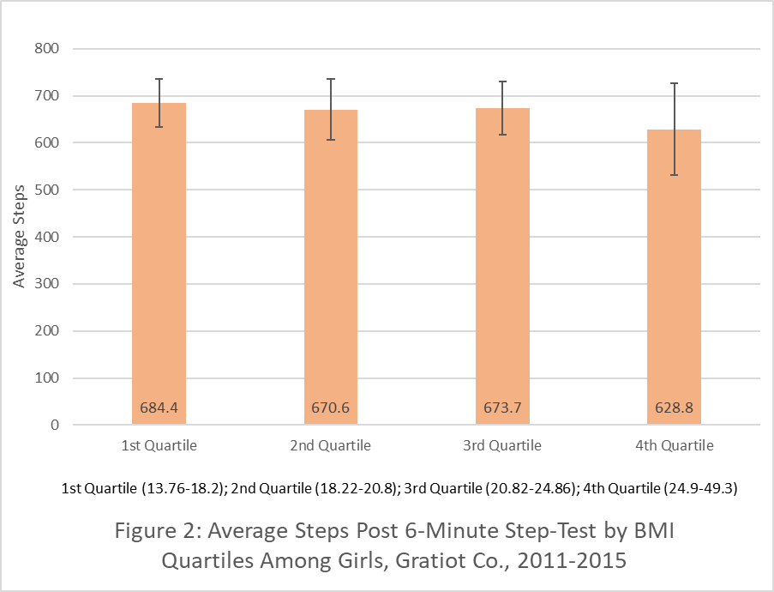
Average Steps vs Body Mass Index

Slide 9
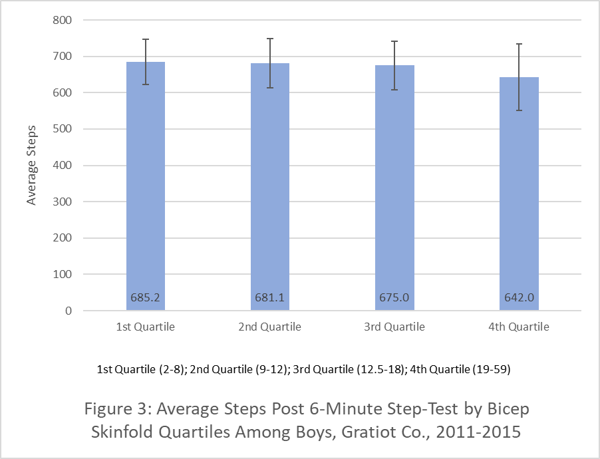
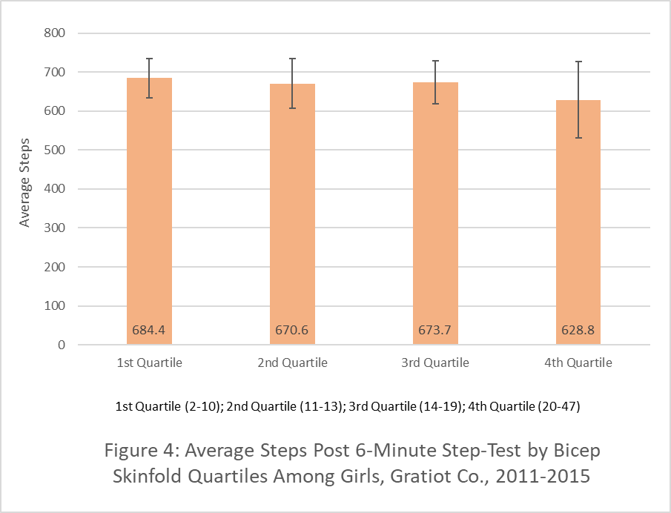
Average Steps vs Bicep Skinfold

Slide 10
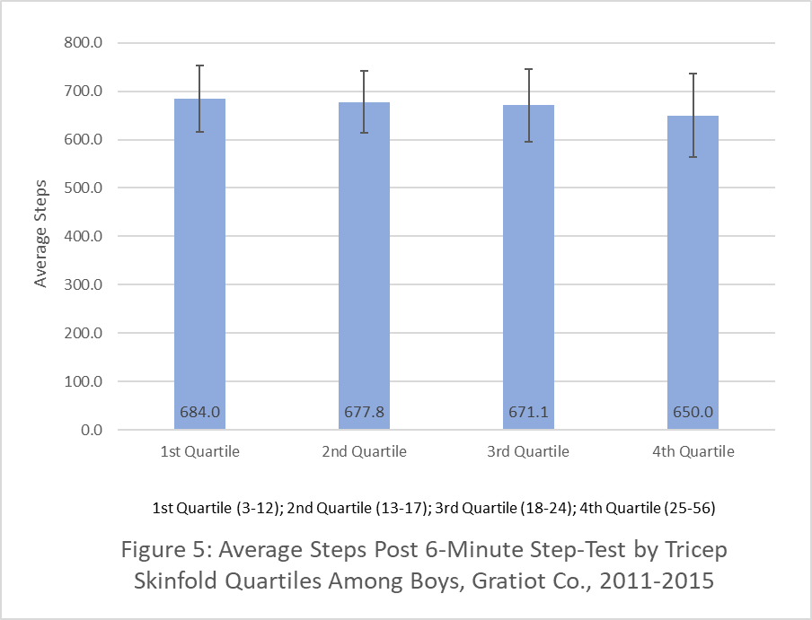
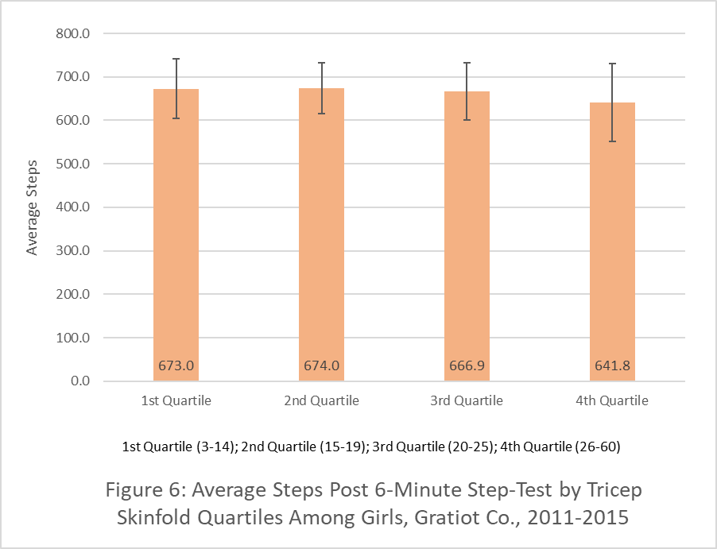
Average Steps vs Triceps Skinfold

Slide 11
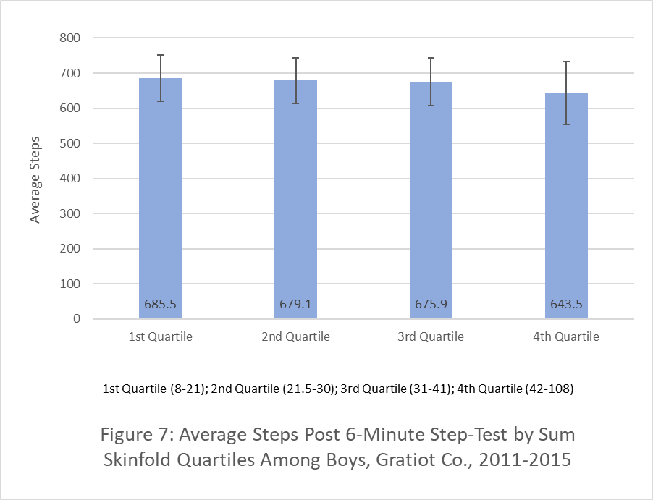
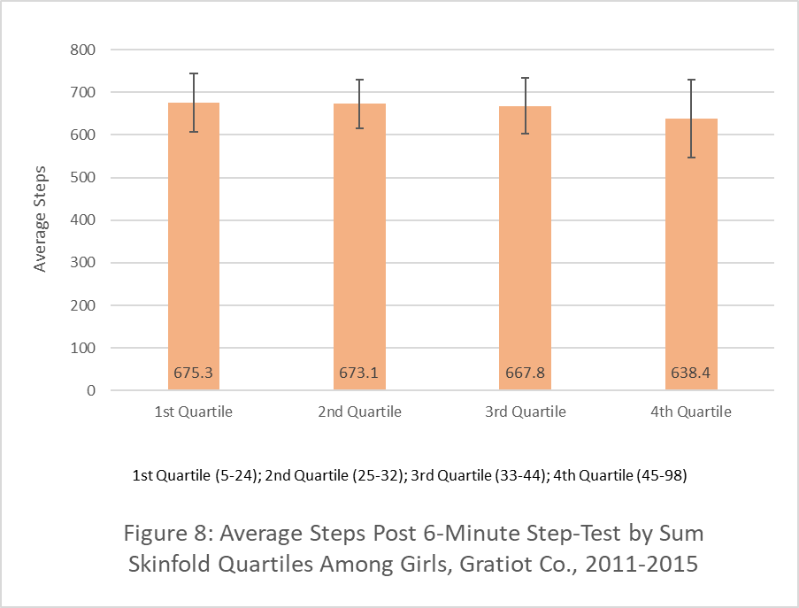
Average Steps vs Summative Skinfold

Slide 12
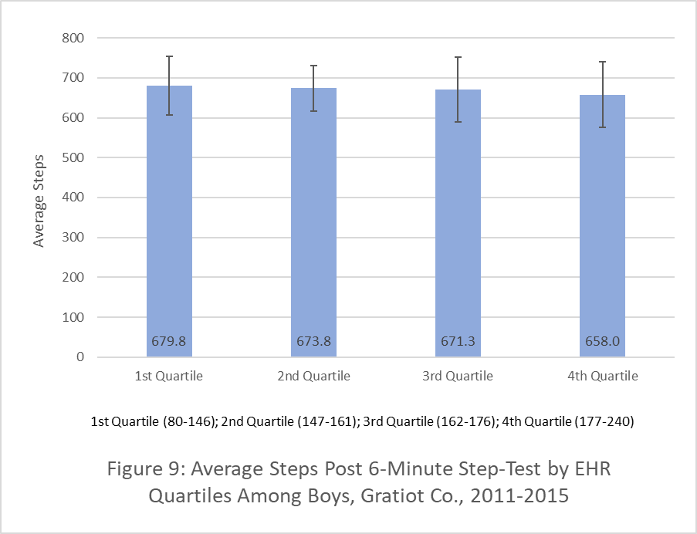
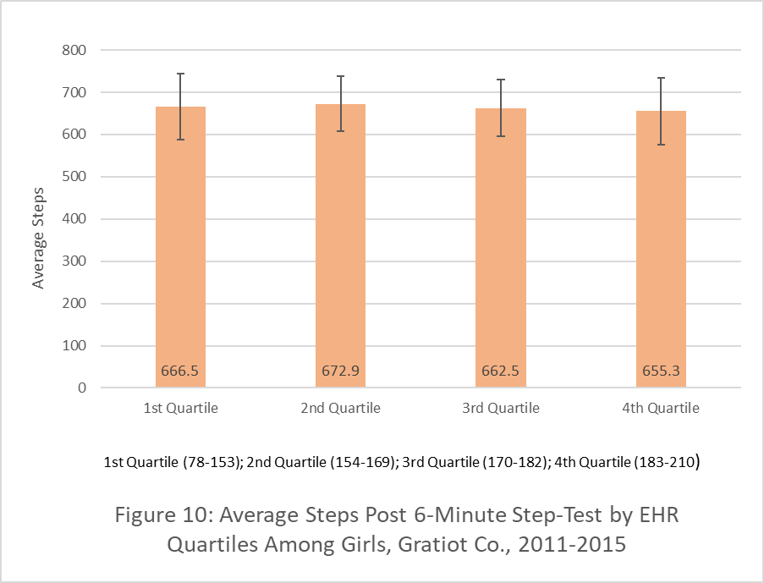
Average Steps vs Exercise Heart Rate

Slide 13
Results - Boys
BMI - X²(3)=61.582, p=0.000
Bicep skinfold - X²(3)=61.985, p=0.000
Triceps skinfold - X²(3)=38.458, p=0.000
Sum skinfold - X²(3)=61.351, p=0.000
EHR - X²(3)=10.404, p=0.015
Reject null hypothesis; there is a difference in the average number of steps between all variables according to their quartiles

Slide 14
Results - Girls
BMI - X²(3)=76.294, p=0.000
Bicep skinfold - X²(3)=39.023, p=0.000
Triceps skinfold - X²(3)=33.709, p=0.000
Sum skinfold - X²(3)=41.090, p=0.000
EHR - X²(3)=10.404, p=0.015
Reject null hypothesis; there is a difference in the average number of steps between all variables according to their quartiles

Slide 15
Discussion
Jankowski M. et al ¹
VO₂ max can be estimated in children using the step test
Excellent cardiorespiratory fitness: EHR of 95-102 bpm
Poor cardiorespiratory fitness: EHR greater than 142 bpm
Raistenskis J. et al – results from 6-minute walk test ²
Obese children engaged in moderate to vigorous activity 22.4 minutes less per day and walked 50.9m less on average than the normal-weight children

Slide 16
Discussion Cont.
Jankowski M. et al ¹
Study implication: excluded those whose EHR exceeded 180 bpm for more than 15 sec
Abu Hanifah R. et al ⁹
Inverse association between body composition measurements and HRR among healthy adolescents
Body composition measurements were correlated with HRR2min in girls and in boys all body composition, except BMI z-score, were associated with HRR2min

Slide 17
Strengths and Limitations
Strengths
Large population size
Kruskal Wallis and Mann Whitney U Tests
Missing data were removed
Limitations
Outliers
Skinfold inclusion

Slide 18
Future Recommendations
Youth Risk Behavior Survey
How many hours do you watch tv per day?
How many hours do you utilize the computer for reasons not related to schoolwork?
During the past 12 months, how many sports teams did you play?
How do you describe your weight?
Continued analysis of data between 2011-2015

Slide 19
References
1. Jankowski M, Niedzielska A, Brzezinski M, Drabik J. Cardiorespiratory fitness in children: a simple screening test for population studies. Pediatr Cardiol. 2015; 36:27-32. Doi: 10.1007/s00246-014-0960-0
2. Dorsey KB, Herrin J, Krumholz HM. Patterns of moderate and vigorous physical activity in obese and overweight compared with non-overweight children. Int J Pediatr Obes. 2011; 6(0):1-15. Doi: 10.3109/17477166.2010.490586
3. Centers for Disease Control and Prevention. About Child & Teen BMI. https://www.cdc.gov/healthyweight/assessing/bmi/childrens_bmi/about_childrens_bmi.html. Published June 29, 2020. Accessed November 11, 2020.
4. Raistenskis J, Sidlauskiene A, Strukcinskiene B, Ugur Baysal S, Buckus R. Physical activity and physical fitness in obese, overweight, and normal-weight children. Turk J Med Sci. 2016; 46(2):443-450. Doi: 10.3906/sag-1411-119
5. Carson V, Hunter S, Kuzik N, et al. Systematic review of sedentary behaviour and health indicators in school-aged children and youth: an update. Appl Physiol Nutr Metab. 2016;41(6 Suppl 3):S240-S265. doi:10.1139/apnm-2015-0630
6. Fakhouri TH, Hughes JP, Burt VL, Song M, Fulton JE, Ogden CL. Physical activity in U.S. youth aged 12-15 years, 2012. NCHS Data Brief. 2014;(141):1-8. PMID: 24401547
7. Trost SG, Pate RR, Sallis JF, et al. Age and gender differences in objectively measured physical activity in youth. Med Sci Sports Exerc. 2002; 34(2):350-355. Doi: 10.1097/00005768-200202000-00025
8. Arundell L, Fletcher E, Salmon J, Veitch J, Hinkley T. A systematic review of the prevalence of sedentary behavior during the after-school period among children aged 5-18 years. Int J Behav Nutr Phys Act. 2016; 13(1):93. Doi:10.1186/s12966-016-0419-1
9. Abu Hanifah R, Mohamed MNA, Jaafar Z, et al. The correlates of body composition with heart rate recovery after step test: an exploratory study of Malaysian adolescents. PloS one. 2013; 8(12): e82893. Doi: 10.1371/journal.pone.0082893

