Slide 1
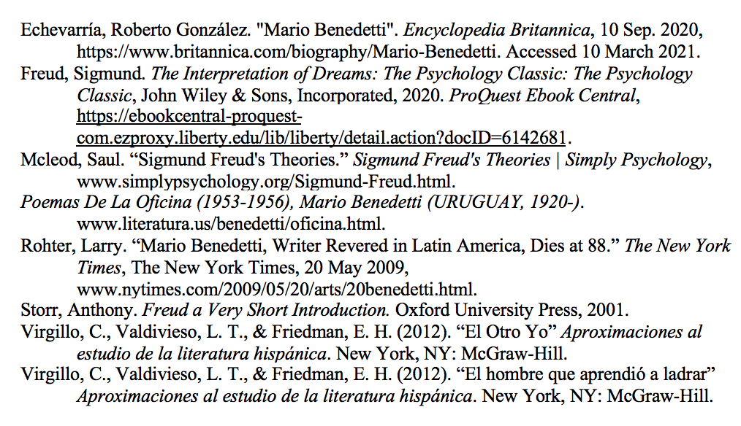
Identity Construction in the Work of Mario Benedetti
Grace Jennings
Abstract
The Repressed Id in Benedetti
Work | Representation of ID | VS | Conscious Self | Classification of Conscious self
“El Otro Yo” | Armando (vulgarity) |  | Otro Yo (public self) | Ego/Super ego
“El hombre que aprendió a ladrar” | Chaos of dog’s bark (Absurdity) |  | Linguistic Order (Rationality) | Ego
“Hermano” | True feelings of self |  | Family self | Super ego
“Ellos” | True, non-work self |  | Work self | Super ego
“El Otro Yo”
Summary:
“El Otro Yo” is a short story written by Benedetti in the year 1986. In the story the character, Armando, is described as being an ordinary boy in all aspects except for the fact that he has another self which prevents him from being his true self. Throughout the text, Armando seems to be presented as the “main” self, the Ego; however, once the “other self” is gone, it seems to reveal Armando as the Id, residing in the unconscious, as he is entirely acting upon instinct and impulse. After the other self is out of the picture, Armando is hardly recognizable as himself and is unable to express himself and feel the way he wants to feel or is actually feeling due to the fact that his “other self” had taken those emotions with him in his death.
Freudian concepts seen in “El Otro Yo”:
Armando = id
El Otro Yo = ego or possibly the super ego
Armando is seen as the id which is represented as vulgar in the story; whereas the other self is seen as the ego and is represented as moral. Throughout the story there is a clear battle between the id and the ego; this can also be expressed as an internal battle between vulgar self and true self. Throughout Benedetti’s works a duality of repressed self and true self can be seen at play.
Conclusion
Abstract:
Mario Benedetti, a native of Uruguay and a prolific writer, contributed vastly to the political context of Uruguay through his literary career. However, it was his twelve-year exile from Uruguay and ban of his work in his home country which forced him to grapple with forming his identity in spite of this and ultimately further connected his work to the hearts and lives of those who read his works developed before, during, and after this time. Several themes displayed in his work such as fate, oppression, love, and identity stem from his own life experiences, especially related to his being part of the Uruguayan middle class. This presentation will examine the life and work of Benedetti focusing on select poems and works of his as spaces where Benedetti experiments with themes of identity and identity construction. More specifically, within his works, Benedetti engages in processes of identity construction that echo Freudian concepts of self and the subconscious. The concept of “id”, “ego”, and “super-ego” used by Freud speak to the human psyche having more than one aspect, which highlights the complexity of identity. An examination of the concept of construction of identity in Benedetti’s life and works, especially through an understanding of Freudian concepts, offers a means to understand how Benedetti creatively incorporates undertones of multifaceted identity in his work.
Freudian Perspectives in Benedetti:
While many think Freud’s ideas solely impacted the realm of psychology, his theories and ideas can be traced to literature as well. Some of his concepts, specifically in the work of Benedetti, can inform literary analysis through his model of the id, ego, and superego, which comprise, for Freud, the three essential parts of the human personality.
These concepts, intertwined with the conscious, the subconscious, and the unconscious inform character development and identity throughout much of literature. Freudian themes in the work of Mario Benedetti, like repressed Id, the conscious vs. unconscious self, and even the absurd, reveal how Benedetti perceives identity as a conflict between selves, our desires, and the “morality” of the world we live in.
In “Hermano,” the poem presents the conflict between family dynamics. The description of the brother, while not openly hostile, seems to be resentful, nonetheless. The narrative voice represses the true feeling he has, not only because of family ties but potentially due to work and society implications.
“Ellos” highlights the difference between one’s work self (the self we present to others, one’s ego), and an internal, desiring self, which is likened to the id not shown to others. The repressed self in “Ellos,” like the id, knows it is hidden from the outside world, leaving only the work self to be seen, the ego.
“El hombre que aprendió a ladrar”
Summary:
In Benedetti’s short story “El hombre que aprendió a ladrar,” the main character is learning how to bark to be able express love through communication. The short story is written in a very matter-of-fact tone while describing the reasons as to why he is learning to bark. Ultimately, the main character is able to succeed in his learning to actually communicate through barking and not just imitate the sound of barking; however, in the end, it is suggested that he does need to work on his accent as his human accent is still coming through when he is barking.
Freudian Concepts seen in “El hombre que aprendió a ladrar”:
In this story there is a direct contrast between chaos and order which can also be expressed as the absurd vs. the rational . The absurd, or chaos, can be seen as the id which is in the realm of the illogical. This story takes an illogical concept and presents it in the most logical of ways (Freud 93).
Introduction
Benedetti:
Benedetti, a native of Uruguay and a prolific writer, was most well-known for his short stories. Born September 14, 1920, to a family of Italian immigrants, Benedetti began his literary career through poetry which quickly turned to short stories. By 1960 his works had not only become best sellers in Uruguay, but he had also become well known throughout Latin America (Rohter). However, beginning in 1973 he was exiled from Uruguay for twelve years by the military dictatorship due to his involvement with a political coalition; during this time his work was also banished from Uruguay (Rohter). Nonetheless, he spent these twelve years in Argentina, Peru, Cuba and Spain before returning to Uruguay in 1983. On May 17, 2009, Benedetti died in Montevideo, the place where he grew up as a young child (Echeverría).
Freud:
Sigmund Freud, an Austrian neurologist and the founder of psychoanalysis, is widely known for the mark he left on psychology. Born May 6, 1856, Freud’s life and ideas changed the field of phycology. He is most well-known for his psychoanalysis which is considered a method for treating mental illness as well as a theory which explains human behavior (Storr 6-15, 40-52, 132-141). Freud developed a topographical model for studying the mind to describe the conscious, the subconscious, and the unconscious; following this model he created a more structural model of the mind composed of the id, ego, and superego (Storr 57-63). On September 23, 1939, Freud died in Hampstead, London; however, his theories and ideas are still used today (Storr 132).
Future Work
As far as future work, examining other works of literature through the lens of psychology, more specifically, using Freud’s concepts of the id, ego, and super ego.
Further studying the works of Benedetti, perhaps focusing more on his larger works, such as novels to study running themes of identity throughout.
Making further connections between the life of Benedetti and his work, focusing specifically on his exile and if and or how that time impacted his style of writing.
“Hermano”
Qué suerte siempre iguales hermano vos y yo desde aquella alegría de nuestro primer sueldo siempre iguales hermano en las licencias en los aguinaldos en los ascensos en las comisiones siempre en el mismo cargo siempre en el mismo sueldo yo usando lo que sé brindando lo que tengo ecuaciones inglés teneduría alemán buena letra logaritmos yo usando lo que sé nada más nada menus vos prendido a la Oreja como una caravana.
“Ellos”
Ellos saben si soy o si no soy, ellos abren la puerta y dicen: «Pase», miran y relativamente son felices, endosan el destino como un cheque y eructan, aquíescentes, sin provocar a nadie. Ellos saben si soy o si no soy, por detrás de los dientes dicen: «Hola», hablan y relativamente son ingenuos y sencillos y escupen y recelan y traspiran a veces en dos dedos de frente. Ellos saben si soy o si no soy, ellos cierran la mano y dicen: «Pero» viven y relativamente son milagros y sueldo y providencia y mal aliento y gastan por docenas los pañuelos sin lágrimas. Ellos saben si soy o si no soy, ellos miran al cielo y dicen «¿Cuánto?», pasan y relativamente son nombrados, pero yo, como ellos me instruyeron, no digo ni caramba ni ahí te pudras.
1 2 3 4 5 6 7 8 9 10 11 12 13 14
1 2 3 4 5 6 7 8 9 10 11 12 13 14
Key Concepts (Methods)
A
B
References
Id:
Based mainly around instincts
Operates on the Pleasure Principle
Entirely unconscious
Ego:
Based mainly around reality
Moderator between id and super-ego
Represents consciousness
Super-ego:
Ego-idea
Ideal and morals
Operates at a preconscious level
(Storr 57-63, 142)
Levels of consciousness:
Conscious:
-Thoughts and feeling we are aware of
Preconscious:
-Thoughts and memories easily retrieved
Unconscious:
-Cannot access
-Exposed in dreams, Freudian slips
(Storr 59-60)
(Frued xi-xii, 354)
C
Key: “Hermano”
Self: yellow
Brother: blue
Actions of self: green
Actions of brother: pink
Identical qualities: gray
Key: “Ellos”
Thoughts of the others: yellow
Expressions of the others: blue
Actions of the others: green
Descriptions of the others: pink
Self: gray

