Slide 1
A Collective Case Study of Factors That Promote Academic Motivation Among High-Performing Economically Disadvantaged Middle School Students
Gregory Shields, Ph.D.
Oral Presentation
For
Liberty University Research Week 2021

Slide 2
Introduction
Economically disadvantaged students Breger, 2017
Lack motivation and self-confidence Cavilla, 2017
Low academic achievement Li et al., 2017
Limited research: factors that promote academic motivation Hegedus, 2018
Theoretical connections
Deci and Ryan’s Self-Determination Theory (1985; 2000; 2017)
Bandura’s Self-Efficacy Theory (1986; 1997)

Slide 3
Rationale for Study
Number of economically disadvantaged students in Georgia
GOSA, 2019
Economically disadvantaged students and academic achievement
GOSA, 2019
Indicators of academic achievement unknown
Therefore, I proposed this study to explore factors that promote academic motivation among high-performing, economically disadvantaged middle school students.

Slide 4
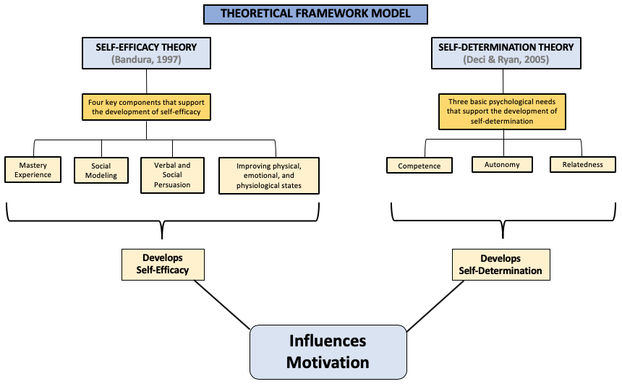
Theoretical Framework Model

Slide 5
Related Literature
Socioeconomic Status:
Neighborhood poverty highly predicts children's academic achievement Mast, 2018
Structural and psychological factors influence student achievement Galster et al., 2016
Motivation and Engagement:
Student engagement and academic achievement Boberg & Bourgeois, 2016
Student Resilience:
Defining student resilience Bender and Ingram, 2018
Students of poverty, resilience, and academic achievement Sattler and Gershoff, 2019
Parent Involvement:
Defining parental involvement Hill et al., 2016
Parental involvement contributes to improved academic outcomes Duppong-Hurley et al., 2018

Slide 6
Related Literature
Positive Learning Environment:
Defining a positive learning environment Hopland & Nyhus, 2016
Positive learning environment promote student motivation and achievement Premo et al., 2018
Teacher-Student Relationship:
Positive outcomes for at-risk students McFarland, et al., 2016
Teacher-student relationship and student motivation Wentzel & Ramani, 2016
Peer-Relationship:
Impacts students’ academic development Ariani, 2017
Emotional and behavioral engagement in the classroom Koca, 2016
School Programs and Extra-Curricular Activities:
Positive impacts on student motivation Foster & Jenkins, 2017

Slide 7
Research Question
Central Question: What factors promote academic motivation among high-performing, economically disadvantaged middle school students?
Sub-question One: What intrinsic factors influence the academic motivation of high-performing, economically disadvantaged middle school students?
Sub-question Two: What extrinsic factors influence the academic motivation of high-performing, economically disadvantaged middle school students?

Slide 8
Research Design
Research Site:
Inner-city
Title I School
Grades 4-8
Sample:
Criterion-Based Purposeful sampling Creswell & Poth, 2018
Sample size:
28 Participants (9 students, 8 teachers, 11 parents)
Participant Selection
Title 1 school
80% or better GPA
Free and Reduce Lunch program
Guidance Counselor selected
Time frame:
Data Collection: 4 weeks
Data Analysis: 6 weeks

Slide 9
Methodology
Method:
Qualitative Creswell & Poth, 2018
Design:
Collective Case Study Yin, 2018
Data Collection:
Interviews Yin, 2018
Teachers
Parents
Focus group Yin, 2018
students

Slide 10
Data Analysis and Triangulation of Findings
A holistic analysis approach Creswell & Poth, 2018; Yin, 2018
Data was triangulated Yin & Campbell, 2018
Participants Perspectives
Student Focus Group
Individual Parent Interviews
Individual Teacher Interviews

Slide 11
Research Findings
Classroom Environment
Encouragement received from the teacher
Parental Involvement
Parent as volunteer within the school
Community Partners and Organizations
Recreational Programs
School-connectedness
Variety of learning models
Being accepted by others
Support from school staff
Student Goals and Determination
Aspirations to attend college
Teacher challenging students
Parent and teacher relationship
Value of education
Tutoring Programs
Faith-based Organizations
Participate in school activities
Way out of poverty

Slide 12
Delimitations & Limitations
Delimitations:
sampling approach used for identifying potential participants
Limitations:
the willingness of parents to participate
availability of fathers as participants

Slide 13
Recommendations for Future Research
Expanding the research to include perceptions from participants at the elementary and high school levels
Obtain the perceptions of building-level administrators
Explore the experiences and perceptions of high school seniors and first-year college students identified as economically disadvantaged.

Slide 14
Questions?

Slide 15
References
Ariani, D. (2017). Do social relationship affect motivation? Advances in Management & Applied Economics, 7(3), 63-91.
Bandura, A. (1986). Social foundations of thought and action: A social cognitive theory. Englewood Cliffs, NJ: Prentice-Hall.
Bandura, A. (1997). Self-efficacy: The exercise of control. W H Freeman/Times Books/ Henry Holt & Co.
Bender, A., & Ingram, R. (2018). Connecting attachment style to resilience: Contributions of self-care and self-efficacy. Personality and Individual Differences, 130(6), 18-20.
Boberg, J. E., & Bourgeois, S. (2016). High-achieving, cognitively disengaged middle level mathematics students: A self-determination theory perspective. Research in Middle Level Education, (39)9, 1-18.
Breger, L. (2017). Poverty and student achievement in Chicago public schools. The American Economist, (62)2, 206 –21.
Cavilla, D. (2017). The effects of student reflection on academic performance and motivation. SAGE Open, 7(3), 215824401773379. https://doi.org/10.1177/2158244017733790
Creswell, J. W., & Poth, C. N. (2018). Qualitative inquiry & research design: Choosing among five approaches. Los Angeles: SAGE.

Slide 16
References
Deci, E. L., & Ryan, R. M. (1985). General causality orientations scale. PsycTESTS Dataset. https://doi.org/10.1037/t06606-000
Deci, E.L., & Ryan, R. M. (2000). Intrinsic and extrinsic motivations: Classic definitions and new directions. Contemporary Educational Psychology, 25(1), 54–67. https://doi.org/10.1006/ceps.1999.1020
Deci, E.L., & Ryan, R. M. (2017). Self-determination theory: Basic psychological needs in motivation, development, and wellness. New York, NY, US: Guilford Press.
Duppong-Hurley, K. L., Lambert, M. C., & Huscroft D’Angelo, J. N. (2018). Comparing a framework for conceptualizing parental involvement in education between students at risk of emotional and behavioral issues and students without disabilities. Journal of Emotional and Behavioral Disorders, 27(2), 67–75. https://doi.org/10.1177/1063426618763112
Foster, E. M., & Marcus Jenkins, J. V. (2017). Does participation in music and performing arts influence child development? American Educational Research Journal, 54(3), 399–443. https://doi.org/10.3102/0002831217701830

Slide 17
References
Galster, G., Santiago, A., & Stack, L. (2016). Elementary school difficulties of low-income Latino and African American youth: The role of geographic context. Journal of Urban Affairs, 38(4), 477–502. https://doi.org/10.1111/juaf.12266
Governor’s Office of Student Achievement, (2019). Accountability report card. Retrieved from https://gosa.georgia.gov/report-card-dashboards-data/report-card
Hegedus, A. (2018). Evaluating the relationships between poverty and school performance. NWEA Research.
Hill, N. E., Witherspoon, D. P., & Bartz, D. (2016). Parental involvement in education during middle school: Perspectives of ethnically diverse parents, teachers, and students. The Journal of Educational Research, 111(1), 12–27. https://doi.org/10.1080/00220671.2016.1190910
Hopland, A. O., & Nyhus, O. H. (2016). Learning environment and student effort. International Journal of Educational Management, 30(2), 271–286. https://doi.org/10.1108/ijem-05-2014-0070
Koca, F. (2016). Motivation to learn and teacher–student relationship. Journal of International Education and Leadership, 6(2).

Slide 18
References
Mast, B. (2018). School performance of schools assigned to HUD-assisted households. US Department of Housing and Urban Development, 20(3), 189–222.
McFarland, L., Murray, E., & Phillipson, S. (2016). Student–teacher relationships and student self-concept: Relations with teacher and student gender. Australian Journal of Education, 60(1), 5–25. https://doi.org/10.1177/0004944115626426
Premo, J., Cavagnetto, A., & Lamb, R. (2018). The cooperative classroom environment measure (CCEM): Refining a measure that assesses factors motivating student prosociality. International Journal of Science and Math Educators, 16(2), 677–697.
Wentzel, K. R., & Ramani, G. (2016). Handbook of social influences in school contexts: social-emotional, motivation, and cognitive outcomes. London: Routledge.
Yin, R. K. (2018). Case study research and applications: Design and methods (6th ed.). Thousand Oaks, California: Sage Publications, Inc.

