Slide 1
Using Task-Based Language Teaching to Contextualize Culture and Improve Spelling for Arabic-Speaking English Language Learners
Ekaterina Batishcheva

Slide 2
Statement of the problem
Arabic-Speaking English language learners (ASELLs) may struggle with correct spelling and upholding cultural standards of politeness/intercultural competence.

Slide 3
Purpose of the study
The purpose of this proposed experimental study is to test how effective metapragmatic Task-Based Language Teaching (TBLT) instruction is in improving ASELLs’ spelling and intercultural competence.

Slide 4
Research Hypotheses
H₀1: The spelling post-test results of ASELLs who received differentiated TBLT instruction is not significantly different than the post-test results of those who receive regular instruction.
H₀2: The intercultural competence post-test results of ASELLs who received differentiated TBLT instruction is not significantly different than the post-test results of those who receive regular instruction.

Slide 5
Background

Slide 6
Differences in Writing
English
Arabic
Latin alphabet
Left to right
Capitalization
26 graphs
Arabic abjad
Right to left
Lack of capitalization
28 graphs
.هذه جملة
This is a sentence.

Slide 7
Spelling Errors
More total errors than other groups of ELLs
More vowel errors than consonant errors
(Deacon, 2017, p.10)

Slide 8
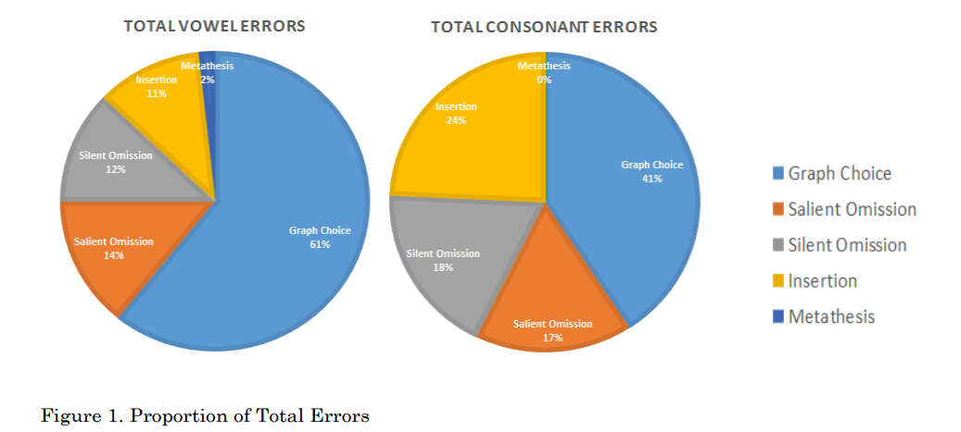
Spelling Errors, cont.
Grapheme to Phoneme Correspondence (GPC)
(Deacon, 2017, p.14)

Slide 9
GPC in English
Grapheme
Phonemes
5 graphs that represent
21 graphs that represent
~11 vowels, ~8 diphthongs
~24 consonants
Notes:
The English system is, thus, a deep system because of the number of digraphs and the variable mapping of phonemes to graphemes, especially for vowels.

Slide 10
GPC in Arabic
Grapheme
Phonemes
28 graphs that represent
3 graphs that represent
(3 diacritics that represent
28 consonants
3 long vowels
3 short vowels)
Notes:
The Arabic system is relatively shallow with more consistent grapheme to phoneme correspondences (GPCs). ALEs may not be accustomed to matching variable graphemes with a particular phoneme as is required in English.

Slide 11
Pragmatic Failure
“the inability to understand ‘what is meant by what is said’” Thomas (1983, p. 91)
“whenever two speakers fail to understand each other’s intentions” Blum-Kulka & Olshtain (1986, p. 166)
Notes:
Thomas (1983: 91) Blum-Kulka y Olshtain (1986: 166)
Thomas, J. (1983). “Cross Culture Pragmatic Failure”, Applied Linguistics, 4(2).
Pragmalinguistic failure:
the pragmatic force of a linguistic structure is different from that normally assigned to it by a native speaker.
Sociopragmatic failure:
the different intercultural perceptions of what constitutes appropriate linguistic behaviour.

Slide 12
Expressing Requests
English
Arabic
Negative face
Less direct
Conditional statements
Past modals: could, would, might
Positive face
More direct
Imperatives
Present modals mostly: can, will, may

Slide 13
Expressing Requests, cont.
English
Arabic
“Can you wait for me so we can go together?”
“Help yourself”
“Can you please open the window?
“Don't go alone, wait for me”
“We want you to have dinner with us”
“Open the window”

Slide 14
Examples
“We want you to have dinner with us… Join us for God's sake… Come eat with us.”
"I swear by Allah I will not accept your invitation next time if you do not join me. I ask you by Allah name not to refuse my invitation… Join us for God's sake... I swear by God, you eat.”
"I swear to divorce my wife if you do not eat"

Slide 15
Differentiated instruction for ASELLs
Understand the student population
Filter the instructions
Increasing student’s participation
Consider value clarification as a teaching method
Keep a teaching journal
(Raza, 2018)
Notes:
“[T]he needs of Arab students differ from others linguistically, culturally, and educationally”
(Raza, 2018, p. 19)

Slide 16
Methodology
Task-Based Language Teaching
Communicative Language Teaching
Meaning is primary.
Real-world activities
Task completion is prioritized
The assessment in terms of outcome

Slide 17
Teaching Politeness ?
Politeness is culture-specific
Choice to be either polite or impolite
Explicit metapragmatic instruction facilitates the development of pragmatic abilities
Notes:
Politeness is a socio-cultural linguistic phenomenon that is culture-specific therefore, the conception, and the degree of politeness "are not the same among different cultures, and thus the different perceptions on politeness may lead to misunderstandings and conflicts in intercultural interactions" (Ae Yu, 2011, p. 386).
"Rather than being taught to be polite, learners should be given the possibility of choosing to be either polite or impolite". (Davies, 1986: 121)
Kasper & Schmidt (1996: 160) say "pragmatic knowledge should be teachable”.

Slide 18
Thank you!

Slide 19
References
Blum-Kulka, S. (1982): “Learning to Say what you Mean in a Second Language: A Study of the Speech Act Performance of Learners of Hebrew as a Second Language”. Applied Linguistics 3 (1): 29-59.
Council of Europe. (2020). Common European Framework of Reference for Languages: Learning, Teaching, Assessment (CEFR). https://www.coe.int/en/web/common-european-framework-reference-languages
Cultural Intelligence Center. (2020). CQ Pro Feedback Report (pp. 1-22, Rep.). Grand Rapids, MI: Cultural Intelligence Center.
Davies, E. (1986): “Politeness and the Foreign Language Learner”. Anglo-American Studies 6: 117-130.
Deacon, R. J. (2017). The causes of spelling errors by Arabic learners of English. Eurasian Journal of Applied Linguistics, 3(2), 1-22. http://ezproxy.liberty.edu/login?qurl=https%3A%2F%2Fwww.proquest.com%2Fdocview%2F2265866771%3Faccountid%3D12085
Elachachi, H. H. (2015). Exploring cultural barriers in EFL Arab learners’ writing. Procedia - Social and Behavioral Sciences, 199, 2015, Pages 129-136, ISSN 1877-0428, https://doi.org/10.1016/j.sbspro.2015.07.496.
Fernández Amaya, L. (2008). Teaching culture: Is it possible to avoid pragmatic failure? Revista Alicantina De Estudios Ingleses, (21), 11-24. doi:10.14198/raei.2008.21.02
Ghazzoul, N. (2019). Linguistic and pragmatic failure of Arab learners in direct polite requests and invitations: A cross-cultural study. Theory and Practice in Language Studies, 9(2), 223-230. http://dx.doi.org/10.17507/tpls.0902.13
Hill, J., & Björk, C. L. (2008). Classroom instruction that works with English language learners: Participant's workbook. Alexandria, VA: Association for Supervision and Curriculum Development.
Kasper, G. and Schmidt, R. (1996): “Developmental Issues in Interlanguage Pragmatics”. In G. Kasper, ed., The Development of Pragmatic Competence. SSLA 18 (2): 149-170.

Slide 20
References
Prabhu, N. S. (1987). Second Language Pedagogy. Oxford University Press. Retrieved 18 January 2013.
Raza, K. (2018). Adapting Teaching Strategies to Arab Student Needs in an EFL Classroom. Journal of Ethnic and Cultural Studies, 5(1), 16-27. http://ezproxy.liberty.edu/login?qurl=https%3A%2F%2Fwww.proquest.com%2Fdocview%2F2131780542%3Faccountid%3D12085
Rifai, D., & Haddad, M. (2015, March 17). What's left of Syria? Al Jazeera https://www.aljazeera.com/news/2015/03/17/whats-left-of-syria/.
Rula, F. B. (2013). On Congratulating, Thanking, and Apologizing in Jordanian Arabic and American English. Journal of Intercultural Communication, (32) http://ezproxy.liberty.edu/login?qurl=https%3A%2F%2Fwww.proquest.com%2Fdocview%2F1703413162%3Faccountid%3D12085
Ryan, A., & Meara, P. (1991). The case of the invisible vowels: Arabic speakers reading English words. Reading in a foreign language, 7, 531-531.
Sadock, J. (1970). Studies Presented to Robert B. Lees by His Students, Whimperatives (14 ed), Linguistic Research, Inc..
Starschenko, A. and Wierzba, M. (2020). L-Rex: Linguistic rating experiments [software], version 0.8, GNU General Public License v3.0, https://github.com/2e2a/l-rex/.
Thomas, J. (1983). “Cross-Cultural Pragmatic Failure”, Applied Linguistics, 4(2).
Todd, Z. (2019, November 19). By the Numbers: Syrian Refugees Around the World. Retrieved November 27, 2020, from https://www.pbs.org/wgbh/frontline/article/numbers-syrian-refugees-around-world/
Wierzbicka, A. (2003). Cross-cultural pragmatics: The semantics of human interaction. Berlin, Germany: Mouton de Gruyter. (Print)
Yu, K. (2011). Culture-specific concepts OF politeness: Indirectness and politeness in English, Hebrew and Korean requests. Intercultural Pragmatics, 8(3). doi:10.1515/iprg.2011.018

