Slide 1
Social and Behavioral Risk Factors of Sexually Transmitted Infections in Community College and University Female Students
by
Olufunmilayo .A. Babarinde MPH Candidate, Ewa Makowka MPH Candidate, Oswald Attin, PhD

Slide 2
Background
Prevalence of STIs continues to increase globally.^{1,2}
Common infections include gonorrhea, syphilis, chlamydia and trichomoniasis^{1,2}
More than one million cases occur daily globally including teens and young adults¹
Health and economic impacts accrue from prevalent STIs^{1,2}

Slide 3
Broad Problem
The United States, like other countries, experiences continuous rise in sexually transmitted infections (STIs), especially among college-aged young adults.³
For the year 2018, one fifth of U.S. residence had a particular STI.³
STI healthcare cost for 2018 was estimated at $16billion ^{2,4}

Slide 4
Specific Problem
An estimated 26million new cases of STI were reported for the year 2018 and almost 50% of these were young adults aged between 15 and 14years. ^{3,4}
Even though this age group accounts for only 27% of the population that is sexually active, they are disproportionately affected by STIs in comparison to other age groups.^{4,5}
The college years account for most of this time frame and, for many biological, behavioral, and cultural reasons, this age group is at a much higher risk of STI infection

Slide 5
Purpose of Study
Whereas college environments foster behaviors favorable for STI contraction, limited research compare risky sexual behaviors between institutional type
The purpose of this study is to:
compare female students’ engagement in behavioral risk factors for STIs between a 4-year university and a 2-year community college to determine the impact of institutional setting on risky sexual behavior.

Slide 6
Methods _{1 of 3}
A cross-sectional study design was adopted for this study
A sample size of 143 female students aged 18 -24 years were purposively recruited from a community college (n=68) and 4-year university (n=75) in central Florida.
Self-administered questionnaires were used to collect data on socioeconomic and behavioral risk factors associated with high incidence of STIs among college-age students.

Slide 7
Methods_{2 of 3}
Validation of the self-developed questionnaire had been done through a prior study and distribution was done to participants in sealed envelopes.^{6,7}
Survey questions focused on identifying socioeconomic and behavioral risk factors associated with high incidence of STIs among college-aged students.

Slide 8
Methods_{3 of 3}
Descriptive statistics was used to obtain summaries of demographics and risky behaviors.
Chi-square test and multiple regression analyses were performed to examine the association between research variables.
The Statistical Product and Service Solution (SPSS) software 20.0 was employed to analyze the results.

Slide 9
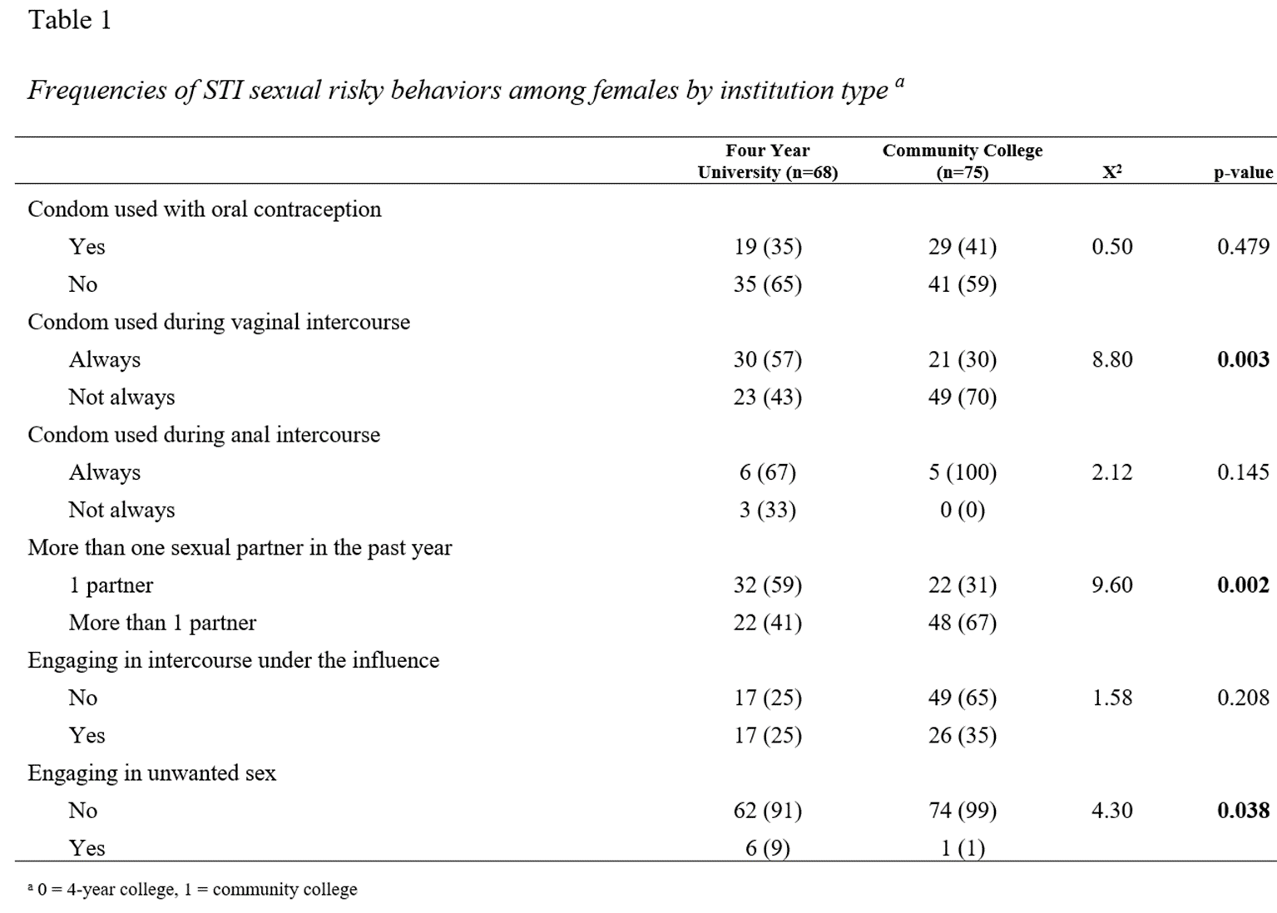
Results_{1 of 6}
Notes:
35% (n = 19) of females in the 4-year university used condoms compared to 41% (n = 29) of females in a 2-year community college (p = 0.479)

Slide 10
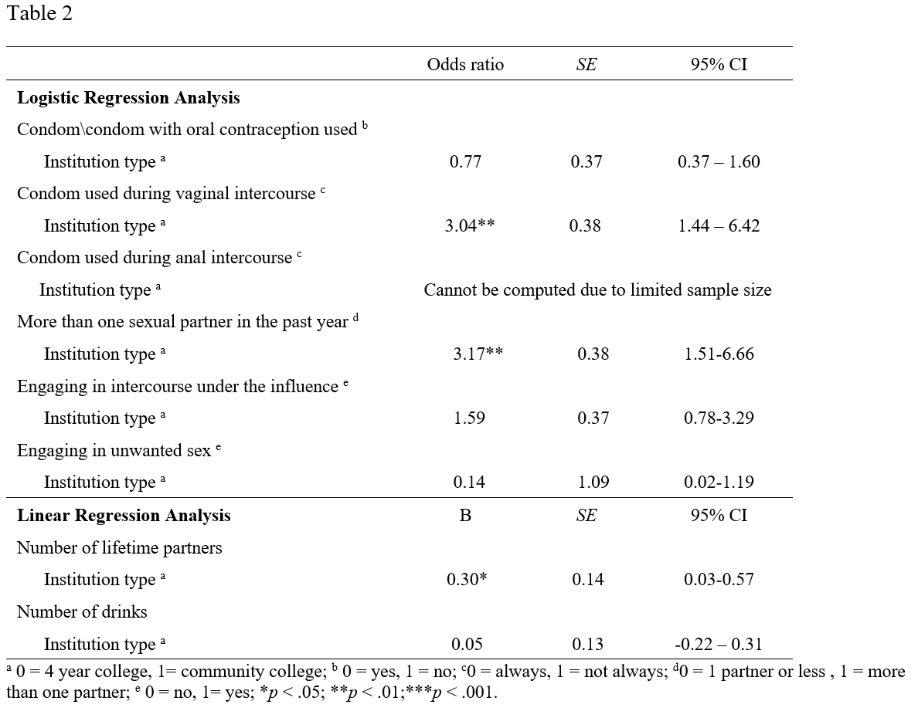
Results_{2 of 6}
Notes:
Females enrolled in a community college were three times more likely to report not always using a condom during vaginal intercourse (OR: 3.04; 95% CI: 1.44-6.43; p<0.01) than those enrolled in a 4-year university

Slide 11
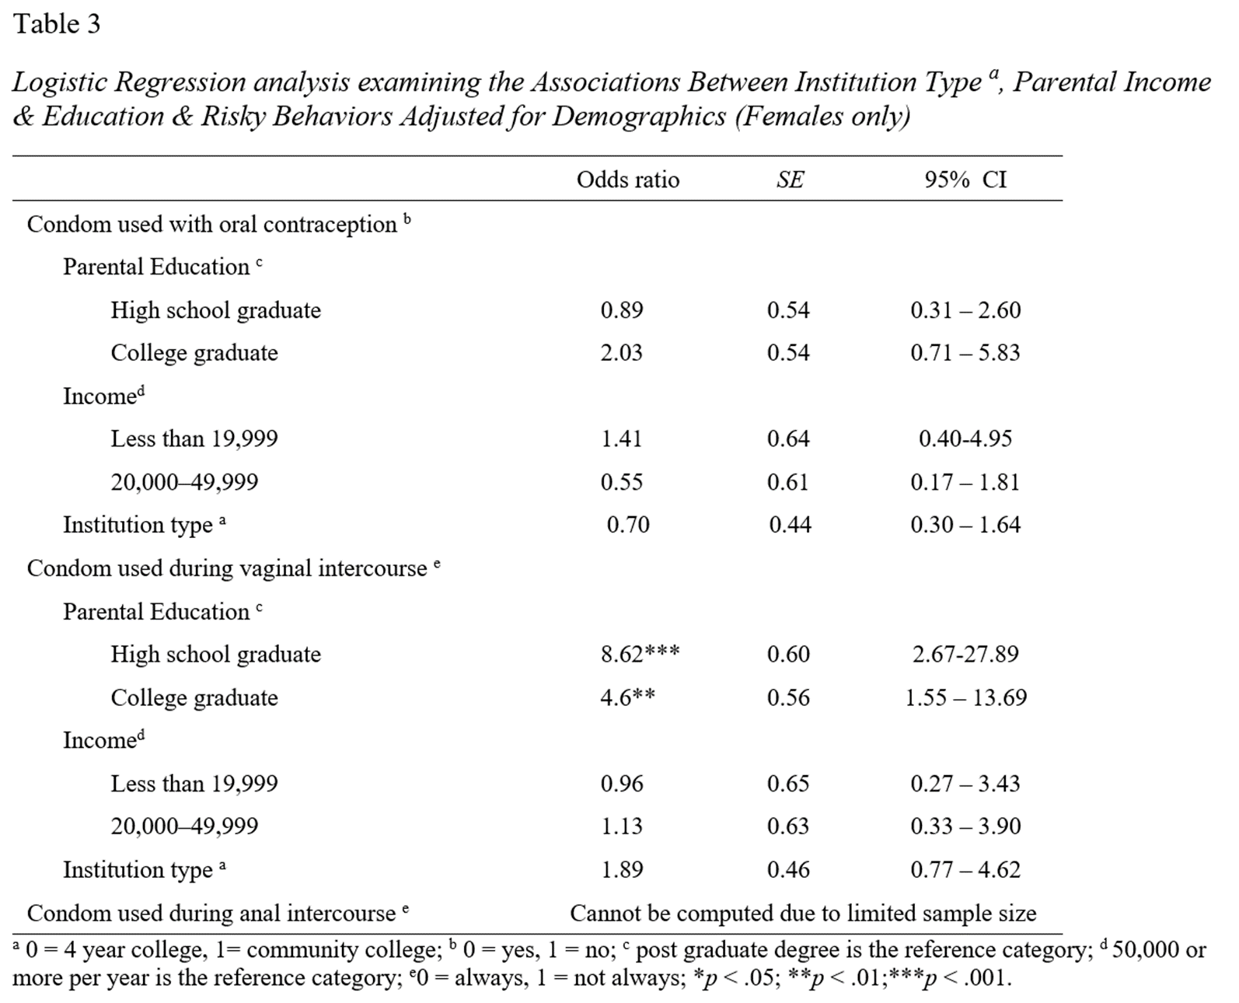
Results_{3 of 6}
Notes:
After controlling for socioeconomic status, no significant differences were observed between females attending community college and those attending 4-year universities for reported condom use.
Parental educational attainment was found to be a significant predictor of condom use during vaginal intercourse, (OR: 8.62; 95% CI: 2.67-27.89, p<0.001)

Slide 12
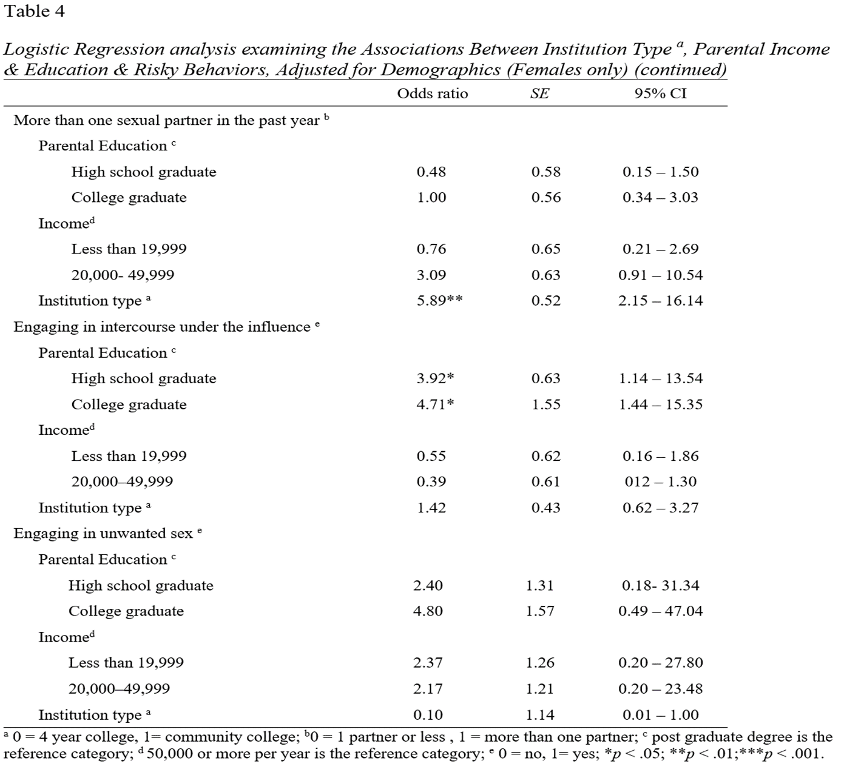
Results_{4 of 6}
Notes:
After controlling for parental socioeconomic status, females enrolled in a community college were nearly six times more likely to report more than one sexual partner within the past year (OR: 5.89; 95% CI: 2.15-16.14, p<0.01)
Neither parent’s educational attainment nor income status was a significant risk factor for number of sexual partners in the past year

Slide 13
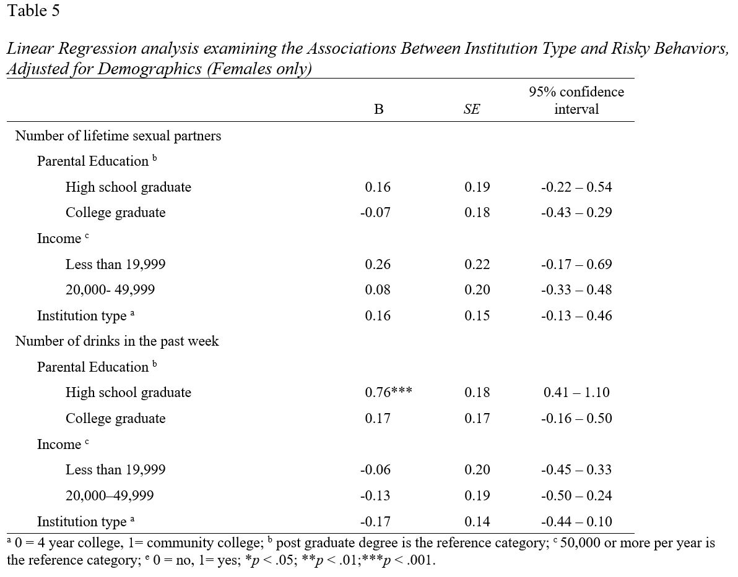
Results_{5 of 6}
Notes:
After controlling for parental education and income, there were no significance differences between enrolled in community colleges and those enrolled in 4-year universities for the number of lifetime partners or the number of reported drinks within the past week. Compared to females whose parents had a post graduate degree, females whose parents had a high school diploma reported on average, nearly 1.5 more drinks within the past week (OR = 0.76, 95% CI: 0.41 -1.10, P<0.001)

Slide 14
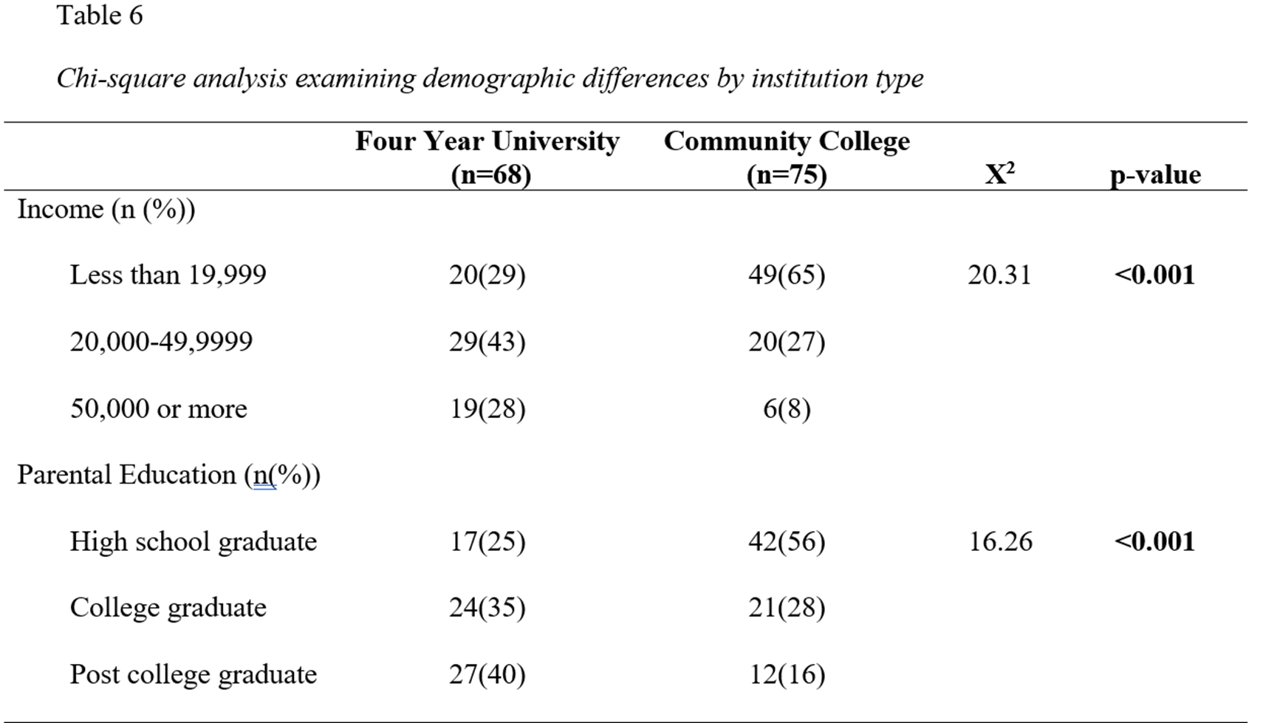
Results_{6 of 6}
Notes:
The results of the chi-square analysis indicated that female 18-24 years of age enrolled in a 2-year community college were more likely to have parents with lower income and lower educational attainment than those enrolled in a 4-year university. 75% of females in the 4-year University reported parents having a higher education at the graduate/ post level as compared to only 44% of 2-year community college students (p<0.001)

Slide 15
Discussion
The results showed that female students from both institutions displayed risky sexual behaviors that increased the probability of contracting STIs.
Female community college students had parents with a lower SES and lower degree of education in comparison to the 4-year university females.
Among students whose parents had a low educational attainment (i.e., high school diploma), the results indicated that condoms were not always used during vaginal intercourse, which demonstrates the effect of socioeconomic status on STI contraction. Several studies also highlight a lack of consistent condom usage among college students and is potential association with low income.^{8,9,10}

Slide 16
Conclusion
A potential correlation between student engagement in risky sexual behaviors and parents’ low socioeconomic status is depicted by study findings.
Programs to increase students’ awareness of STIs are essential in college institutions to tackle the STI problem among young adults.

Slide 17
Strengths and Limitation of Study
Strengths
Use of pre-validated questionnaire
Appropriate Study design
Advanced Statistical analyses
Limitation
Non-randomization
Purposive sampling

Slide 18
Recommendation
More in-depth studies to identify specific contributing factors low condom use, multiple sexual partners, poor drinking habits and more risk factors for different institution types.
Health education programs to increase students’ awareness of STIs should be instituted periodically in colleges and among young adults in communities.
Interventions should be implemented to attract students from diverse socio-economic groups

Slide 19
Biblical Rationale
This research is an investigative process to unveil the truth about contributing factors of risky sexual behaviors
“Buy the truth, and sell it not; also wisdom, and instruction and understanding”. Proverbs 23:23 (Kings James Version)
Control of risk factors is essential for successful sexual-purity and STIs prevention efforts.

Slide 20
Future Work
Findings would be used to inform future research and interventions aimed at designing targeted primary, secondary and tertiary preventive measures for reducing burden of STIs among young adults.

Slide 21
References
World Health Organization. Report on Global Sexually Transmitted Infections Surveillance, 2018. Available at https://apps.who.int/iris/bitstream/handle/10665/277258/9789241565691-eng.pdf?ua=1. Accessed March 15th, 2021.
Hull S, Kelley S, Clarke JL. Sexually transmitted infections: compelling case for an improved screening strategy. Popul. Health Manag. 2017;20(1):S1-S11. doi:10.1089/pop.2017.0132.
Scholly K, Katz AR, Cole D, Heck RH. Factors associated with adverse sexual outcomes among college students. AJHS. 2010; 25(4): 176.
United States Centers for Disease Control and Prevention. CDC Fact Sheet: incidence, prevalence, and cost of sexually transmitted infections in the United States. Available at www.cdc.gov/nchhstp/newsroom/docs/factsheets/2018-STI-incidence-prevalence-factsheet.pdf. Accessed March 14th, 2021.
Collado A, Johnson PS, Loya JM, Johnson MW, Yi R. Discounting of condom-protected sex as a measure of high risk for sexually transmitted infection among college students. Arch. Sex. Behav. 2017;46(7):2187-2195. doi: 10.1007/s10508-016-0836-x.
Attin OM. Comparing two-year community college and four-year university student social and behavioral sexually transmitted infection risk factors (doctoral dissertation). Walden University, 2012. Available from ProQuest Dissertations and Theses database. (UMI No. 3518537)

Slide 22
References
7. Lewis LM, Melton RS, Succop PA, Rosenthal SL. Factors influencing condom use and STD acquisition among African American college women. J Am Coll Health. 2000;49(1):19-23. doi: 10.1080/07448480009596278.
8. Fehr SK, Vidourek RA, King KA, Nabors, LA. Perceived barriers and benefits to condom use among college students. AJHS. 2017;32(4):219-233.
9. Fehr SK, Vidourek RA, King KA, Nabors LA. Relationship factors’ impact on condom use among college students. Sex Cult. 2018;22(1):724-739. https://doi.org/10.1007/s12119-018-9503-9.
10. Harling G, Subramanian SV, Barnighausen T, Kawachi I. Socioeconomic disparities in sexually transmitted infections among young adults in the United States: examining the interaction between income and race/ethnicity. STD. 2013;40(7): 575-581. doi:10.1097/OLQ.0b013e31829529cf.
11. Solomon. Holy Bible. King James Version. Available at https://biblehub.com/commentaries/proverbs/23-23.htm. Accessed March 15th, 2021

