Slide 1
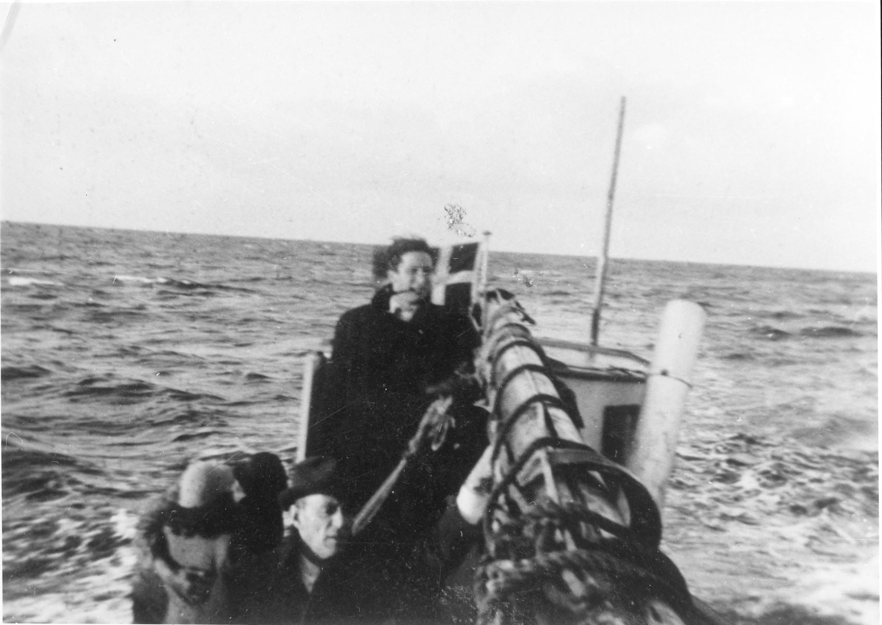
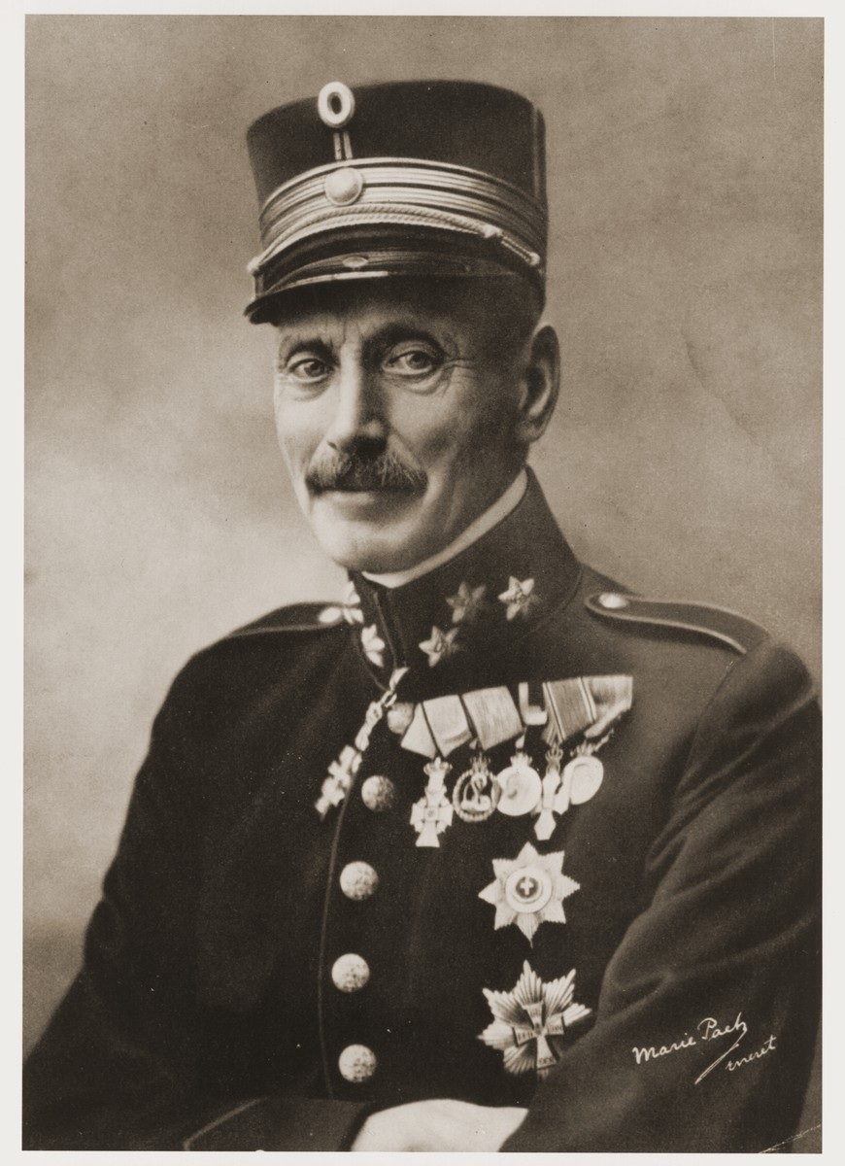
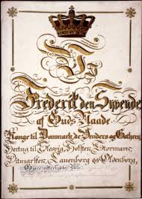
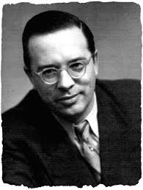
The Danish Exception: A Study of Human Equality During the Holocaust
Larisa C. Neilson
Abstract
This research sought to answer the question of why the Danish people treated their Jews differently than most all of Europe at the time of the Nazi Holocaust. The story of the Jewish exception in Denmark during World War II was a phenomenon not found in any other country on such a large scale. Approximately 99% of the Jews in Denmark survived the atrocities of World War II due to the collective help of the Danish population, and the support of the Swedish government in providing a safe haven for Jewish refugees. The reasons behind the Danish treatment of her Jews, was the driving force in this research. The findings suggest that the Danish people were not so much less Anti Semitic or against the persecution of the European Jews, so much as they were wholly and completely loyal to those who claimed Denmark as their home. Denmark has a rich history of governing itself with a priority on human rights and dignity, reaching back to their original constitution. However, these privileges were limited to those within the Danish national community. To be Danish triumphed over any other ethnic, religious, or political difference that individuals may have, and because of this the Danes would not abandon their Jewish brothers to the atrocities of the Nazi regime.
Methods
The most effective sources for historical resources are at the primary level. For research on the Holocaust, diaries/ personal accounts, and memoirs from survivors contain a wealth of information. Newspapers form the period were helpful in this research as well to show not only current events on a day-by-day basis, but also the climate into which the news was disseminated both during and after the war.
The Holocaust has been widely studied, and there are many wonderful secondary sources that greatly aided the research in this project.
Conclusion
The findings suggest that the Danish people were not so much less Anti Semitic or against the persecution of the European Jews, so much as they were wholly and completely loyal to those who claimed Denmark as their home. Denmark has a rich history of governing itself with a priority on human rights and dignity, reaching back to their original constitution. However, these privileges were limited to those within the Danish national community. Denmark rejected refugees not so much on a racial basis but on the economic basis of not seeing how they could help those outside of their sphere without disrupting their national community. To be Danish triumphed over any other ethnic, religious, or political difference that individuals may have, and because of this the Danes would not abandon their Jewish brothers to the atrocities of the Nazi regime.
Jewish Refugees Flee to Sweden in Fishing Boats
Many fishermen risked their lives using their boats and time to ferry Jewish families to Safety in Sweden
Available to use for research purposes. Retrieved from https://collections.ushmm.org/search/catalog/pa1066939
Immigration–Open or Closed?
Denmark had to face the issues of increasingly large numbers of refugees swarming out of Germany.
The Danish government restricted an influx of Jewish immigrants in order to prevent Denmark from having a ‘Jewish problem’ and creating an antisemitic atmosphere which lead to social instability.1
Denmark rejected refugees not so much on a racial basis but on the economic basis of not seeing how they could help those outside of their sphere without disrupting their national community.
King Christian X
Did much to protect the Jews living in Denmark by keeping the Nurmeburg Law persecution out of the country.
Available to use for research purposes. Retrieved from https://collections.ushmm.org/search/catalog/pa1099652
Future Work
There is room for more research on the personal experiences of Danish Resistors and Jews during this period. As the Holocaust is a broad topic with many facets to study, involving many countries and nationalities, customs and methods, there are still many areas left in which to research. Further research in this vein would include a comparison between cooperative countries and the treatment of Jews. Specifically, a juxtaposition of the Danish Jewish experience and the Hungarian Jewish experience.
No Persecution
After The German invasion and subsequent occupation (9 April. 1940) King Christian retained his monarchical position and the Danish Parliament was still active. This ruling power kept the Nuremburg Laws out of Denmark and away from the Danish Jews.
King Christian X of Denmark is said to have responded to Renthe-Fink’s phraseology “Jewish question” with, “There is no Jewish question in this country. There is only my people.”2
Danish custom of civil rights was established further in the year 1814 when the Danish Parliament passed a bill making “all racial and religious discrimination punishable by law.”2
The Danish people as a whole stood against persecution of Jewish people.
When warned about the round up of Jews set for 1 October 1943, almost the entire country came together to hide Jews and secure safe passage to Sweden.
Grundloven-1849-forside
Denmark’s constitution remains largely unaltered to this day and has many provisions for the freedom of religion and indiscrimination based on race and creed.
This work is in the public domain. Retrieved from https://en.wikipedia.org/wiki/Constitution_of_Denmark
References
1 Banke, Cecilie Felicia Stokholm. "Copenhagen- Refugees and Rescue: The Ambivalence of Danish Holocaust History." Humanity in Action. 2013. https://www.humanityinaction.org/knowledge_detail/copenhagen-refugees-and-rescue-the-ambivalence-of-danish-holocaust-history/ (accessed May 4, 2020)
2 Flender, Harold. Rescue in Denmark. New York: Simon and Schuster, 1963.
Ignatieff, Michael. "The Surprising Truth about Denmark in the Holocaust." NewStatesman. January 3, 2014. https://www.newstatesman.com/europe/2014/01/surprising-truth-about-denmark-holocaust (accessed May 3, 2020).
Jespersen, Knud J. V. A History of Denmark . New York: Palgrave Macmilan, 2004.
Petrow, Richard. The Bitter Years: The Invasion and Occupation of Denmark and Norway April 1940-May 1945. New York: William Morrow & Company, Inc., 1974.
Pundik, Herbert. In Denmark It Could Not Happen. Jerusalem: Gefen Publishing House, 1998.
Richards, Julian D. Vikings: A Very Short Introduction. Oxford: Oxford University Press, 2005.
The Danish Parliament. "The Constitutional Act of Denmark." FOLKETINGET. n.d. https://www.thedanishparliament.dk/en/democracy/the-constitutional-act-of-denmark (accessed May 3, 2020).
Victory, Valdemar. Jyske Law. Translated by Ole and Jansen, Christian R: Jydske Law in Modern Danish (1991) Fenger. 1241.
Yahil, Leni. "National Pride and Defeat: A Comparison of Danish and German Nationalism." Journal of Contemporary History, 1991: 453-478.
Resistance and Deportation
In the early years, many Danes sought to resist the Germans by harmless pranks, embarrassments, communal gatherings to keep alive the traditions and identity of their people.
Later, Resistance groups blew up railway lines, sacked factories, and formed fighting groups who were ready and waiting to rise up when the time came.
German plans to round up all Jews, drive them to the coast, and deport them to Theresienstadt.
Georg Duckwitz met with leading Social Democrat, Hans Hedtoft and the Danish Socialist Democratic Party to convey the news of the deportation, imploring them to pass the news to the Jewish community.
Most Jews found hiding places during the round up and were smuggled to Sweden over the next days and week.
Georg Ferdinand Duckwitz
Instrumental in warning the populace of the German plan to deport the Jews and is honored as Righteous Among the Nations for doing so.
Copyright © Jewish Foundation for the Righteous Use allowed for educational purposes. Retrieved from https://jfr.org/rescuer-stories/duckwitz-georg-ferdinand/
Notes:
Put in text boxes the background on Danish Gov, Conts
All points I want to high9light put into a box
Pictures
Thesis, etc
Nationalism
Only put the highlights of my references
The rubric does require a “methods” section so figure this out- highlight Primary sources

