Slide 1
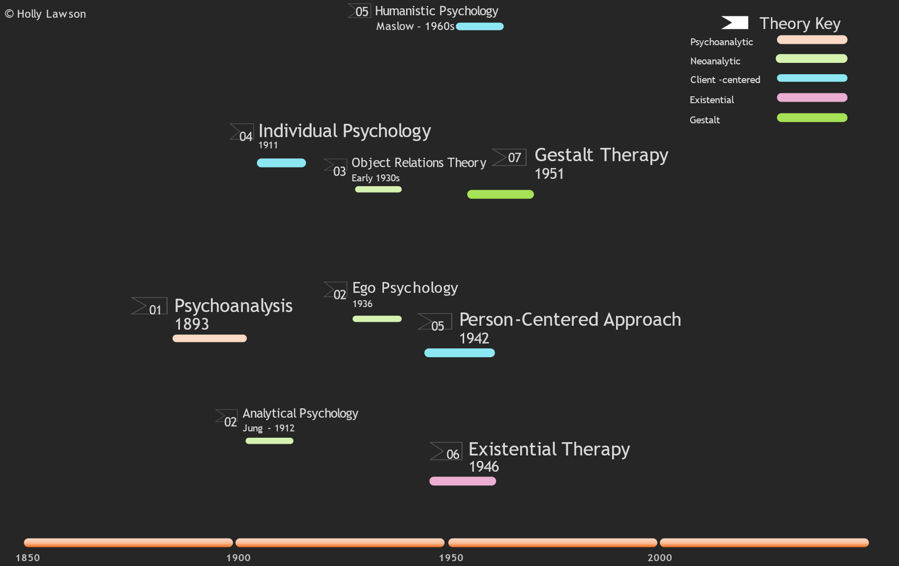
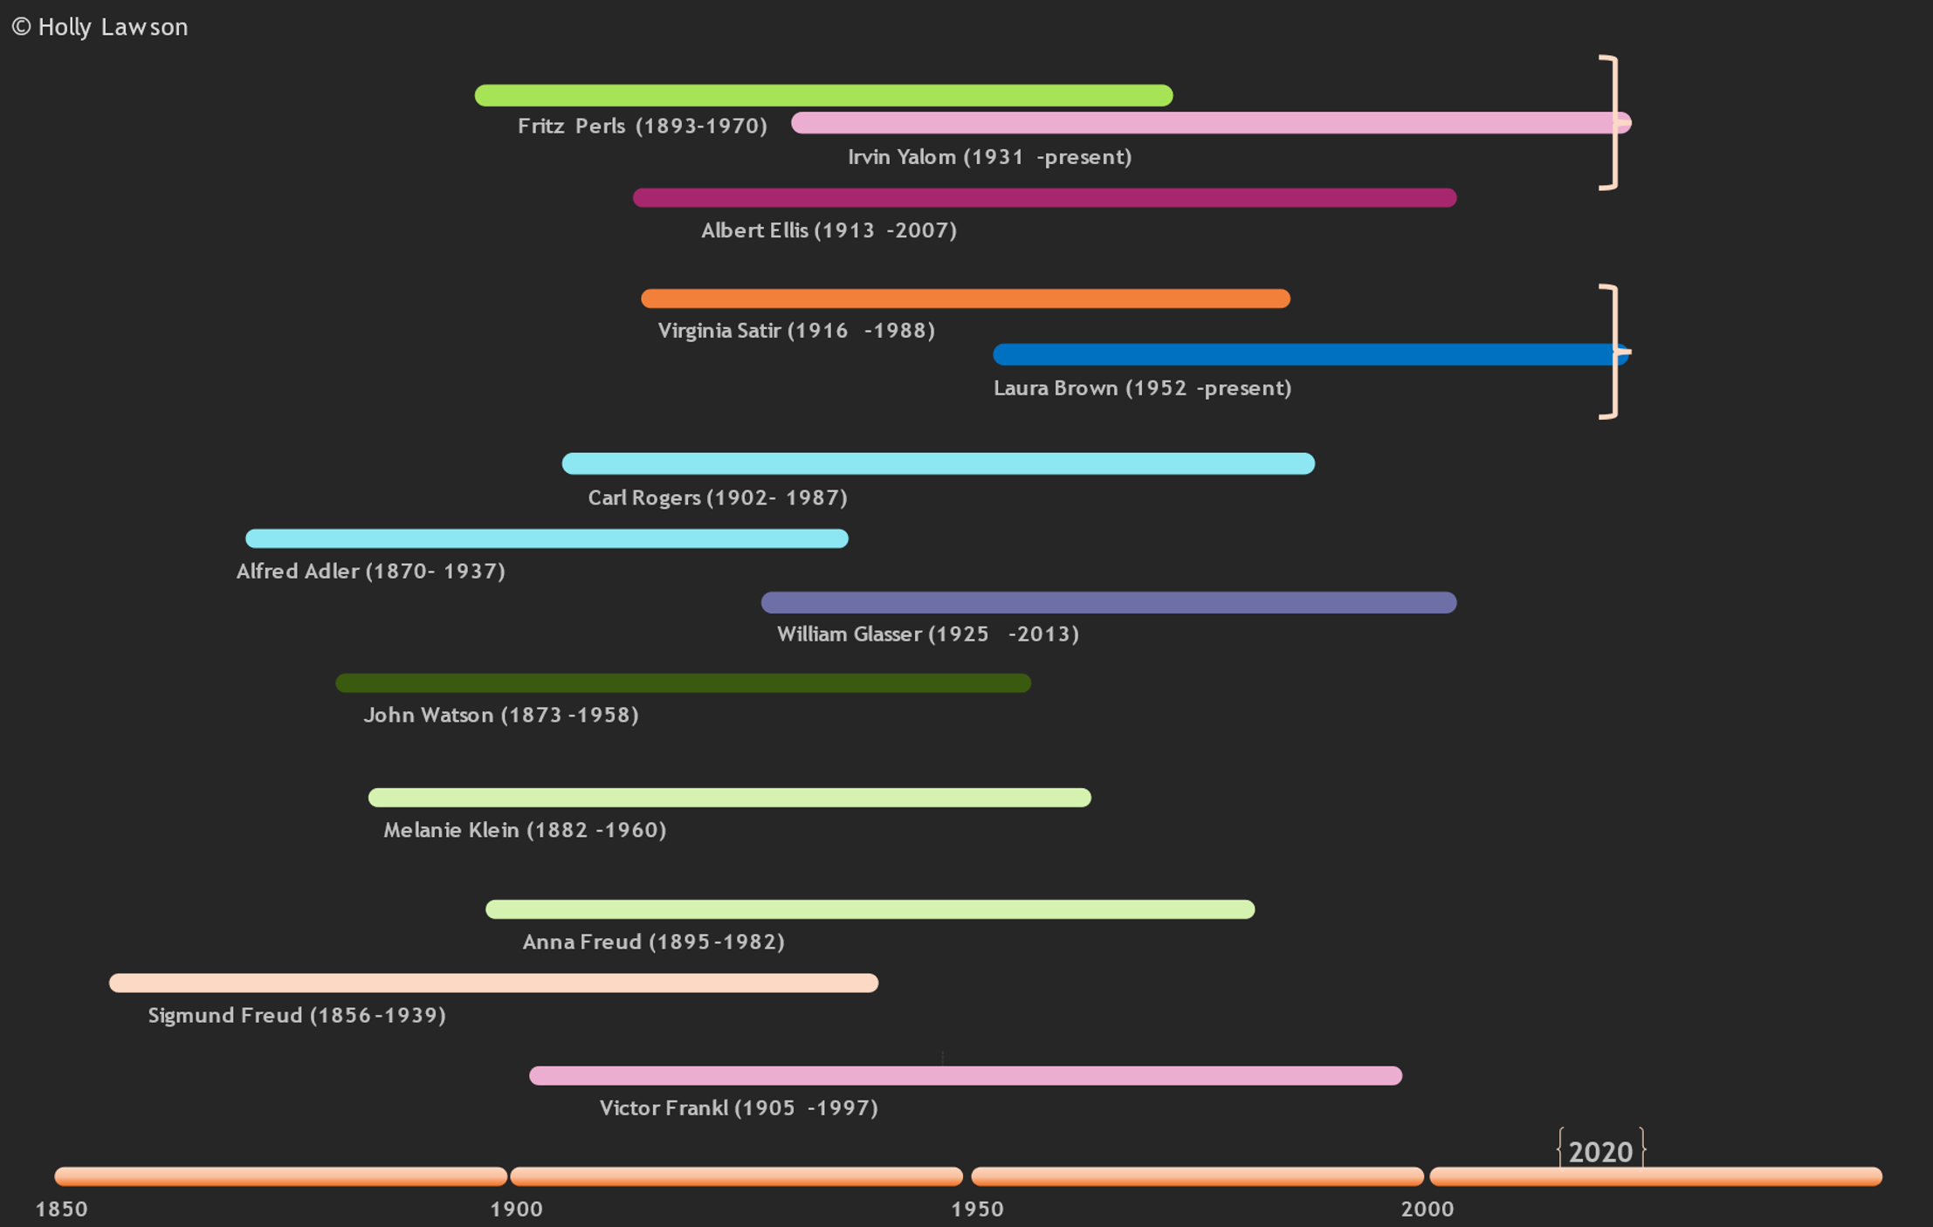
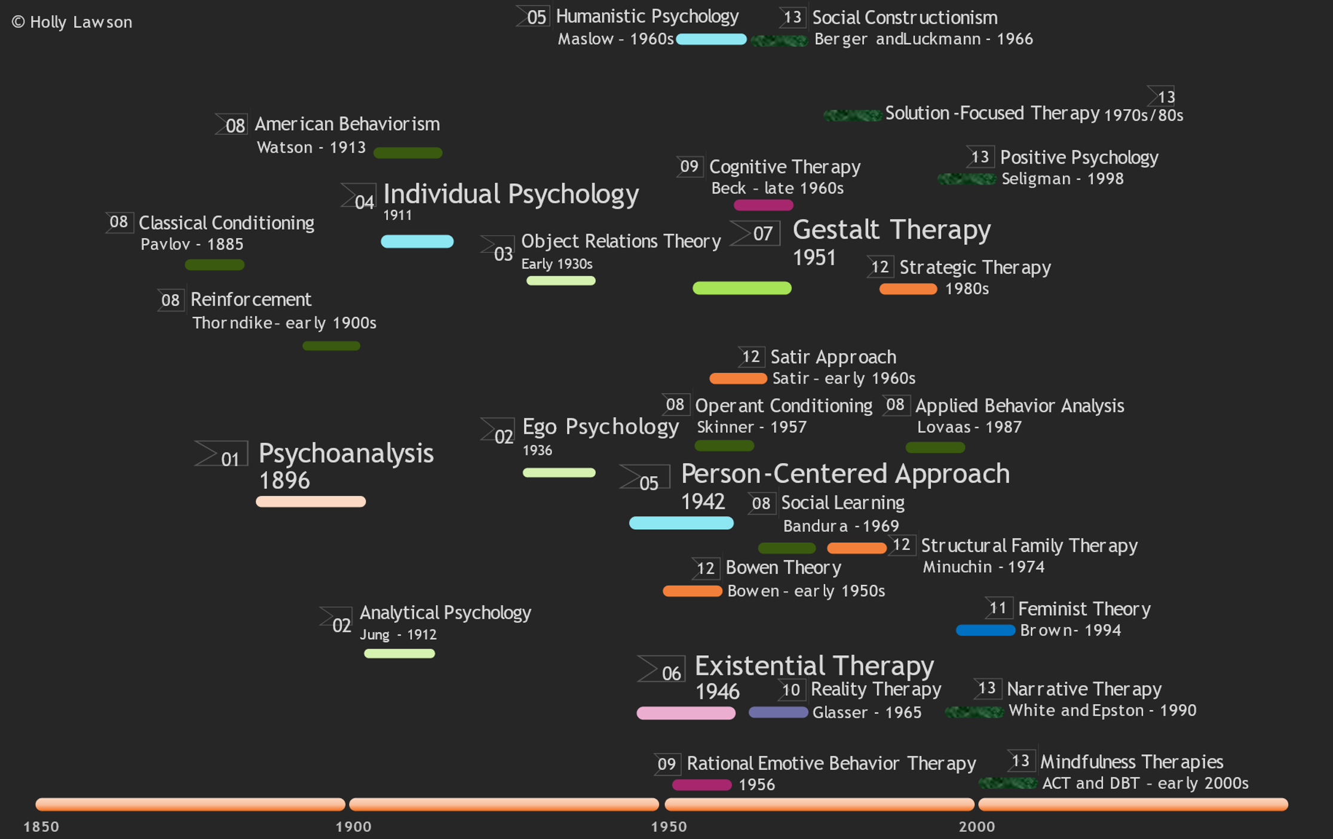
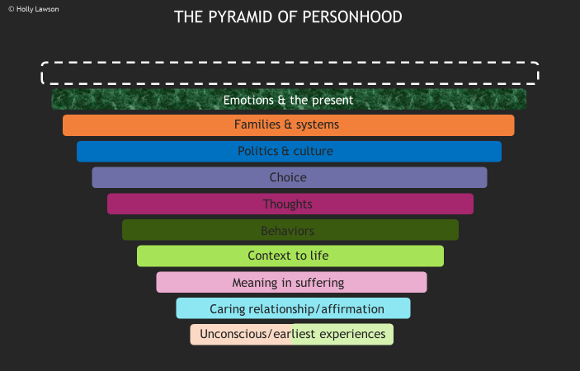
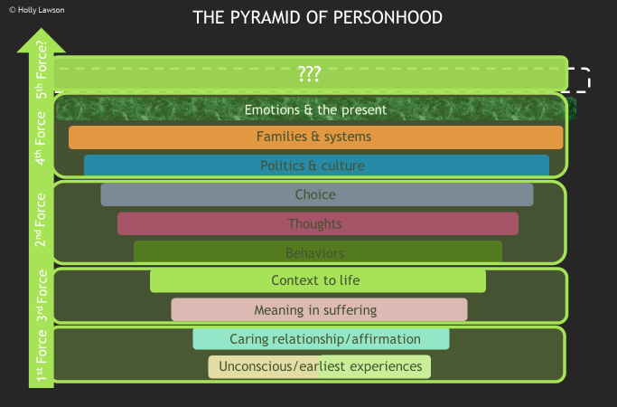
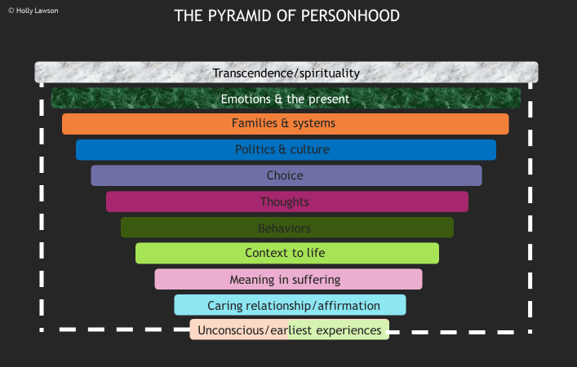
Analyzing the Past & Predicting the Future: 120 Years of Counseling Theories
Holly Lawson, B.S.
Abstract
Results and Conclusion
Background: More than 10 major theoretical approaches have been developed thus far in the field of professional counseling, along with many other smaller approaches and newer conceptualizations. The history of counseling theories is often described as unfolding in “waves” or “forces.” The waves/forces approach helps counseling students identify major historical contributions to the field of professional counseling. The waves approach is also a fitting analogy, since students may feel that they are wading into an ocean of information when first introduced to available theoretical conceptualizations. Methods: The analysis presented here investigates whether there is a discernable pattern of key themes among the theories that have been developed thus far that can aid in understanding, integrating, and applying the wealth of theoretical information available. Included is an investigation of whether a logical prediction for a future direction in theory development can be formed based on existing information. Results: Several gaps in theoretical development still exist. Future theory development seems to be aimed towards the area of transcendence/spirituality, which is of increasing interest to practitioners and researchers but has yet to be widely acknowledged and provided with a full theoretical treatment. Conclusion: The prediction of a future direction for theory development can aid current practitioners, educators, and students as they navigate the rapidly-changing theoretical dynamics within the field. These findings highlight the need for students and practitioners to carefully consider the application of transcendence/spirituality to counseling and the need for further theoretical development in this area.
A
1
2
Results
The major theories that have been developed thus far lend themselves well to being categorized according to a unifying core concept or theme. When major themes are identified and compared to one another, a much less fragmented—a more complete, holistic—picture of personhood is clearly identifiable. In addition, several gaps in theoretical development still exist based on an analysis of the key themes presented. The predicted direction for future theory development is in the area of transcendence/spirituality. The predicted emergence of this theme follows logically from the current emphasis on emotions and present-moment mindfulness and the historical emphasis on the relevance of the past to current functioning. There is abundant evidence within the research literature for the beginning of thought development and conceptualization in this area. Based on current literature, it is an area of increasing interest to practitioners and researchers, but it has yet to be fully acknowledged and provided with a full theoretical treatment (Alton, 2020; Frederick & Muldoon, 2020; Hoffman & Hoffman, 2020; Peteet, 2018; Salimi et al., 2016).
Conclusions
These findings offer a new way of understanding counseling theories for practitioners and students, including both an understanding of what has been covered well thus far and what gaps in theory development exist that need further treatment. They also highlight the need for students and practitioners to begin thinking more carefully about the application of transcendence/spirituality in counseling and further theoretical development in this area. Mainstream integration of this theme could serve to pull together certain Eastern and Western worldview dynamics, enhance multiculturalism, increase the move away from strict empiricism, and provide a more prominent place for Christianity and other religions in psychotherapeutic research, teaching, and practice. A holistic picture of human nature, psychology, or counseling cannot exist without a thorough treatment of the theme of transcendence/spirituality (Adler, 1998/1927; Hoffman & Hoffman, 2020; Maslow 2017/1962).
B
3
4
C
A
04, 05 Client-centered
Introduction and
Research Questions
Since the late 1800s, the field of psychology and professional counseling has grown exponentially. For a relatively young field of study, contributors to the field have been incredibly active and prolific. It is important to remember that none of the major theorists existed in a vacuum. They each borrowed ideas from one another and adapted and expanded upon existing ideas. Even Freud was influenced by his predecessors and contemporaries (2020/1913). There may be another way of understanding the contributions to the field of counseling theories thus far that differs both from a wave approach and a fragmented one-theory-per-chapter approach. Each major theoretical approach seems to represent a single core concept or theme pertaining to a specific dimension of human life or personhood. Understood from the vantage point of core themes, a more simplified organizational structure emerges for understanding the information within each theory. Organization by core theme still allows for the complex interplay of ideas within the major theoretical approaches. Aspects of certain themes are covered in other approaches but not to the same degree of depth or emphasis as in the approach designated by that core theme. There are two questions that are the focus of the current study:
Is there a discernable pattern or thematic organizational structure among the theories that have been developed thus far?
If present, will an analysis of this historical pattern or structure yield enough evidence on which to form a prediction for a future direction?
02
Analytical Psychology
Jung - 1912
Figure 3. Competitive fitness advantage.
Quantification of fitness was based on the direct comparison of log CFUs of one species to another. There was a significant fitness advantage of group A, if not even more with group B through overcoming colonization resistance.
Future Work
Conceptualizing a theoretical approach to counseling that emphasizes transcendence/spirituality as its core theme
Increasing study, research, teaching, and professional development in the area of transcendence/spirituality
Enhancing multicultural perspectives and contextual approaches through increased emphasis on transcendence/spirituality
Developing more holistic, simplified methods of presenting theory information to counseling students
D
5
6
4
MG1655
02
Analytical Psychology
Jung - 1912
B
A
B
References
6
Adler, A. (1998). Understanding human nature (W. B. Wolfe, Trans.). Fawcett
Publications. http://www.alfred-adler.us/understanding.pdf (Original work
published 1927)
Alton, G. (2020). Toward an integrative model of psychospiritual therapy: Bringing
spirituality and psychotherapy together. The Journal of Pastoral Care &
Counseling, 74(3), 159-165. https://doi.org/10.1177/1542305020946282
Freud, S. (2020). The interpretation of dreams: The psychology classic (T. Butler- Bowdon, Ed.). Capstone, A Wiley Brand. (Original work published 1913)
Hoffman, M., & Hoffman, L. (2020). Transcendence and immanence in contemporary
psychotherapies: Trends, tensions, and treatment. Journal of Psychology and
Theology, 48(4), 239-254. https://doi.org/10.1177/0091647120956961
Maslow, A. H. (2017). Toward a psychology of being. Dancing Unicorn Books.
(Original work published 1962)
Peteet, J. R. (2018). A closer look at transcendence and its relationship to mental health.
Journal of Religion and Health, 57(2), 717-724.
https://doi.org/10.1007/s10943-018-0560-z
7
Methods
Figure 1. A timeline of the five early foundational theories: psychoanalytic, neoanalytic, client-centered/humanistic, existential, and gestalt.
Figure 2. A timeline of the lifespans of important figures in the history of counseling theories color-coded according to their main field of contribution.
Figure 3. A timeline of the major counseling theories thus far dated according to historical debut or seminal work publication.
Figure 4. A theory key for reference containing each major theory category listed alongside the color chosen for that specific category.
Figure 5. An inverted pyramid-shaped graph of the major theoretical approaches thus far labeled according to main theme with a blank space for a future predictive layer.
Figure 6. The inverted pyramid-shaped graph from figure 5 with a transparent overlay that groups the major approaches into historical forces or waves.
Figure 7. The inverted pyramid-shaped graph from figure 5 with an added eleventh layer predicting the next major theme to be covered: transcendence/spirituality.
Methods utilized include:
the construction of multiple timelines (Fig. 1, 2, & 3)
the analysis of historical patterns (Fig. 5 & 6)
the identification of key themes
the construction of a pyramid-shaped graph to layer the key themes
the prediction of a future direction for theory development (Fig. 7)
the investigation of any existing evidence in the research literature for the beginning of thought development in the predicted area

