Slide 1
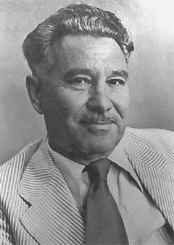
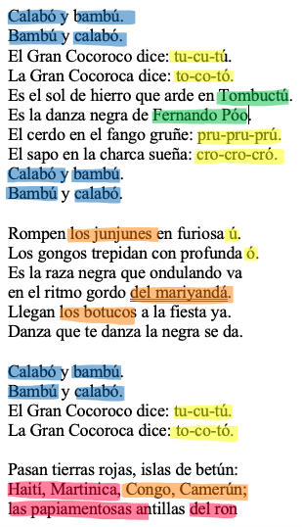
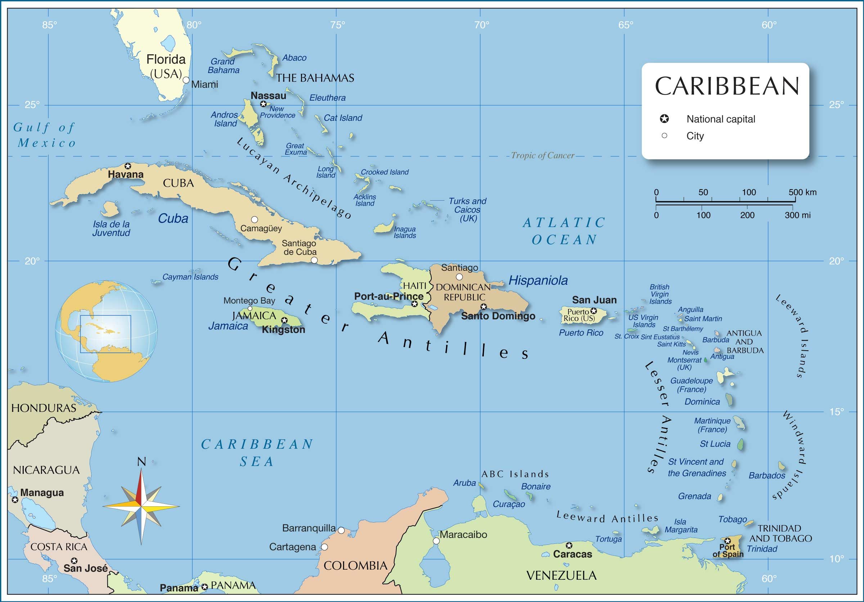
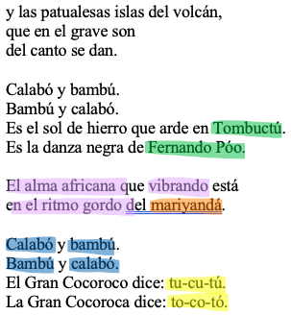
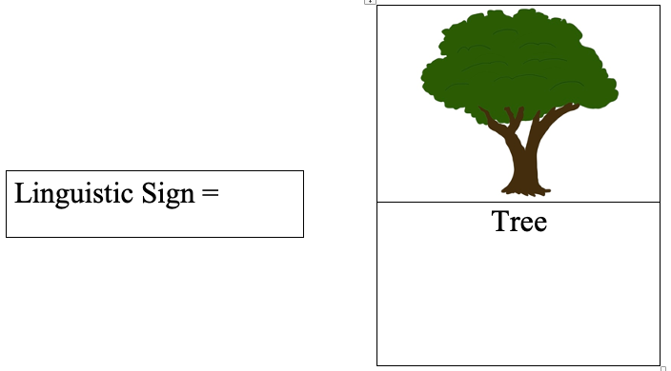
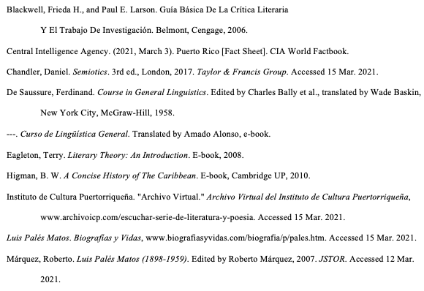
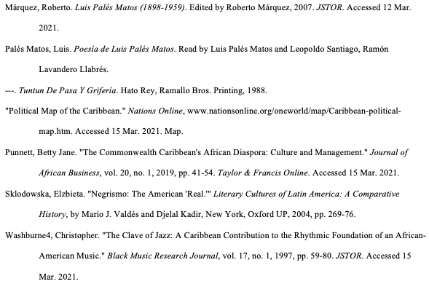
Stretching the Limits of Language:
Luis Palés Matos, Poetry, and Processes of Signification
Jieli Kasprzak, Spanish BA and ASLI BA, Department of Modern Languages
Luis Palés Matos
“Danza negra”
Literary Analysis (Results)
Luis Palés Matos was born in 1898 in Guayana
Puerto Rico. He was born into a family with
two well-known poets, Vicente Palés and
Consuelo Matos (Márquez 174). He was
fascinated with Afro-Caribbean culture, even
more so its music. To convey the music
within written language, he would take the
arbitrariness of words and use onomatopoeic
language to evoke new meaning and portray the
African-Antillean culture. Palés Matos is the
“inaugural voice” and who comes to mind when
one considers the “negrista” movement
(Márquez 174).His ability to subvert the linguistic sign and overcome its denotative meaning has influenced many poets and the “negrista” movement.
The literary theories used to analyze Luis Palés Matos’ poem are semiotics and deconstruction. Based in language and linguistics, they view words as arbitrary, and as such, Palés Matos deconstructs the sign’s original meaning to give way to musical significance that contains cultural overtones as well. In the poem “Danza negra,” Luis Palés Matos goes beyond the denotative meaning of a word to imitate Afro-Antillean music. The words replicate the rhythm and sound of African-descended music through specific linguistic phenomena; occlusives such as bilabials and dentals in combination with back rounded vowels, specifically, create a sense of drumming. Instead of hearing the drums performed externally, however, the reader, by voicing the words, becomes the percussive instrument and internalizes the meaning of the poem. Even though some words that Palés Matos uses do not have a dictionary meaning, they evoke the instruments, sounds, rhythms, and beats of African music. For example, “Calabó … bambú,” are not used in a traditional way, which exists only to create musical meaning, rather than serving as a reference to the plant itself. In short, the author gives words alternative meanings through the usage of onomatopoeic words, such as “tu-cu-tú … to-co-tó,” which call to the readers’ mind and imagination African-inspired music in the Caribbean. This process of deconstructing and even disregarding the sign and replacing/adding to it creates new and more complex signs with the purpose of connecting a signifier with a cultural framework to be signified. Ultimately, Palés Matos dismantles the linguistic sign and frees it from its denotative, meaning-making function. He experiments with the limitations and rules of language as examined by Saussure and so stretches the limits of language to accommodate culture.
Luis Palés Matos. Biografías y Vidas, www.biografiasyvidas.com/biografia/p/pales.htm. Accessed 15 Mar. 2021.
.
Glossary:
Bambú: Type of grass used for construction.
Tu-cu-tú, to-co-tó: Onomatopoeia.
Tombuctú: Timbuktu.
Fernando Póo: Leader.
Pru-pru-prú, cro-cro-cró: Onomatopoeia.
Los junjunes: violin like instrument.
El mariyandá: a type of dance.
(Palés Matos 126-134).
Background
Linguistics:
Linguistics is the scientific study of language. The linguistic study of words and their attached meaning began with Ferdinand de Saussure. Saussure differentiated the “langue” from “parole” (Saussure 41). Saussure defines the “langue” as the lexicon, structure, and vocabulary that is essential for meaning making (41). The “parole” is the physical speech (Saussure 41). Saussure noted that signs, or words, consist of two entities that associate with each other: signifier and signified (67). The signifier is the sound or written sequence of letters that form the word, and the signified is what the signifier is referring to. For example, the sign, or word, tree consists of the sound, signifier, and the image, the signified.
Semiotics:
Semiotics is the study of signs (Chandler 1). It stems from Saussure's idea of signs and how humans make meaning (Blackwell and Larson 20; Chandler 1).
Literary Theory and Criticism:
Literary Theory is the study of literary and how to analyze it (Blackwell and Larson 20). Semiotics stems from the study of linguistic sign as well as deconstruction (Blackwell and Larson 20). Deconstructionism states that there is no one meaning. It separates the signifier from its denotative meaning and arrives at the conclusion that there can be multiple meanings within language (Blackwell and Larson 20).
“Negrismo”
According to
Elzbieta Sklodowska,
“Negrismo”is a
movement that
“flourished” in
Caribbean poetry and
celebrates African
traditions (269).
Sklodowska
notes that this movement began in the Caribbean, specifically Cuba, Puerto Rico, and the Dominican Republic, and is present within art from this region (Sklodowska 269).
The Caribbean was the first place where Columbus stepped foot on when he journeyed to the Americas (Higman 3). The first people who inhabited the Caribbean crossed the Bering Sea land bridge from Northern Asia (Higman 3). The Europeans brought over enslaved people from Africa, some of which escaped and created their own settlements (Higman 98;115). According to Punnett, not all Africans were slaves (42). As of 2018, Afro-Caribbean people make up of 73% of the population (Central Intelligence Agency).
Implications for Future Work
Language and art: The way we use language, particularly in art, does not “respect” the rules of language necessarily. Within art, there is the purpose to appeal to the senses of the reader or observer. Because of this, the goal in mind is to have the meaning come across even at the expense of preserving the constraints and regulation of language.
Language and Culture: The Sapir-Whorf Hypothesis proposes a link between language and culture, which means that one reflects the other. Language represents culture, history, and the people behind it. Language can be an identity. Through language, one is able to share interests and ideas. Signs can be broken down, and the signifier and signified can be separated; therefore, signs depict more than their agreed upon denotative meanings. Culture can be held within language, and meaning is not merely a definition, but also an understanding of one’s culture and how language connects the culture and the people through processes of meaning making. Through language, people have the ability to break down the sign from its intended meaning to create an entirely new meaning. In the case of Luis Palés Matos, he breaks down the constraints of a linguistic sign from its denotative meaning to bring forth a new meaning that bridges language and culture.
Christian worldview: The poem shows the importance of meaning and context as he uses onomatopoeia. We use words to encourage each other to pursue love and goodness. As Christians, we know the power of God’s word, in particular, the Word we know as His Son, Jesus Christ. When Jesus is referred to as the word, we are not referring merely to a signifier, but also, and primarily, to the signified, to the image of God himself, made flesh through the person of Christ.
"Political Map of the Caribbean." Nations Online, www.nationsonline.org/oneworld/map/Caribbean-political-map.htm. Accessed 15 Mar. 2021. Map.
Method
Afro-Caribbean Music:
Began in places with a large African population.
Rhythms such as son clave, cinquillo, and tresillo are prevalent in jazz today (Washburne 59).
African music has impacted today’s music such as Reggae and jazz.
According to Washburne, jazz comes from Europe, but the rhythm of jazz orginates from African rhythms and beats (59). This influence has not only impacted the Caribbean but the United States as well (Washburne 59).
Palés’ Poetry Performed
Palés’ poetry was recorded and brought to life by the Instituto de Cultura Puertorriqueña.
Palés performs readings of his works set to music, accompanied by instruments that add background rhythms that give even more meaning and context to his already rich verse.
References
This study is a literary textual analysis that examines “Danza negra” by Luis Palés Matos. A way to analyze literary texts is to read the work through the lens of a particular literary theory. One critical mode of engaging a text is derived from linguistic analysis: semiotics. Furthermore, building upon semiotics and the foundational concepts of the arbitrary nature of linguistic signs/meaning, other literary theories have stemmed from the field of semiotics, specifically structuralism and deconstruction. This presentation focuses on deconstruction, which is “the name given to the critical operations by which [binaries] can be partly undermined, or by which they can be shown partly to undermine each other in the process of textual meaning” (Eagleton 115). As such, I read the text for semiotic and deconstruction principles, which I color coded for clarity.

