Slide 1
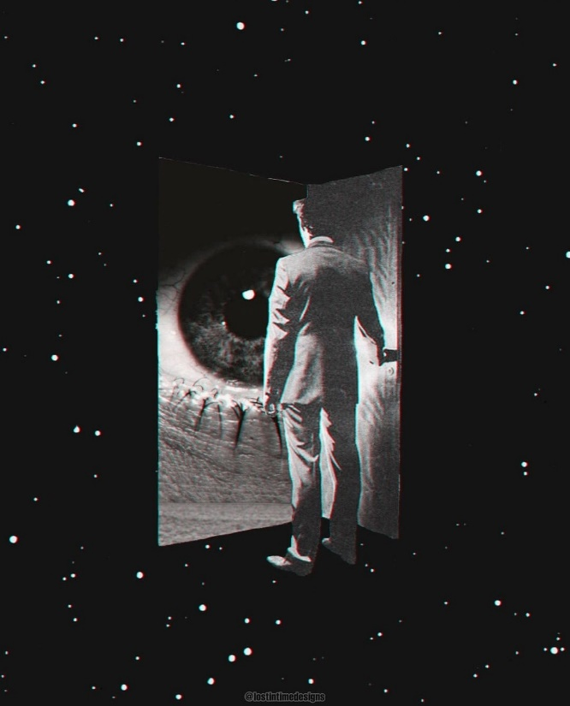
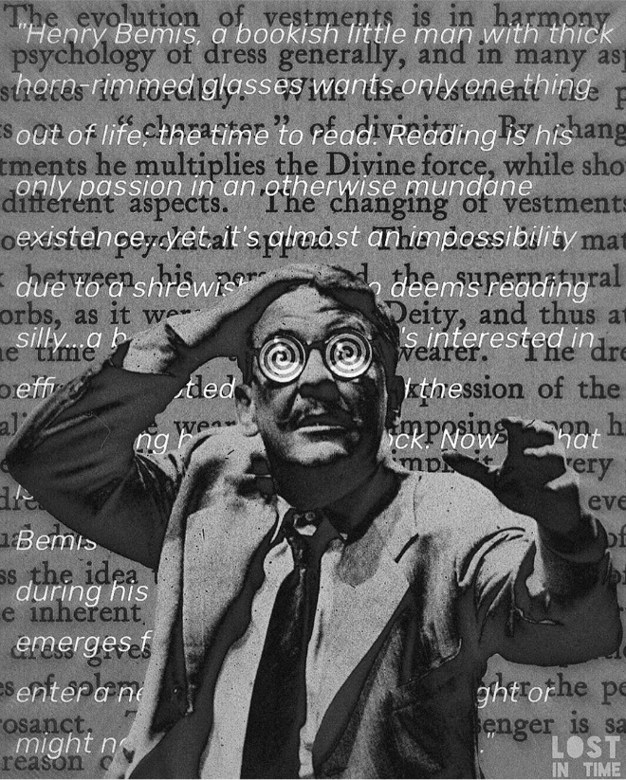
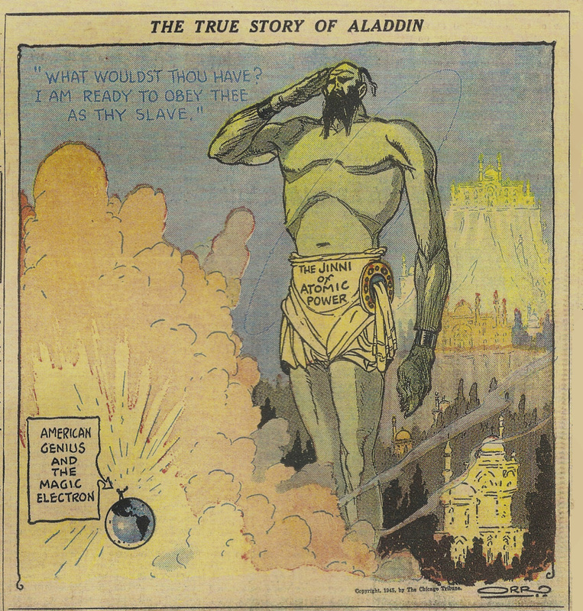
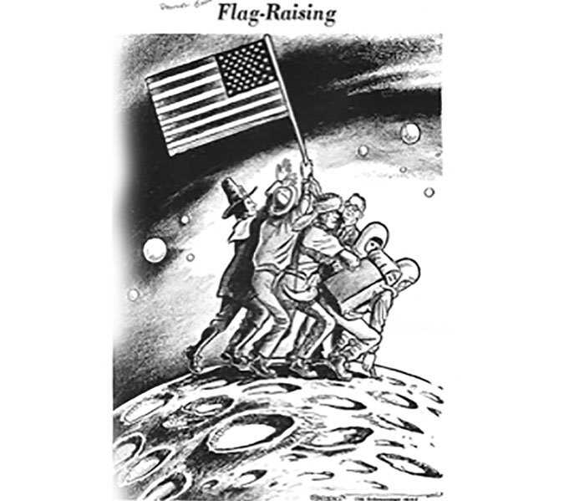
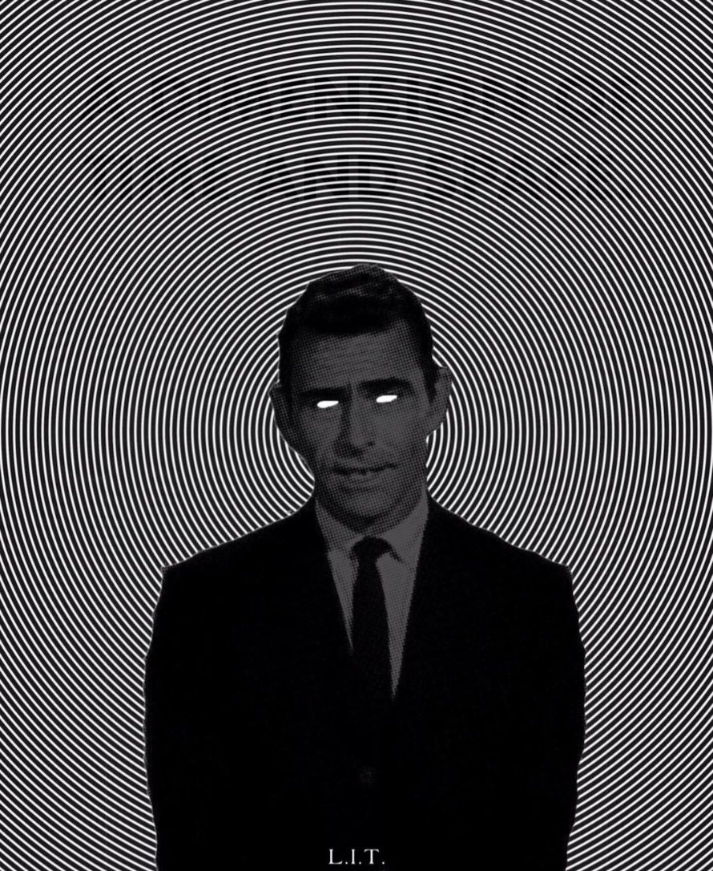
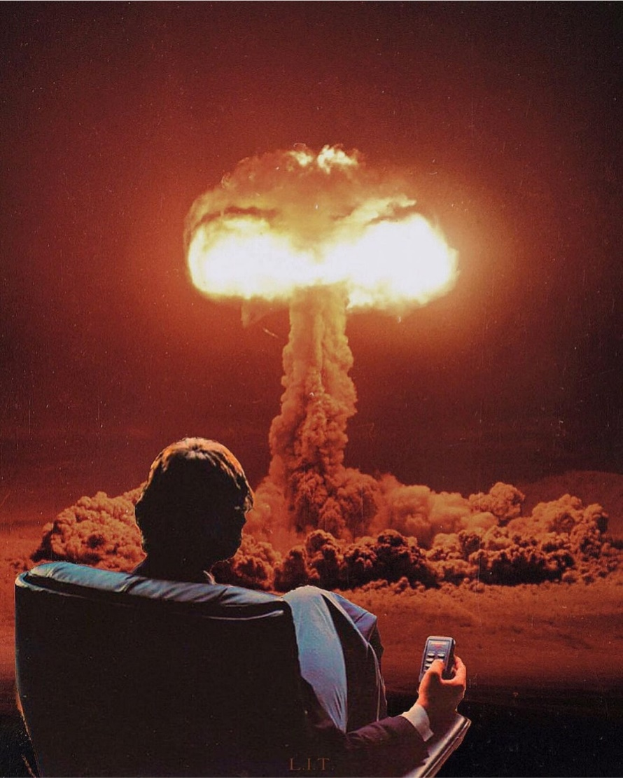
Cold War America in the Fifth Dimension
Madelynn Hobson
Abstract
Results
Television shows of the 1950s and 1960s are characterized by their happy-go-lucky spirit. However, one tv show broke out of this mold. The Twilight Zone, which ran from 1959 to 1964, delved into the darker side of the human mind. Playing on its viewers’ fears, it appeared totally normal at first, but always culminated in an unsettling twist ending. At the same time, the constant threat of nuclear destruction presented by the Cold War loomed over Americans. Heavy censorship from sponsors worked as a double-edged sword for the show’s creator, Rod Serling, who wanted to portray themes of uncertainty and mistrust.
Studying the influence racism, the threat of nuclear war, and the space race had on the creation of The Twilight Zone demonstrates that the series was created to deal with Americans’ concealed fears and stir their emotions to positive action against evil.
“ʻYou tricked me, Hangman!’ I shouted then. “That your scaffold was built for other men. And I no henchman of yours,” I cried, “You lied to me, Hangman, foully lied!”
Then a twinkle grew in his buckshot eye: “Lied to you? Tricked you?” he said, “Not I. For I answered straight and I told you true: The scaffold was raised for none but you.
“For who has served me more faithfully than you with your coward’s hope?” said he, “And where are the others that might have stood side by your side in the common good?”
“Dead,” I whispered; and amiably “Murdered,” the Hangman corrected me; “First the alien, then the Jew... I did no more than you let me do.”
Beneath the beam that blocked the sky, none had stood so alone as I - and the Hangman strapped me, and no voice there cried “Stay” for me in the empty square.”
-Ogden, excerpt from “The Hangman” (1954)
The Twilight Zone was an artistic interpretation and social commentary on the suffocating concerns Cold War era America experienced.
Racial struggles stemming from hatred proved to be controversial and remarkably difficult to present to the public eye, but Serling deemed the battle against censorship and sponsors a worthy cause. Imminent threat of nuclear war bubbled under the surface, and Americans were escaping the effects of the Red Scare. Neighbor suspected neighbor and no one was safe. The bleak postmodern outlook on the world characteristic of The Twilight Zone encapsulated the distrust and uncertainty against the government during the space race.
Serling’s creative genius was a safe way for America to explore its hidden fears during the Cold War era in The Twilight Zone.
Future Work
Introduction
This topic has not been fully examined, likely due to its uncomfortable nature, but this is precisely why it should be considered. When one can better understand hidden fears, they can come to a fuller knowledge of history. This research has only examined three episodes, but there is much to be uncovered in how The Twilight Zone handled:
1. Lost Youth
2. War
3. Isolation
Three episodes were studied. “I Am the Night, Color Me Black” urged viewers to stomp out evil in their communities by presenting a complicated story surrounding racism, hidden motives, and people turning a blind eye to injustice. The ending explicitly called out the viewer to consider evil in their own town.
“Third From the Sun” was a twisted “what-if” scenario based on the total destruction of nuclear war. In it, two families attempt to illegally escape their world but are exposed by a coworker, a true threat in an America coming out of McCarthyism.
In “Where is Everybody?” Serling communicates concerns common to Americans by highlighting terrifying, and potentially very real, problems associated with the already unpopular space race against the USSR.
Bibliography
“The True Story of Aladdin,” Chicago Tribune (1945)
“Flag-Raising,” Birmingham News (1969)
Brooks, Charles. “Flag-Raising.” Birmingham News, July 22, 1969. https://www.pbs.org/wgbh/americanexperience/features/chasing-moon-drawing-political-lines-apollo/.
Danzara, Dave. Lost in Time Designs. Digital Collage. 2015-2021.
Ogden, Maurice. “The Hangman.” Masses and Mainstream 7 no. 1 (1954).
Serling, Rod. Interviewed by Bernie Harrison. 1968. https://www.youtube.com/watch?v=LFVJYFI93Bk.
Serling, Rod. Interviewed by Mike Wallace. 1959. https://www.youtube.com/watch?v=ZpKkHCVbSyw.
Stanyard, Stewart T. Dimensions Behind the Twilight Zone: A Backstage Tribute to Television’s Groundbreaking Series. Toronto: ECW Press, 2007.
“The True Story of Aladdin.” Chicago Tribune, August 9, 1945.
The Twilight Zone. Produced by Rod Serling. Cayuga Productions 123Inc., 1959-64.
1 2 3 4 5 6 7 8 9 10 11 12 13 14
1 2 3 4 5 6 7 8 9 10 11 12 13 14
“The point of a dramatic show, which is used as a vehicle of social criticism, is to involve an audience, to show them wherein their guilt lies.”
-Serling, interviewed by Bernie Harrison (1968)
“A sickness known as hate- not a virus, not a microbe, not a germ- but a sickness, nonetheless. Highly contagious, deadly in its effects. Don’t look for it in the Twilight Zone, look for it in the mirror. Look for it before the light goes out altogether.”
-Serling, “I Am the Night, Color Me Black” (1964)
A
B
Methods
C
Research was conducted through a variety of sources. Primary sources proved most helpful because they typically give a true reading of the temperature of the times. These included interviews, political cartoons, newspapers, poems, psychological studies, public opinion polls, letters, and the show itself. The most helpful sources were the interviews. They provided a direct perspective into Serling’s motives in creating and executing the series. Because the interviews were conducted nine years apart, they demonstrate how the producer’s ideas changed in relation to contemporary national events. Secondary sources included books and journal articles.
“They chopped it up like a roomful of butchers at work on a steer.”
-Serling, on the process of submitting his script to his sponsors for censorship in Stanyard’s Dimensions Behind the Twilight Zone: A Backstage Tribute to Television’s Groundbreaking Series

