Slide 1
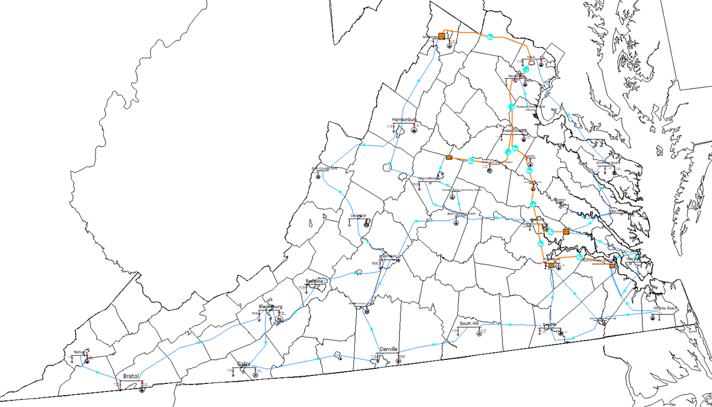
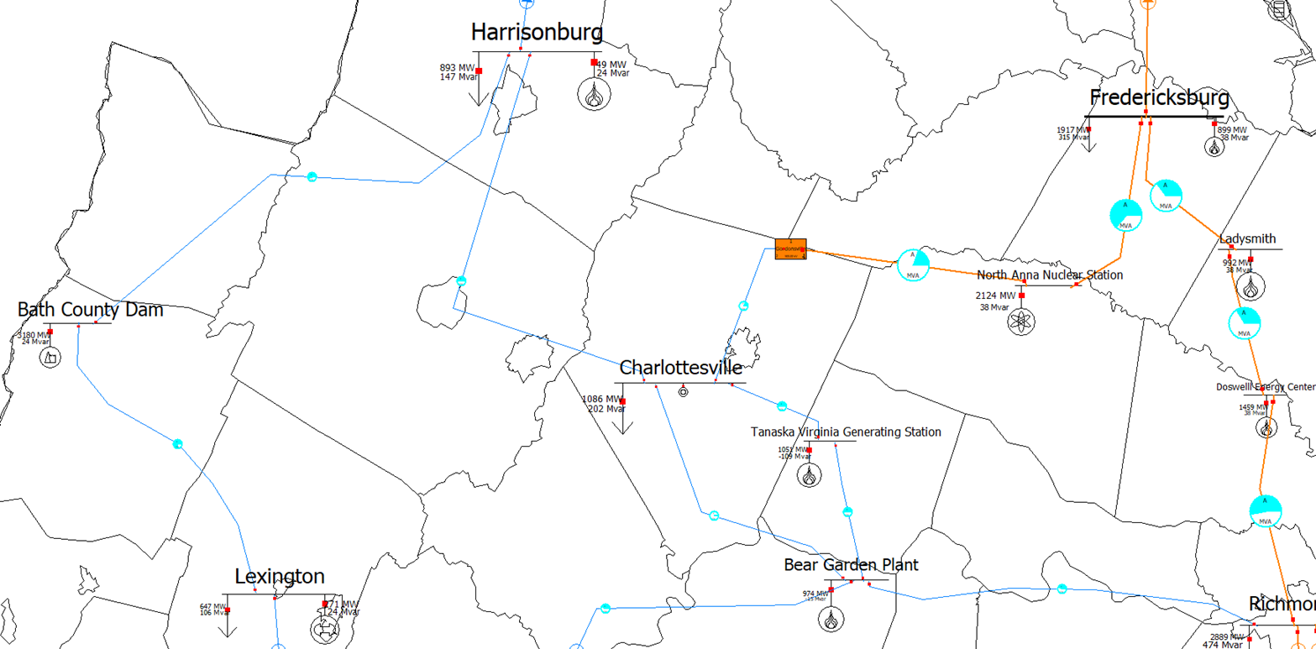
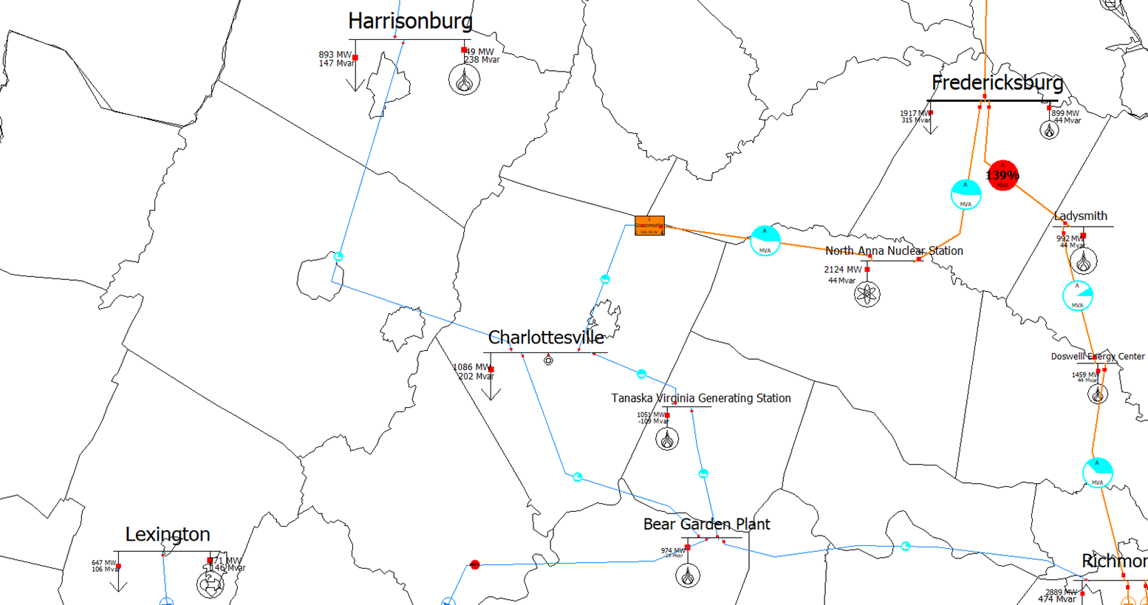
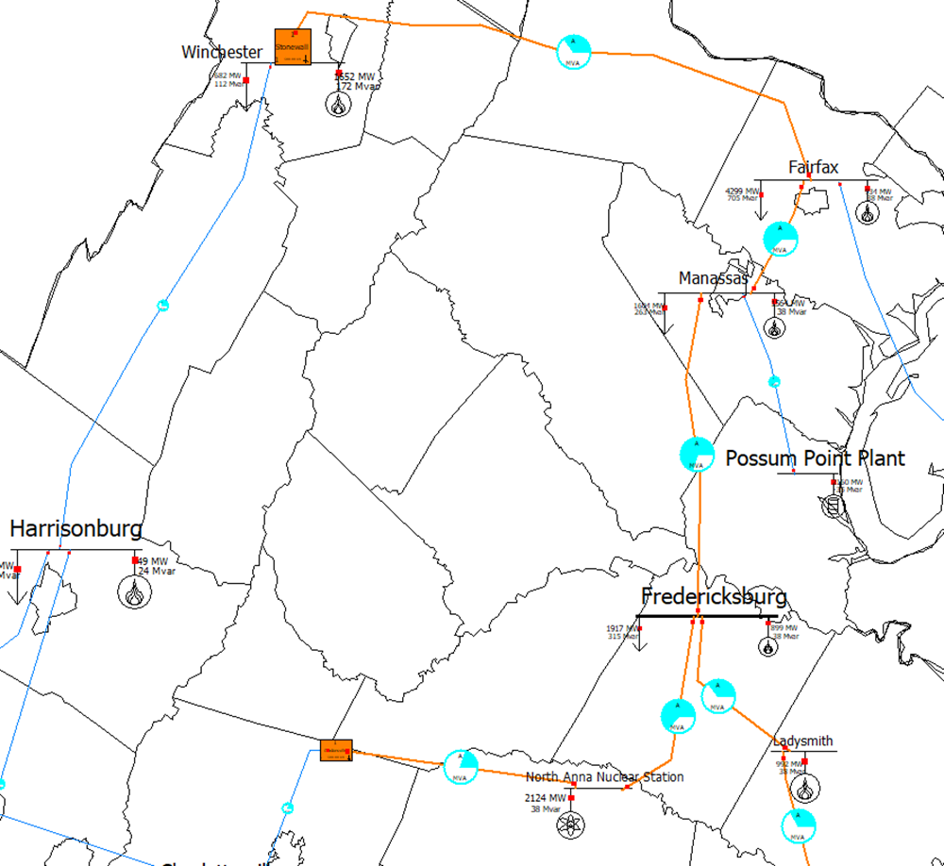
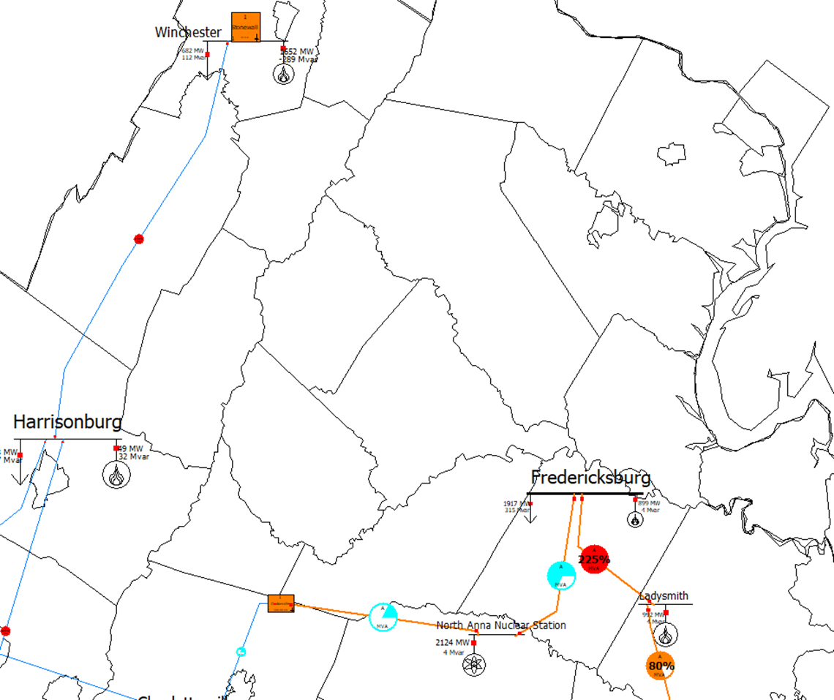
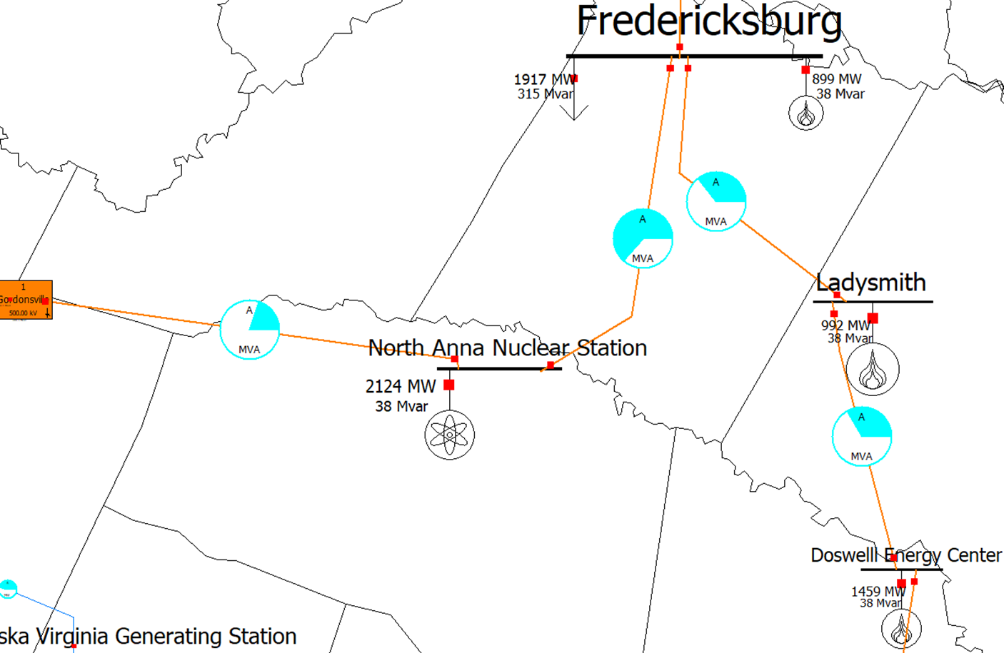
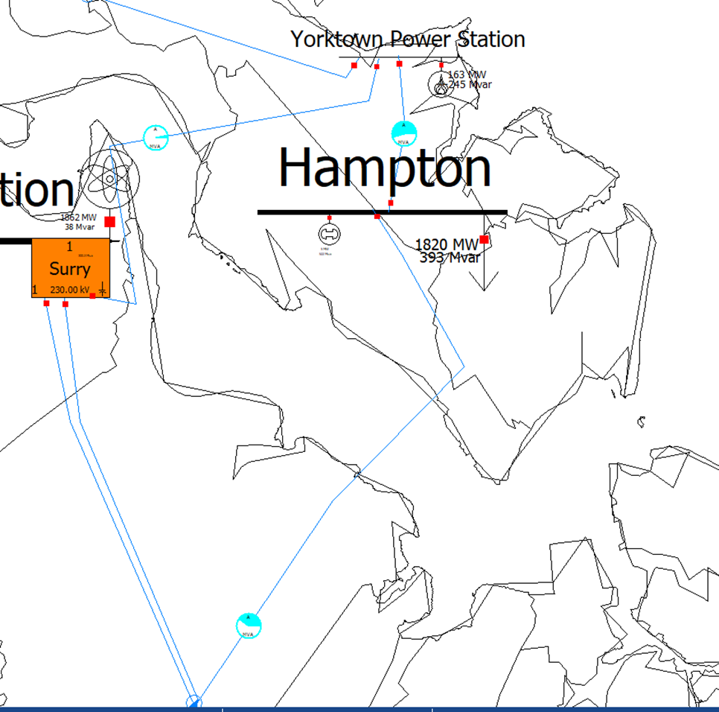
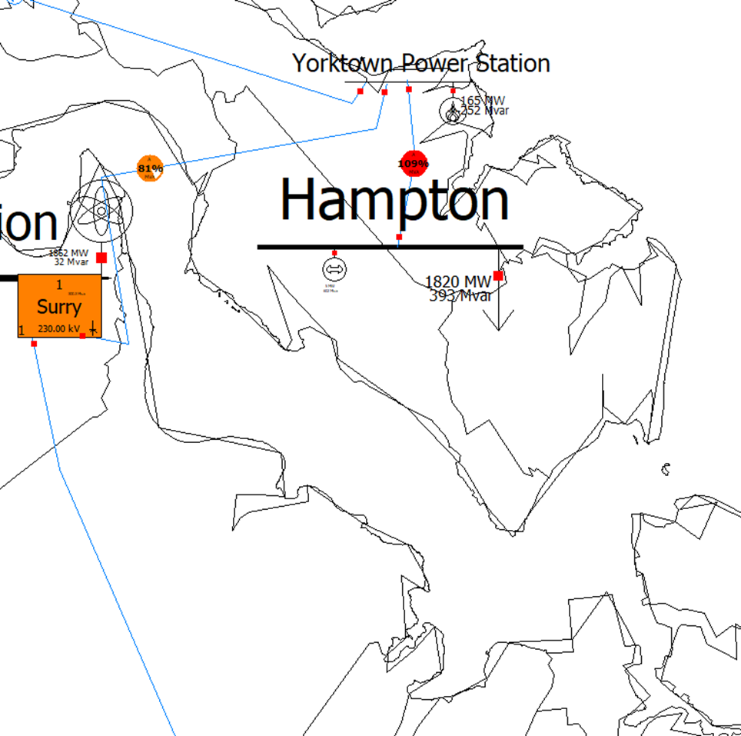
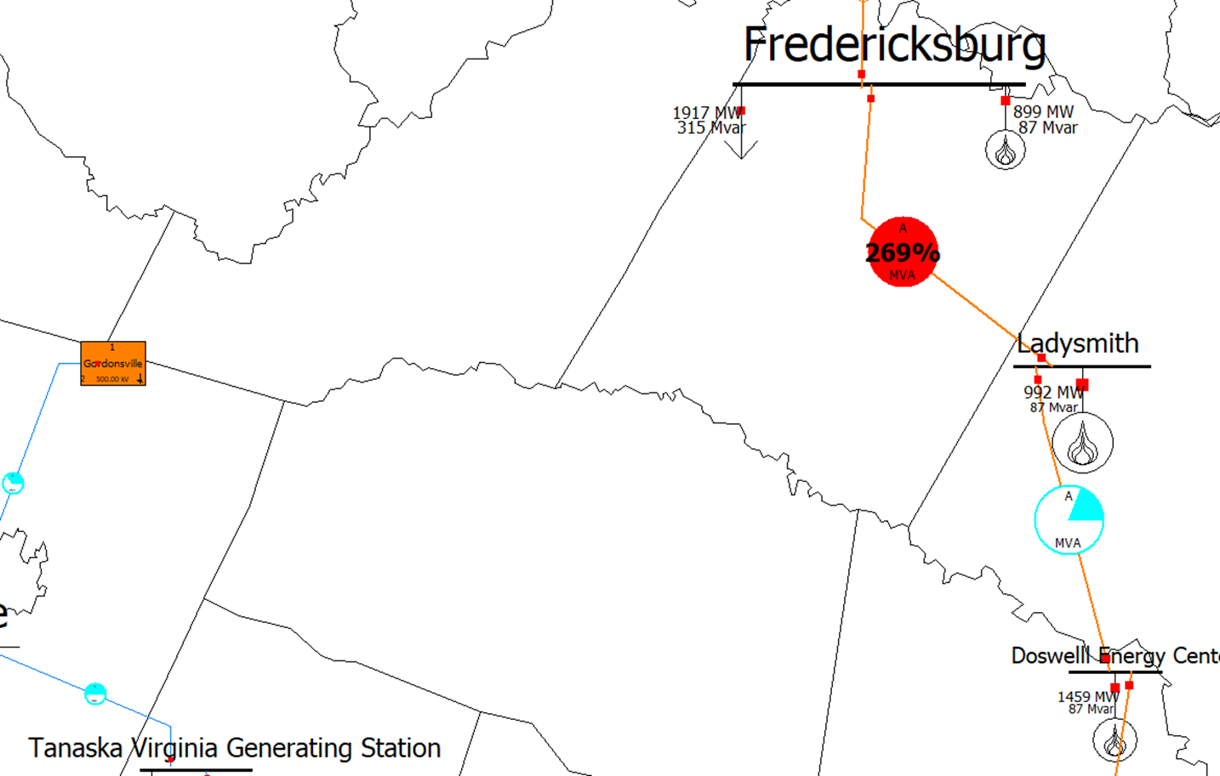
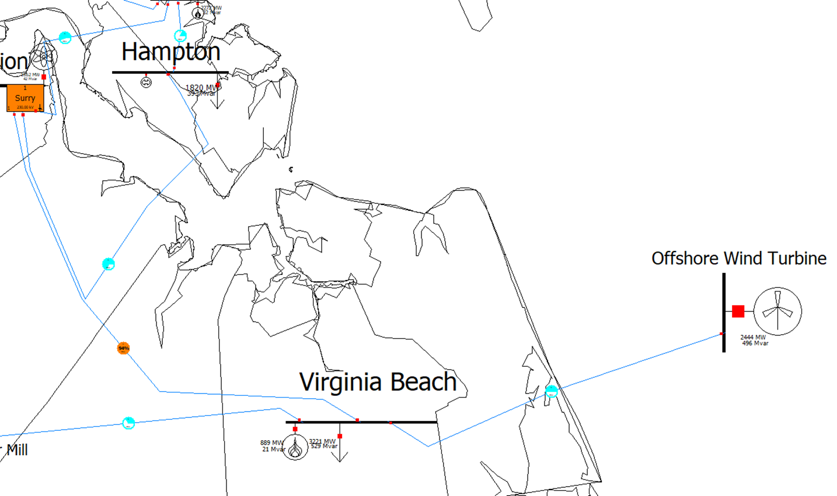
Power System Modeling and Simulations for the Virginia Power Grid
Parker W. Hall
Abstract and/or Background
Results and/or Conclusion
Background: The study of state-wide power systems as a synthetic system is an underused learning tool for the engineering education experience. When a system is said to be synthetic, that means that the simulation is an approximation based on only some or commonly held information to build a simulation. The Virginia power system is a great subject for power system study because it contains multiple different components that make it unique. The computer simulation application PowerWorld allows the Virginia power grid to be studied with reasonable accuracy, including addressing possible vulnerabilities. However, the PowerWorld software used was only a student version so the software was limited in its capabilities. Methods: The Virginia power grid was constructed using publicly held information on the various power plants in Virginia, usage data used along side Census data, as well as data from educational material for transmission line parameters. The simulation was run fully calculating the AC power flow for the most realism. There were five scenarios run to test the system against potential issues which is called contingency analysis. Results: The data found yielded a very realistic representation of the Virginia power grid within PowerWorld. The results of the five scenarios exposed that the system could use reinforcement and redundancy work. Conclusions: Studying state power systems like Virginia’s is a great educational opportunity for Electrical Engineering students. Using the PowerWorld software, even if it is an education license, creates a fairly realistic system to simulate for both study and testing.
Results
Results
PowerWorld exhibited that it was an effective simulation tool even though we were limited to an educational version. First as a DC Power Flow was performed to ensure that the data entered was correct and that the power flow equations that the simulation performs would be stable. Then the AC Power Flow was performed to ensure convergence of the system and whether the system is practical and realistic. The AC Power Flow gave a result that displays everyday operation and conditions, which verified the accuracy of the simulation compared to actual conditions. The contingency analysis consisted of five different scenarios that included a dam burst, Washington D.C. EMP, major line out, Nuclear station meltdown, and addition of offshore wind turbines. All of these scenarios produced different results that pointed to the same need, the need to improve redundancy and strength within the aging and ever changing system.
Conclusions
The goal of constructing the simulation was to test the effectiveness of the PowerWorld program as well as perform a contingency analysis on the Virginia power grid. Though each of the scenarios produced a different result, they all pointed back to the same problem in the system, that there was not enough infrastructure in the main backbone of the system. The dam burst scenario revealed that more lines would be needed along the I-81 corridor to supply small towns if the dam were to burst. The D.C. emp scenario showed that more redundancy is needed to feed the Northern Virginia area in case of an attack on the nation’s capital. The James River line out scenario showed that new lines built in the area would be able to supply the peninsula if needed. The nuclear station meltdown scenario further proved that the I-95 corridor needs further infrastructure to handle any additional load. The new wind turbine scenario provided information that more lines would need to be constructed to be able to withstand the new incoming power. The simulations provided a definite result that could be studied further and in more detail.
Figure 1: The complete map of the Virginia Power Grid
Introduction and/or Research Question
This project seeks to learn more about large-scale power systems by studying the power grid of the state of Virginia. Using data found on the internet collected by public agencies and educational materials, a simulation was built using the power system simulator application PowerWorld. Power world is a power system simulation software that utilizes multiple different calculation methods to simulate power systems. However, only an educational use version was used, so the simulation is limited to only a 42-bus system. By creating a 42 bus system that is fairly accurate ,although synthetic, knowledge was sought about the weak points of the Virginia grid and where the system sees the most stress.
A synthetic system uses approximations and assumptions to create a system that behaves similar to the real system that is intended to be studied. Information can be gathered from the Energy Information Administration, Census Borough, and other educational materials such as textbooks to collect data to build a synthetic system. That information could then be compiled into a package that can be utilized in the educational version of the PowerWorld software. Does a PowerWorld simulation create an accurate representation of the Virginia power grid for study?
We chose to take a methodical direction to make sure the realism of the simulation was as close as possible even with limited information and flexibility within the PowerWorld software. However, even with an abundance of data and information, much had to be done to prepare the data to be entered into the software.
Figure 2: Bath County Dam Burst – The top photo shows the preexisting lines before the dam burst, the bottom photo shows the missing lines taken out by the burst dam as well as the effect on surrounding lines.
Figure 3: Washington D.C. EMP Attack – The left photo shows the existing infrastructure before an attack, the right photo shows the lines taken out and the effect on the other lines.
Future Work
Take practice gained during research period and apply it to workplace
Use information found and bring it into class room to show students how the Virginia power grid around them works
Take expertise in PowerWorld gained by both student and instructor and translate that into the classroom
1 2 3 4 5 6 7 8 9 10 11 12 13 14
1 2 3 4 5 6 7 8 9 10 11 12 13 14
Methods
The system is built within PowerWorld using 41 connection points called “buses”, 12 that include power generators only, 23 that represent the electrical load “districts” with 18 of them containing additional generators, and 7 for voltage transformers. The buses are connected using transmission lines that have been configured to have similar parameters to the actual lines in the system. The PowerWorld program then ran calculations to find out the loads on the transmission lines and whether the generators can supply the loads of the system. PowerWorld also provides many visual tools for analyzing the simulation, including line load pies that go from blue to orange or red when under heavy loads. The simulation resulted in a system that behaves like the real Virginia power grid, because there are transmission lines that had load values that were similar to indications given by media reports. A contingency analysis, which is an analysis that identifies weaknesses by implementing potential threats of the system, was then conducted that included five different scenarios.
A
B
Figure 4: James River Line Out – The left photo displays the existing infrastructure, including the newly constructed line (as of 2018), and to the right is the result of if the old line fails.
References and/or Acknowledgments
C
EIA, “U.S. Energy Mapping System,” U.S Energy Information Administration, District of Columbia, 2019.
EIA, “Electric Power Monthly,” U.S. Energy Information Administration, District of Columbia, 2019.
Electric Choice, “How Much Electricity on Average Do Homes in Your State Use? (Ranked by State),” ElectricChoice.com, 2017.
Hunt, Alteneder, Silva, Mistry, Wruble, Olivas, Cummings, Gunawardena, Cruz, Keel and Francoeur, “Guidelines for Electric System Planning,” SRP, 2013, pp. 31.
Reta-Hernandez, Manuel, “Transmission Line Parameters,” Taylor & Francis Group, LLC., 2006, ch. 13, pp. 22-23.
T. Buonomano, A. Conklin, R. McQuaid, “An Analysis of WPI’s Power Grid in Worcester, Massachusetts”, Worcester Polytechnic Institute, Worcester, Mass
U.S. Census Bureau, “Virginia: 2010,” U.S. Department of Commerce, District of Columbia, 2012, pp. 6-7.
Figure 5: North Anna Nuclear Plant Meltdown – The top photo displays the existing infrastructure of both the nuclear station and surround areas, the bottom photo displays the lines taken out of commission and the impact on the lines on the main I-95 corridor backbone.
Figure 6: New Offshore Wind Turbines – This photo displays the new wind turbines connected to the existing system. By the orange in the load indicator pie there is more power than the infrastructure can handle.

