Slide 1
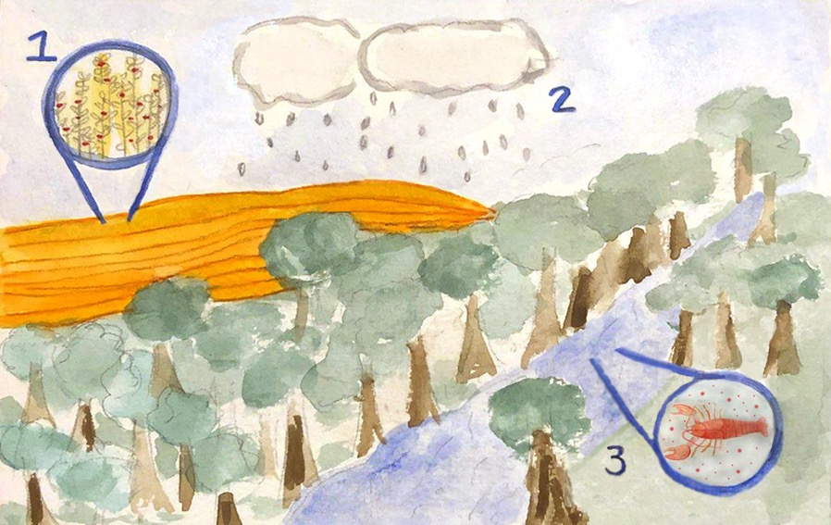
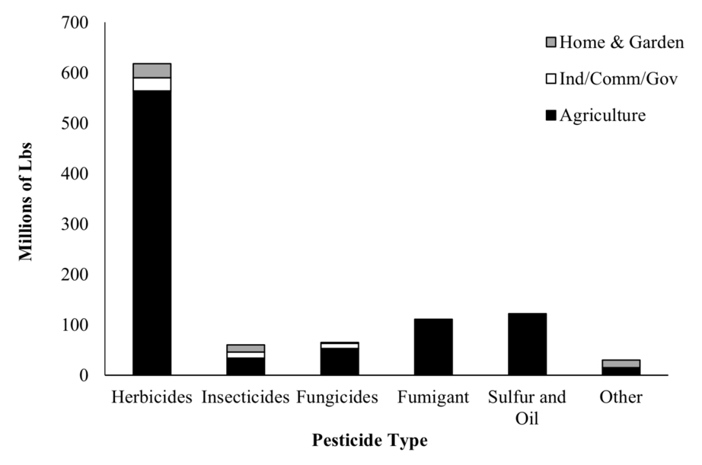
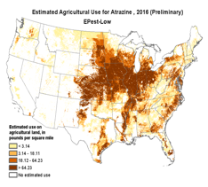
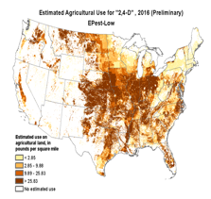
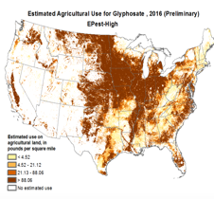
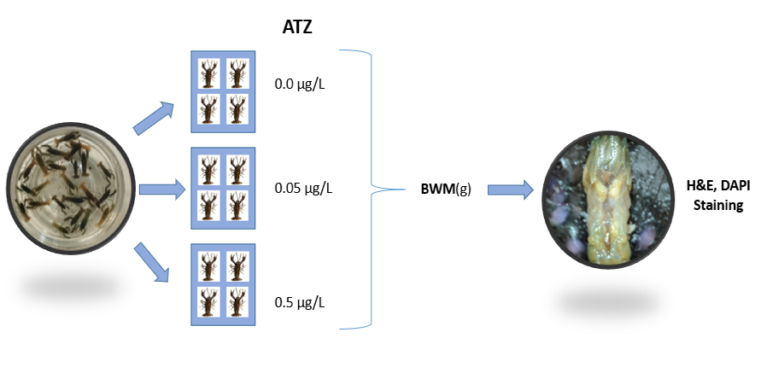
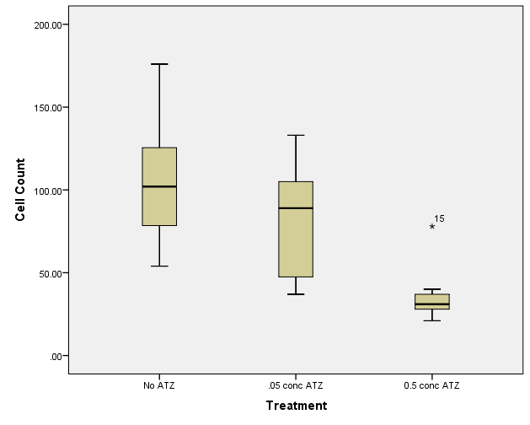
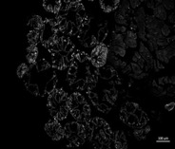
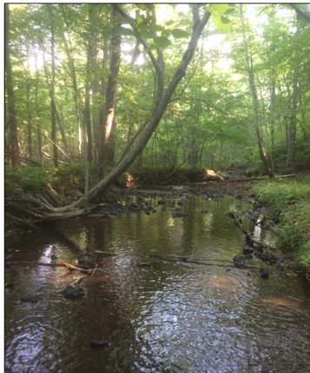
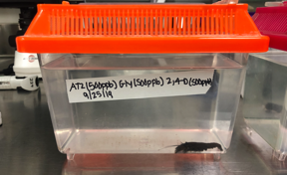
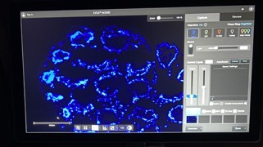
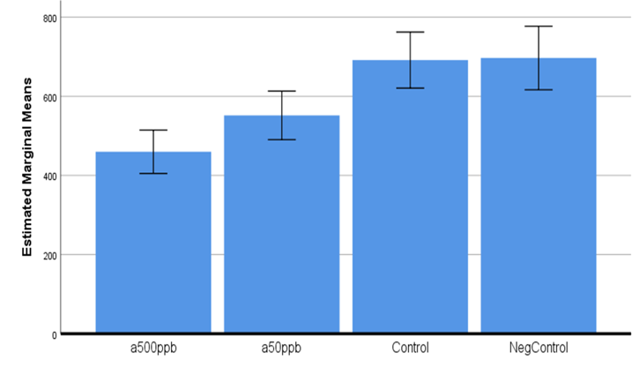
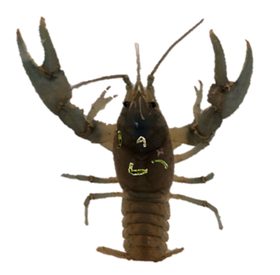
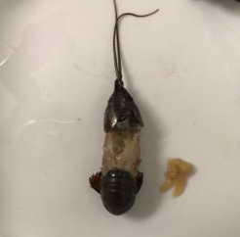
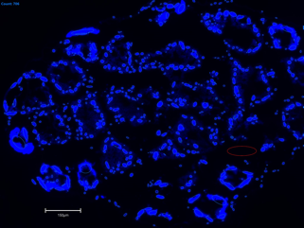
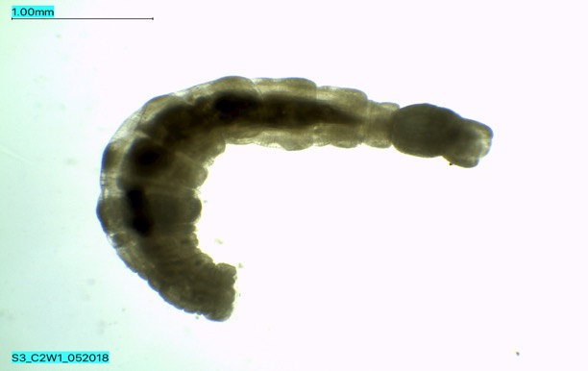
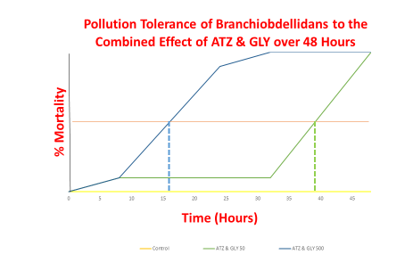
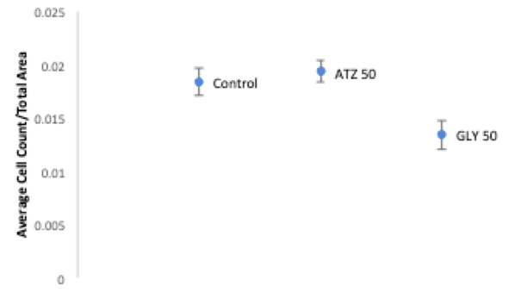
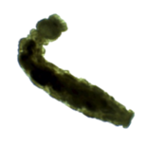
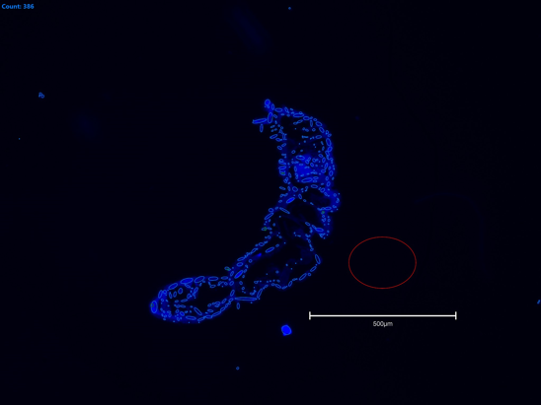
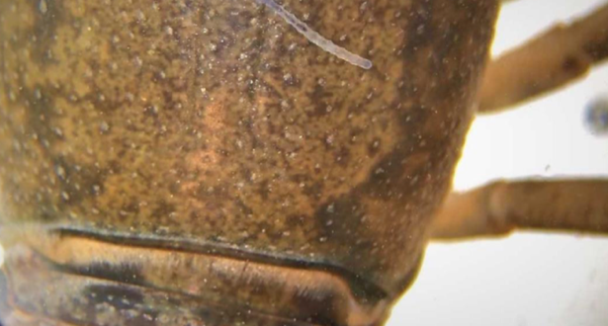
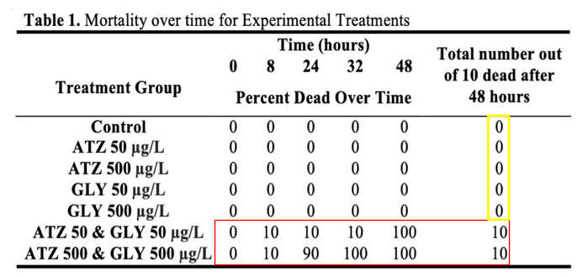
Exploring the Lethal and Sub-Lethal Effects of Pesticide Pollution in Crayfish and their Ectosymbionts
Zachary Youngbar, Kathryn St. Clair, Megan Pizzo, Brittany Carnathan & Kyle Harris
Abstract
Results and Conclusions
Pesticides (e.g. herbicides and insecticides) are commonly applied to limit the abundance of target organisms (e.g. weedy plants or crop eating insects). However, with the abundance of pesticide application, these pesticides have the possibility to enter the surrounding ecosystems and come in contact with non-target organisms. Freshwater ecosystems near urban and agricultural development may have a higher occurrence of exposure to three common pesticides (e.g. Atrazine(ATZ), Glyphosate(GLY), and 2, 4-D) due to run-off events after rainfall. This study explores the impact of three of the most commonly used pesticides on crayfish along with crayfish annelid ectosymbionts called Branchiobdellidan worms(BW). Chronic exposure of juvenile crayfish to ATZ revealed stunted growth and degradation of hepatopancreas tissue. In addition, acute exposure of adult crayfish to ATZ, GLY, and 2, 4-D revealed significant hepatopancreas tissue degradation. Interestingly, while single treatments of ATZ and GLY did not result in BW mortality, the combined acute 48 hour treatments resulted in 100% mortality. BW survivors from the single GLY treatment also revealed significant tissue degradation. These results provide evidence to support the potential impact of environmentally relevant doses of common pesticides on common non-target freshwater organisms. Such evidence supports the need to control pesticides from entering aquatic ecosystems in an effort to conserve non-target species.
This study sought to explore the lethal and sub-lethal effects of common pesticides on non-target organisms within freshwater ecosystems.
Q1) Preliminary investigations revealed developmental and tissue specific toxicity induced by low-level Atrazine exposure in juvenile crayfish. Chronic sub-lethal (0.05, 0.5 μg/L) Atrazine exposure resulted in suppressed juvenile growth and an increase in hepatopancreas tissue degradation (Figure 2).
Q2) Combined acute and chronic exposure (150 and 1500 μg/L) of common pesticides (Atrazine, Glyphosate, and 2-4D) was then was assessed in adult crayfish. These environmentally relevant concentrations revealed significant sub-lethal hepatopancreas tissue degradation (Figure 3).
Q3) The acute pollution tolerance of crayfish ectosymbionts (Branchiobdellidans) were assessed from single and combined pollutants (Atrazine, Glyphosate) at 150 and 1500 μg/L. Single pesticide exposure did not result in mortality while the combined exposure resulted in 100% mortality after 48hrs (Figure 4). Survivors from the individual treatments where histologically assessed for sub-lethal effects and revealed significant tissue degradation in the Glyphosate treatment (Figure 4).
Introduction
Figure 1 Background: Pesticide introduction in river systems due to runoff (left); and pesticide type and usage maps of ATZ, GLY, and 2,4-D usage (Right).
Runoff from rainfall can lead to the introduction of various pollutants into freshwater ecosystems (Figure 1). Some of these can be lethal and others can have a range of sub-lethal effects (e.g. endocrine disruption) which may go unnoticed (Hayes & Hansen, 2019; Mac Loughlin et al., 2016). Within this study, three of the most commonly used pesticides (Atrazine(ATZ), Glyphosate (GLY), and 2,4-D) are explored for their effects on the growth, development, and mortality of crayfish and crayfish ectosymbionts called Branchiobdellidan worms (BW).
Three experiments focused upon the following questions:
Q1) Will chronic low dose environmentally relevant concentrations of ATZ(0.05, 0.5 μg/L) suppress juvenile crayfish growth and development?
Q2) Will acute exposure of environmentally relevant concentrations of ATZ, GLY, and 2,4-D result in sub-lethal effects on adult crayfish tissue?
Q3) Will acute exposure of environmentally relevant concentrations of ATZ and GLY result in lethal and/or sub-lethal effects on crayfish ectosymbionts (BW)?
Figure 2 Experiment 1: Experimental design with juvenile male crayfish (left) and the resulting average hepatopancreas cell counts based on seven fields of view at 40x focused on individual cross sections of stained with DAPI(right).
These findings support that even at or below environmentally relevant exposure to pesticides from runoff can disrupt the life history patterns of crayfish and the more pollution sensitive annelid ectosymbionts. Application of these findings supports the pursuit of positive anthropogenic stewardship of freshwater and adjacent terrestrial ecosystems.
Figure 3 Experiment 2: Experimental design with adult crayfish exposed to 50 and 500 μg/L over 48 hrs and then examined histologically for potential sublethal effects (left). Cell counts in the treatment groups are significantly lower (p<0.001) than the control(right).
Methods
Experiment 1: Juvenile male crayfish were collected from a local second order stream, were housed individually, aerated, and fed bi-weekly with shrimp pellet. ATZ was added to establish concentrations of 0.05 and 0.5 μg/L which are below the EPA accepted level of 2.5 μg/L and to mimic a reasonable chronic exposure. Crayfish growth was charted over five months. At the end of this time, the hepatopancreas tissue was removed for histological analysis and growth patterns were compared (Figure 2).
Experiment 2: Adult crayfish were collected from a local second order stream, were housed individually, aerated, and exposed to combined ATZ, GLY, and 2,4-D treatments of 50 and 500 μg/L over 48hrs. After 48 hours crayfish were sacrificed for the removal of hepatopancreas tissue. That tissue was prepared with a cryostat and DAPI stain was applied to the apical end of the hepatopancreas for cell counting with an EVOSM5000 scope (Figure 3).
Experiment 3: Crayfish were collected from a local stream and branchiobdellidan worms (BW) were removed and housed in watch glasses with stream water. Cohorts of 10 BW were placed in individual and combined treatments of ATZ and GLY at 50 and 500 μg/L over 48 hours. Mortality was assessed and recorded across treatments at 8, 24, 32, and 48 hours post exposure. Survivors from individual treatments were histologically assessed with a cryostat and DAPI stain. Cell counts were then compared (Figure 4).
Future Work
1 2 3 4 5 6 7 8 9 10 11 12 13 14
1 2 3 4 5 6 7 8 9 10 11 12 13 14
The production of gamma-glutamyl-transferase (GGT), an enzyme produce in the presence of reactive oxygen species, will be investigated in the hepatopancreas in order to understand the individual toxicity of ATZ, GLY, and 2,4-D.
A
B
References and Acknowledgments
Banaee, M., Akhlaghi, M., Soltanian, S., Gholamhosseini, A., Heidarieh, H., & Fereidouni, M. S. (2019). Acute exposure to chlorpyrifos and glyphosate induces changes in hemolymph biochemical parameters in the crayfish, Astacus leptodactylus (Eschscholtz, 1823). Comparative Biochemistry and Physiology Part C: Toxicology & Pharmacology, 222, 145–155.
Hayes, T.B. & Hansen, M. (2017). From silent spring to silent night: Agrochemicals and the anthropocene. Elementa: Science of the Anthropocene, 5, 57,
Loughlin, C. M., Canosa, I. S., Silveyra, G. R., Greco, L. S. L., & Rodríguez, E. M. (2016). Effects of atrazine on growth and sex differentiation, in juveniles of the freshwater crayfish Cherax quadricarinatus. Ecotoxicology and Environmental Safety, 131, 96–103.
2011 Pesticide Use Maps (2017, January 17). Retrieved October 14, 2017, from https://water.usgs.gov/nawqa/pnsp/usage/maps/show_map.php?year=2011&map=GLYPHOSATE&hilo=H&disp=Glyphosate
2012 Pesticide Use Maps (2017, January 17). Retrieved October 14, 2017, from https://water.usgs.gov/nawqa/pnsp/usage/maps/show_map.php?year=2011&map=ATRAZINE&hilo=L&disp=Atrazine
EPA Pesticides Industry Sales and Usage 2008 – 2012 Market Estimates https://www.epa.gov/sites/production/files/2017-01/documents/pesticides-industry-sales-usage-2016_0.pdf
Estimated Annual Agricultural Pesticide Use – U.S. Geological Survery http://water.usgs.gov/nawqa/pnsp/usage/maps/show_map.php?year=2012&map=24D&hilo=L&disp=2,4-D
The researchers would like to thank the many undergraduate students that have been involved in this project in recent years. Special thanks to Dr. Kyle Harris who conceived the study, contributed to the experimental design and data analysis as well as the Virginia Academy of Science and the Liberty University Center for Research and Scholarships for funding continuing research on crayfish ecotoxicology.
C
Figure 4 Experiment 3: Experimental design exposed BW (left) to individual and combined treatments of pesticides over 48 hours. While ATZ and GLY at 50 and 500 μg/L alone did not result in mortality over 48 hours, the combined effect of ATZ and GLY resulted in 100% mortality (center). Surviving BW from individual treatments were analyzed histologically for sub-lethal effects. While the BW slides at 500 μg/L did not turn out, partially due to the difficulty of preparing the slides, the BW at 50 μg/L revealed significant cell degradation in the GLY 50 treatment (right).

