Slide 1
The Delivery of Reproductive Health Knowledge to African Women Living in Low-Resource Regions
Cali Anderson & Megan Revis

Slide 2
Background
Influence of unsafe sexual intercourse¹
Importance of education and training for women¹⁻⁴
High illiteracy rates in women
Discrimination in access to education⁴

Slide 3
Educational Need
Gender-biased school curriculum
Lack of understanding of:
Anatomy
Menstrual cycle
Pregnancy
Sexually transmitted infections⁴

Slide 4
Menstrual Stigma
Girls considered unclean during menstrual cycle⁵
Restricted from:
Cooking & housekeeping
Using same bathroom as family
Talking to boys⁶

Slide 5
Existing Literature
Need for comprehensive sexuality education (CSE)⁷
Presidential Initiative on AIDS Strategy for Communication to Youth⁸
Eastern and southern African ministerial commitment to CSE⁹
National Sexuality Education Framework 2018¹⁰
Notes:
http://theconversation.com/ugandas-new-sex-education-framework-will-do-more-harm-than-good-98634
https://www.google.com/search?client=safari&rls=en&q=when+was+PIASCY+released&ie=UTF-8&oe=UTF-8
https://allafrica.com/stories/201806140177.html

Slide 6
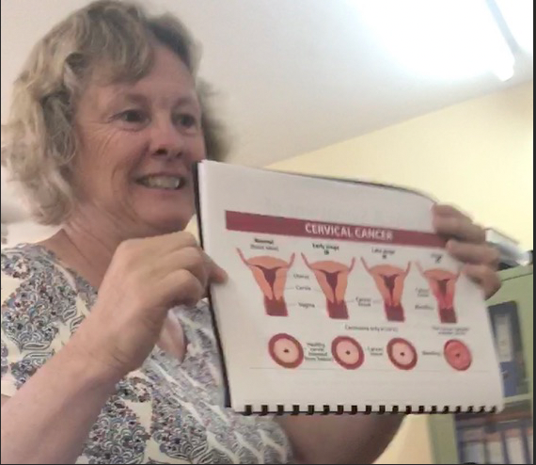
Methods
Demographic and descriptive analyses
Pre-trip focus groups
Curriculum development
Pilot testing
Menstrual hygiene kit distribution
Additional focus groups
Curriculum refinement
(Cali Anderson). Cervical Cancer Teaching Visual [digital image].

Slide 7
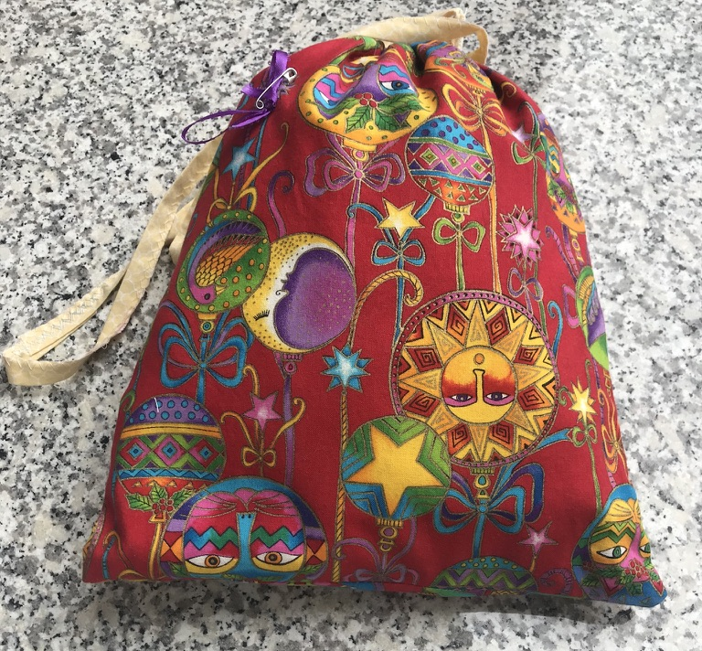
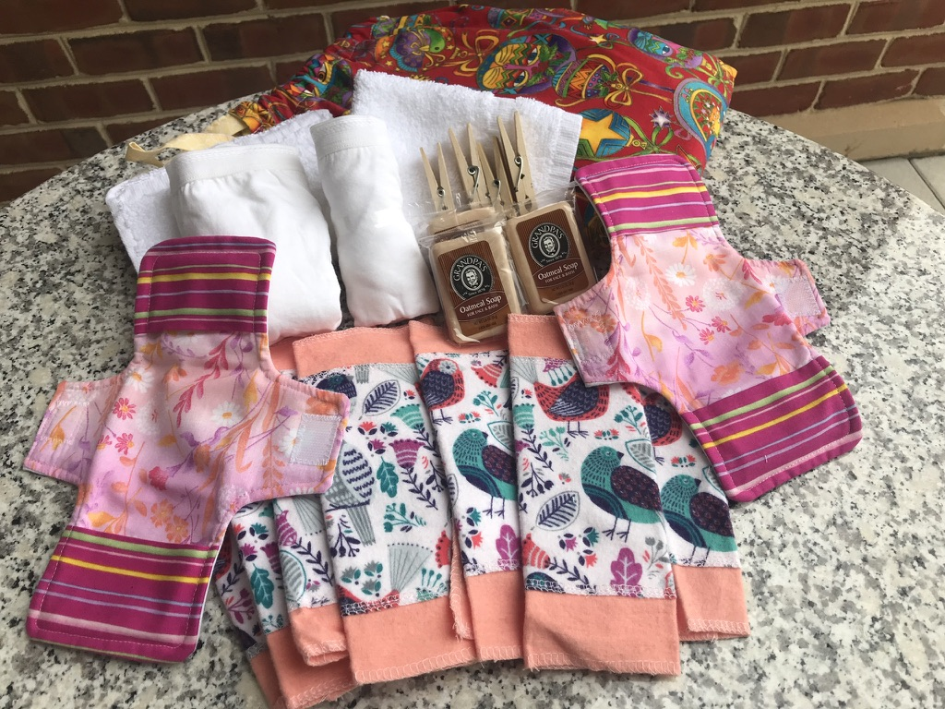
Proposed Plan
Curriculum development
Tailor to population based on analyses
Refine through testing
Menstrual hygiene kit distribution
Gleaning for the World WINGS kits
(Robyn Anderson). WINGS kit [digital image].

Slide 8
Final Product
A sexual and reproductive health education curriculum for Ugandan and Rwandan women
User friendly for groups without a health background
Able to be used by non-profit and missionary groups

Slide 9
References
World Health Organization. Women and health: today’s evidence tomorrow’s agenda. https://apps.who.int/iris/bitstream/handle/10665/44168/9789241563857_eng.pdf;jsessionid=D0D26F18134A03A3D00F54D838E10EA5?sequence=1. Published 2009. Accessed January 2020.
Basu AM, Stephenson R. Low levels of maternal education and the proximate determinants of childhood mortality: a little learning is not a dangerous thing. Soc Sci Med. 2005; 60(9): 2011-2023. https://doi.org/10.1016/jsocscimed.2004.08.057.
Grown C, Gupta GR, Pande R. Taking action to improving women’s health through gender equality and women’s empowerment. Lancet. 2005; 365(9458): P541-543. https://doi.org/10.1016/S0140-6736(05)17872-6.
United Nations Entity for Gender Equality and the Empowerment of Women. The United Nations fourth world conference. https://www.un.org/womenwatch/daw/beijing/platform/educa.htm. Published September 1995. Accessed January 2020.
IsGlobal, Barcelona Institute for Global Health. Knowledge attitudes and practices concerning Menstrual Hygiene Management (MHM) of adolescents in rural primary schools in Malawi. https://www.isglobal.org/documents/10179/7339333/MFP+Daniel+Enzler/4565e949-c2d2-48d9-b1c5-52fb30571a39. Published June 27, 2018. Accessed February 20, 2020.
Sommer M, Caruso BA, Sahin M, Calderon T, Cavill S, Mahon T. A time for global action: addressing girls’ menstrual hygiene management needs in schools. PLoS Med. 2016; 13(2): e1001962. https://doi.org/10.1371/journal/pmed.1001962.
United Nations Population Fund. Comprehensive sexuality education. https://www.unfpa.org/comprehensive-sexuality-education. Updated September 2016. Accessed January 2020.
The Republic of Uganda Ministry of Education & Sports. Presidential Initiative on AIDS Strategy for Communication to Youth (PIASCY). https://hivhealthclearinghouse.unesco.org/sites/default/files/resources/PIASCY_Helping_pupils_to_stay_safe_290b_EN.pdf. Published 2003. Accessed March 1, 2020.
United Nations Educational, Scientific and Cultural Organization (UNESCO). Ministerial commitment on comprehensive sexuality education and sexual and reproductive health services for adolescents and young people in Eastern and Southern Africa (ESA). http://www.unesco.org/new/fileadmin/MULTIMEDIA/HQ/HIV-AIDS/pdf/ESACommitmentFINALAffirmedon7thDecember.pdf. Published December 7, 2013. Accessed March 2, 2020.
Reproductive Health Uganda. National sexuality education framework launched. https://www.rhu.or.ug/national-sexuality-education-framework-launched/. Published May 23, 2018. Accessed March 2, 2020.

