Slide 1
Collaborative Learning using: wikis
Liberty University Online Education

Slide 2
Collaborative Learning
Definition:
A situation in which two or more people learn or attempt to learn something together.
Why is this Important:
Cooperative teams achieve higher levels of thought and retain information longer than students who do their work individually
How do we accomplish this when learners are separated by time and place?

Slide 3
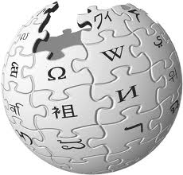
A Whole New World of Wiki
What is a Wiki?
How do Wikis accomplish collaborative learning?

Slide 4
Wiki
Definition: a collaborative web space where anyone can add content and anyone can edit content that has already been published
The term ‘wiki’ is derived from the Hawaiian phrase, ‘wiki-wiki’ which means quick.

Slide 5
What Can Wikis Accomplish?
Enhances asynchronous communication and cooperative learning among students, and promote cooperation rather than competition
Encourages peer interaction and group work, and facilitates sharing and distributing knowledge and expertise among a community of learners

Slide 6
Perks of Wikis
For Instructor:
For Students:
Keep track of how much an individual student contributes to a group project
Creates a forum for group projects that allow for easy collaboration and communication

Slide 7
Wiki Project Categories Based on Bloom’s Taxonomy

Slide 8
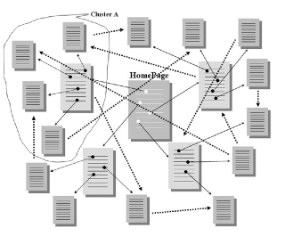
Example Assignment: Critical Thinking
Home Page:
Themes in “To Kill A Mocking Bird”
Divide class into groups and assign each group a specific theme
Each group member works on a subtopic related to their specific theme
The group then works together to create one article for their theme
Groups then read through other group articles, finding how they can be linked to their own

Slide 9
Grading Recommendations
“Students were significantly more inclined to participate with the wiki when such use was… backed up by explicit assessment or grading scheme”
Constructing rubrics and making them available early in a project helps groups to focus their tasks, measures their own progress, and strive for higher levels of quality.
Have several check points along the way.

