Slide 1
Clickers in the Classroom
Examples from
Math 115: Math for Liberal Arts
Bob Young

Slide 2
Example: Flooring (1.3.22)
Chapter 1: Problem Solving
A gymnasium floor has an area of 2400 square yards. Each gallon of floor sealant covers an area of 350 square feet. How many gallons of sealant are needed to cover the gymnasium floor?
1. Understand the Problem.
2. Devise a Plan.
3. Carry Out the Plan.
4. Check the Results.
2 gal
7 gal
21 gal
62 gal
77 gal

Slide 3
Example: Dripping Faucet #2 (1.3.26)
Chapter 1: Problem Solving
A faucet is leaking at a rate of one drop of water per second. Assume that the volume of one drop of water is 0.1 cubic centimeter (0.1 cm³).
How many days would it take to fill a rectangular basin 30 cm by 20 cm by 20 cm?
1. Understand the Problem.
2. Devise a Plan.
3. Carry Out the Plan.
4. Check the Results.
7.5 days
.77 days
1.4 days
14.0 days
Notes:
Last slide for -002 on 28 Feb 2011

Slide 4
Review: Universal set
Chapter 2: Sets
The actor Tom Cruise is a member of a set.
What is the universal set?
The set of professional actors.
The set of American men.
The set of American citizens.
The set of followers of Christian Science.
It depends on the discussion.
Notes:
Last slide for -002 on 19 Jan 2011

Slide 5
Review: Not well defined
Chapter 2: Sets
Which of the following sets is not well-defined?
{x | x is a US senator}
{x | x is a college football powerhouse}
{good, bad, ugly}
{x | 4 < x < 10}

Slide 6
Review: Compare the sets
Chapter 2: Sets
A is the set of states.
B is the set of state capitals.
Equal
Equivalent
Neither
Both

Slide 7
Clicker Example
Chapter 2: Sets
Let A = {Sears, JC Penny, Footlocker}
B = {x | x is store at the River Ridge Mall}
Which of the following is true?
A  B
A  B and A  B
A  B and A  B
B  A

Slide 8
Clickers Ready:
Chapter 2: Sets
Rapid-fire TRUE/FALSE quiz
You will have 10 seconds to answer each of the following questions.

Slide 9
b  {l, i, b, e, r, t, y}
Chapter 2: Sets
True
False

Slide 10
{b}  {l, i, b, e, r, t, y}
Chapter 2: Sets
True
False

Slide 11
{b}  {l, i, b, e, r, t, y}
Chapter 2: Sets
True
False

Slide 12
{l, i, b, e, r, t, y}  {l, i, b, e, r, t, y}
Chapter 2: Sets
True
False

Slide 13
{l, i, b, e, r, t, y}  {l, i, b, e, r, t, y}
Chapter 2: Sets
True
False

Slide 14
{l, i, b, e, r, t, y}  {l, i, b, e, r, t, y}
Chapter 2: Sets
True
False

Slide 15
  {l, i, b, e, r, t, y}
Chapter 2: Sets
True
False

Slide 16
  {l, i, b, e, r, t, y}
Chapter 2: Sets
True
False

Slide 17
{}  {l, i, b, e, r, t, y}
Chapter 2: Sets
True
False

Slide 18
Elements & Sets Examples: True or False?
Chapter 2: Sets
b {l, i, b, e, r, t, y}
{b} {l, i, b, e, r, t, y}
{b} {l, i, b, e, r, t, y}
{l, i, b, e, r, t, y} {l, i, b, e, r, t, y}
{l, i, b, e, r, t, y} {l, i, b, e, r, t, y}
{l, i, b, e, r, t, y} {l, i, b, e, r, t, y}
 {l, i, b, e, r, t, y}
 {l, i, b, e, r, t, y}
{} {l, i, b, e, r, t, y}
TRUE
FALSE
TRUE
FALSE
TRUE
FALSE
FALSE
TRUE
FALSE
Notes:
Last slide on 21 Jan for -002

Slide 19
A ∩ B' = ?
Chapter 2: Sets
U
A B
f
c a
w r
h
b t g
p m
z
{f, r, g}
{a, h}
{c, w, b, t}
Notes:
Start here on 26 Jan 2011

Slide 20
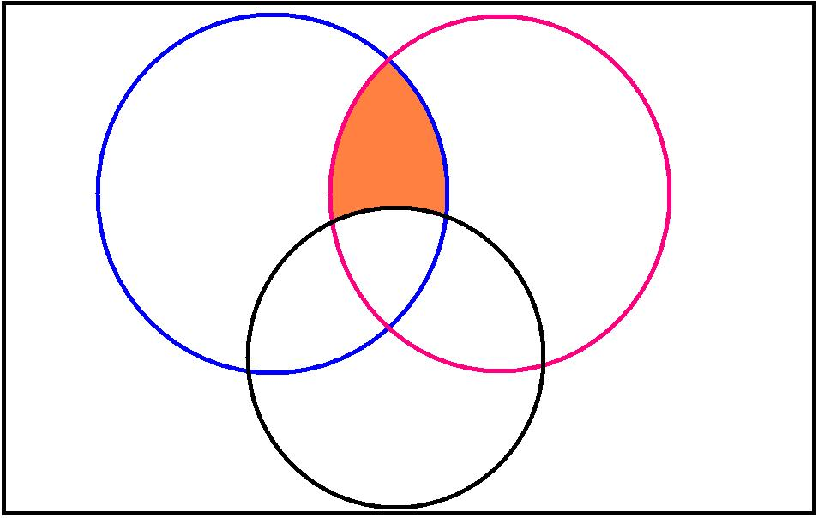
Example:
Chapter 2: Sets
Write a statement for the shaded region
A B
C
(A  B) – C
C'  (A  B)
(A  B)  C

Slide 21
Example: Writing Negations
Chapter 3: Logic
Write the negation of the statement.
Some candy bars contain nuts.
Some candy bars do not contain nuts.
No candy bars contain nuts.

Slide 22
Example: Writing Negations
Chapter 3: Logic
Write the negation of the statement.
Some candy bars contain nuts.
Since “some” means “at least one” this statement is true.
The negation is not, “Some candy bars do not contain nuts.” … Why not?
The negation is:
No candy bars contain nuts.
(which is a false statement)
Notes:
Last slide on 31 Jan 2011 for both sections

Slide 23
Example: Writing Negations
Chapter 3: Logic
Write the negation of the statement.
Some dogs with long hair do not get cold.
Some dogs with long hair do get cold.
All dogs with long hair get cold.
Some dogs with short hair do not get cold

Slide 24
Practice: Write the Negation
Chapter 3: Logic
No one likes asparagus.
Everyone likes asparagus.
Some people don’t like asparagus.
Some people like asparagus.

Slide 25
Practice: Write the Negation
Chapter 3: Logic
All houses are wired using parallel circuits.
All houses are not wired using parallel circuits.
Some houses are not wired using parallel circuits.
No houses are wired using parallel circuits.

Slide 26
Examples: Sampling technique?
Chapter 13: Statistics
The first 30 people entering a pet store are asked about increases in pet license fees.
Random Sampling.
Systematic
Cluster
Stratified
Convenience

Slide 27
Examples: Sampling technique?
Chapter 13: Statistics
100 numbered balls are mixed in a bin and one is chosen at random to determine the winner of a raffle.
Random Sampling.
Systematic
Cluster
Stratified
Convenience

