Slide 1
"Memory Loss"
The Construction of Meaning in Eudora Welty’s The Optimist’s Daughter

Slide 2
Welty, Southern Literature, and Postmodern Reality
There is little question that Eudora Welty holds her place in a long and luminous line of southern writers. With few exceptions, her works deal consistently with those issues and characteristics for which southern writers are distinguished, traits such as realistic setting, strong family ties, and a powerful sense of the past. Welty’s novel The Optimist’s Daughter is no exception to these typical traits.
Yet, for all of its traditional features, Welty’s work raises what some could argue are distinctively contemporary and postmodern subjects by seriously challenging the construction of human reality. Furthermore, the disposition of southern literature lends itself to a close connection with a postmodernity, a notion illustrated and strengthened throughout Welty’s The Optimist’s Daughter by the construction of reality through Laurel’s memory and the “quilting” together of words to create meaning.
Eudora Welty
Photo by Stanley Von Medvey

Slide 3
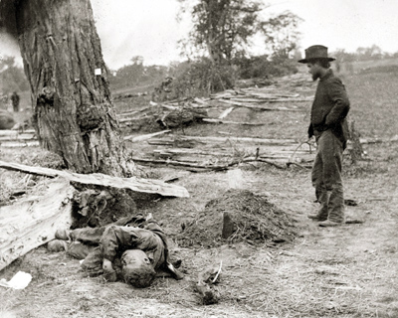
The Southern Writer
According to Fred Hobson in his work The Southern Writer in the Postmodern World, the south and its literature is usually characterized, among other things, by a “tragic sense;” and, like postmodern writers, southern authors have used this tragic self-awareness as an opportunity for art (3-4).
A Confederate Grave
Alexander Gardner
Welty’s The Optimist’s Daughter corresponds with the characteristics of southern literature, including the impression of defeat that southern and postmodern literature share.

Slide 4
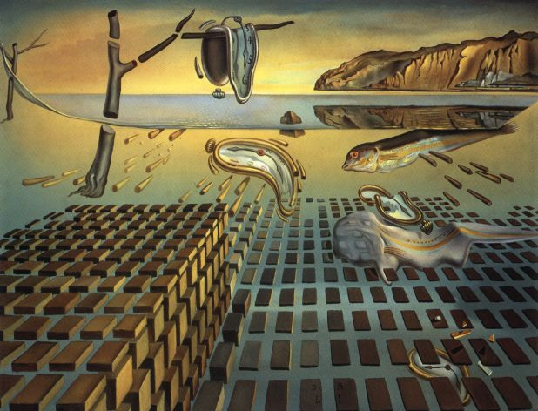
The Optimist's Daughter and its postmodern place
Furthermore, The Optimist’s Daughter ventures further into postmodern territory by emphasizing the construction of reality through the main character Laurel’s memory and the past—a medium that is ultimately unreliable and subjective.
“The Disintegration of the Persistence of Memory” by Salvador Dali

Slide 5
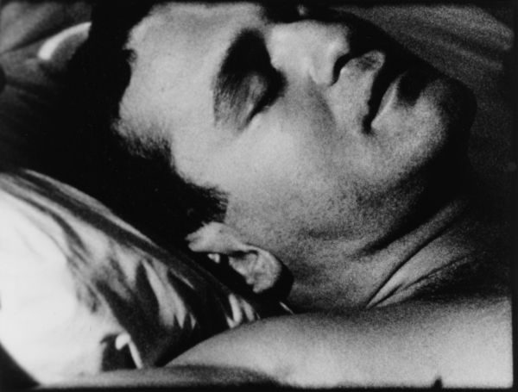
Memory: A "Velvety Cloak of Words"
The ability to construct one’s reality, through memory or otherwise, is a postmodern device; however, the limitations and instability of reminiscence calls into question an individual’s ability either to correctly recall the past or truthfully know the present:
When Laurel was a child . . . She closed her eyes like this and the rhythmic, nighttime sound of the two beloved reading voices came rising in turn up the stairs every night to reach her . . . She was sent to sleep under a velvety cloak of works, richly patterned and stitched with gold, straight out of a fairy tale . . .
The Optimist’s Daughter 57
“Sleep” by Andy Worhol

Slide 6
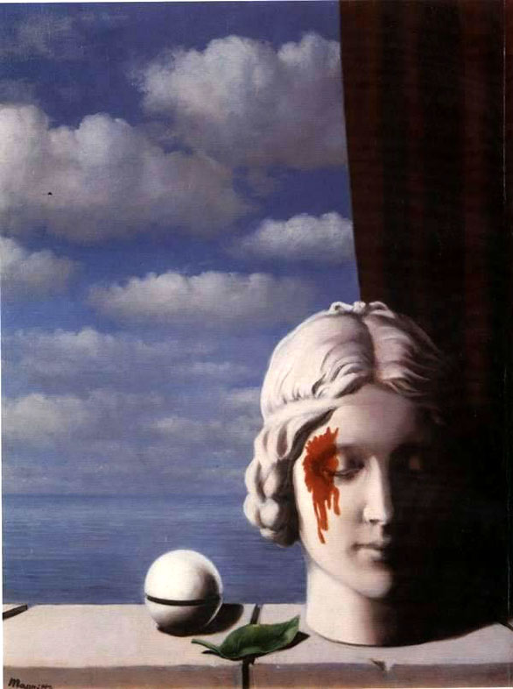
Reader Sympathy
Furthermore, a postmodern reading of Welty’s text would question whether the reader’s sympathy is manipulated to adopt Laurel’s rendering and interpretation of her past and present realities. The only versions of events afforded to the reader are those given by Laurel—calling into question both Laurel’s ability to correctly construct reality, and the manipulation of the narrative voice.

Slide 7
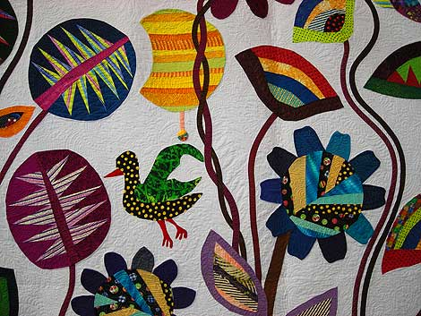
Grandmother's Quilt: The construction of Word-Meaning
Shoko Kikuchi “The Gate to Another World”.
Images of quilts and patchwork are worked throughout The Optimist’s Daughter, usually juxtaposed with scenes in which Laurel recalls her past. Several critics have interpreted these images as a symbol of Laurel’s ability to assemble reality from scraps of memory, and furthermore as a commentary on the manner in which the meanings of words themselves are constructed—that is, pieced together from multiple layers, as opposed to inherently meaningful.
Welty rarely fails to pursue the thematic suggestiveness of words’ synonyms and homonyms. She seems vividly aware of the multiplicity of meaning inherent in single words, and her linguistic playfulness creates echoes through our readings . . .
Gail Mortimer “Image and Myth in Eudora Welty’s The Optimist’s Daughter”

Slide 8
The Postmodern Plunge
Martin Waugh “Liquid Sculpture”
In giving the reader a character who creates her reality through the constructs of her memory, The Optimist’s Daughter takes a dive into the postmodern questions of reality and the individual’s abilities to correctly perceive and relay existence. By linking memory and story-telling with quilt images, the story conveys the impression that reality, and the words which make up that reality, is an essentially two-dimensional entity—beautiful on the surface, yet essentially empty.

Slide 9
Our Postmodern Implications
Considering texts like Welty’s The Optimist’s Daughter and different postmodern readings raises several significant implications , including:
1. The construction of reality through memory,
2. The fundamental ability of words to “mean,”
3. The consequences of postmodernism on literary texts, as well as larger culture and religion
Ultimately, as Christian scholars, we must be willing to honestly and rigorously investigate such issues, keeping in mind our fragile and broken state as fallen beings, as well as the certain existence and undeniable presence of definitive, overarching truth.

Slide 10
Works Cited and Bibliography
Work Cited
Chouard, Geraldine. “Sew to Speak: Text and Textile in Eudora Welty.” South Atlantic Review 63.2 (1998): 7 – 26. JSTOR. Liberty University Lib., Liberty U, Lynchburg, VA. 12 February 2008 <http://www.jstor.org>.
Kreyling, Michael. Understanding Eudora Welty. Columbia: University of South Carolina P, 1999.
Hobson, Fred. The Southern Writer in the Postmodern World. Atlanta: University of Georgia P, 1991.
Mortimer, Gail L. “Image and Myth in Eudora Welty’s The Optimist’s Daughter.” American Literature 62.4 (1990): 617 – 633. JSTOR. Liberty University Lib., Liberty U, Lynchburg, VA. 12 February 2008 <http://www.jstor.org>.
Skei, Hans H. “The Last Rose of Mount Salus.” The Late Novels of Eudora Welty. Ed. Jan Nordby Gretlund and Karl-Heinz Westarp. Columbia: University of South Carolina P, 1998. 122 – 133.
Welty, Eudora. The Optimist’s Daughter. New York: Vintage Books, 1969.

